Slide 1
https://GSePC.org

Slide 2
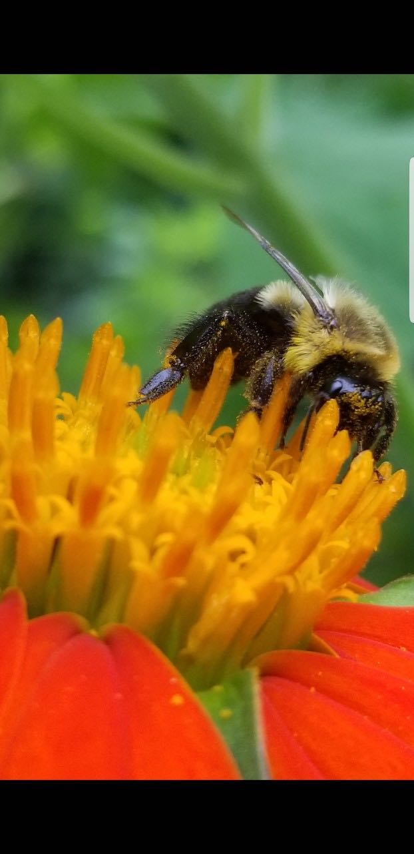
In August, people from Georgia, South Carolina, North Carolina and Florida will come together for the annual effort to document our pollinator populations. Anyone can participate in this important initiative. Families, school groups, scouts, garden clubs, church groups, individuals – everyone! You don’t have to be an entomologist to participate!

Slide 3
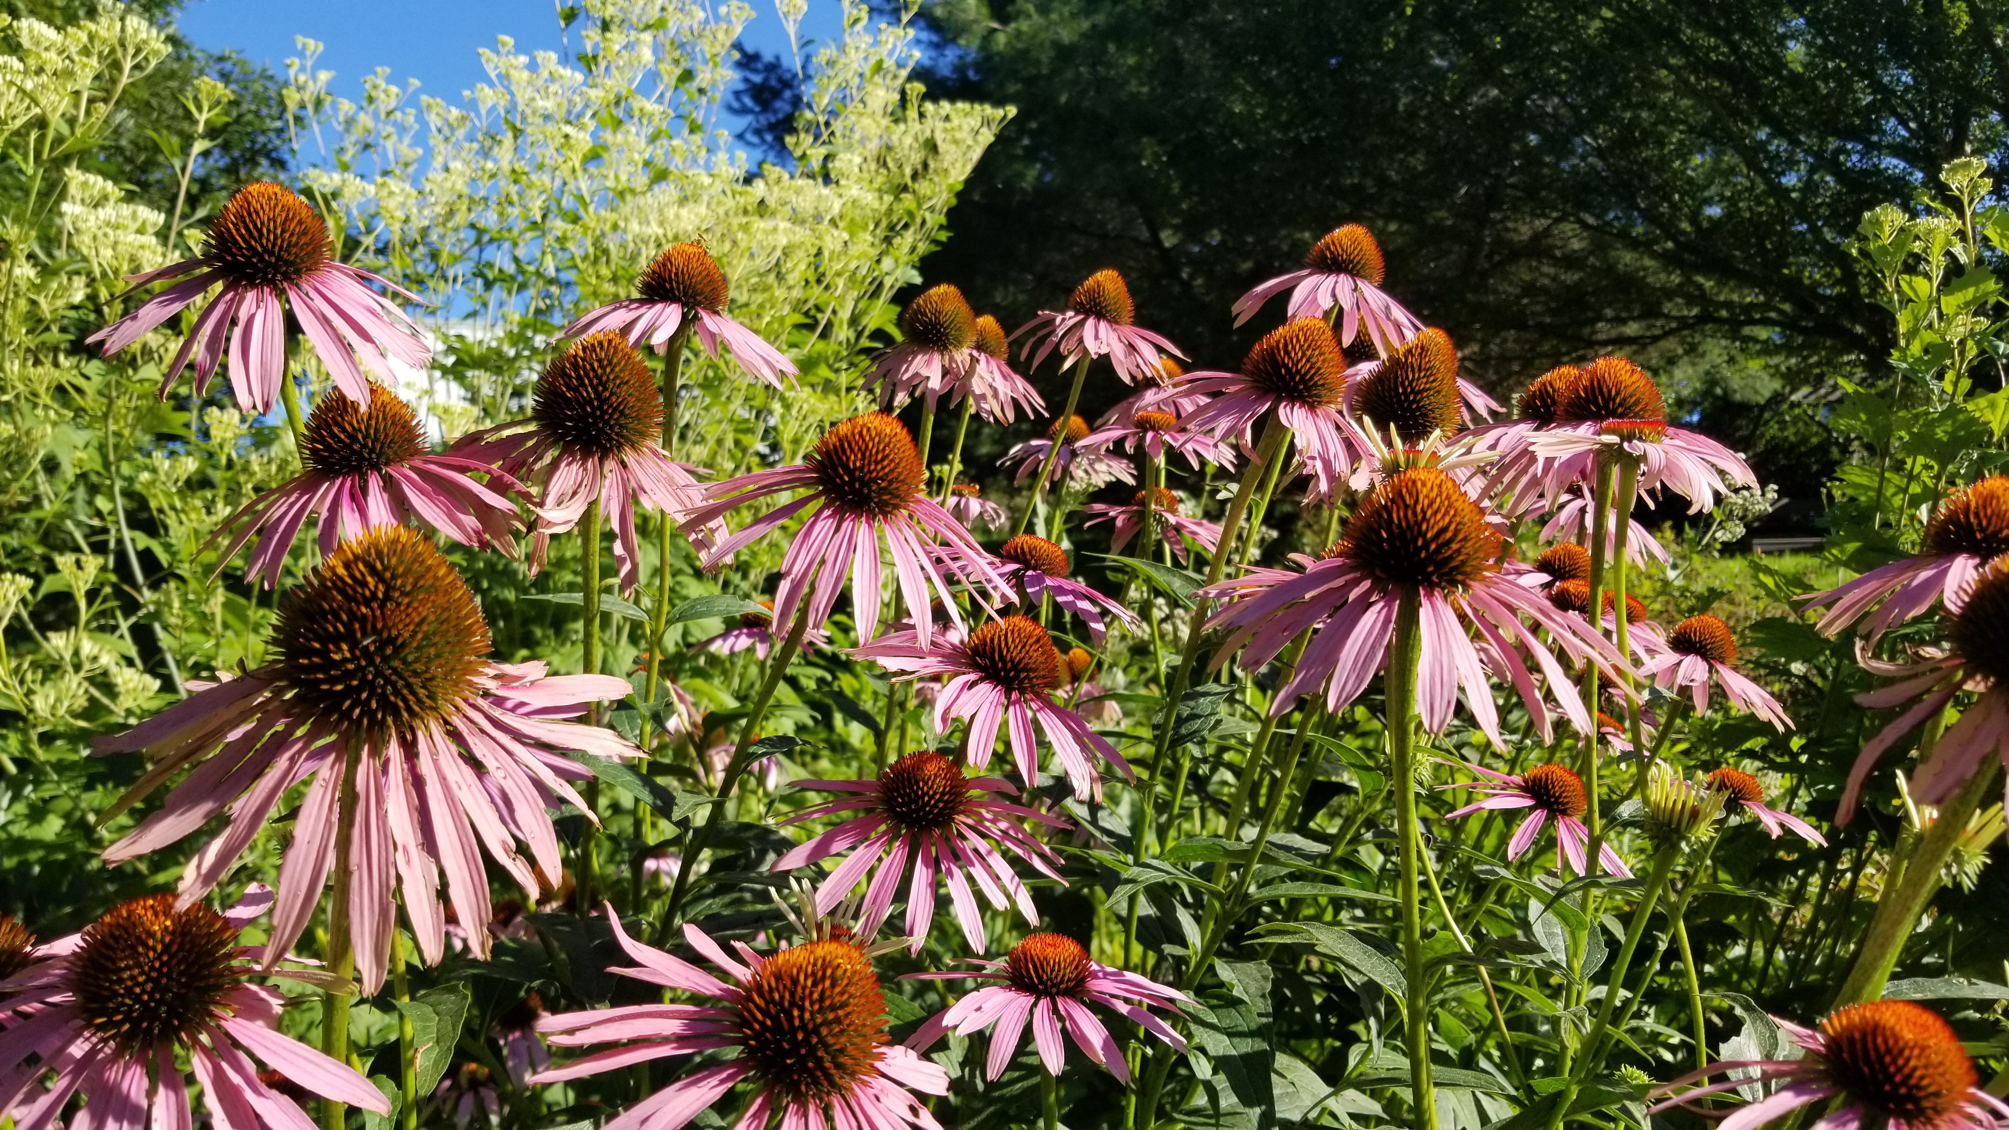
Participants count each time an insect lands on one favorite pollinator plant for 15 minutes. Counts are easily recorded on the project website (https://GSePC.org). Remember, you are counting each time an insect lands on your plant.
Make sure your pollinator garden includes plants that will be blooming in August!

Slide 4
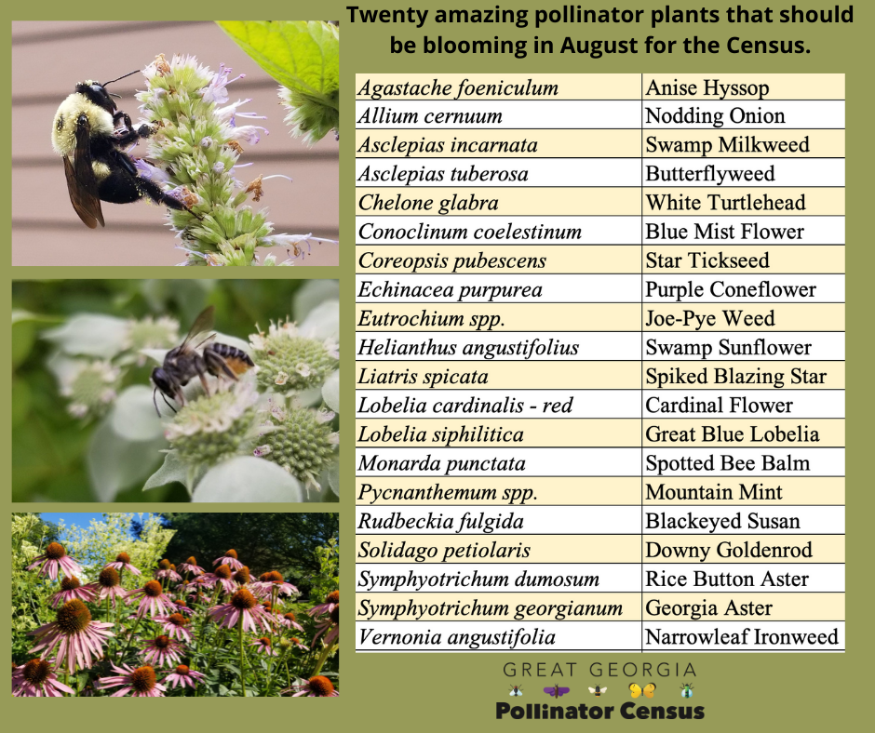
Partial list of pollinator plants that should be blooming across
the Southeast at the time of the Census
*based on research done by Heather Alley and Becky Griffin

Slide 5
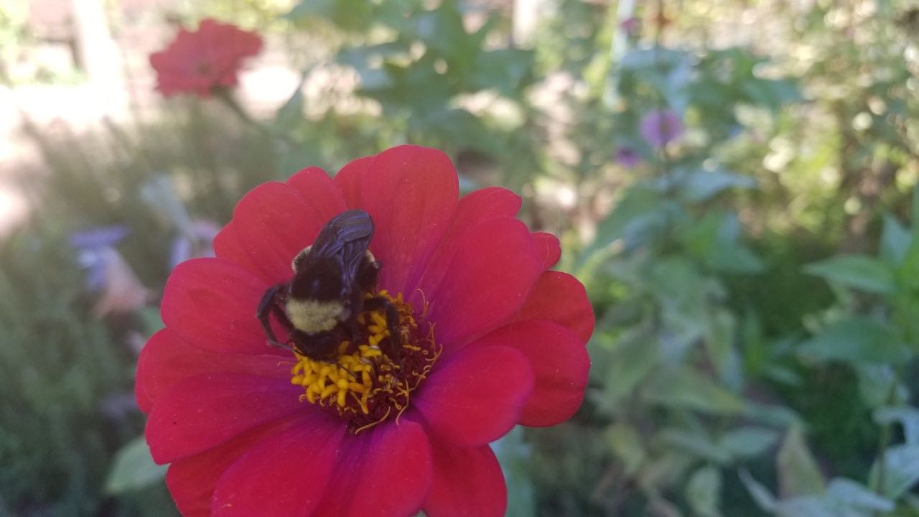
Participants place the insects they count into one of these categories:
1. Carpenter bees
2. Bumble bees
3. Honey bees
4. Small bees
5. Wasps
6. Flies
7. Butterflies/Moths
8. Other Insects

Slide 6
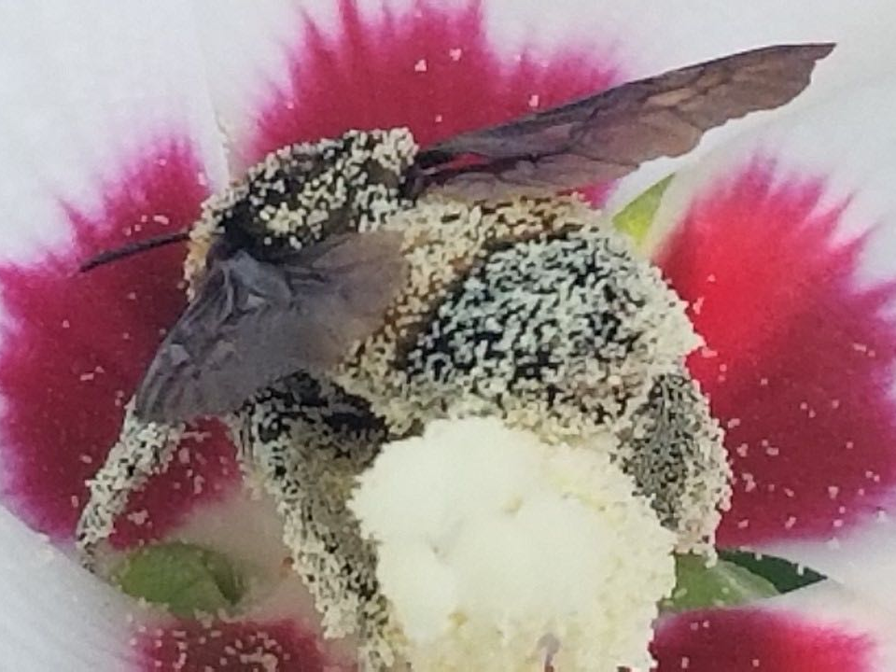
Let’s look at the categories in depth!

Slide 7
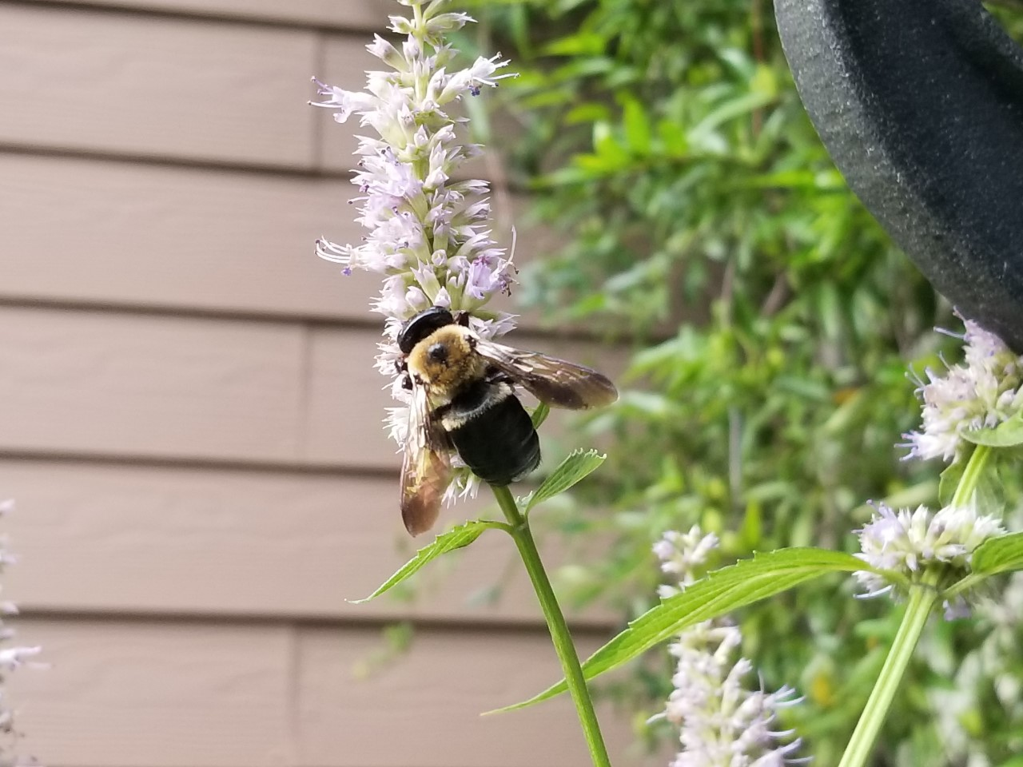
Carpenter Bee

Slide 8
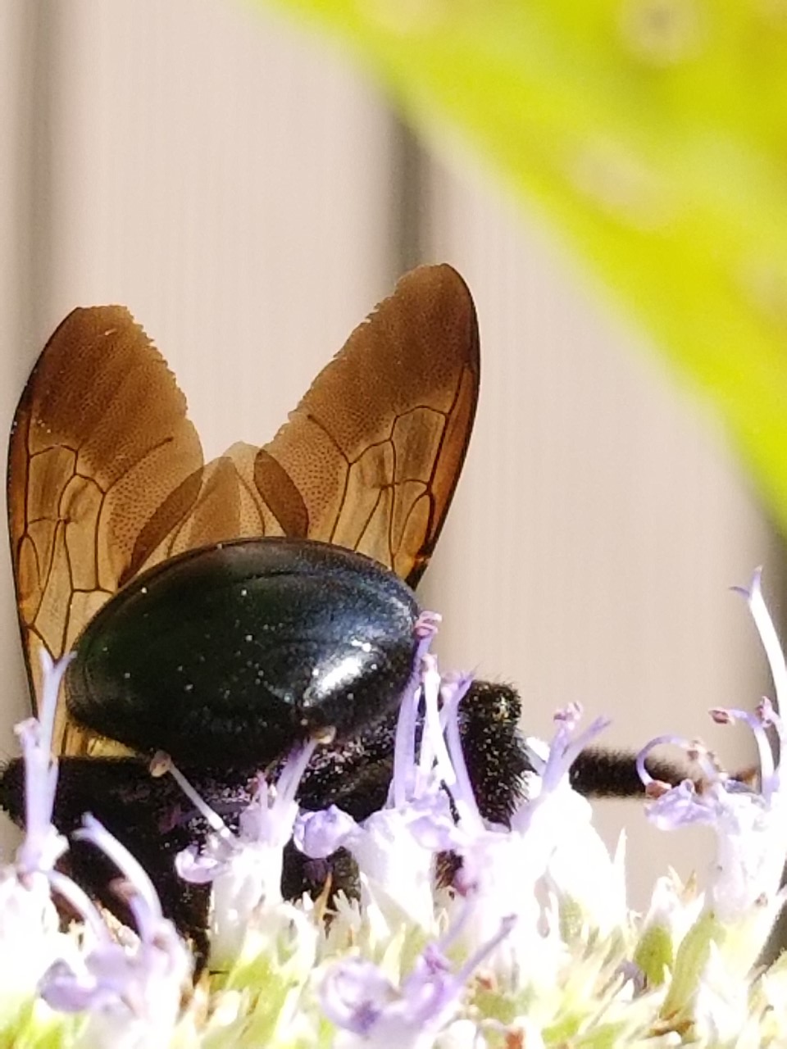
Carpenter Bees
(16 – 22 mm)
Black body with yellow and black bands
Dense hair on head and thorax
NO HAIR on abdomen
Broad head, thick body
Males have yellow to white coloring on face, females all black on face

Slide 9
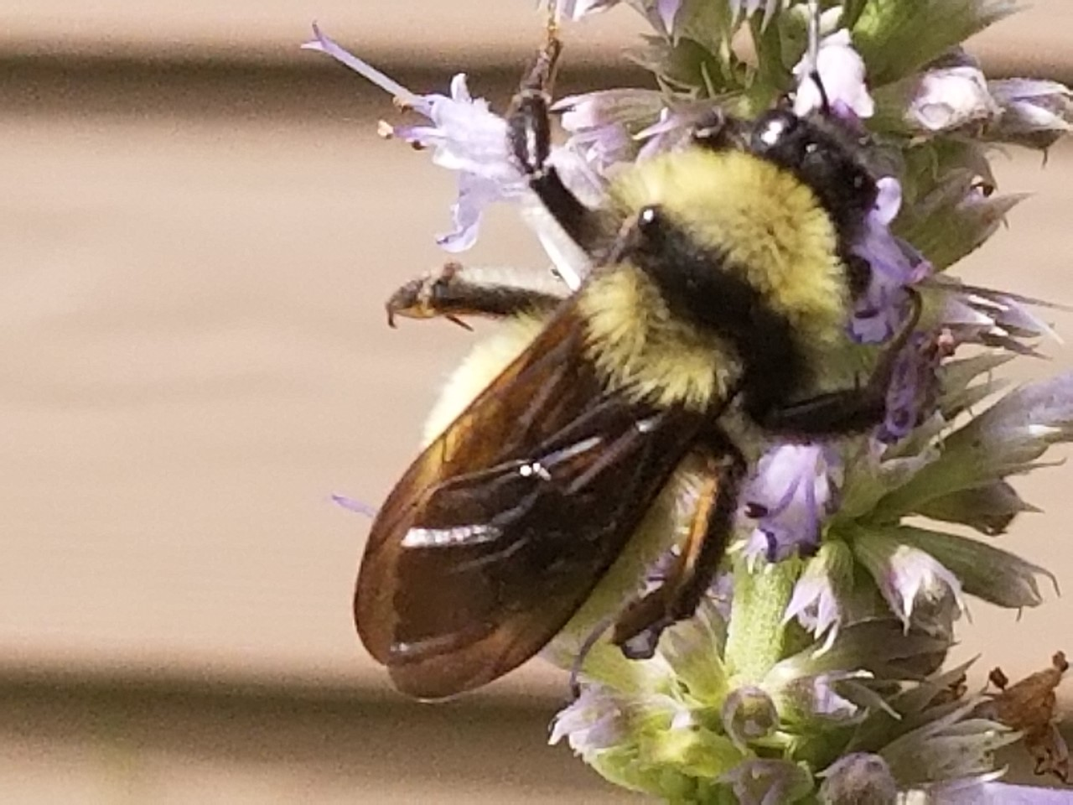
Bumble bee
Notes:
Yellow Bumble bee

Slide 10
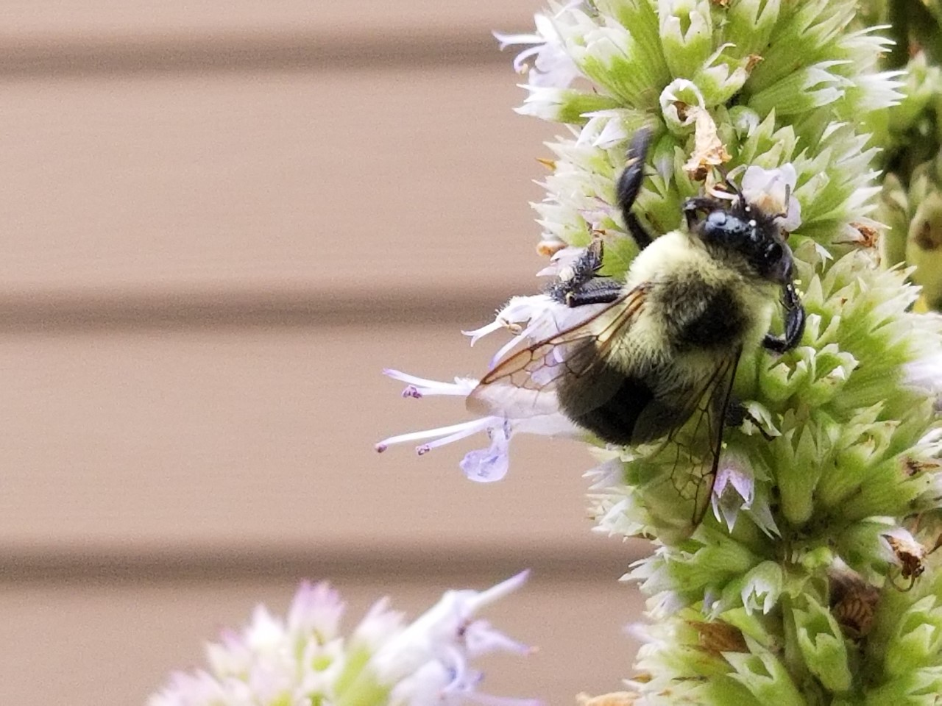
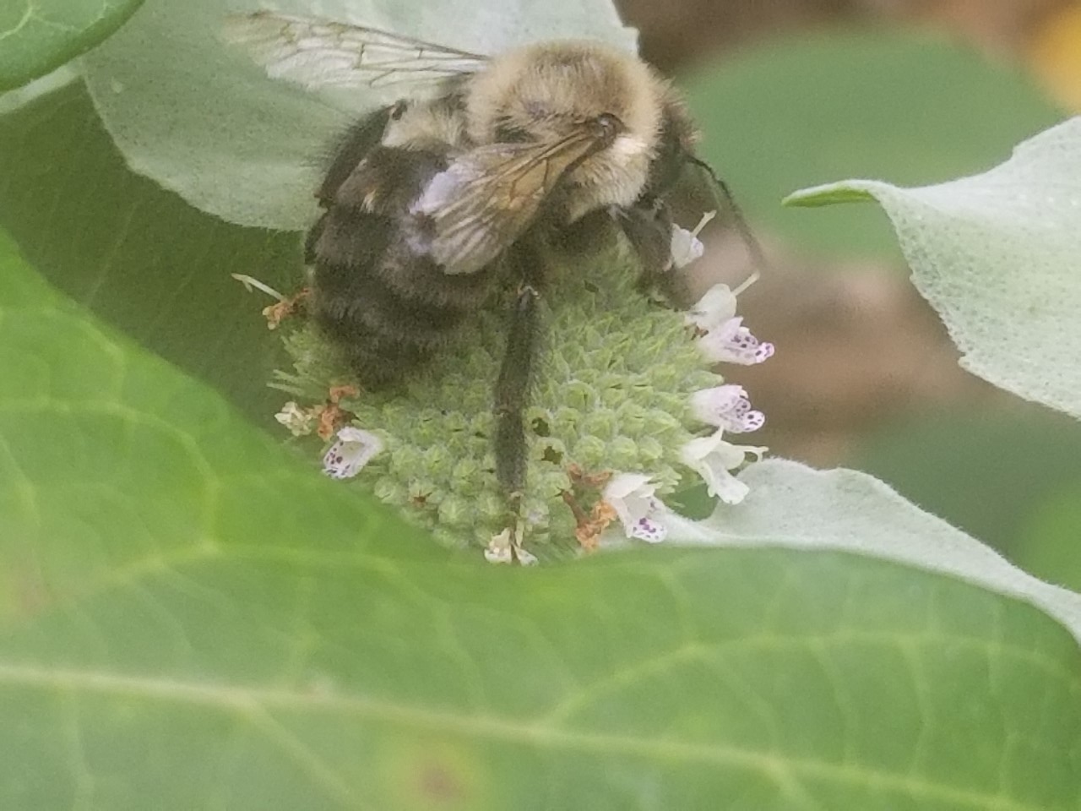
Bumble Bees
(10 – 19 mm)
Black body covered with dense yellow and black hair
Fat bee with small head
Large thorax and abdomen
Hairy abdomen

Slide 11
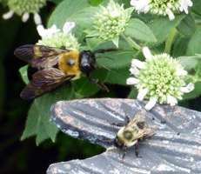
This photo illustrates the differences between the
carpenter bee and a bumble bee. The carpenter bee is a “mack truck” while the bumble bee is more of a “pickup truck.”

Slide 12
And remember, a bumble bee has a “fuzzy rear” while a carpenter bee has a “shiny heinie”!

Slide 13
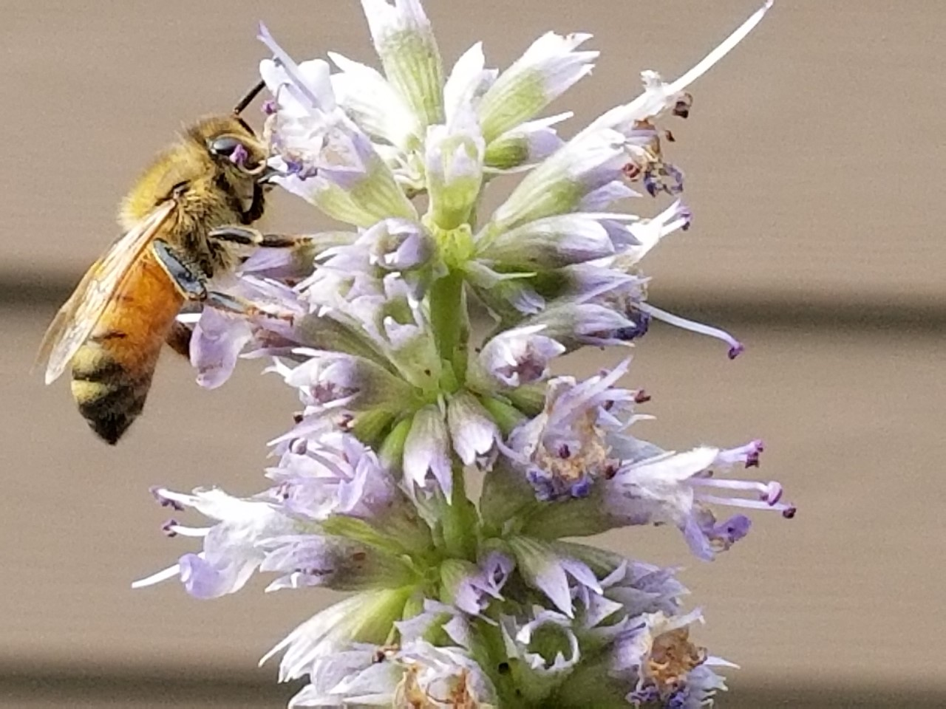
Honey Bees
(12 – 15 mm)
Brown or black stripes on body
Golden-brown hair covers abdomen
Honey bee

Slide 14
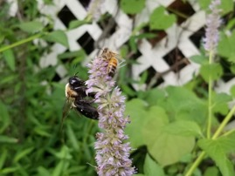
This photo shows a honey bee
and a
bumble bee together.
Although some bumble bees are smaller, The two types
are easily distinguishable.
Honey Bee
Bumble Bee

Slide 15
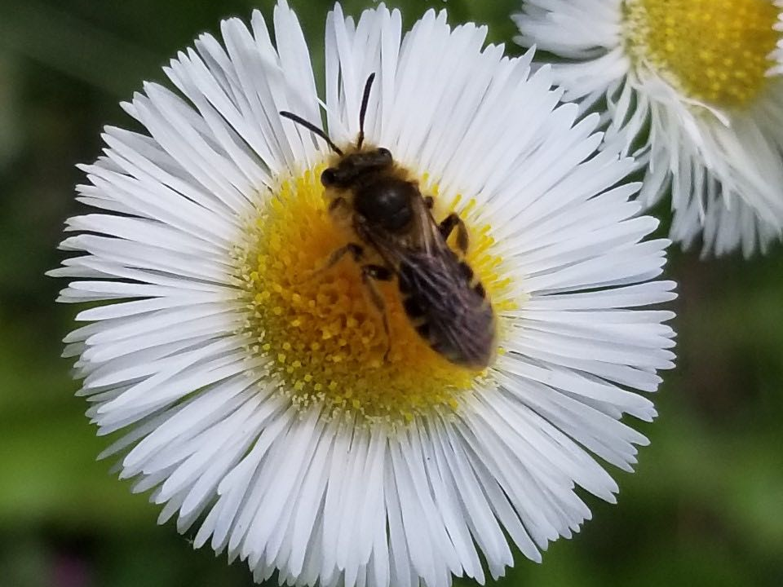
Small bees

Slide 16
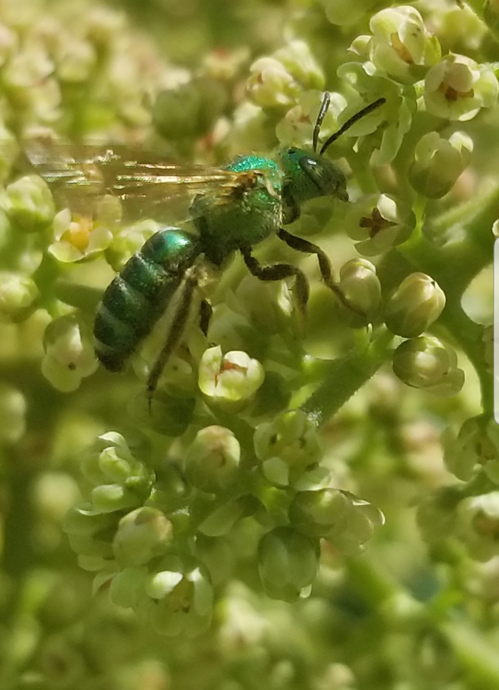
Small Bees
(Any bee smaller than a honey bee)
Can include:
Leafcutter Bees
Sweat Bees
And others
Note: Keep a lookout for the metallic shine of the sweat bees from the family Halictidae. Even though these bees can be small, the metallic color is easy to spot when the sun is shining on them.

Slide 17
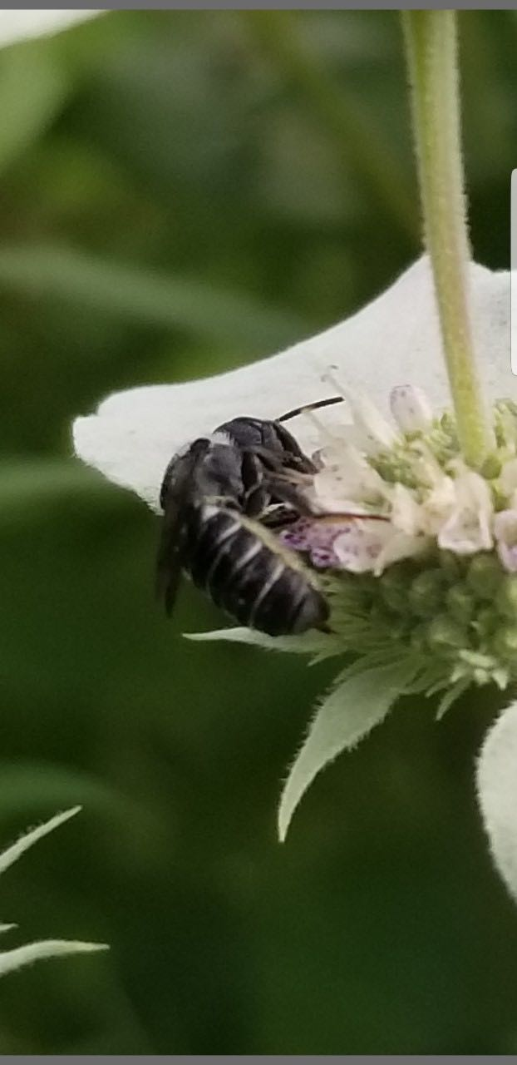
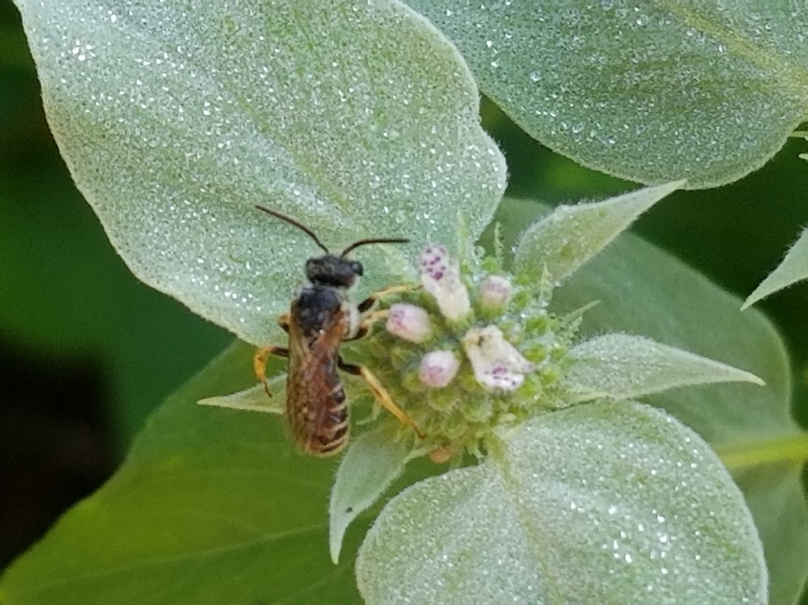
Photos of small bees

Slide 18
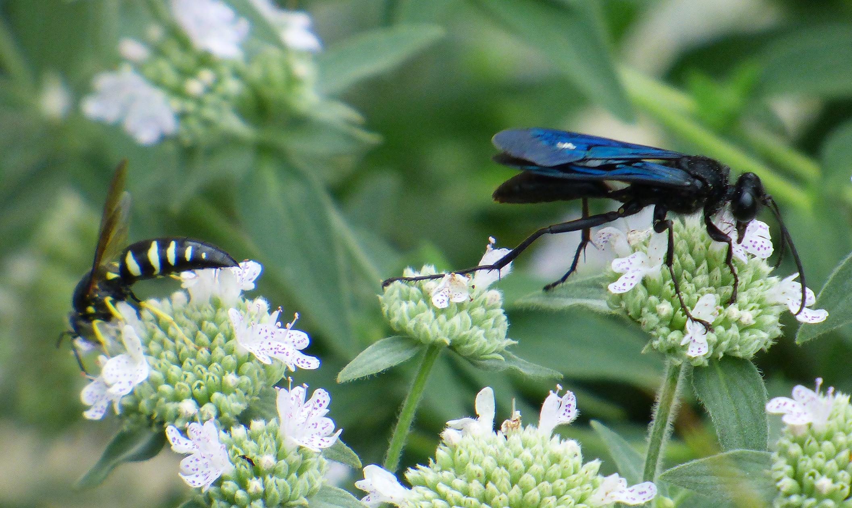
Wasps

Slide 19
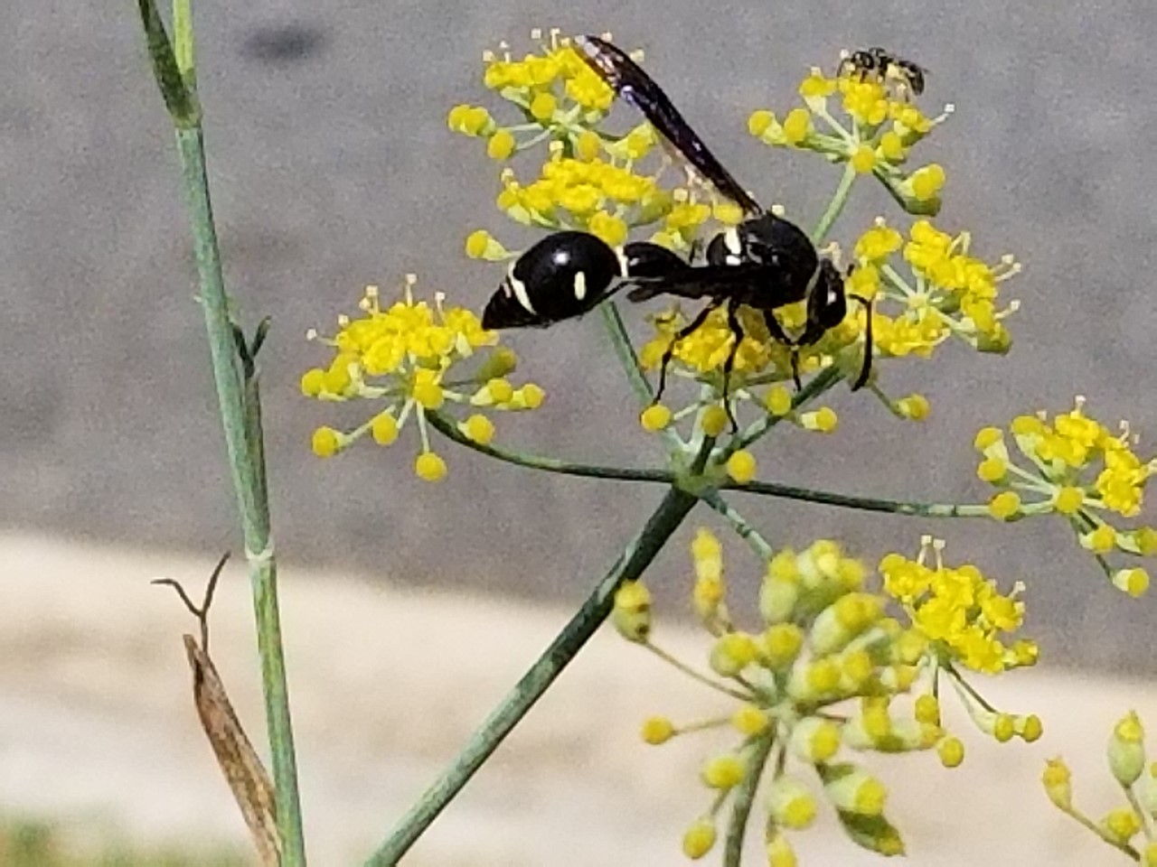
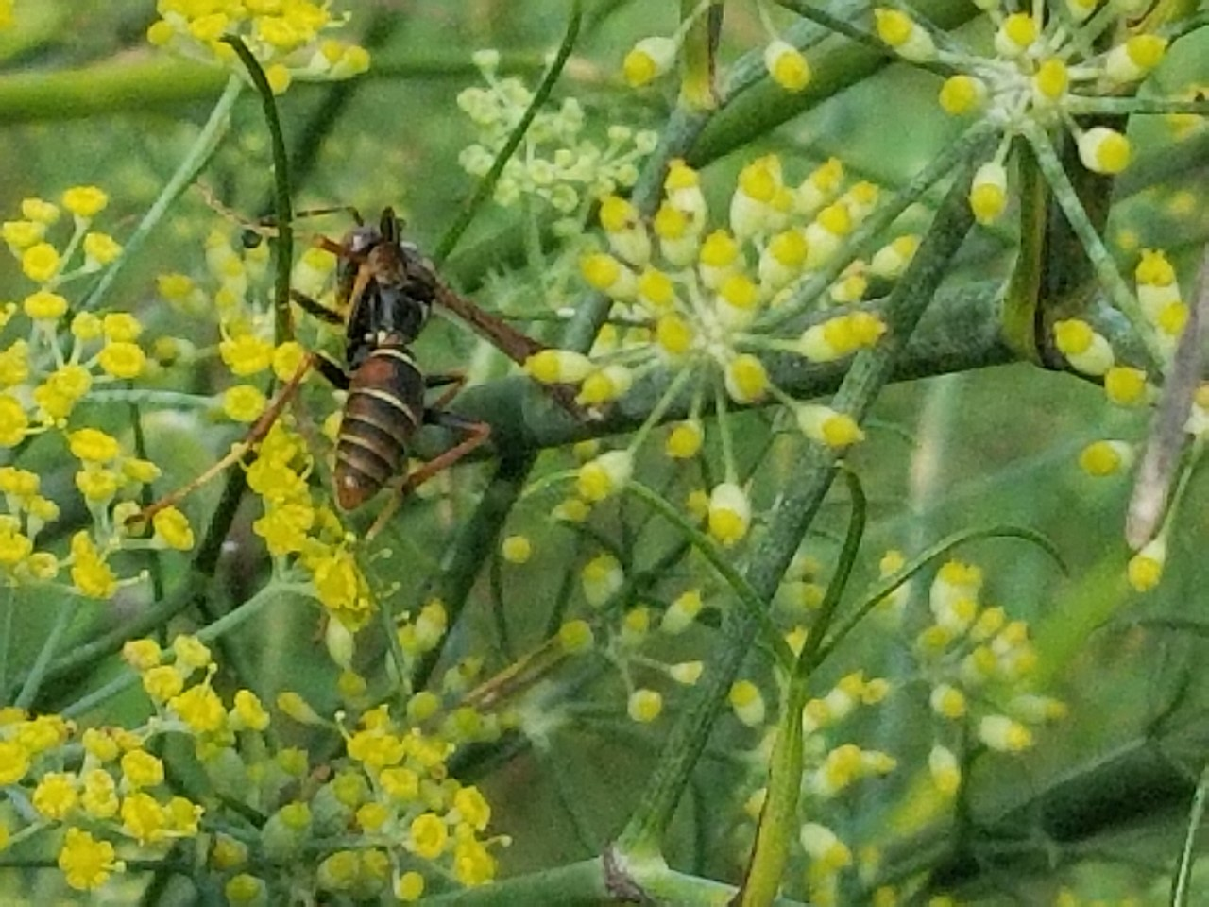
Wasps
(13 - 25 mm)
Can include:
Potter Wasps
Paper Wasps
And others
These are generally hairless. Some have very narrow waists.
Note: Yellow jackets are not often seen on flowers.
Potter Wasp
Paper Wasp

Slide 20
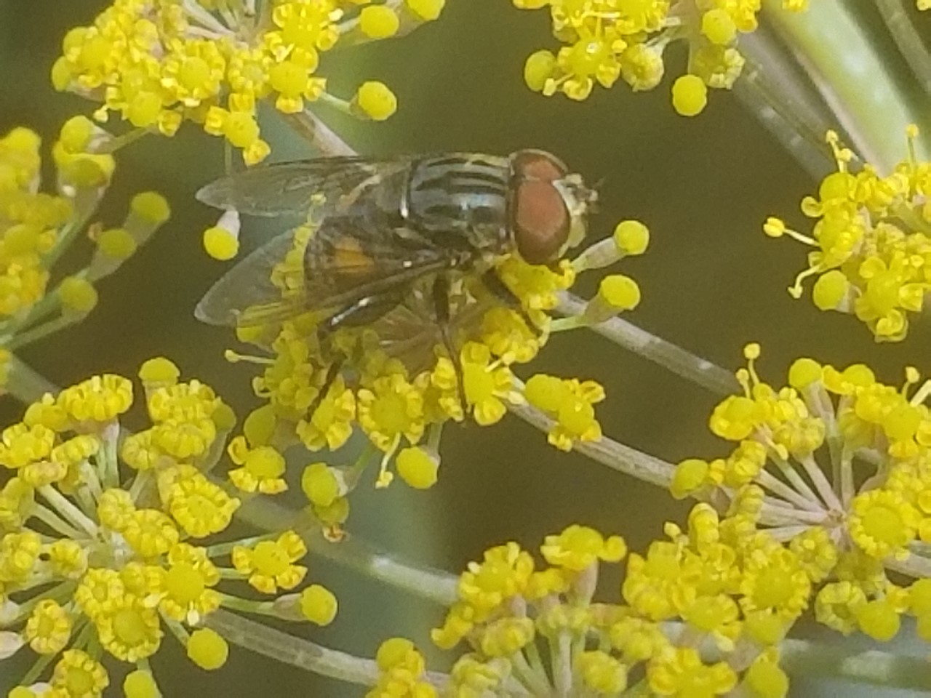
Fly

Slide 21
Comparing bees with flies
Bees
Flies
Have four wings
Have prominent antennae
Have two large eyes and three smaller ones in between (ocelli)
Carry pollen in pollen baskets (corbicula) or scopa (on bottom of abdomen)
Are generally hairy
Have two wings
Have smaller antennae
Have two prominent eyes
Do not carry pollen
Are generally not very hairy

Slide 22
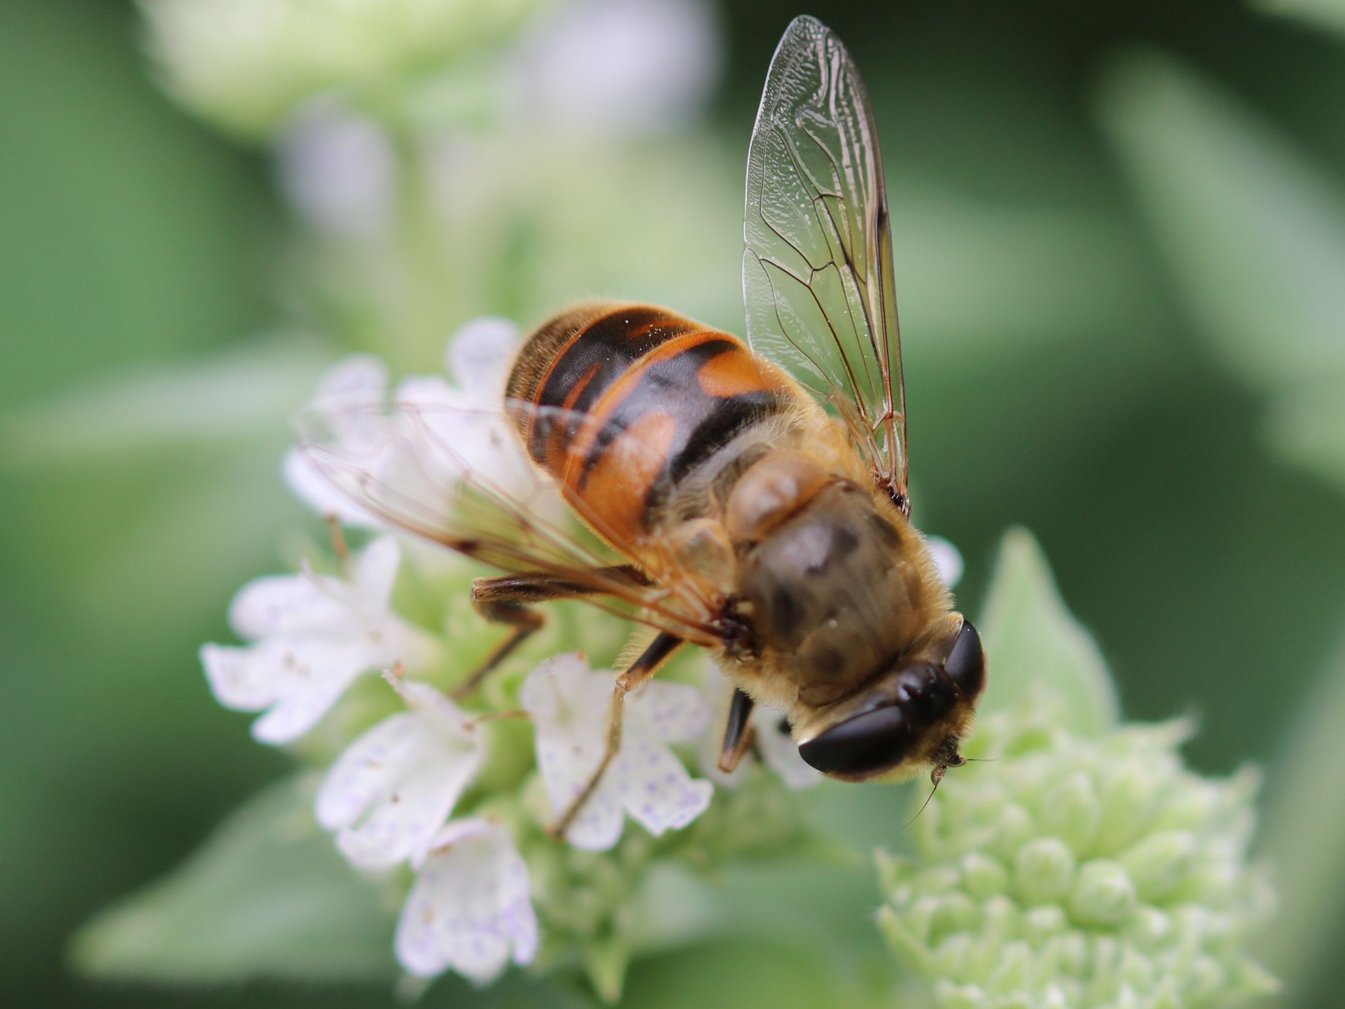
Syrphid Fly
Notice the very small antennae and that the eyes are close together with no ocelli. It is hard to tell if there are two wings or four wings hooked together. Often bees rest with their wings laying flat on their back. Do you see any pollen? No! This is definitely a fly that resembles a bee, a bee mimic.

Slide 23
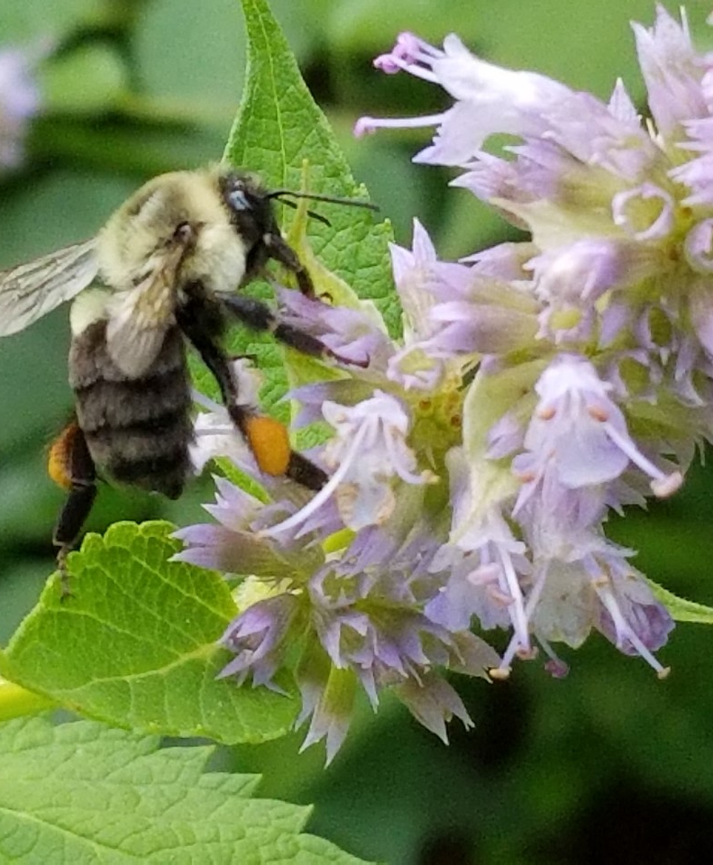
On this bumble bee you can see pollen in the pollen basket (corbicula). Also, notice the long antennae.

Slide 24
Is this a bee or a fly??
Notes:
This is a fly!

Slide 25
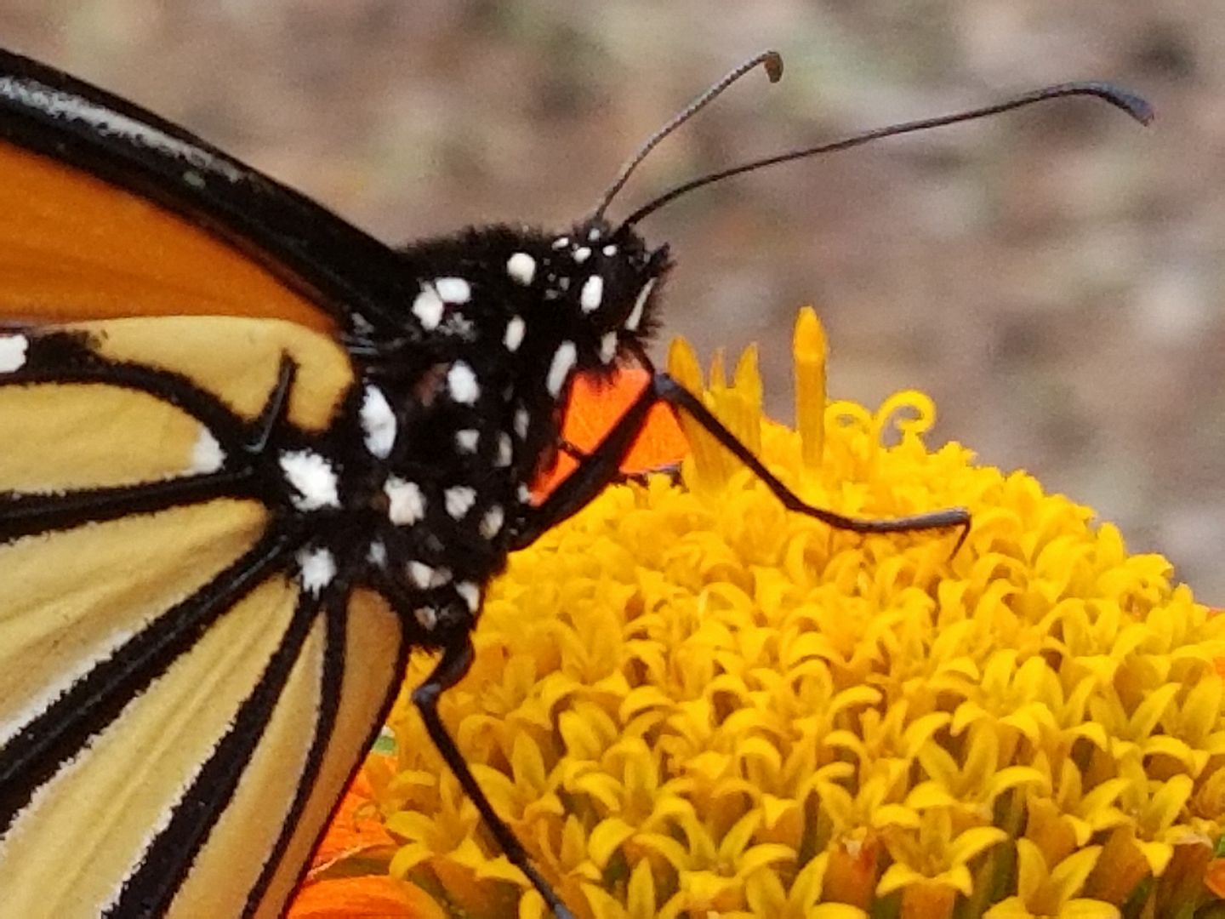
Butterflies and Moths

Slide 26
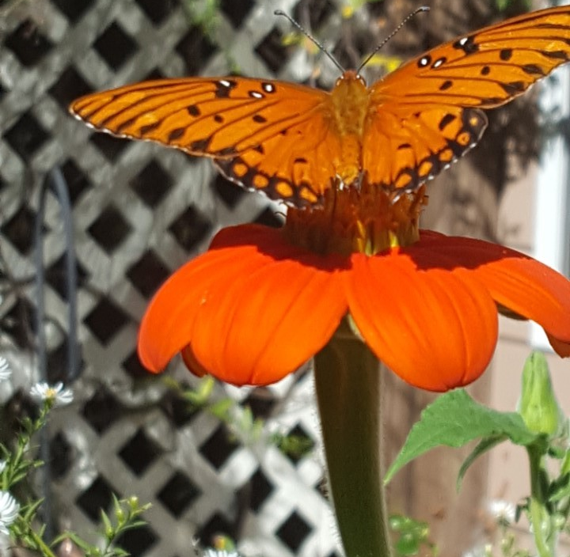
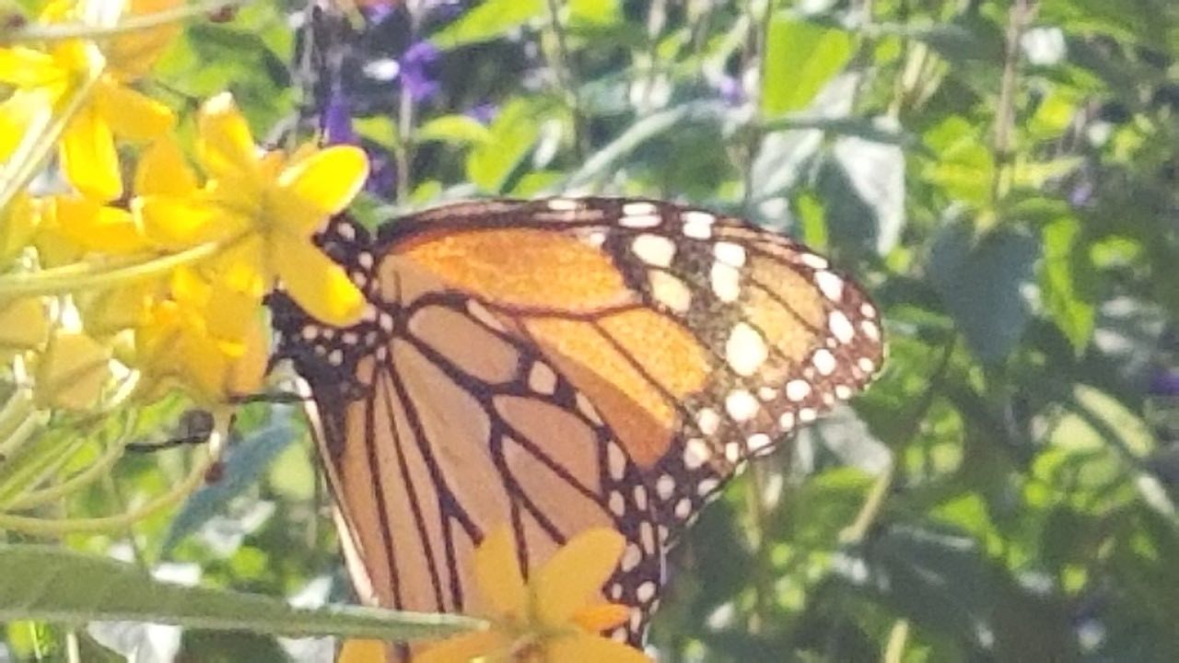
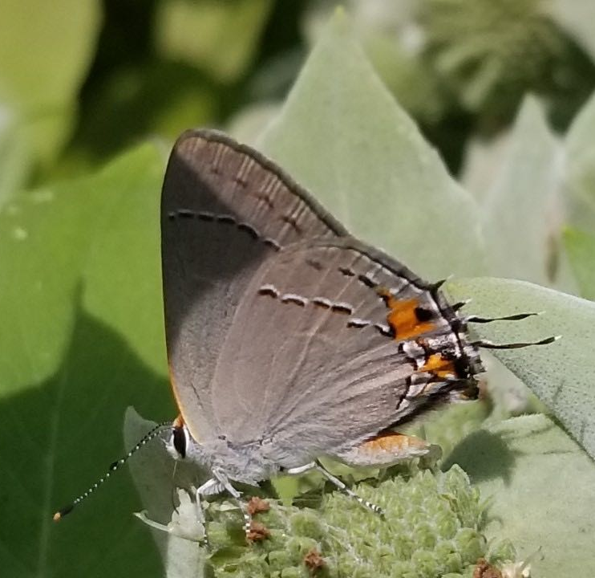
Monarch
Gulf Fritillary
Gray Hairstreak
Butterflies

Slide 27
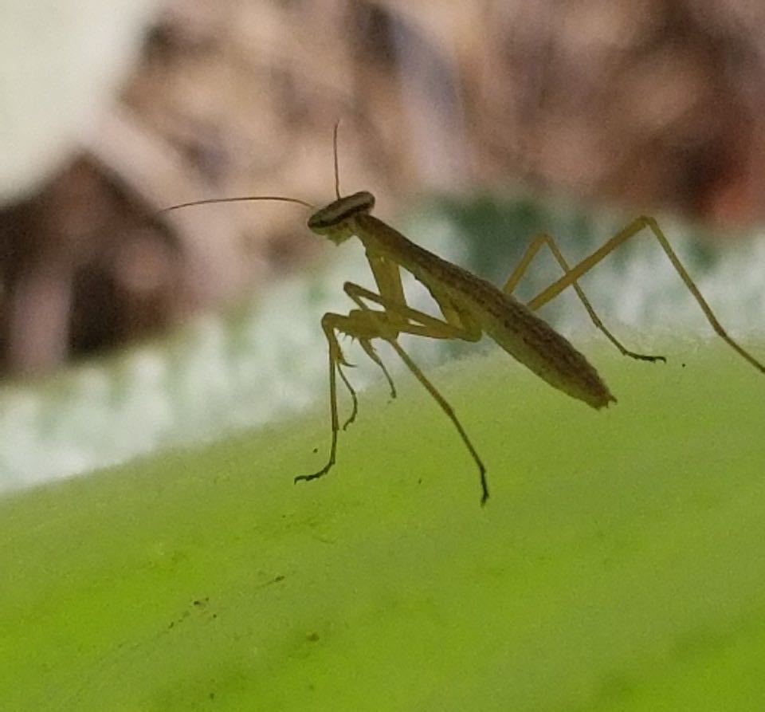
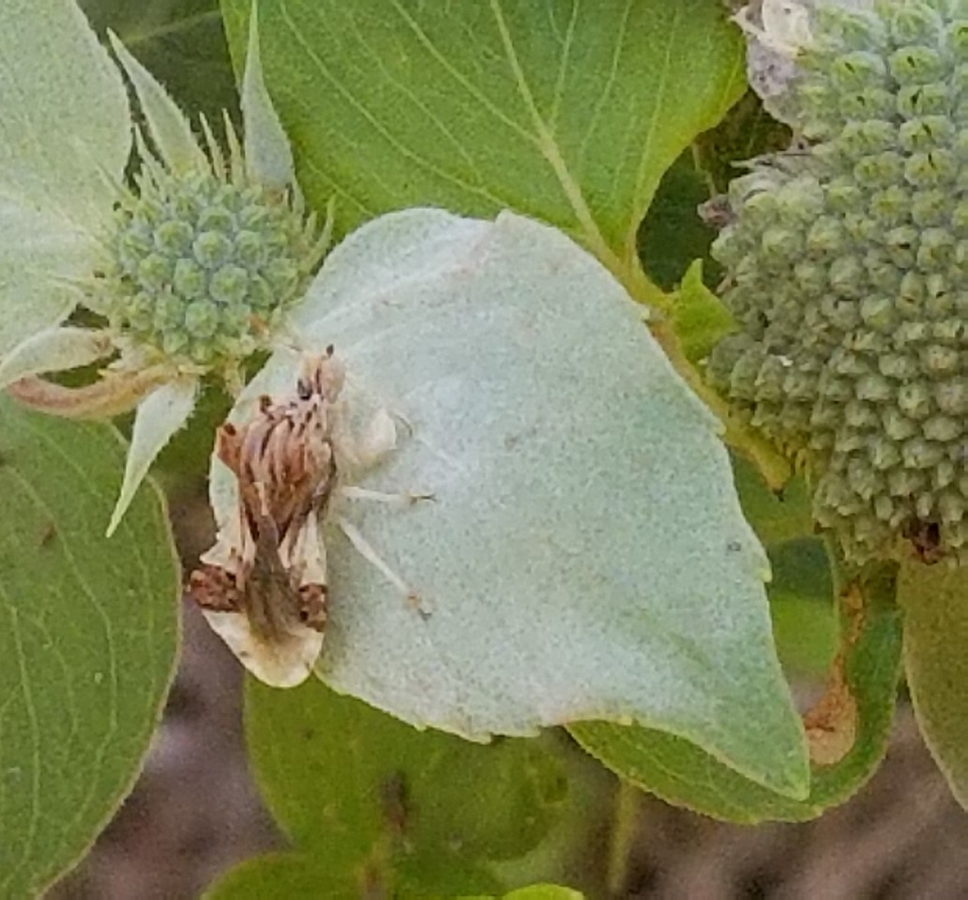
Praying Mantis
Ambush bug
Any insect that doesn’t fit into one of the previous categories falls into the “other insect” category.

Slide 28
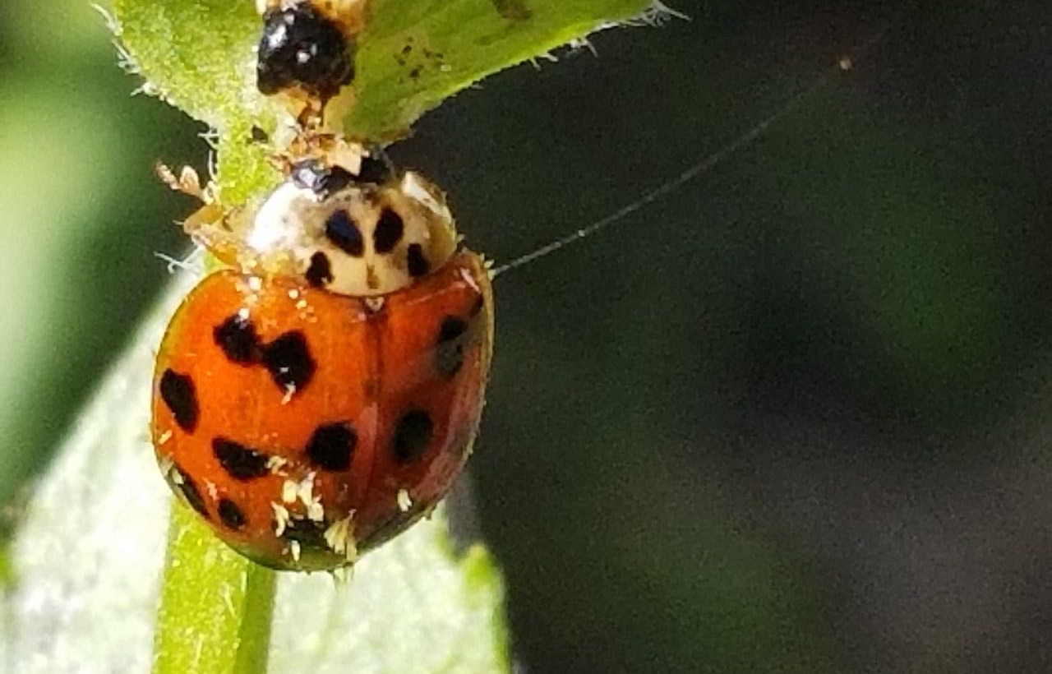
Lady Beetle

Slide 29
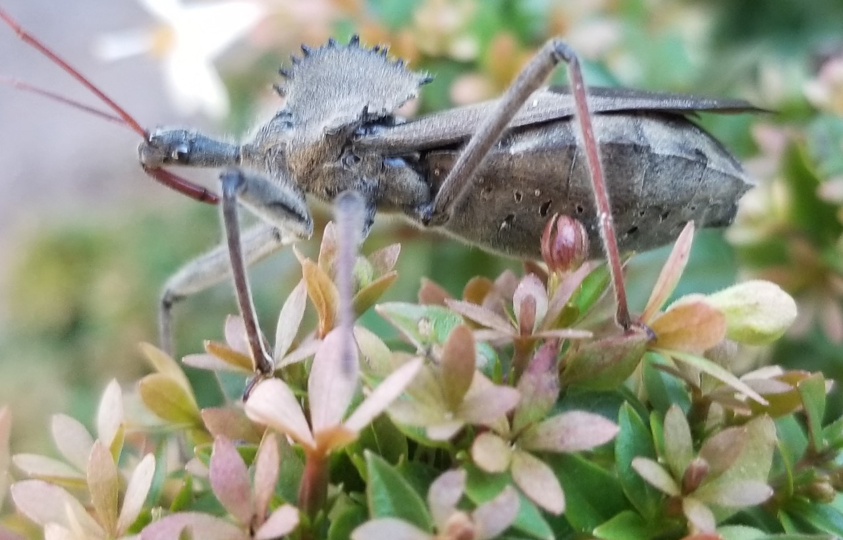
Wheel Bug

Slide 30
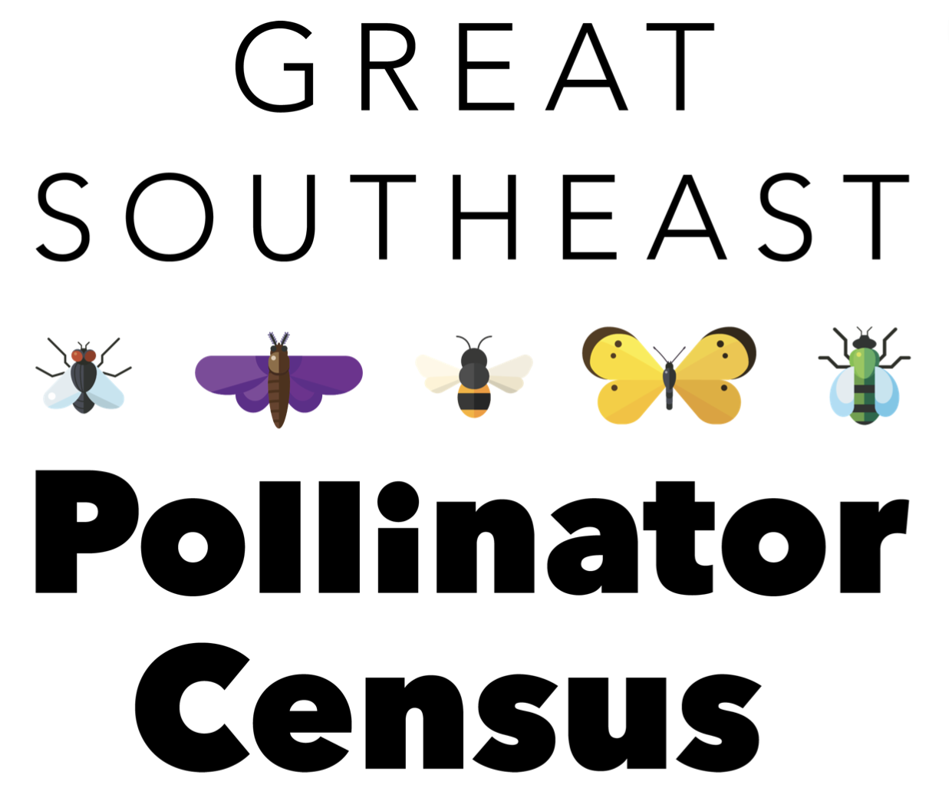
Counts are simply uploaded to the website https://GSePC.org

Slide 31
Sign up for a periodic newsletter at https://GSePC.org
The website also contains other interesting information for participants including lesson plan links for teachers, an Insect Counting and Identification Guide, a counting sheet, and Spanish language materials, and ideas for fun Census activities.
Join our Southeast Pollinator Census Facebook page and follow us on Instagram @SoutheastPollinators.
Find out what your local Extension offices have planned for the census.
For more information contact the project coordinator Becky Griffin at beckygri@uga.edu.

