Slide 1
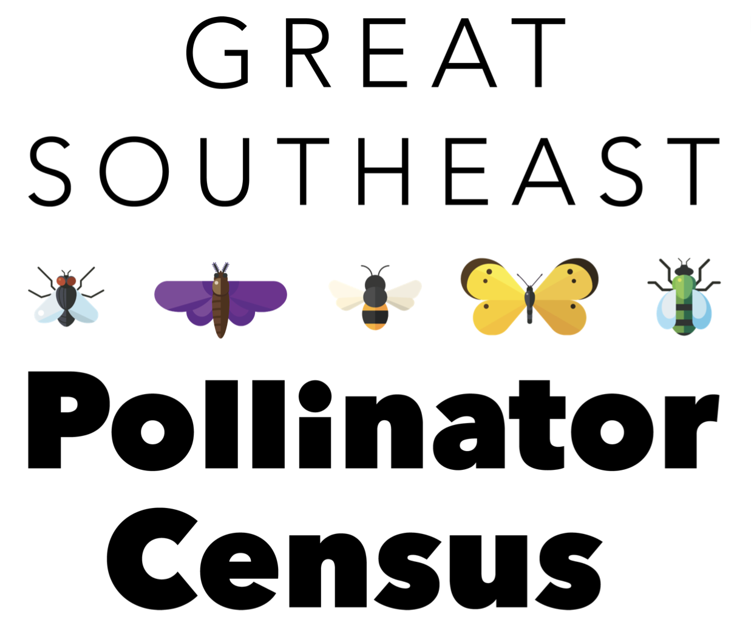
https://GSePC.org
How to participate in the Great Southeast Pollinator Census
For Youth

Slide 2
Each year in August, citizens from Georgia, South Carolina and North Carolina participate in the Great Southeast Pollinator Census documenting our pollinator populations. Anyone can participate in this important initiative. Families, school groups, scouts, garden clubs, 4-H groups, individuals – everyone! You don’t have to be an entomologist to participate!

Slide 3
Participants will be counting insects that land on one favorite pollinator plant for 15 minutes. Counts will be easily recorded on the project website.
Make sure your pollinator garden includes plants that will be blooming in August!

Slide 4
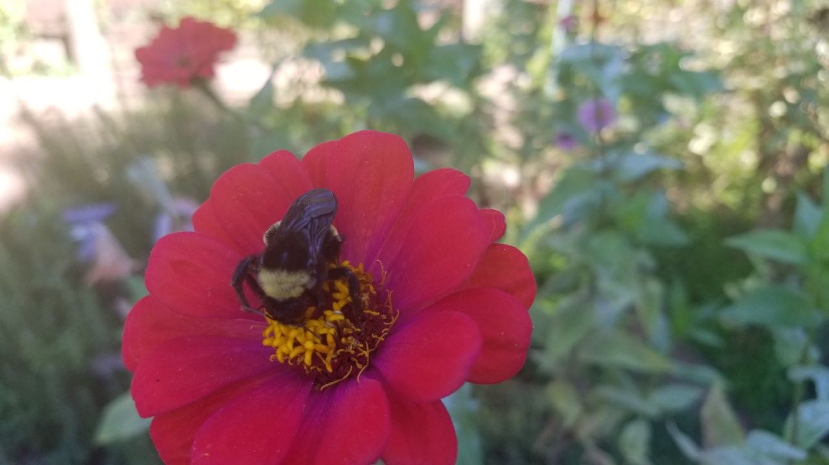
Participants will count insects in these categories:
Carpenter bees
Bumble bees
Honey bees
Small bees
Wasps
Flies
Butterflies
Other Insects

Slide 5
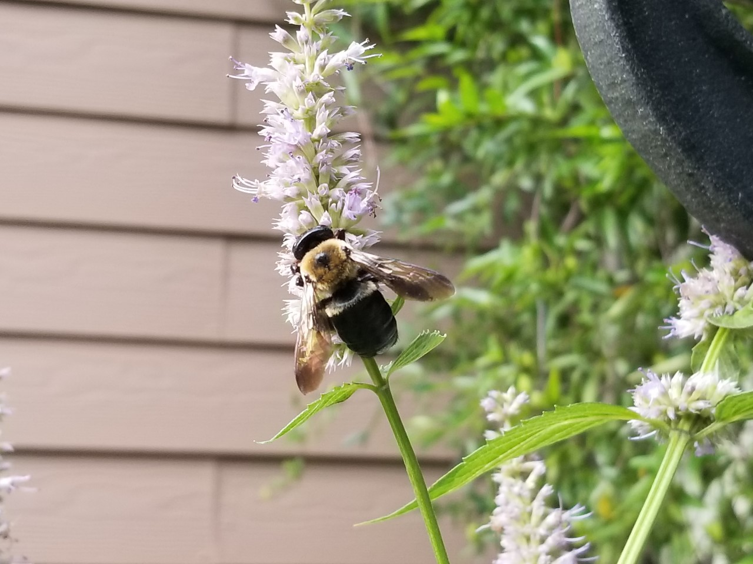
Carpenter Bee

Slide 6
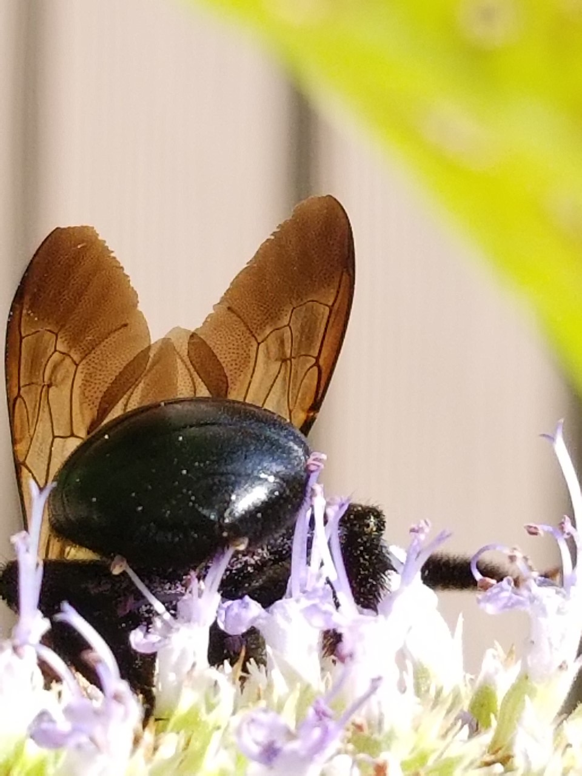
Carpenter Bees
(16 – 22 mm)
Black body with yellow and black bands
Dense hair on head and thorax
NO HAIR on abdomen
Broad head, thick body
Males have yellow to white coloring on face, females all black on face

Slide 7
Carpenter Bees
have “shiny heinies!”

Slide 8
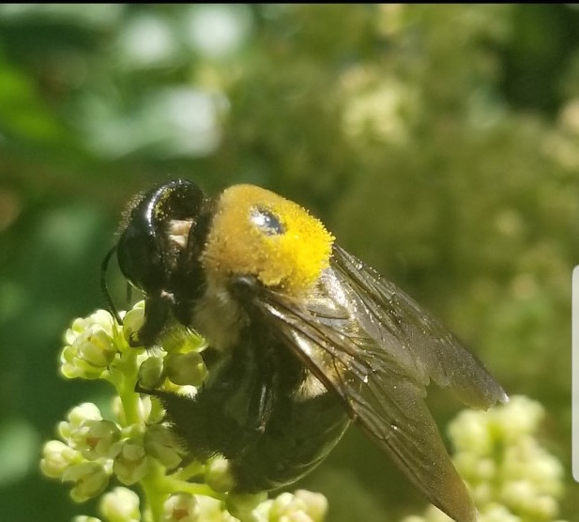
Carpenter bees build a nest by chewing holes in wood, sometimes in homes, fences, or barns. The pollen on the top of this carpenter bee’s thorax shows what a great pollinator this bee is!

Slide 9
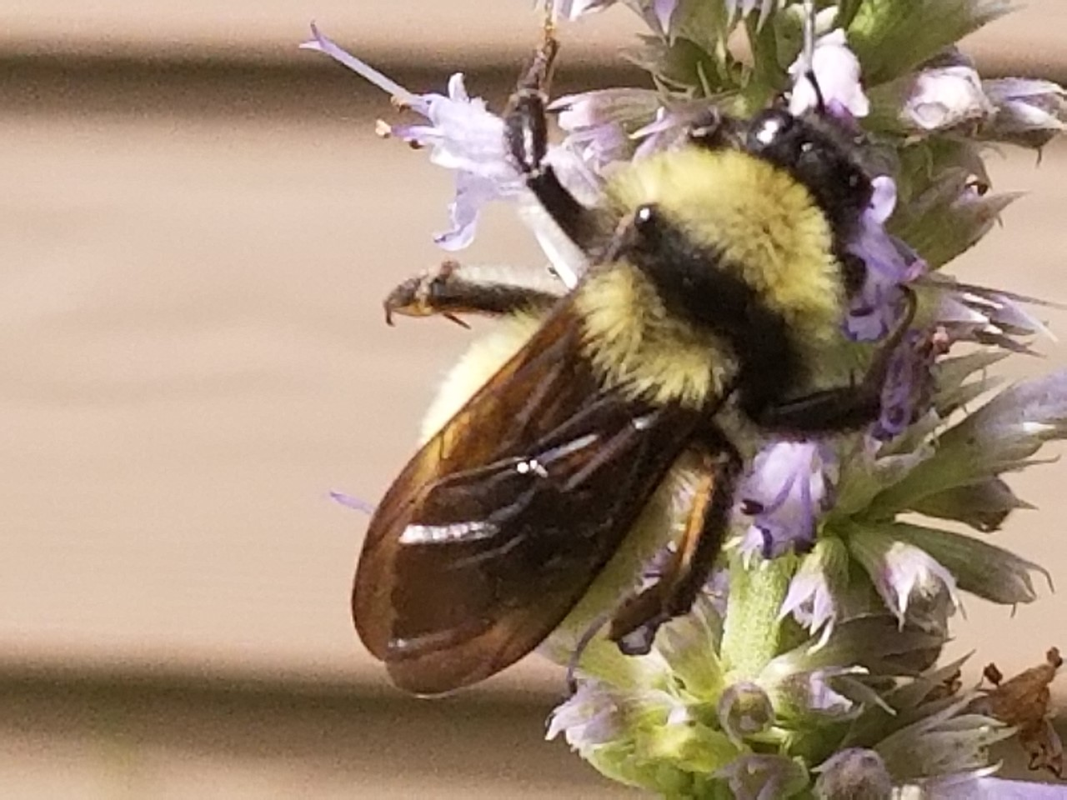
Bumble bee
Notes:
Yellow Bumble bee

Slide 10
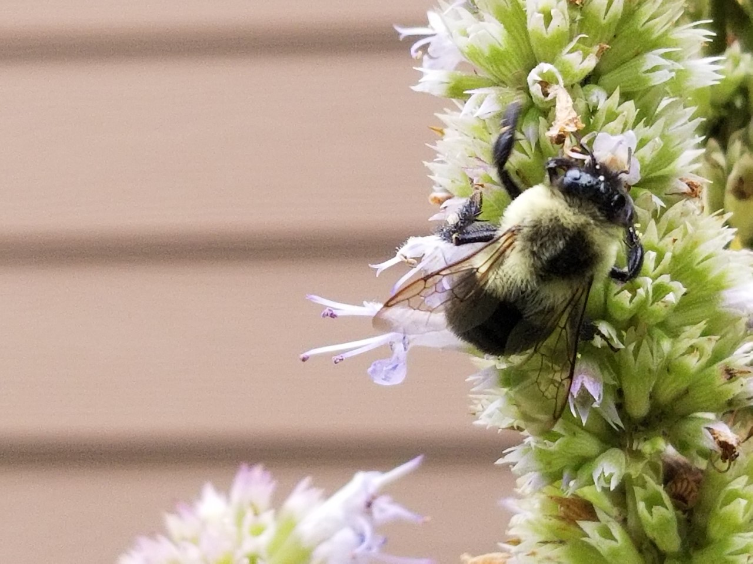
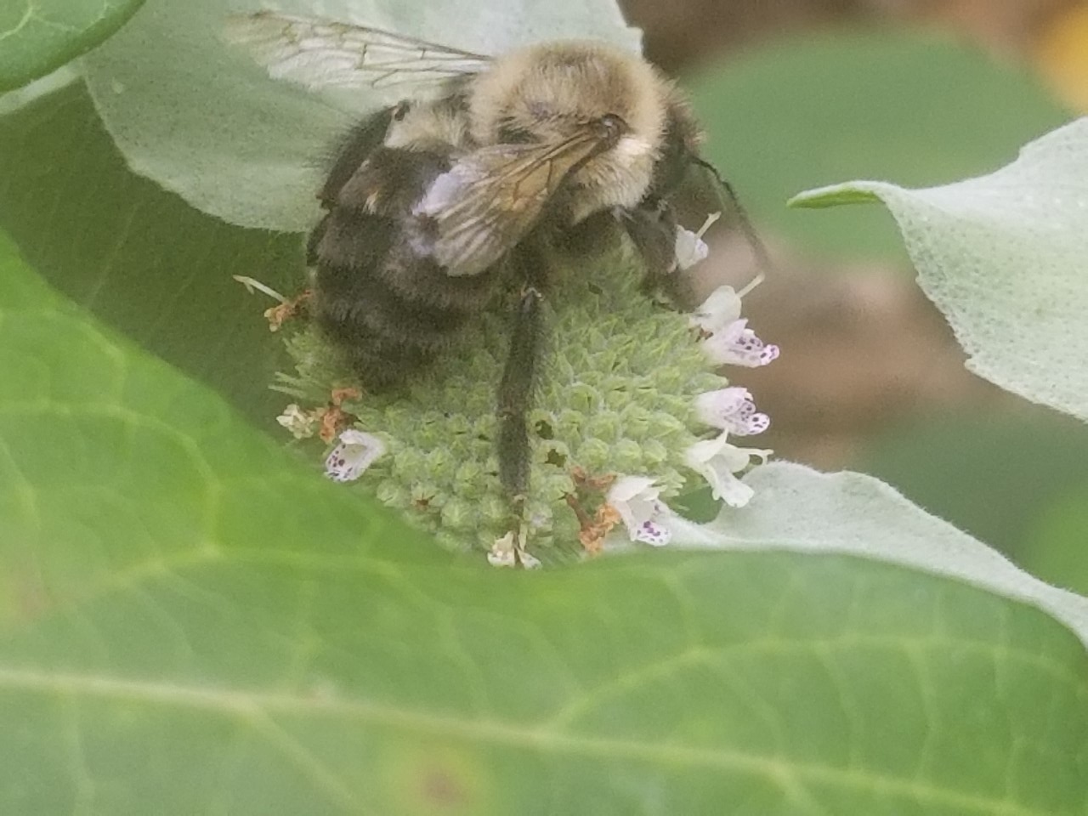
Bumble Bees
(10 – 19 mm)
Black body covered with dense yellow and black hair
Fat bee with small head
Large thorax and abdomen
Hairy abdomen

Slide 11
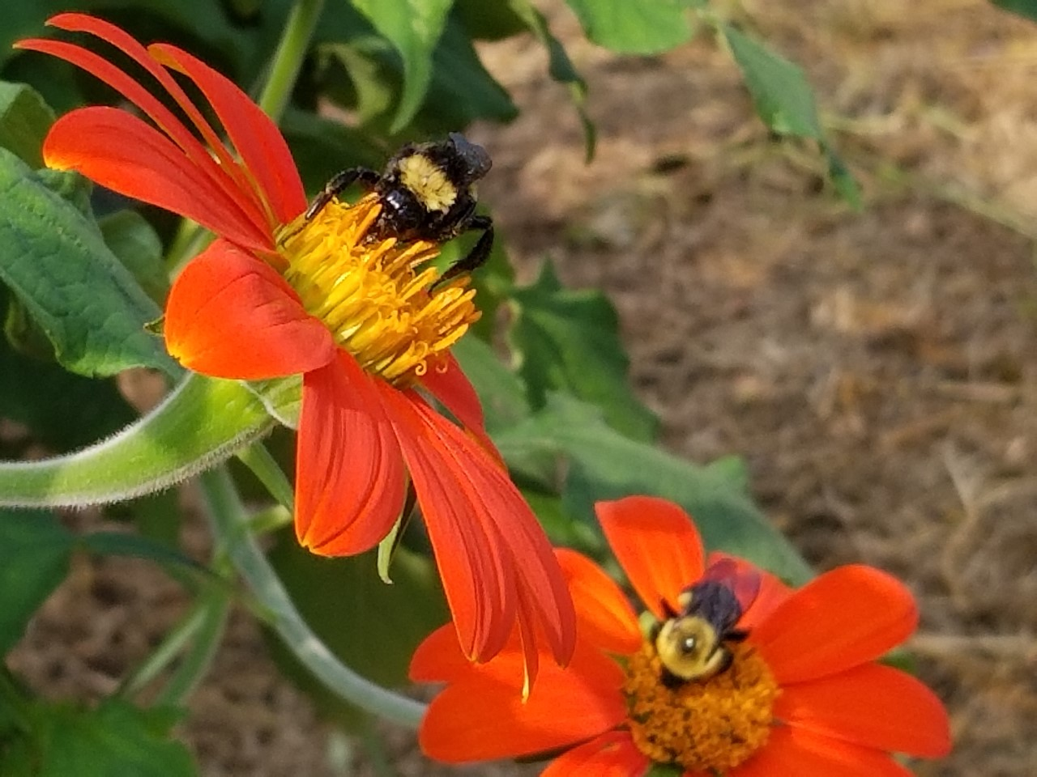
Notes:
Two bumble bees on Mexican sunflowers

Slide 12
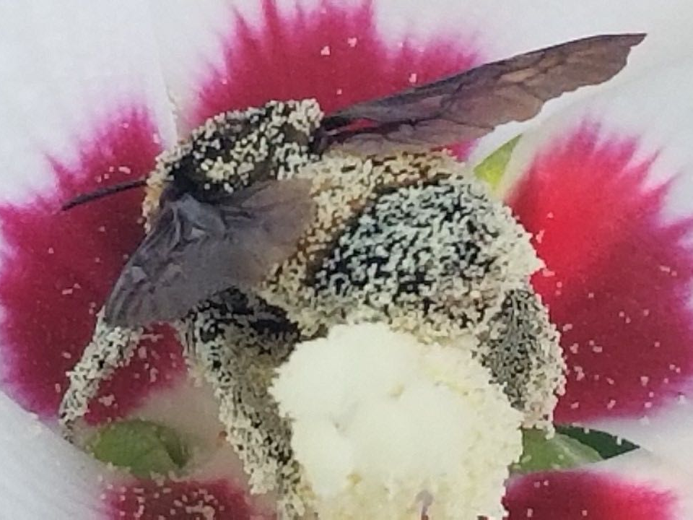
As bumble bees fly their hairs become positively charged. When they land on a flower the slightly negatively charged pollen is attracted to their hairs.

Slide 13
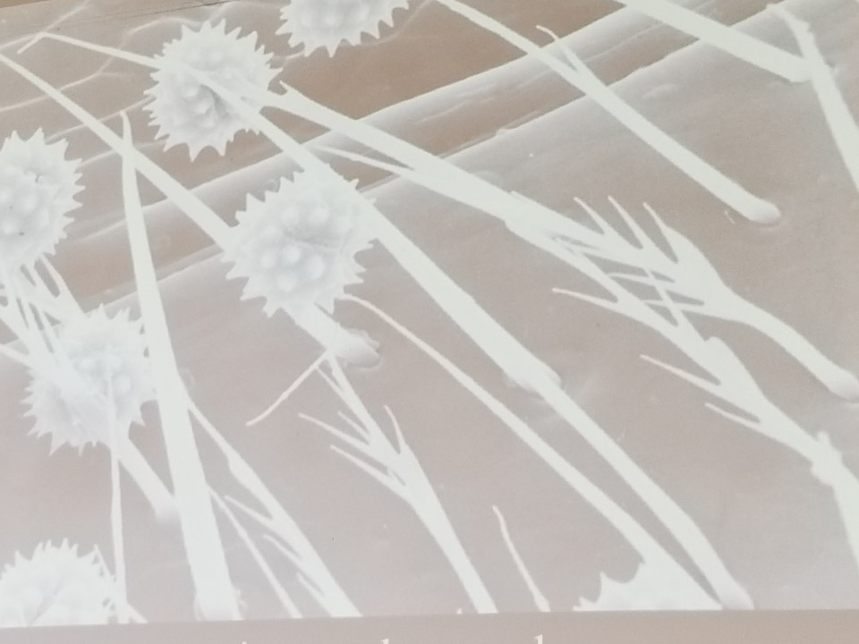
This photo from Dr. Francis Ratnieks shows how the branched hairs of a bee trap pollen.

Slide 14
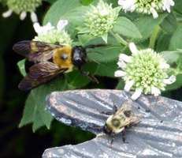
This photo illustrates the differences between the
carpenter bee and a bumble bee. The carpenter bee is a “mack truck” while the bumble bee is more of a “pickup truck.”

Slide 15
And remember, a bumble bee has a “fuzzy rear” while a carpenter bee has a “shiny heinie”!

Slide 16
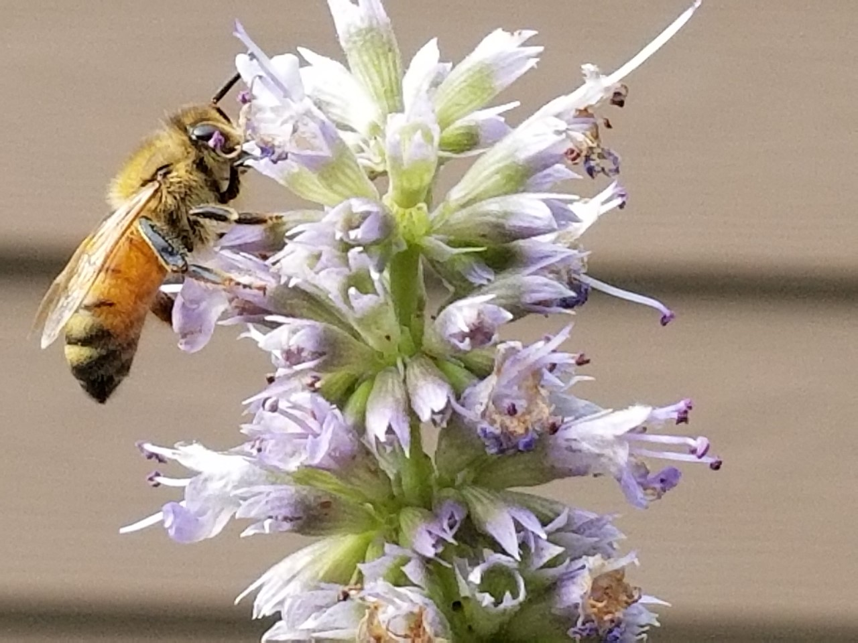
Honey Bees
(12 – 15 mm)
Brown or black stripes on body
Golden-brown hair covers abdomen
Honey bee

Slide 17
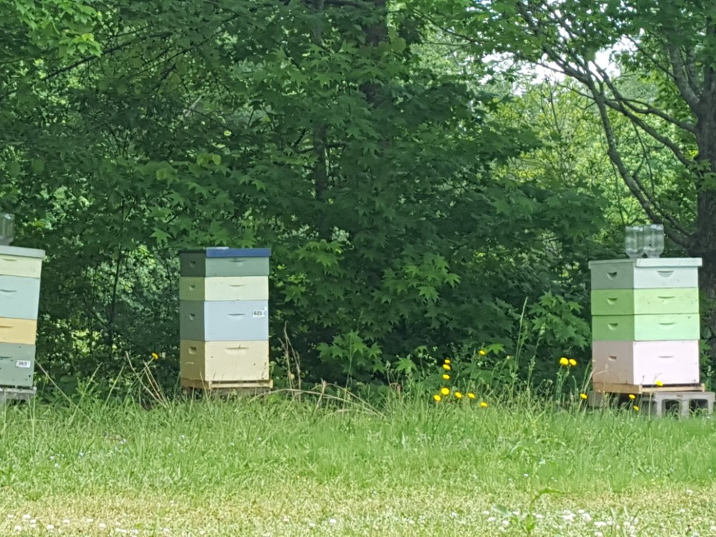
Honey Bees (Apis Mellifera) nest in bee hives that are managed by beekeepers. In the height of summer a strong hive could contain over 60,000 bees. Honey bees came to this county from Europe in the 1600s.

Slide 18
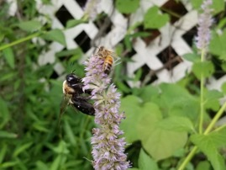
Honey Bee
This photo shows a honey bee
and a
bumble bee together.
Although some bumble bees are smaller, The two types
are easily distinguishable.
Bumble Bee

Slide 19
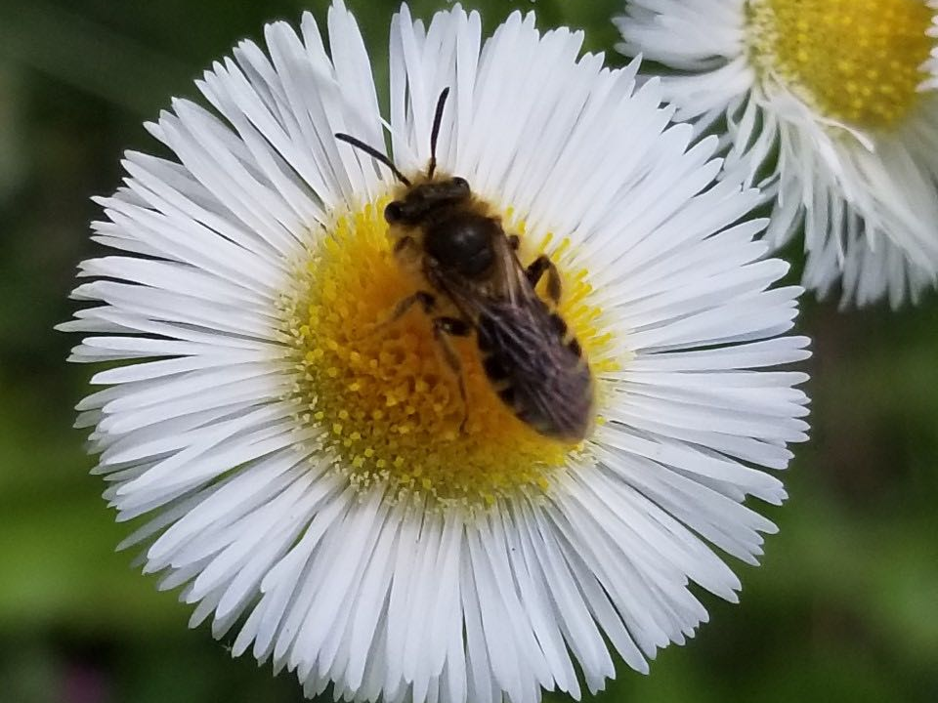
Small bees

Slide 20
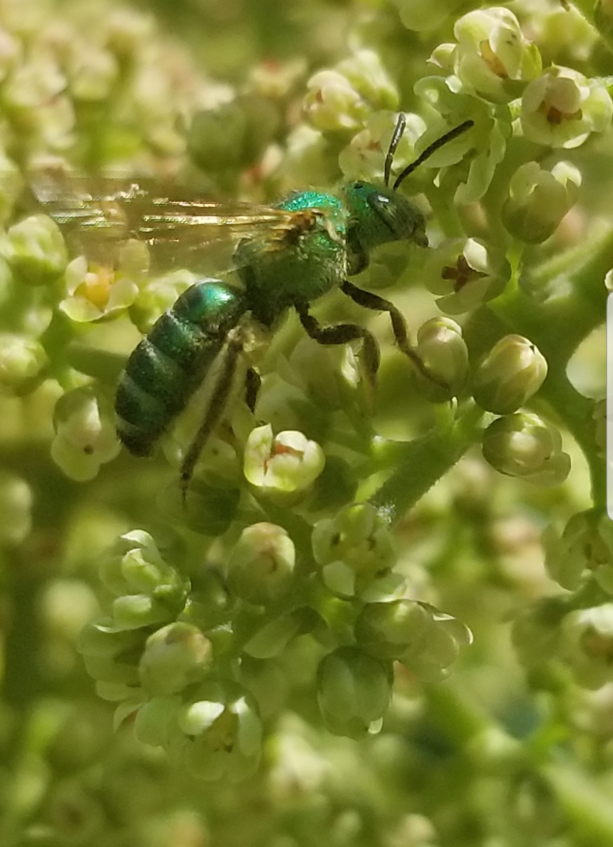
Small Bees
(Any bee smaller than a honey bee)
Can include:
Leafcutter Bees
Sweat Bees
And others
Note: Keep a lookout for the metallic shine of the sweat bees from the family Halictidae. Even though these bees can be small, the metallic color is easy to spot when the sun is shining on them.

Slide 21
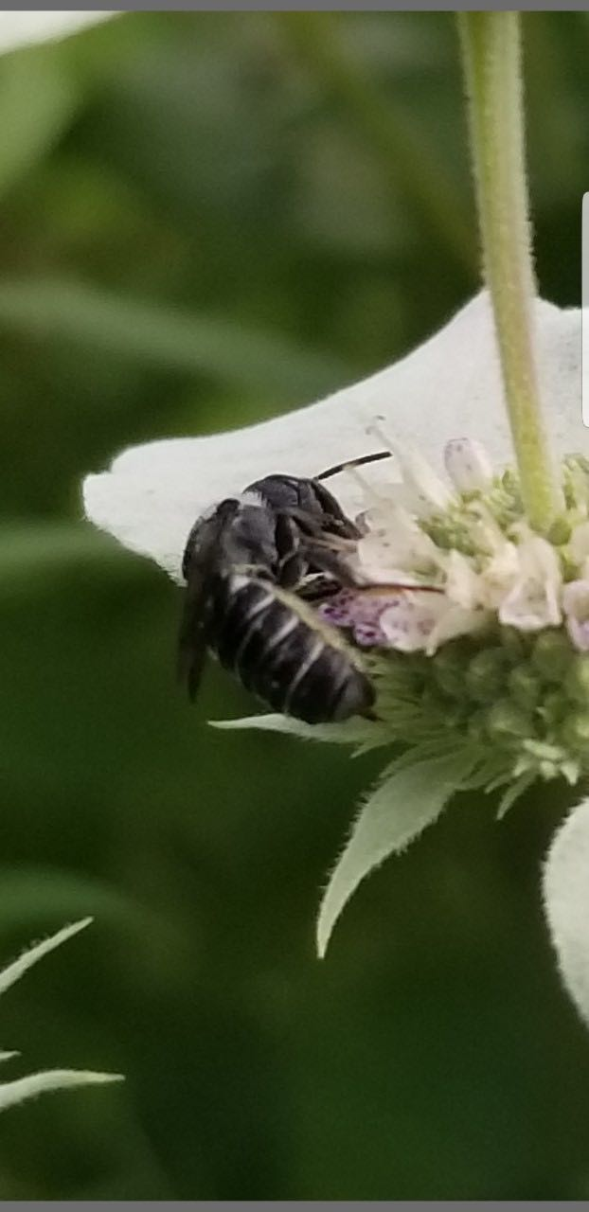
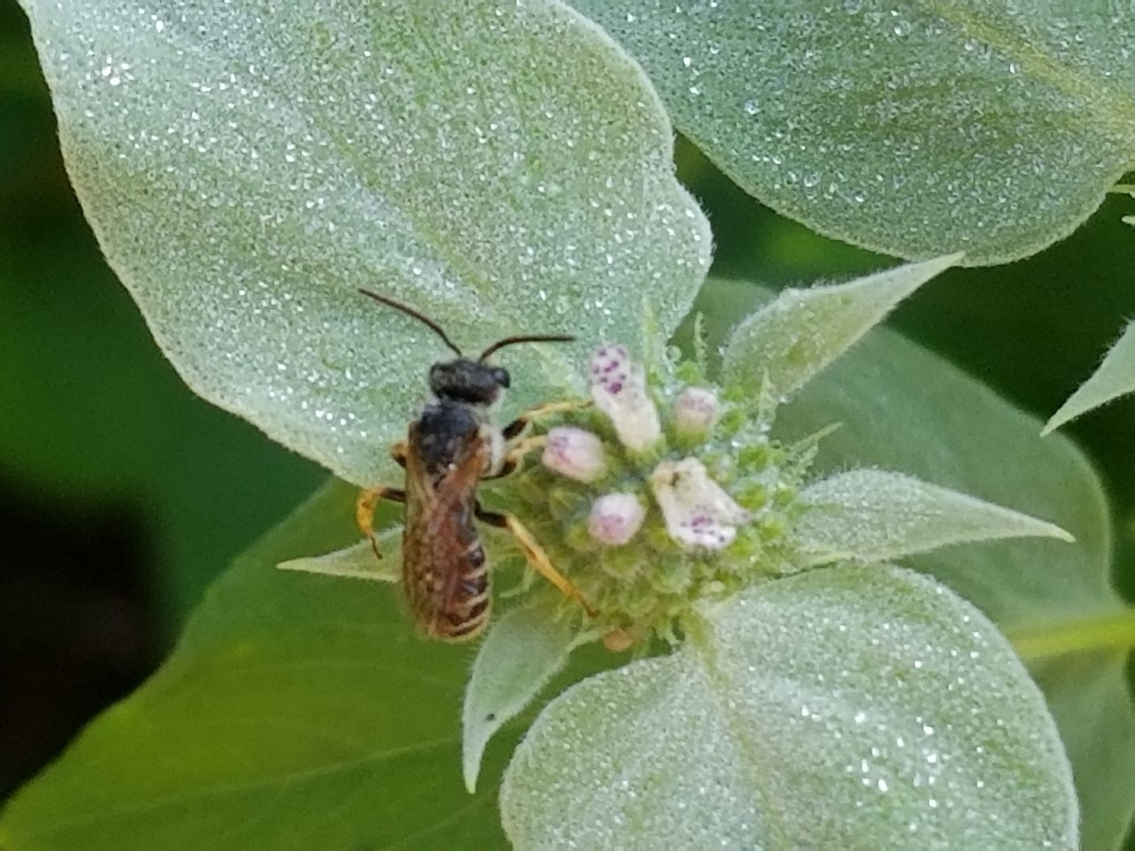
Small Bee
Small Bee
Leafcutter Bee

Slide 22
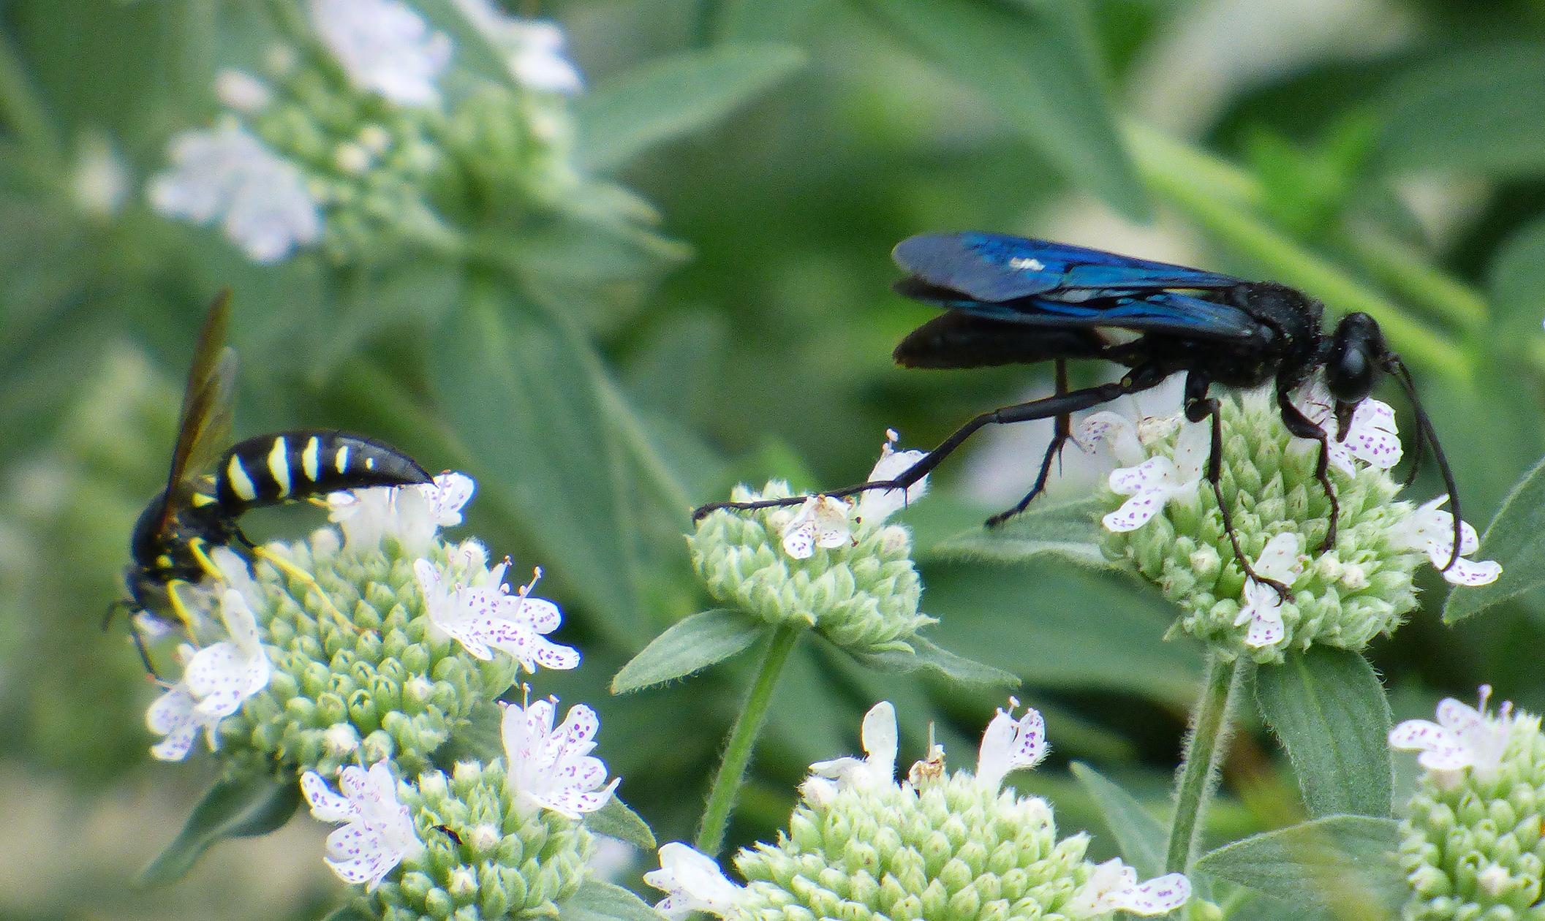
Wasps

Slide 23
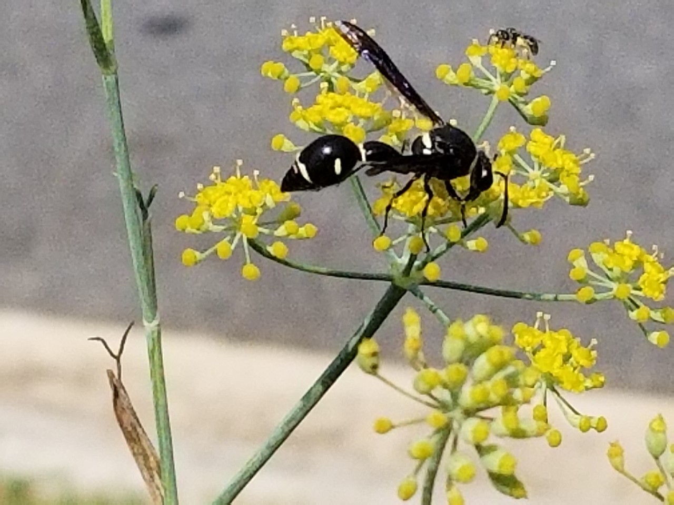
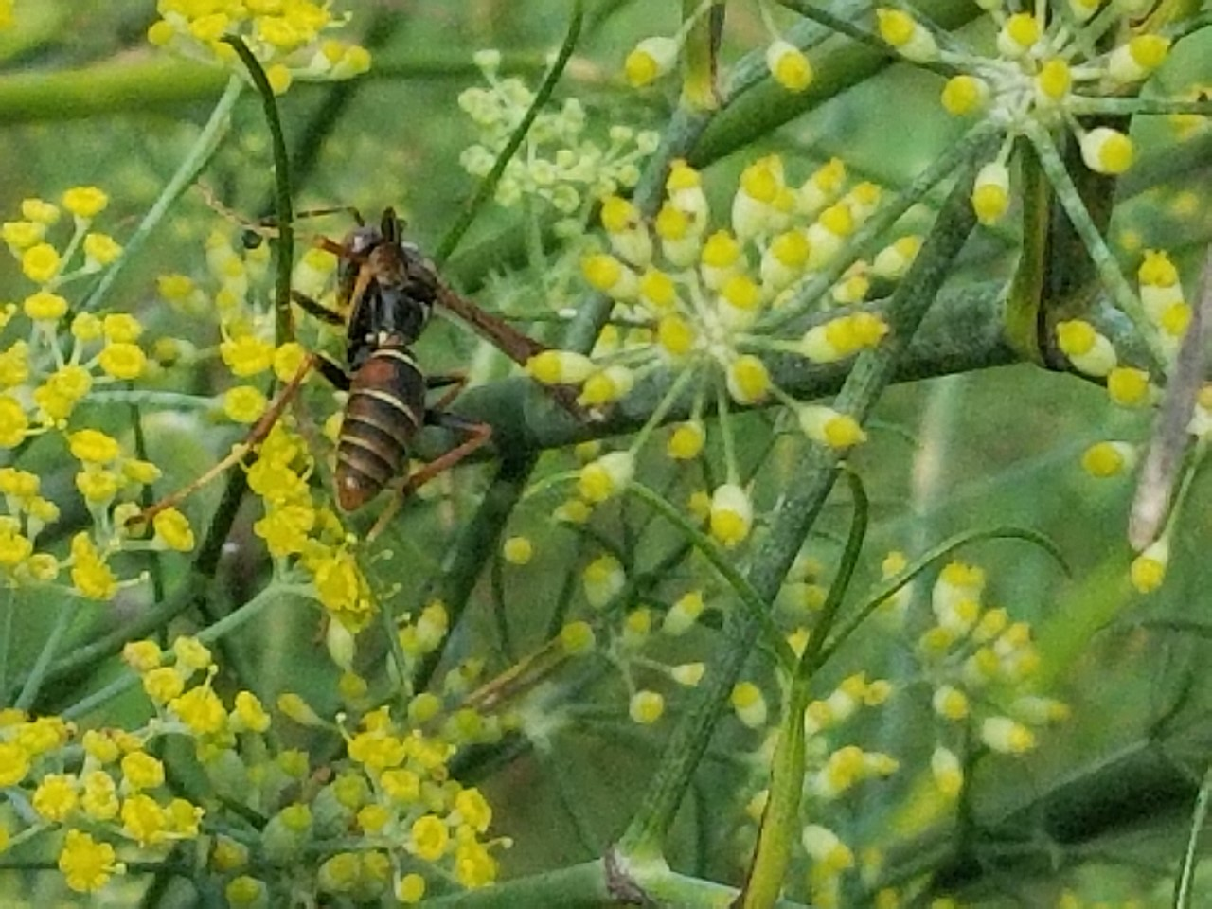
Wasps
(13 - 25 mm)
Can include:
Potter Wasps
Paper Wasps
And others
These are generally hairless. Some have very narrow waists.
Note: Yellow jackets are not often seen on flowers.
Potter Wasp
Paper Wasp

Slide 24
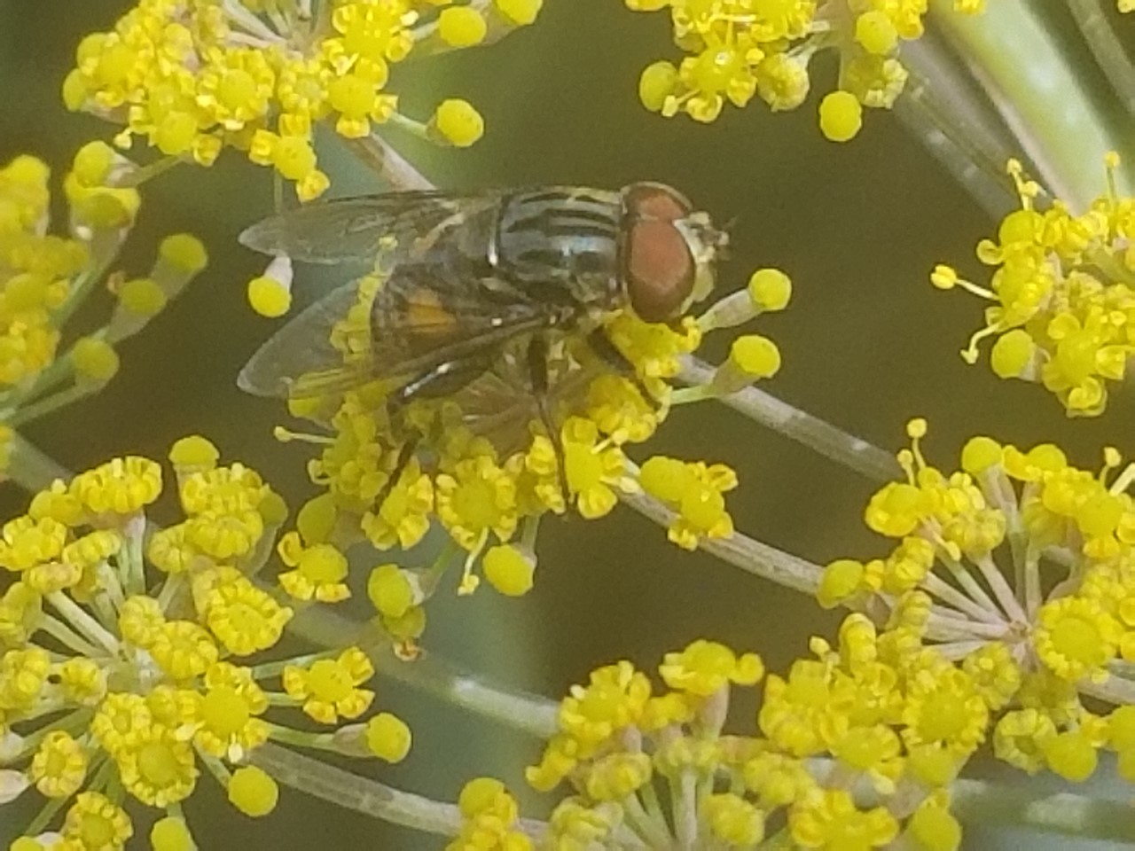
Flies

Slide 25
Comparing bees with flies
Bees
Flies
Have four wings (they hook together as they fly)
Have prominent antennae
Have two large eyes and three smaller ones in between (ocelli)
Carry pollen in pollen baskets (corbicula) or scopa (on bottom of abdomen)
Are generally hairy
Have two wings
Have smaller antennae
Have two prominent eyes
Do not carry pollen
Are generally not very hairy
When not flying the wings are generally spread and not laying across their body.

Slide 26
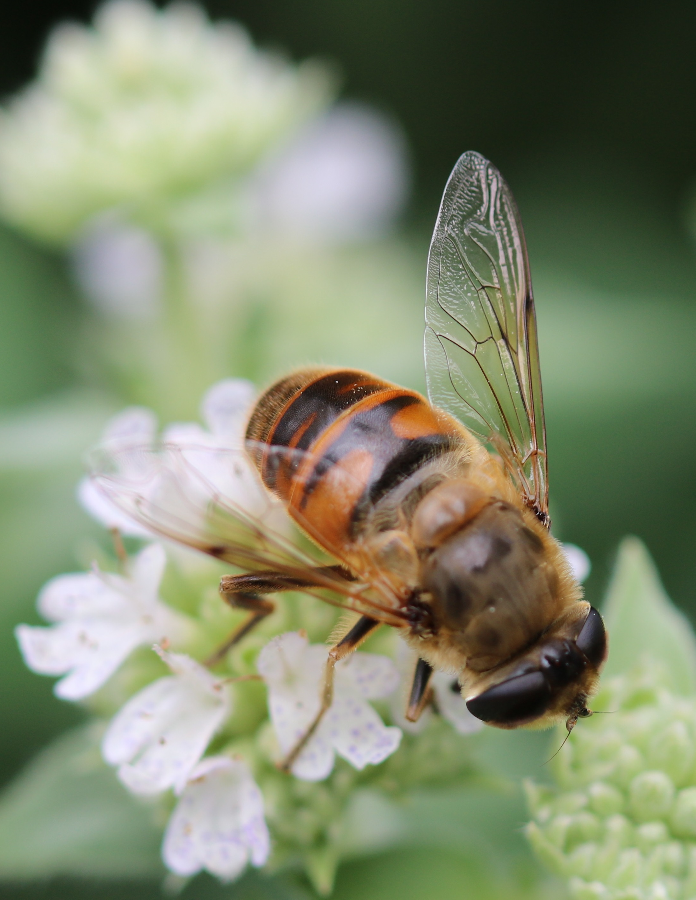
Syrphid Fly
Notice the very small antennae. Also, the eyes are close together with no ocelli. It is hard to tell if there are two wings or four wings hooked together. Often bees rest with their bees laying flat on their back. Do you see any pollen? No! This is a fly that resembles a bee, a bee mimic.

Slide 27
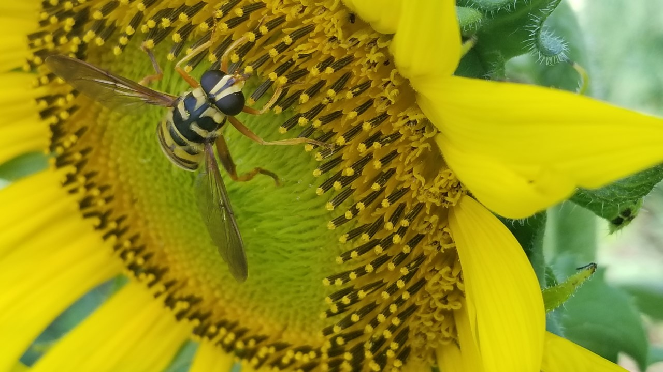
This is another fly. Notice the eyes are close together and there are no obvious antennae. The wings are spread open as the insect stands on the flower. There is no pollen gathering structure.

Slide 28
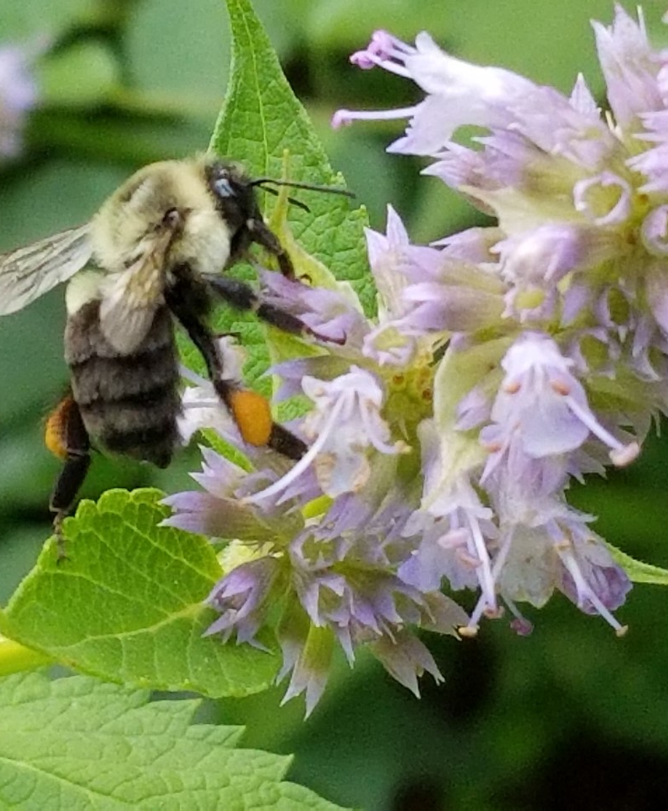
On this bumble bee you can see pollen in the pollen basket (corbicula). Also, notice the long antennae. This is definitely not a fly.

Slide 29
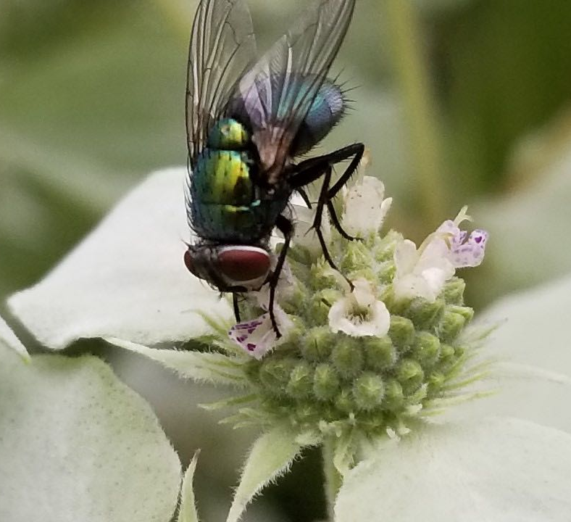
Is this a bee or a fly??
Notes:
This is a fly!

Slide 30
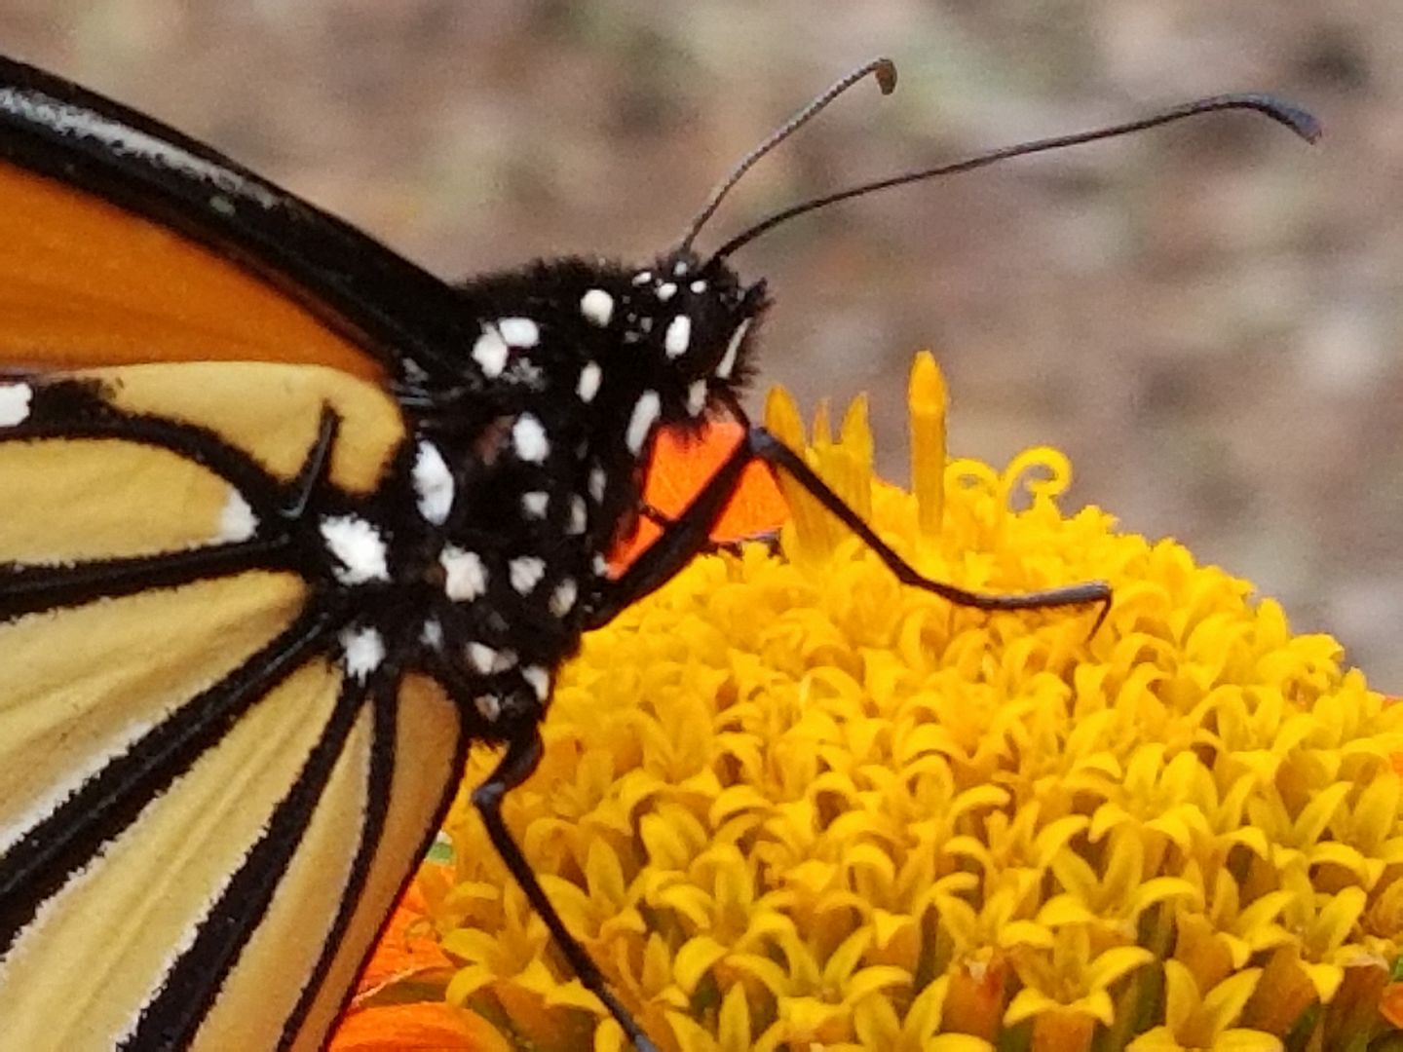
Butterflies and Moths

Slide 31
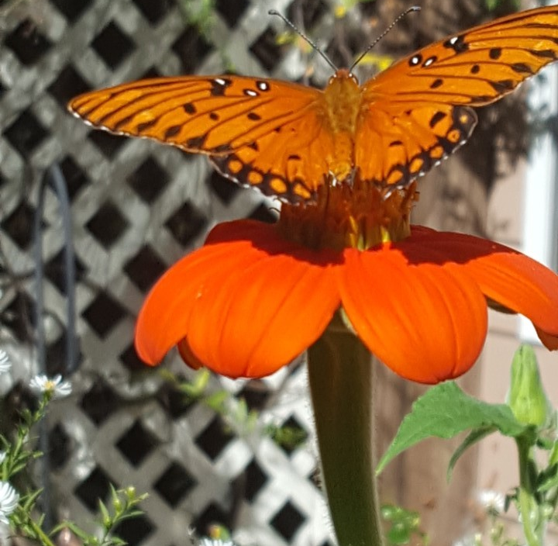
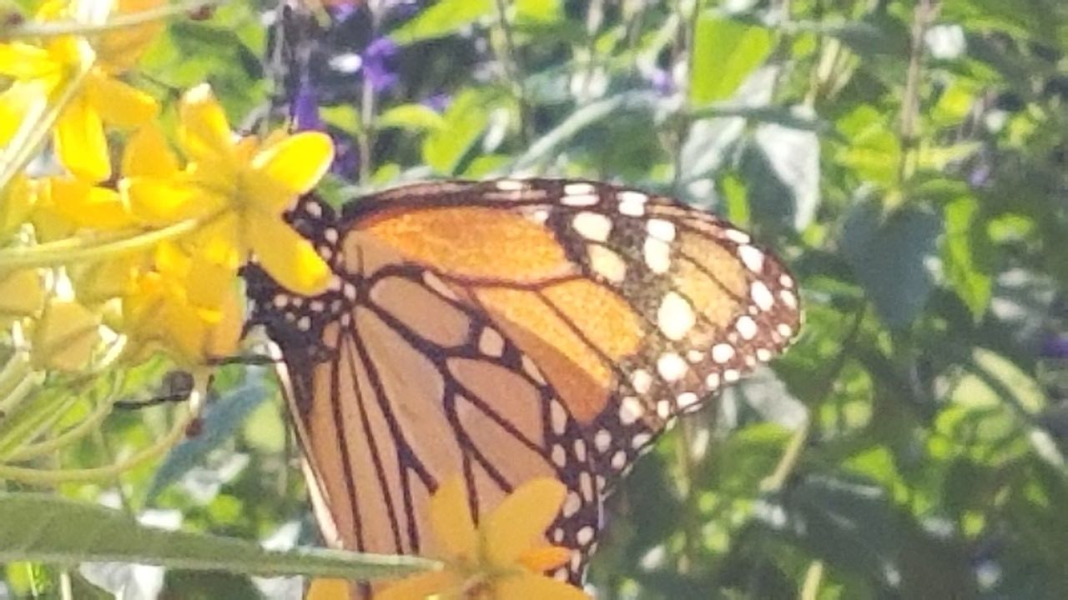
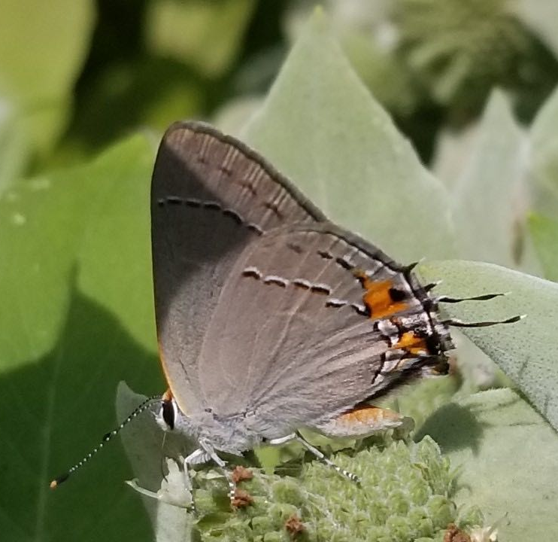
Monarch
Gulf Fritillary
Gray Hairstreak
Butterflies/Moths

Slide 32
Spring Moth

Slide 33
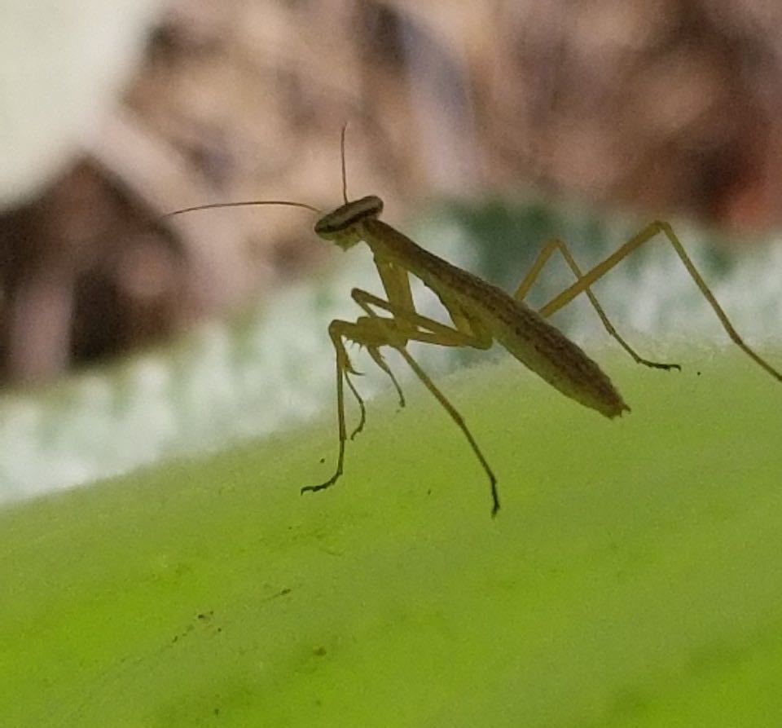
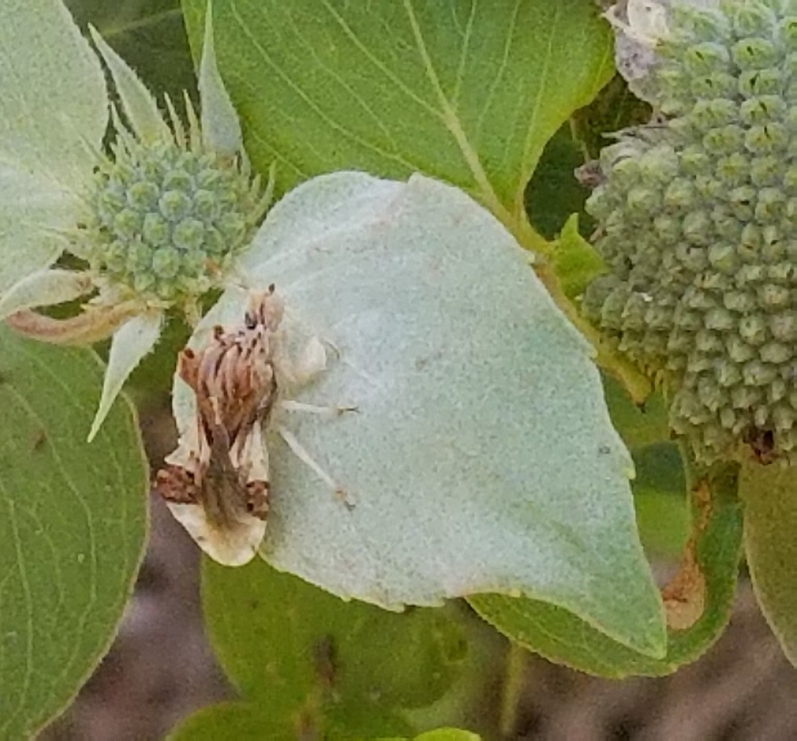
Praying Mantis
Ambush bug
Any insect that doesn’t fit into one of the previous categories falls into the “other insect” category.

Slide 34
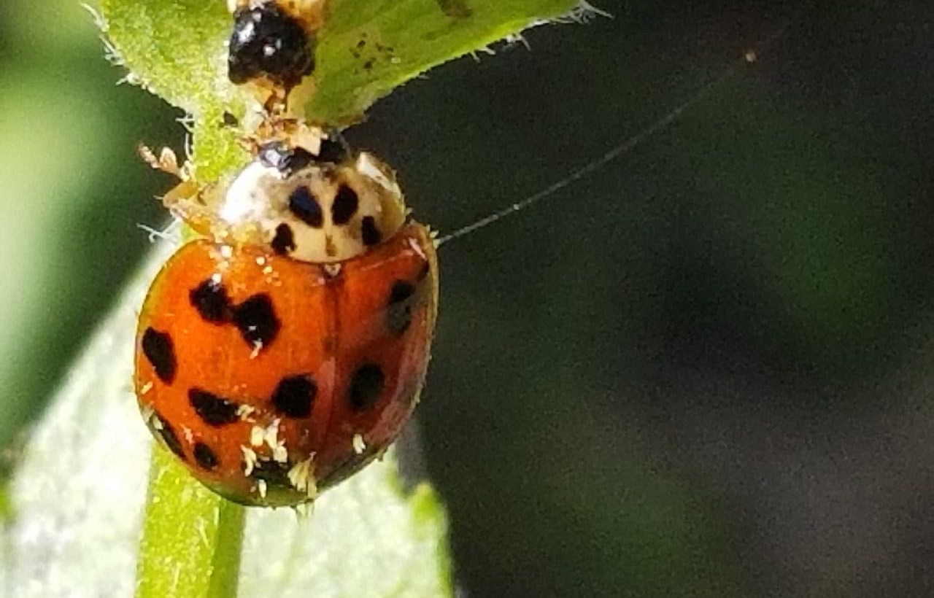
Lady Beetle

Slide 35
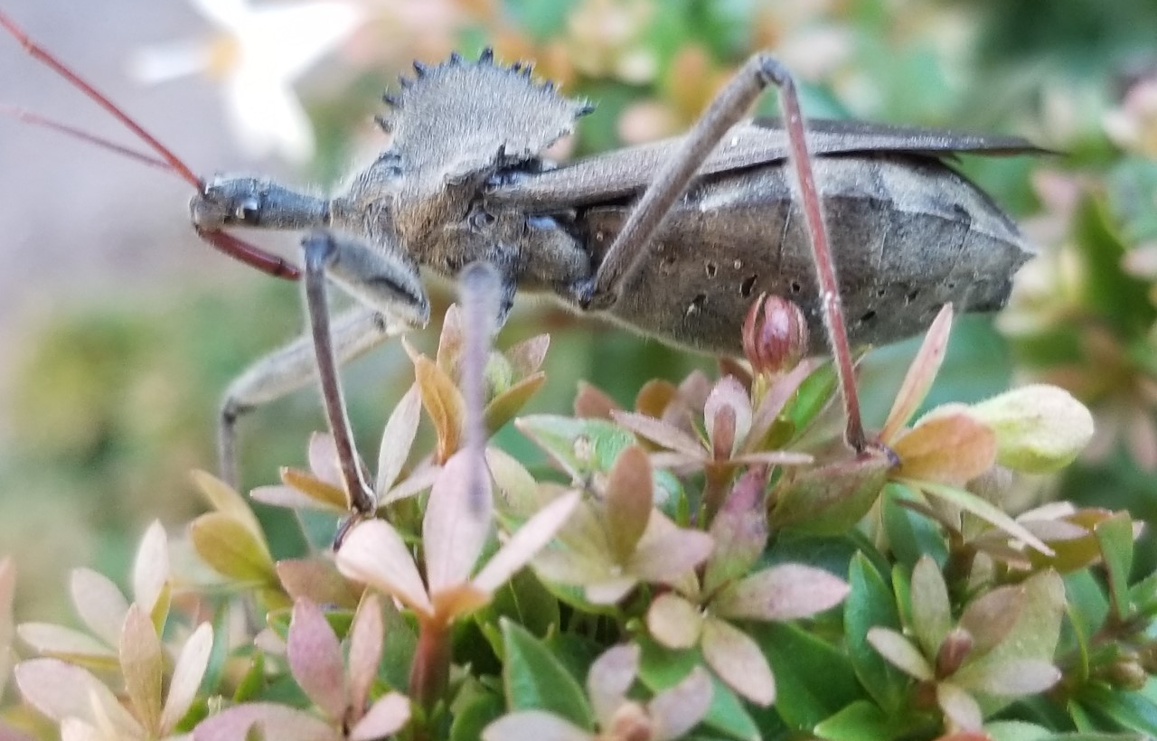
Wheel Bug

Slide 37
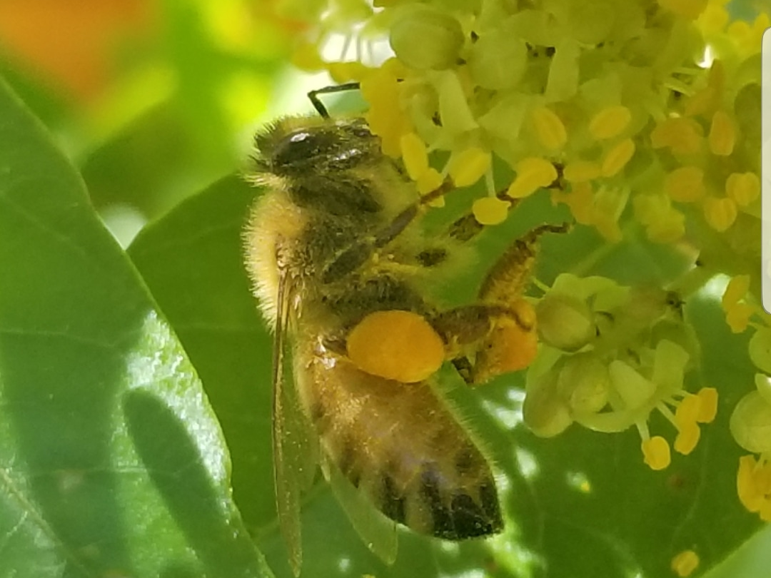
Carpenter Bee
Bumble Bee
Honey Bee
Small Bee
Wasp
Fly
Butterfly/Moth
Other Insect
Notes:
In which category would you put this insect? Honey bee

Slide 38
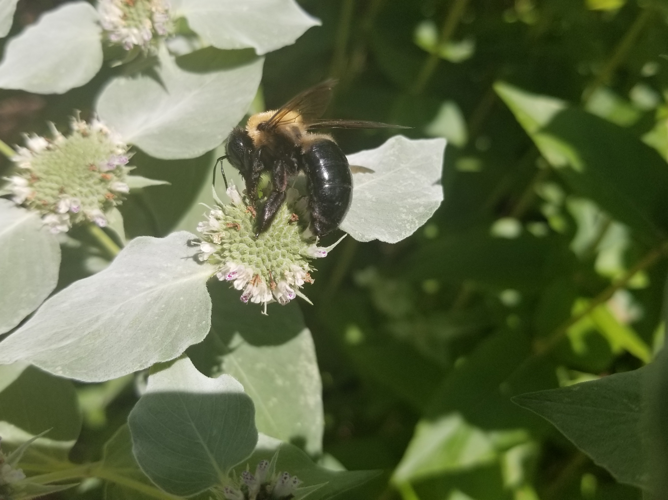
Carpenter Bee
Bumble Bee
Honey Bee
Small Bee
Wasp
Fly
Butterfly/Moth
Other Insect
Notes:
Carpenter bee – see the bald abdomen

Slide 39
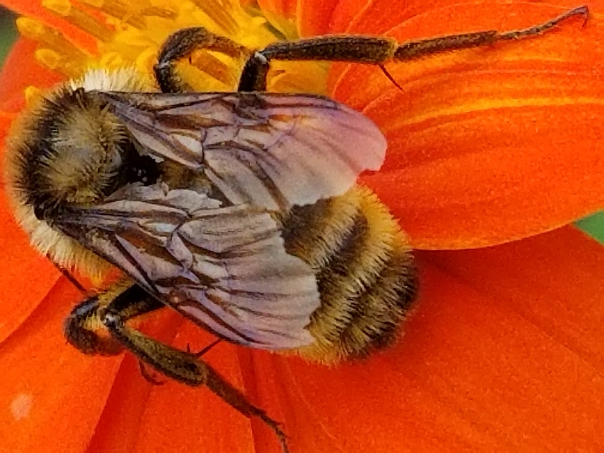
Carpenter Bee
Bumble Bee
Honey Bee
Small Bee
Wasp
Fly
Butterfly/Moth
Other Insect
Notes:
Bumble bee

Slide 40
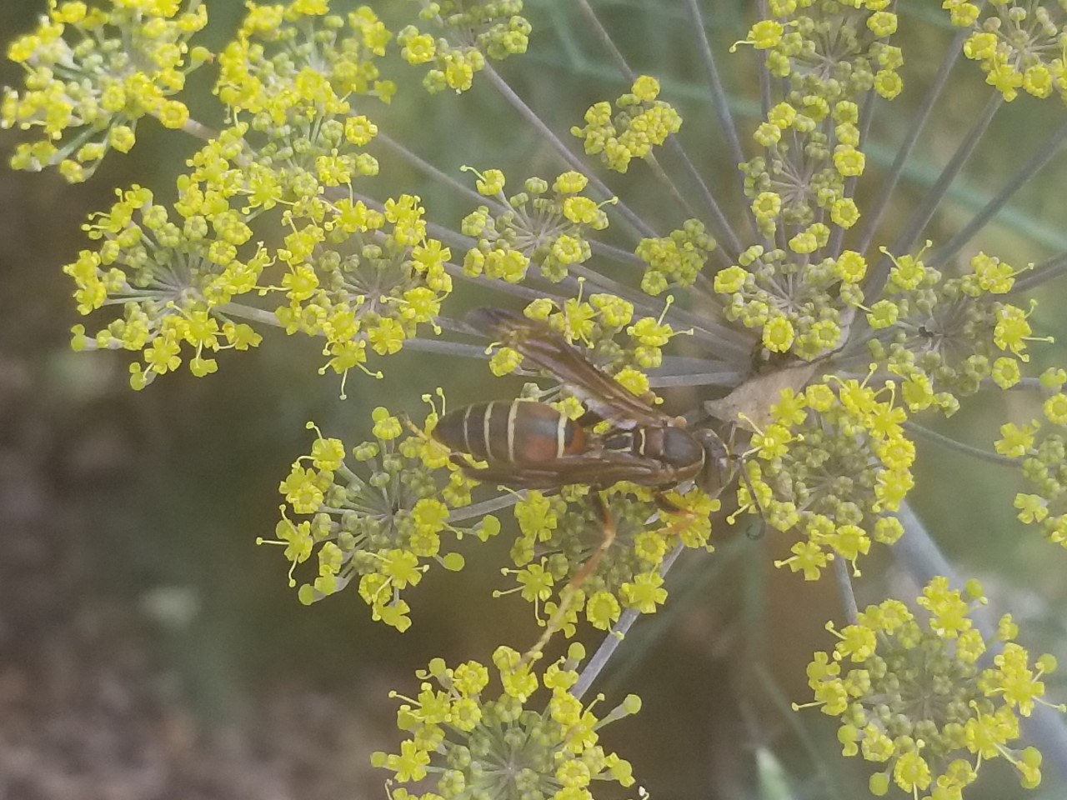
Carpenter Bee
Bumble Bee
Honey Bee
Small Bee
Wasp
Fly
Butterfly/Moth
Other Insect
Notes:
Wasp

Slide 41
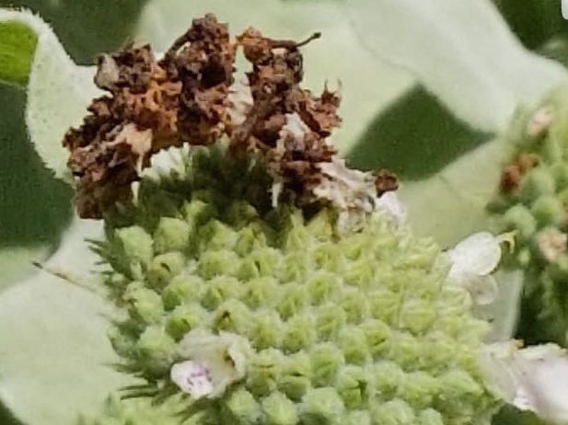
Carpenter Bee
Bumble Bee
Honey Bee
Small Bee
Wasp
Fly
Butterfly/Moth
Other Insect
Notes:
Other insect – lacewing larva covered in plant debris

Slide 42
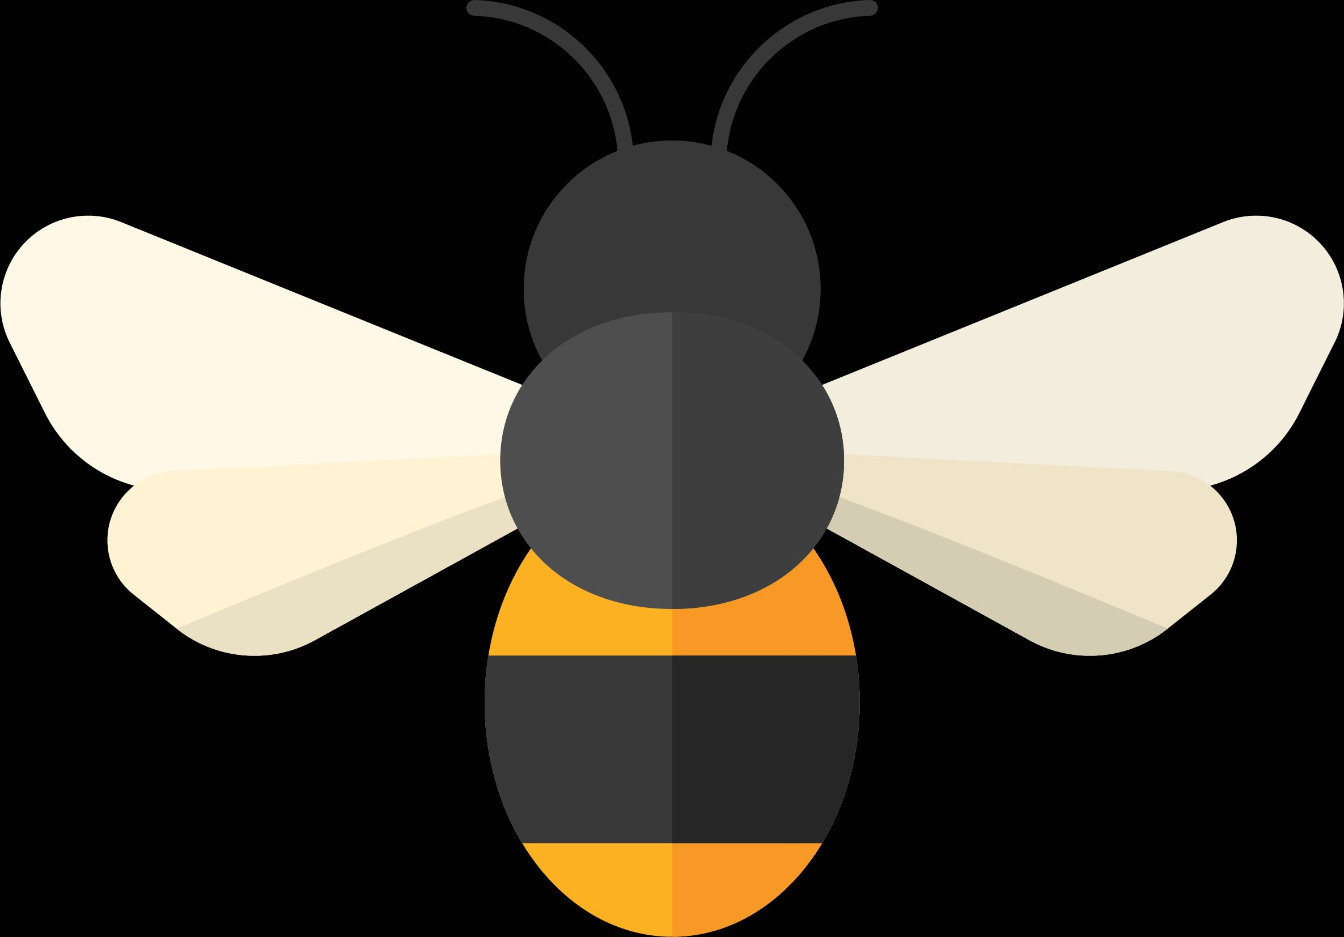
Counts are simply uploaded to the website https://GSePC.org

Slide 43
The data will be analyzed and a public report will follow.
Sign up to participate in the census by going to the website https://GSePC.org
The website also contains other interesting information for pollinator lovers including lesson plan links for teachers, Spanish language materials and the Insect Counting and Identification booklet.
Ask to join the Southeast Pollinator Census Facebook page and follow us @SoutheastPollinators Instagram.
Find out what your local UGA Extension office has planned for the census.
For more information contact the project coordinator Becky Griffin at beckygri@uga.edu.

