Slide 1
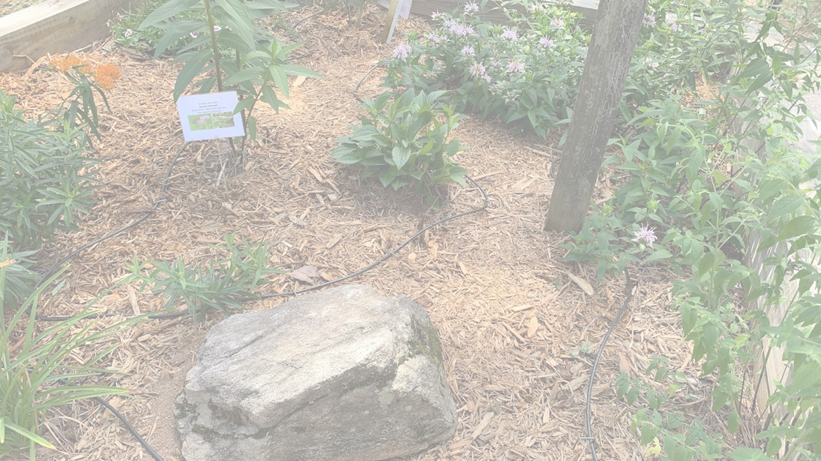

Butterflies and Moths
Anna Yellin
Wildlife Conservation Section
GA Department of Natural Resources

Slide 2
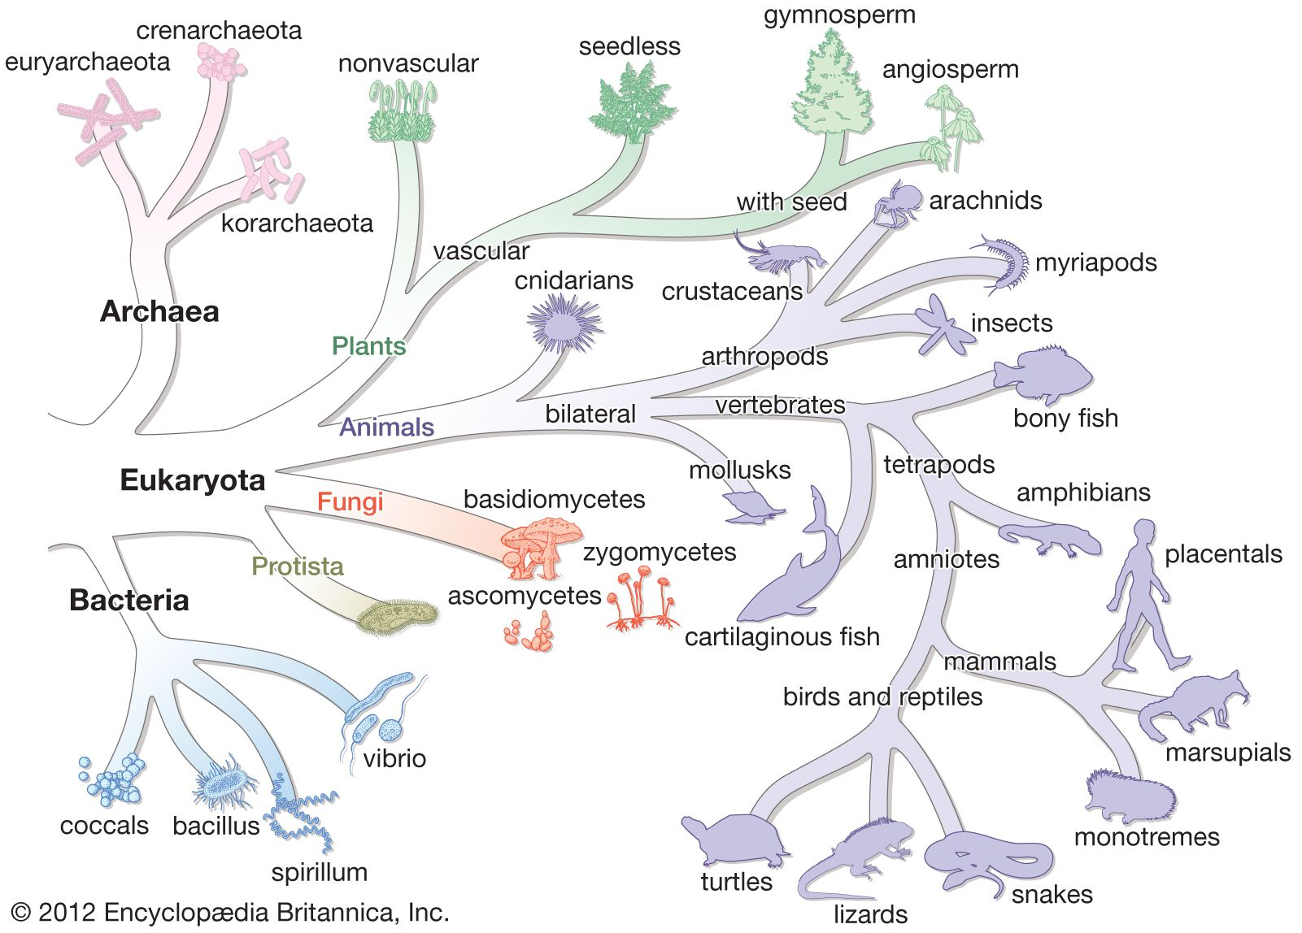
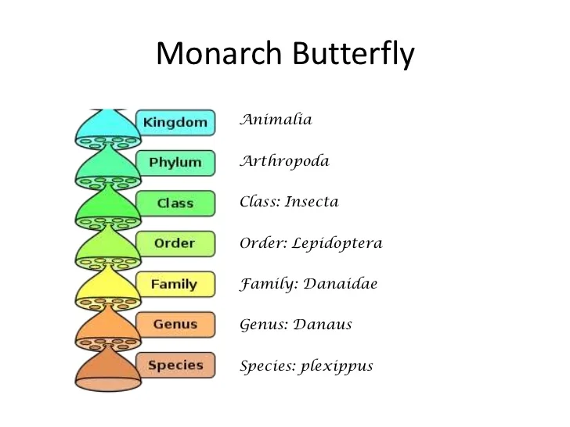
Classification of Lepidoptera
Linnean System
Example:
Butterflies & Moths

Slide 3
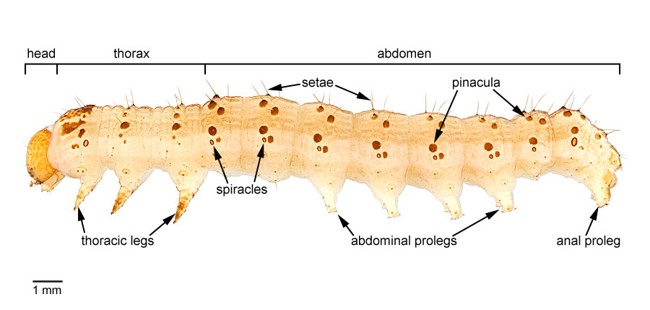
Morphology: Caterpillar
https://idtools.org/id/leps/lepintercept/morphology.html
Notes:
Note the six thoracic legs. These are the only true legs. Like the adult butterfly and all insects, caterpillars have six true legs that are part of the thoracic anatomy.

Slide 4
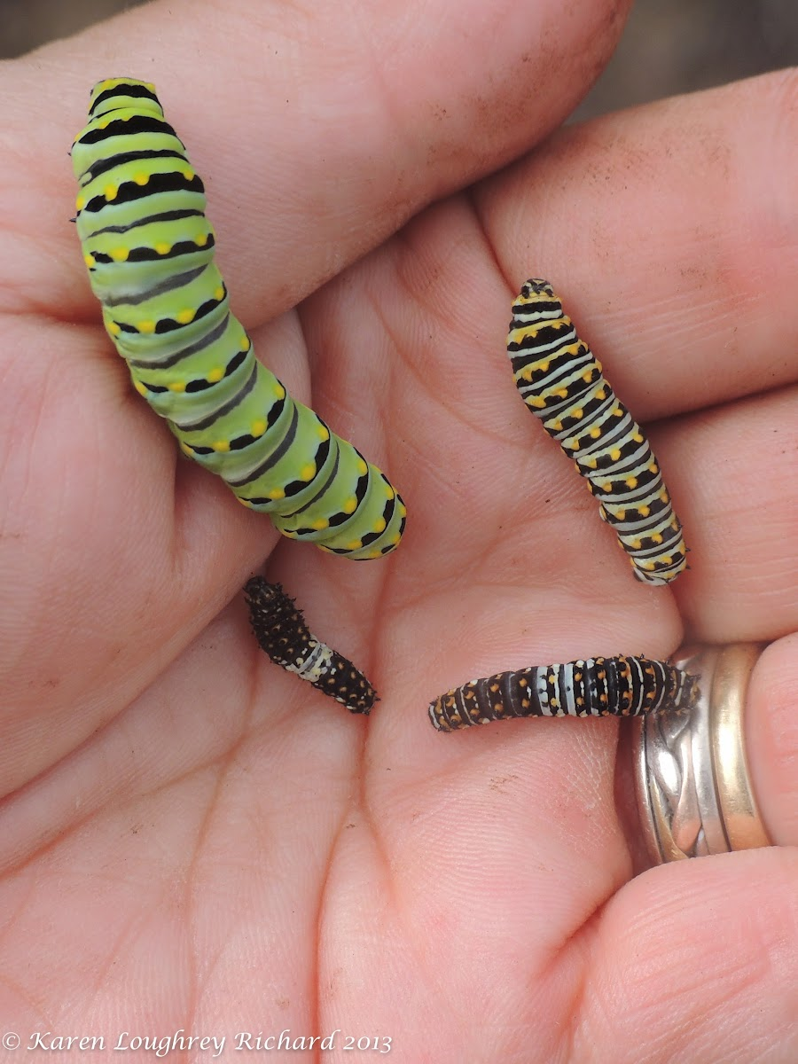
Caterpillar growth
One species of butterfly or moth will only lay eggs on a specific species (or genus) of plant. (Example: Monarchs laying eggs on milkweed)
Caterpillars rely on that plant species to survive. Eating any other species will kill the caterpillar.
The caterpillar stage is about 2-4 weeks
For many Lepidoptera, this is the longest life stage
Growth is quick. As the caterpillar grows, it molts.
Each time it molts it becomes a new instar
Example: Black swallowtail has four caterpillar instars before forming a chrysalis
https://www.projectnoah.org/spottings/39870042
Notes:
Molting and Instars
As caterpillars grow, their exoskeleton becomes tight on them, so they molt (lose their old exoskeleton). Ecdysone is the molting hormone of insects. It causes an insect to molt.
After the molt, while the new skin is still soft, they swallow a lot of air, which expands their body. Then, when the cuticle hardens, they let the air out and have room for growth. Caterpillars molt four or five times as they grow. Each different caterpillar stage is called an instar. https://www.enchantedlearning.com/subjects/butterfly/anatomy/Caterpillar.shtml

Slide 5
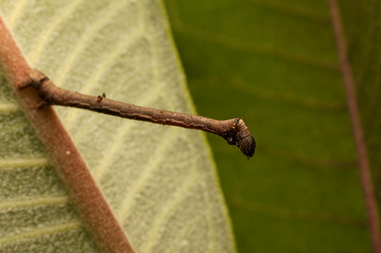
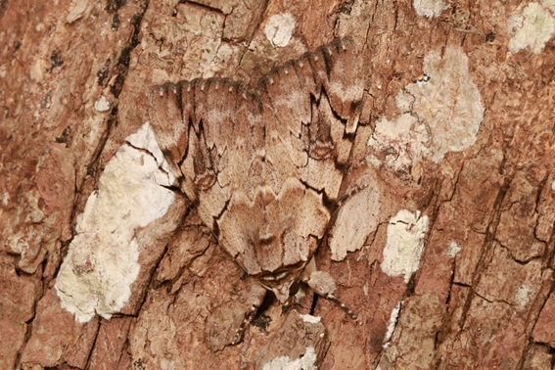
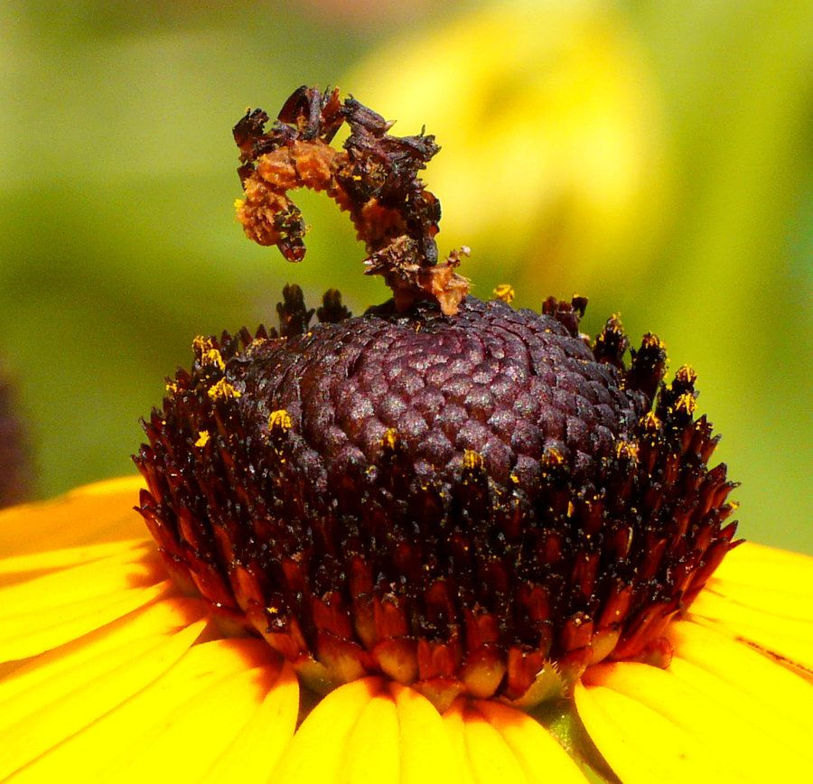
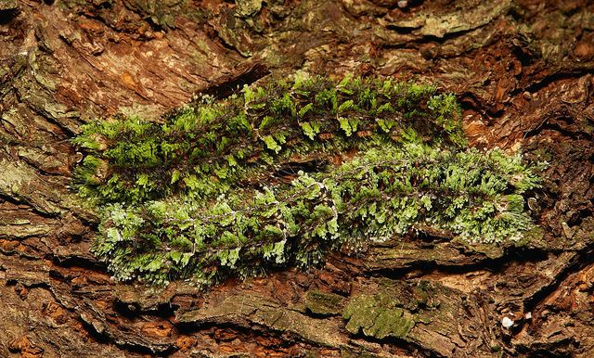
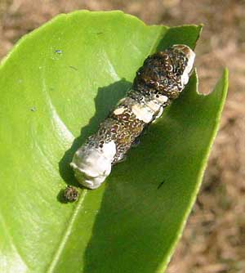
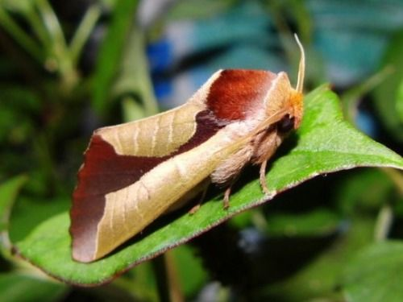
Caterpillar Design: Evolved cryptic coloration and form
Photos above from the internet

Slide 6
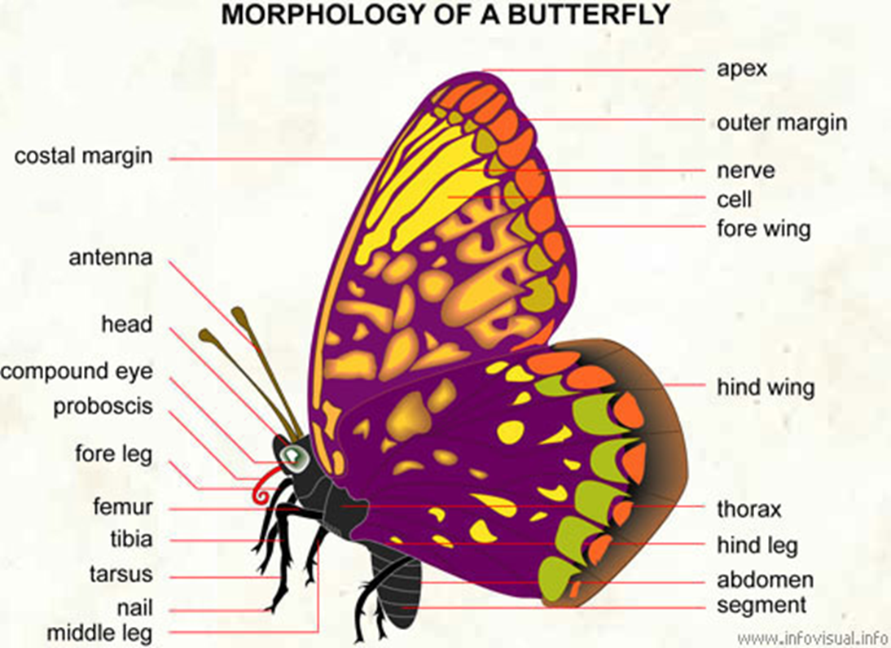
Morphology: Butterfly and Moth
Notes:
Butterflies and moths have the same parts, but some of the structures are different. The next slide will be a comparison/ contrast

Slide 7
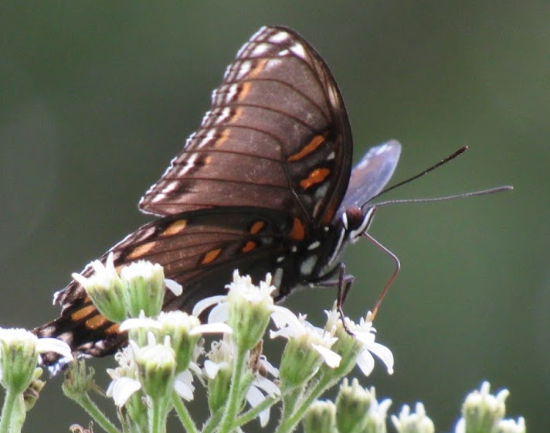
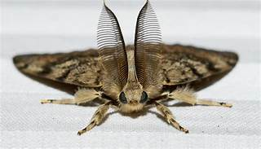
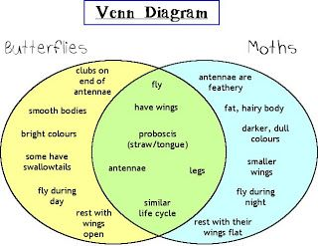
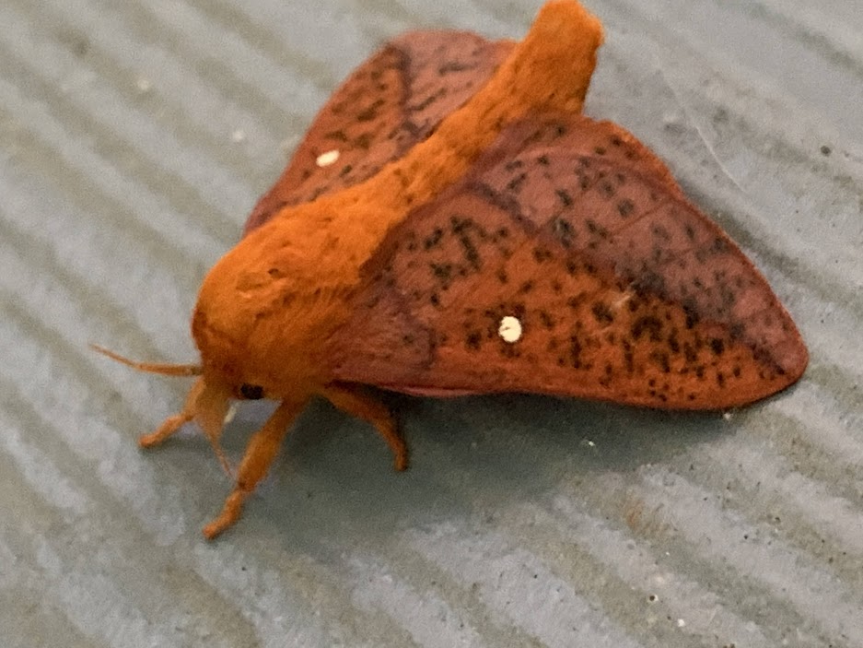
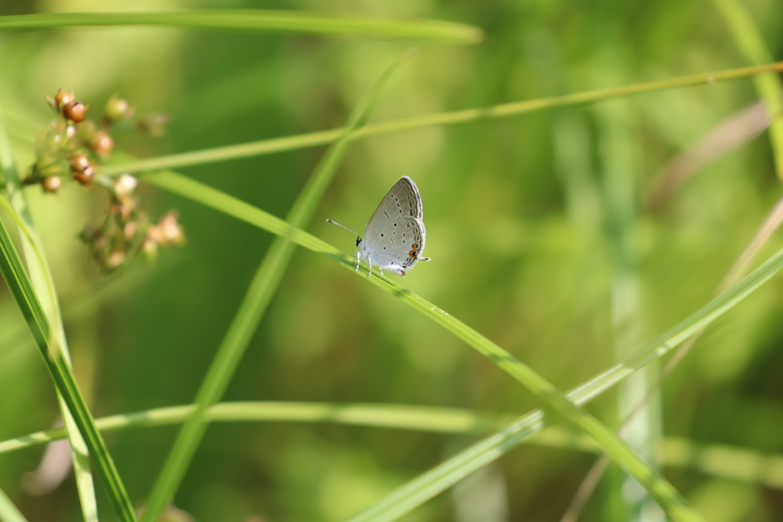
Butterfly vs. Moth
Image above: http://www.futurity.org/male-moths-antennae-1442972-2/
Butterflies: ~ 176 species in Georgia
Moths: Thousands of species in Georgia
Notes:
The Venn Diagram is from Google. One of these photos is from the internet. The cinnamon moth on the right sat on my house in Statham yesterday (6/26/2022). You might note that the examples don’t show a great amount of contrast in coloration. There are some butterflies that are brilliant in coloration. However, I would argue that there are also moths that have pretty amazing coloration also. Coloration is a good guideline to follow, but I’d argue that all the differences above have outlyers. For example, butterflies do have swallowtails. Luna moths are both beautiful and also have wings not totally dissimilar from swallowtails.

Slide 8
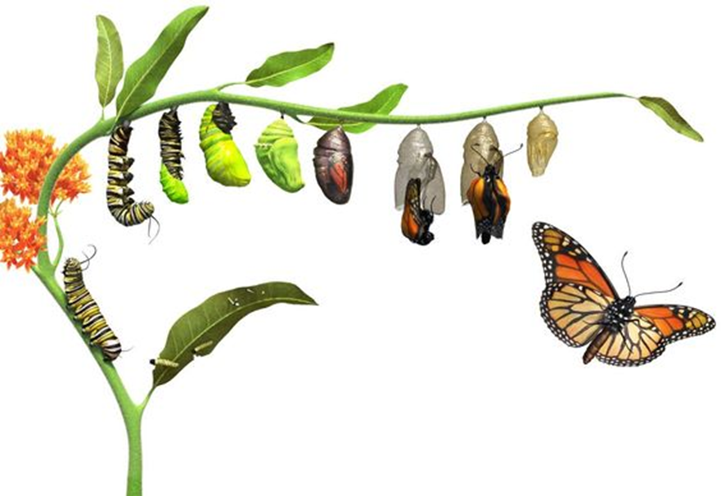
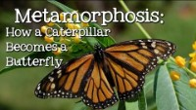
Metamorphasis: caterpillar to butterfly
Butterfly
Video from 0:45 to 2:30 is a good short summary
https://www.dkfindout.com/us/animals-and-nature/insects/butterfly-life-cycle/
Notes:
Metamorphosis occurs within the pupal case. During this period, the larval brain stimulates the release of enzymes which dissolve most of its tissues into their constituent proteins through a process called histolysis. Then a group of specialised cells called histoblasts proceed to reconstruct the broken-down caterpillar body into that of a butterfly or a moth. Despite metamorphosis, moths hold on to memories from their days as a caterpillar
Information from https://phys.org/news/2014-08-metamorphosis-moths-memories-days-caterpillar.html

Slide 9
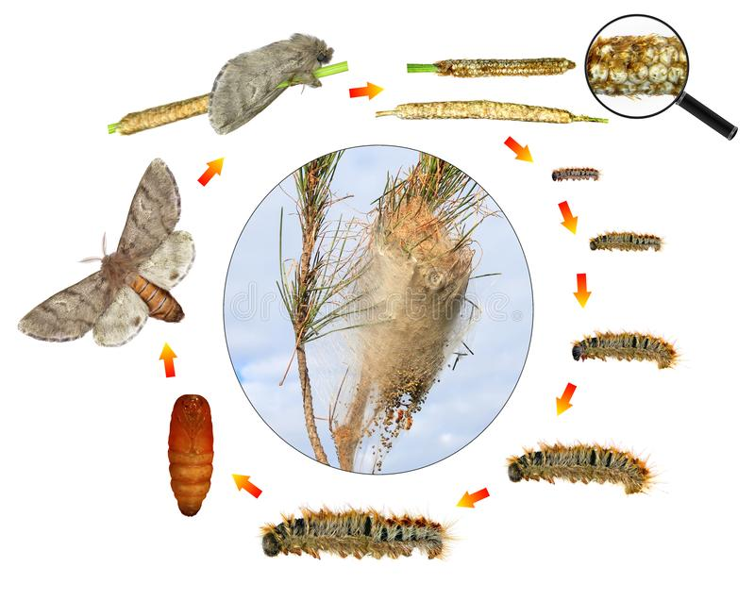
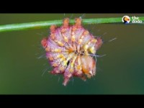
Metamorphasis: caterpillar to moth
https://www.dreamstime.com/illustration/life-cycle-moth.html

Slide 10
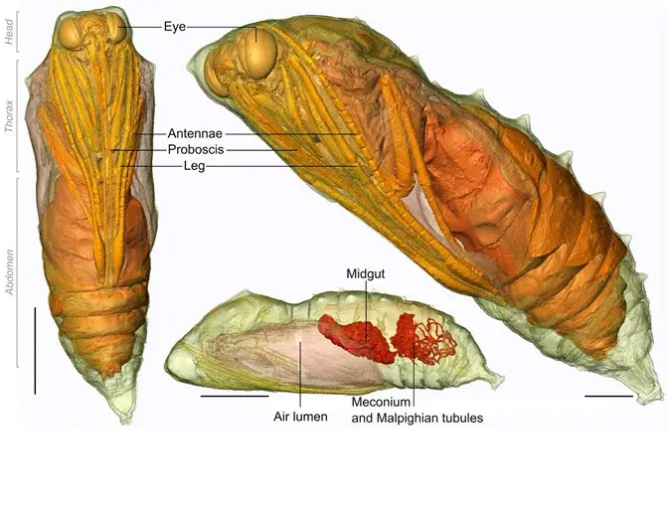
Morphology inside the Chrysalis or Cocoon

Slide 11
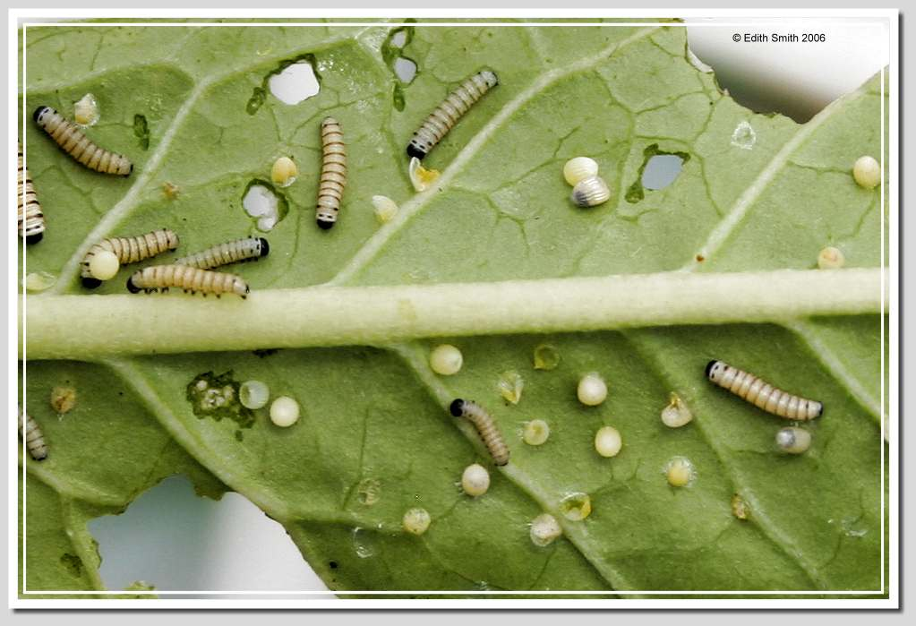
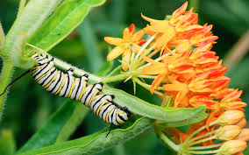
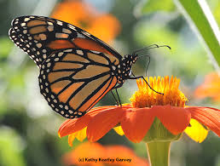
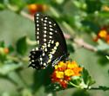
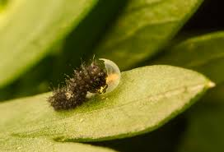
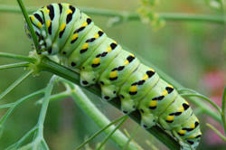
Diet and Life stages:
90% of the insects that eat plants can develop and reproduce only on the plants with which they share an evolutionary history (Doug Tallamy)
Nectar plants for the adults- generally diverse
Host plants for the larvae- species specific
Monarch on milkweed
Monarch on Butterfly milkweed
Monarch on Tithonia
Food
Black Swallowtail on Parsley
Black Swallowtail on Dill
Black Swallowtail on Lantana
Notes:
Going back to food….

Slide 12
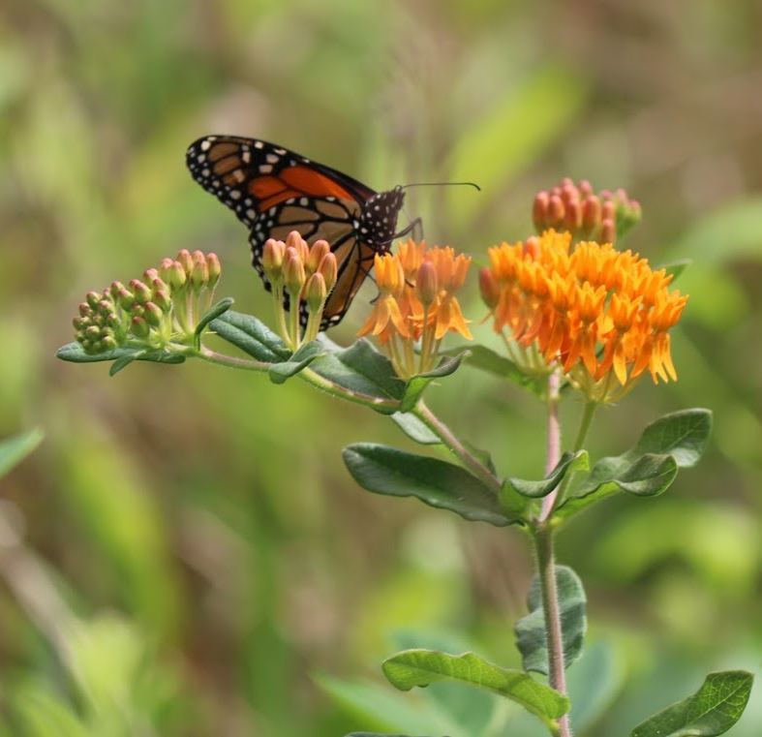
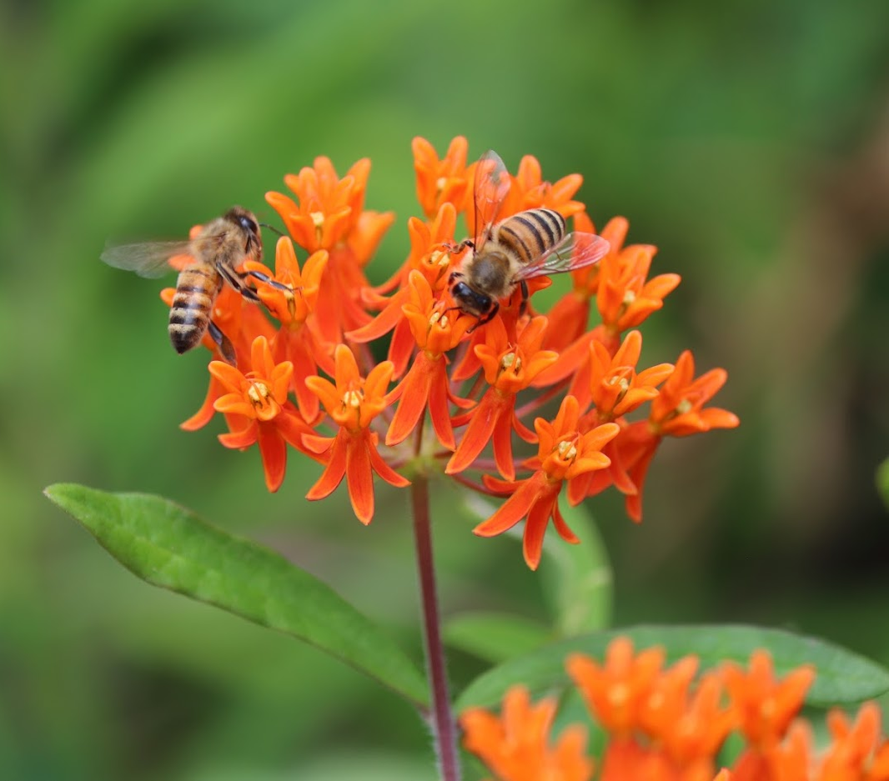
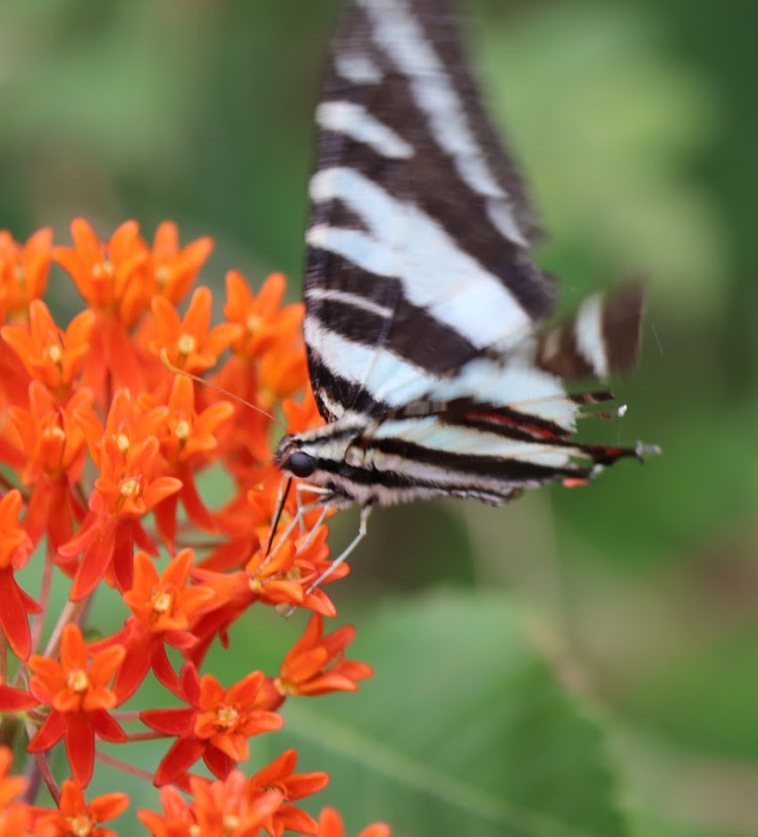
Adults: Unlike caterpillars, most are generalists
Food
Notes:
Bloom time matters- continuous food is necessary

Slide 13
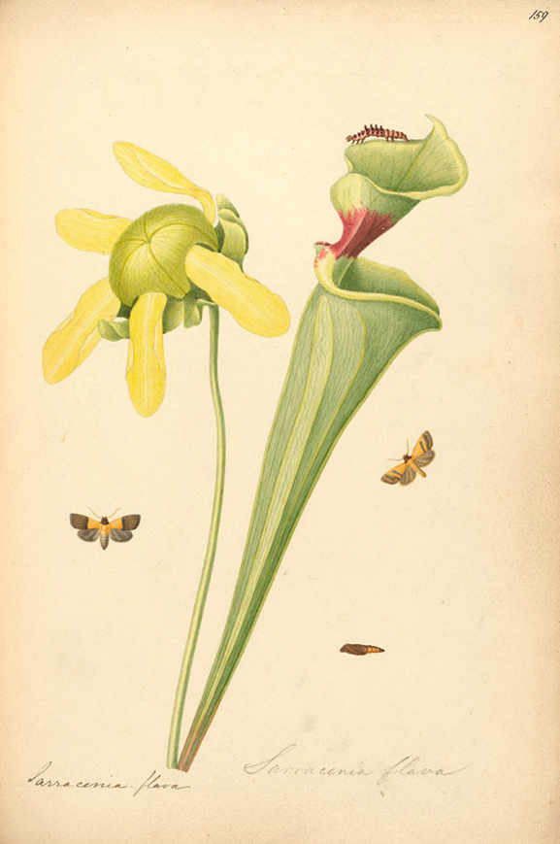
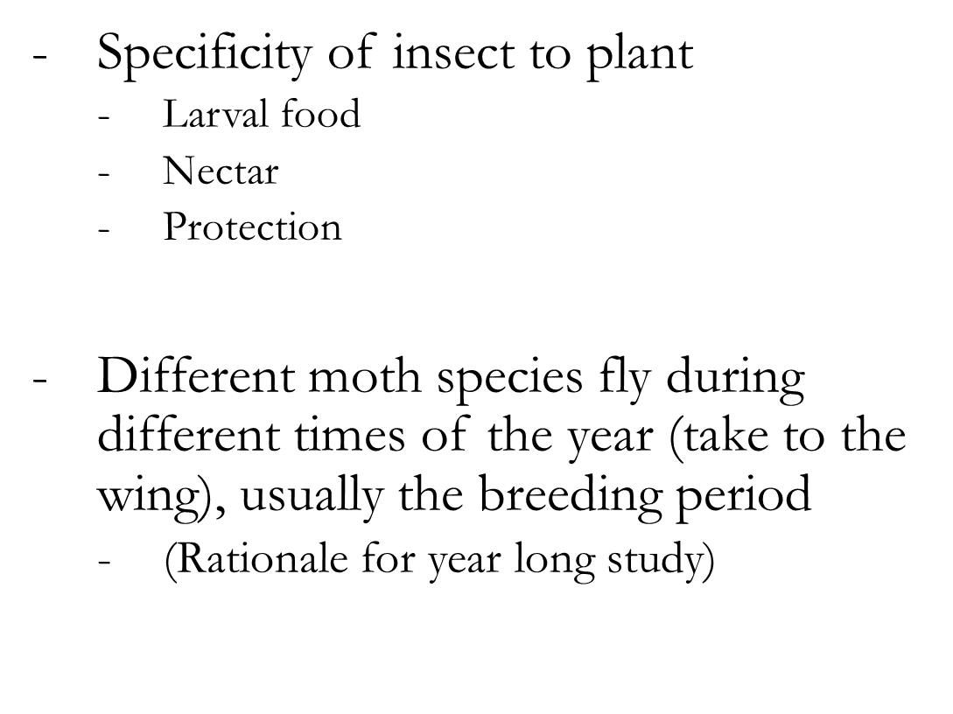
Coevolution Plants and Lepidoptera

Slide 14
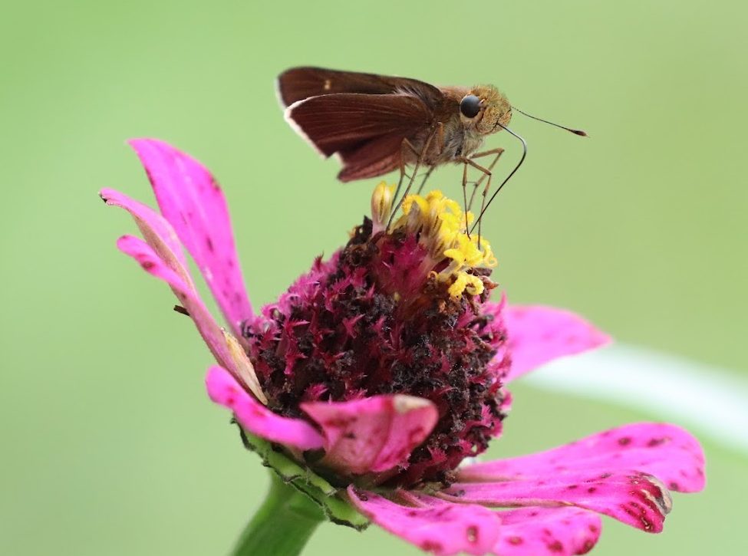
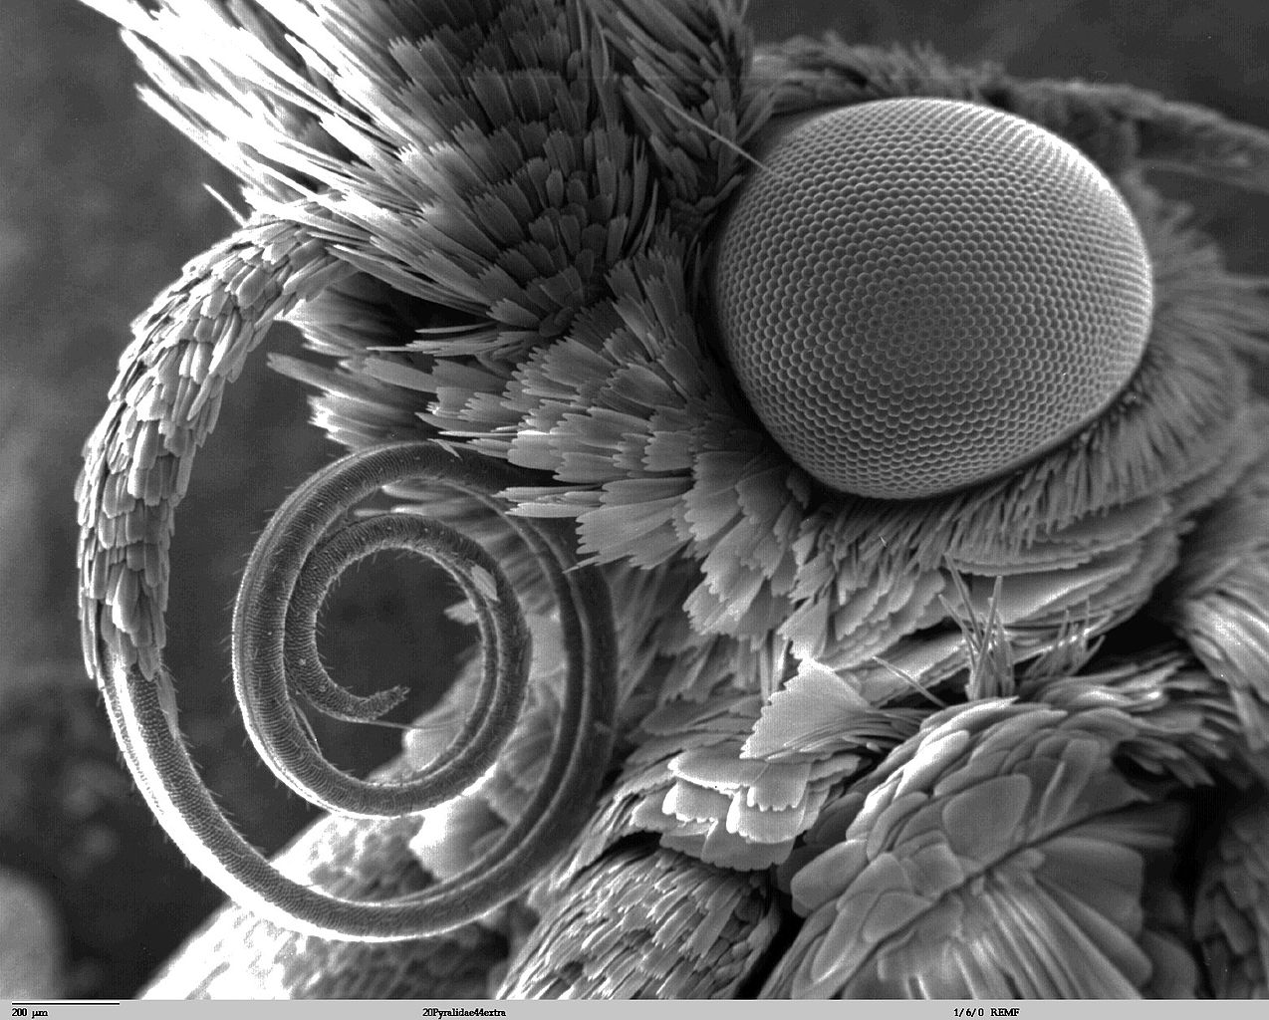
Coevolution: Flowers and Lepidoptera
https://www.youtube.com/watch?v=QYoYQAbPXbU
Examples include:
Insect morphology and flower shape
Bloom time, nectar flow, and flight time

Slide 15
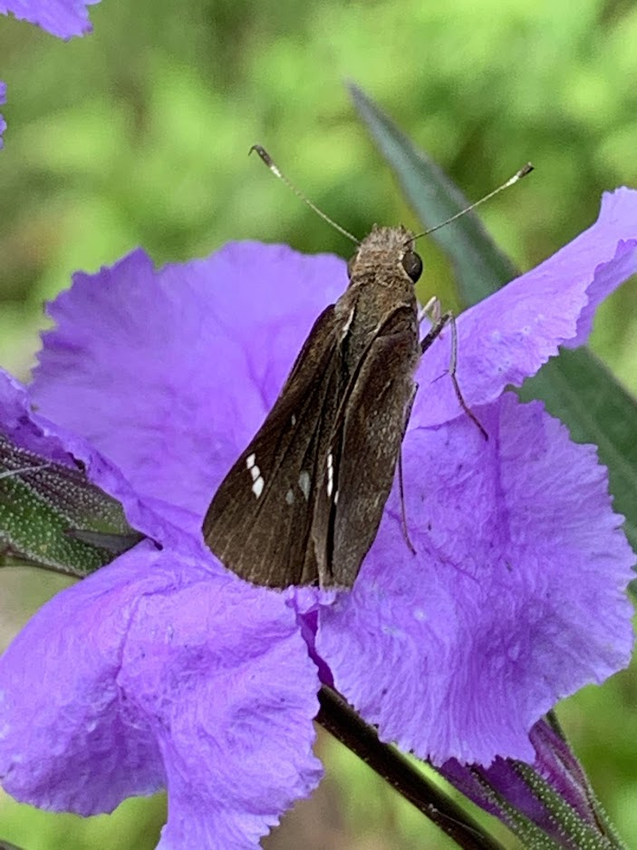
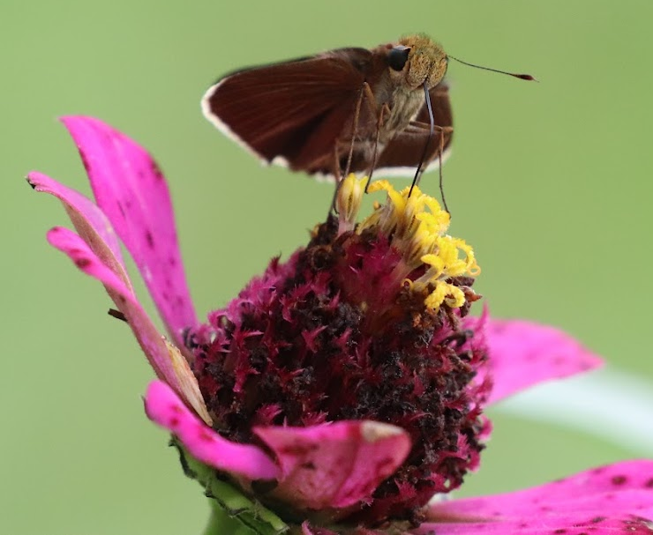
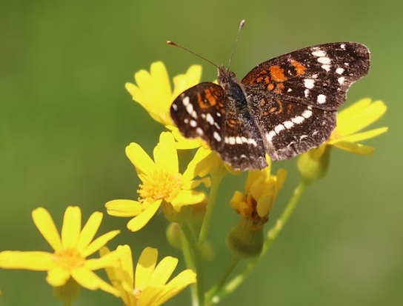
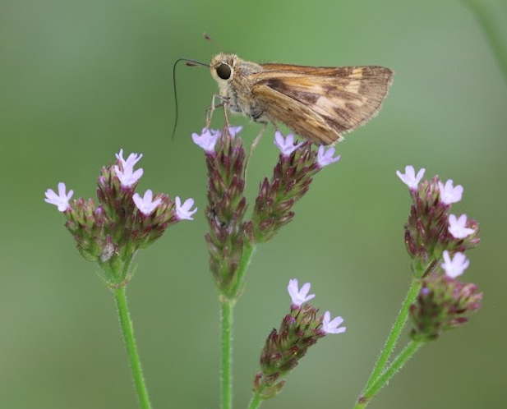
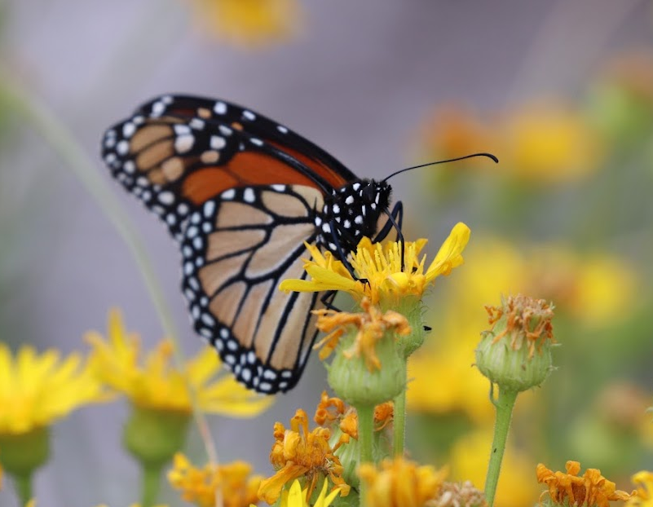
Preferred colors
Butterflies – like bright colors… disfavor blue and green
Moths – not particular, but do like pale colors and white- night blooming flowers…perfume
Habitat

Slide 16
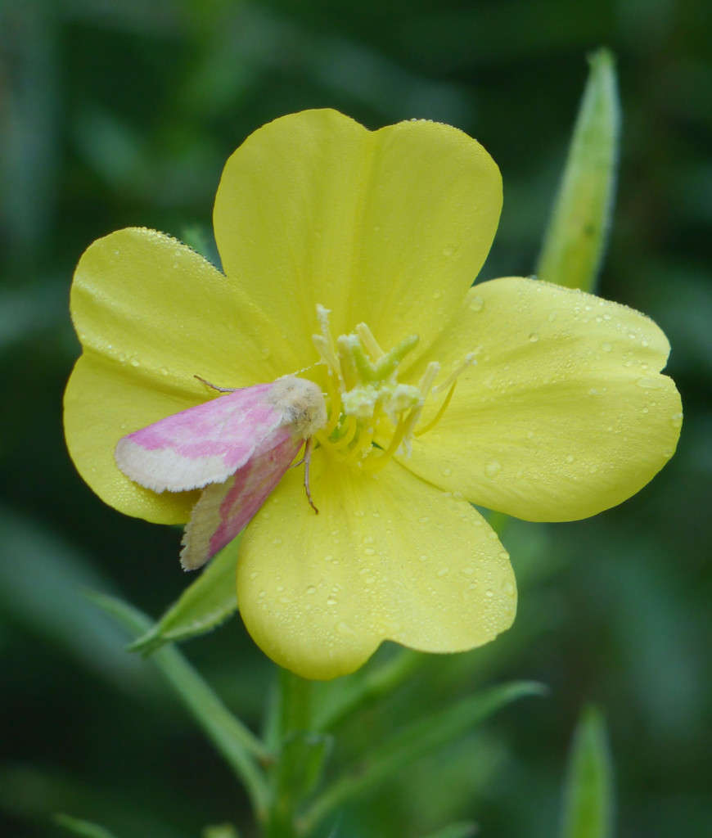
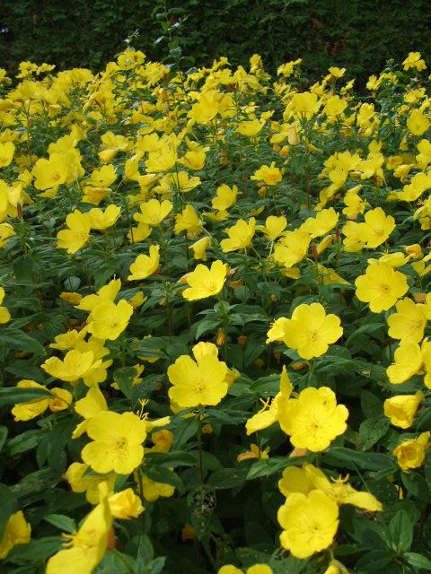
Planting for Moths
Night blooming, scented, yellow/white
Oenothera biennis
common evening primrose
Notes:
Some moth flowers. Photos from internet.

Slide 17

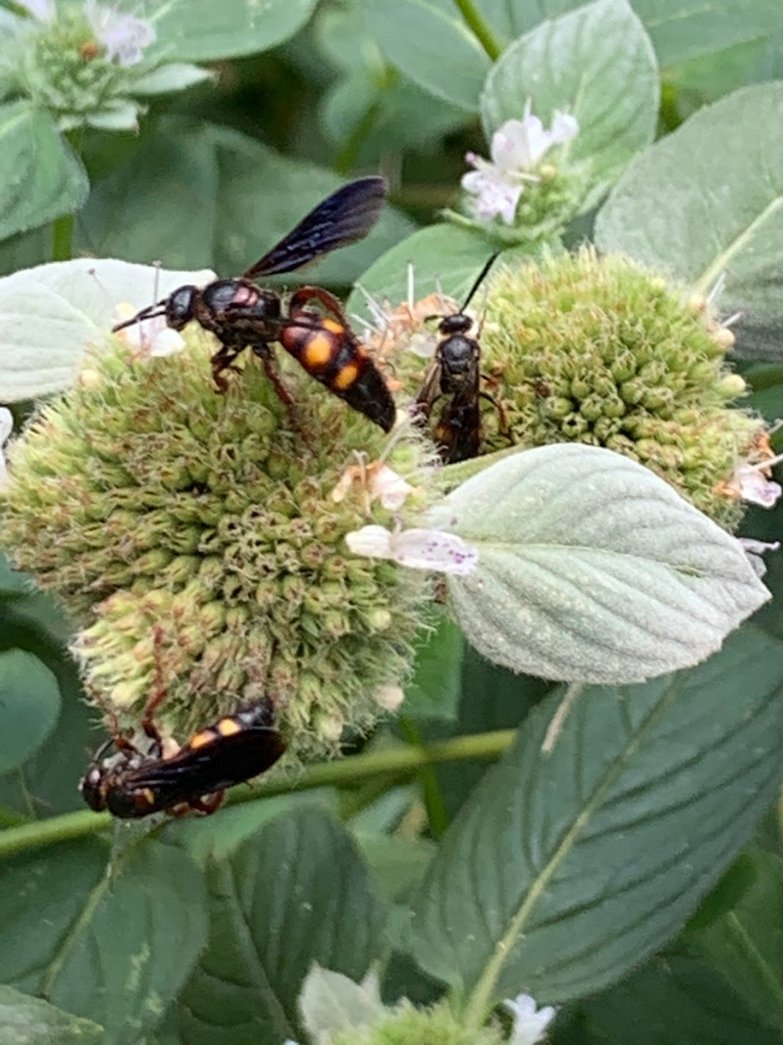
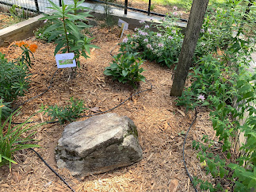
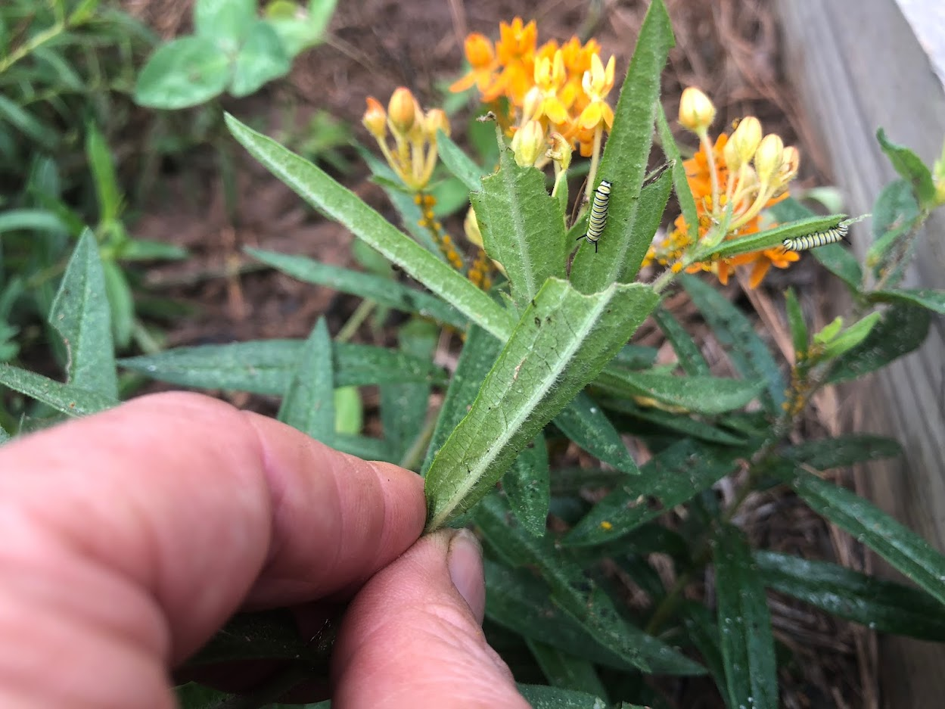
Habitat needs
habitat for offspring
food
water
shelter

Slide 18
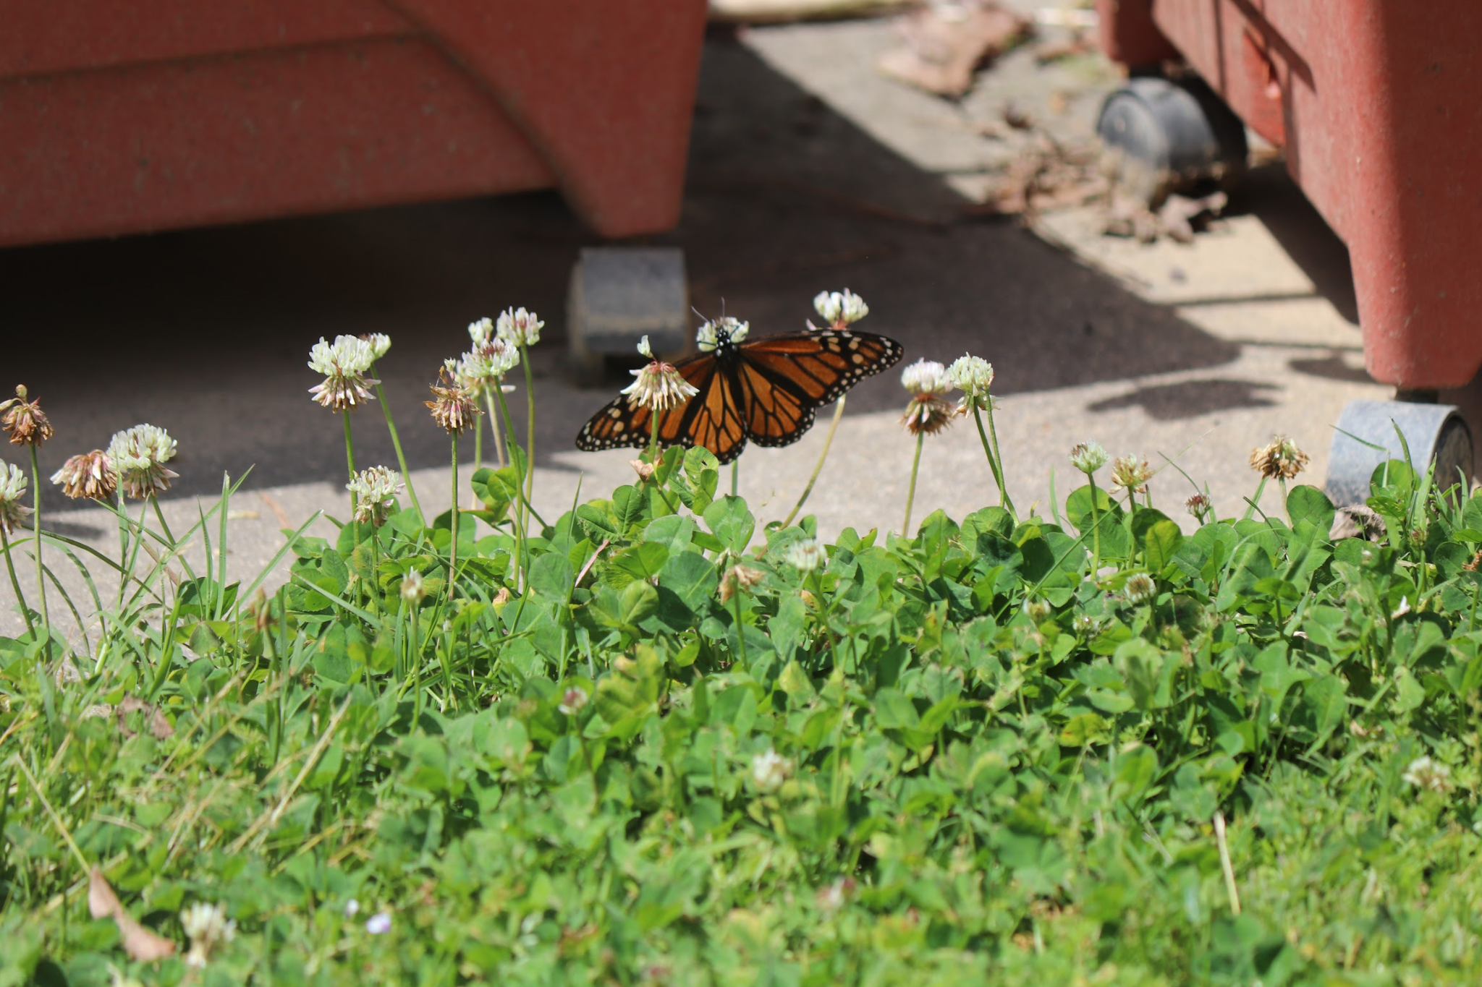
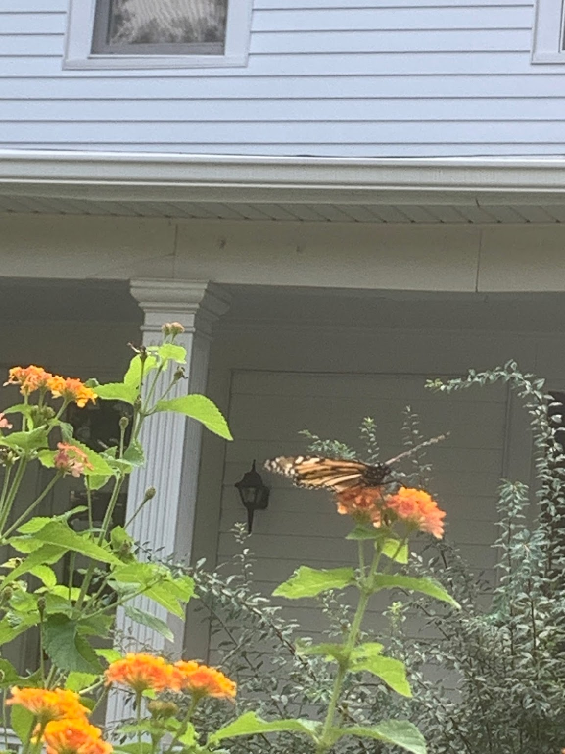
Gardens as habitat

Slide 19
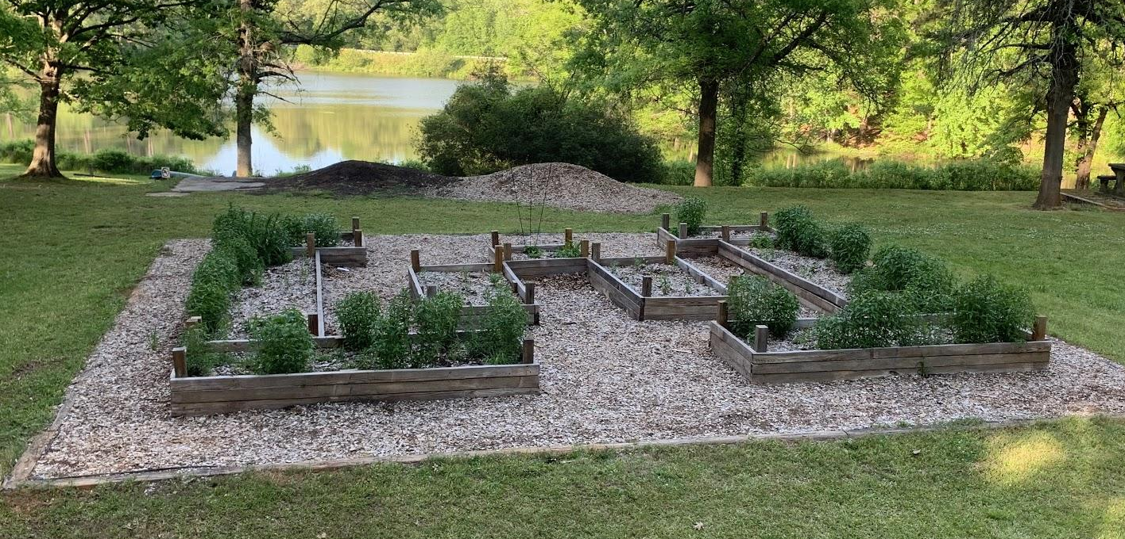
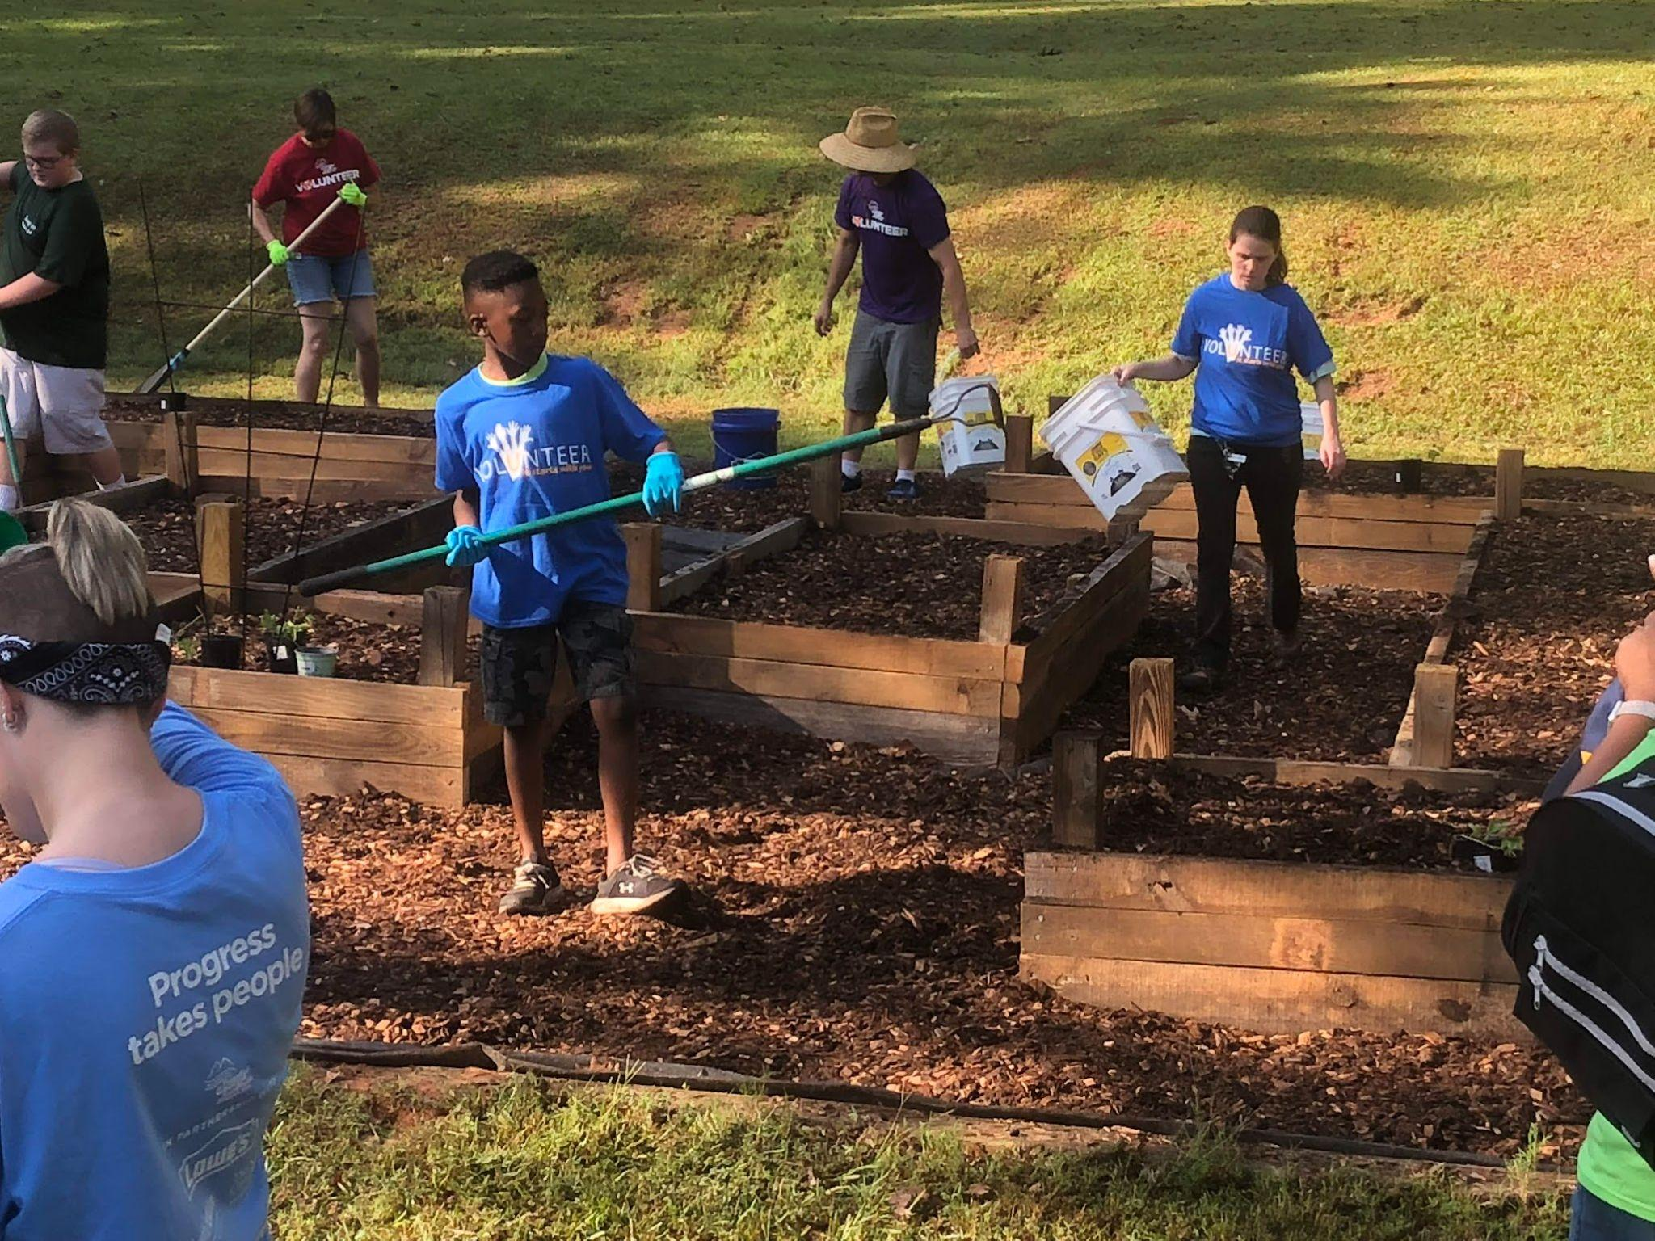
Hard Labor Creek State Park: Pollinator Garden Creation
Notes:
During the build and after one month

Slide 20
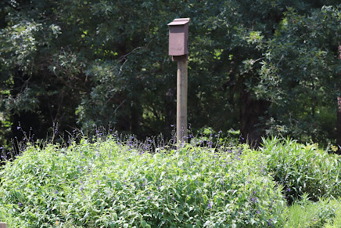

Hard Labor Creek State Park
Notes:
The following year

Slide 21

Planning guides
Full Sun
Shelter from wind
Nectar flowers
Host plants for egg laying and caterpillars
Puddle/ Salt sources- sandy areas or large flat rocks
http://furnitureproduct.net/butterfly-garden-designs/butterfly-garden-designs-budget-diy-landscaping/
Notes:
Many guides are available. In fact, there are so many that it can be overwhelming. The goal is to try to plant different species of flowering plants that will bloom during the spring, summer, and fall. Plant regionally native plants to feed native species.

Slide 22
What to plant?
www.nwf.org/Nativeplantfinder
Notes:
This is one of many excellent resources that can assist with planning.

Slide 23





Create Habitat Stepping Stones/Corridors

Slide 24




Backyard Gardens Provide Connections
Notes:
Pictures from internet

Slide 25


Gardens as Corridors

Slide 26



Creating a Migratory skyway:
Spring:
February, March, April
Native azelias
Lawn ‘weeds’ - Dandelions
Fragrant sumac
Fall:
September, October
Joe Pye weed
Goldenrods
Tithonia (Mexican sunflower)
Aster
https://www.nwf.org/Garden-For-Wildlife/About/Native-Plants/Monarch-Nectar-Guides.aspx
Notes:
Well known example. Mention other species that also rely on milkweed

Slide 27





Along the Skyway: Need for nectar / resource stops

Slide 28

http://georgiabiodiversity.org/
Notes:
This WCS Biodiversity portal provides information about some of our rare species of Lepidoptera (and other species)

Slide 29




Regional Research
MOVES
(Monarchs Overwintering Eastern States)
Notes:
Here are some regional butterfly research projects that need community volunteers

Slide 30



National Outreach
https://www.naba.org/
https://journeynorth.org/
https://rosalynncarterbutterflytrail.org/
Notes:
Rosalynn Carter is a butterfly conservation leader. Her influence is strong in Georgia and beyond.

Slide 31

Global Conservation
https://www.inaturalist.org/
Notes:
Contributing observation data to apps such as inaturalist provide valuable information to conservation biologists.

Slide 32


