Slide 1
Pollinators other than bees INTRODUCTION AND OVERVIEW
Recognize common wasps, beetles and flies in the orders Hymenoptera, Coleoptera and Diptera
Dr. Kris Braman
Notes:
In this lecture I would like you to learn to recognize common wasps, beetles and flies in the orders Hymenoptera, Coleoptera and Diptera that you may observe visting floral resources.

Slide 2
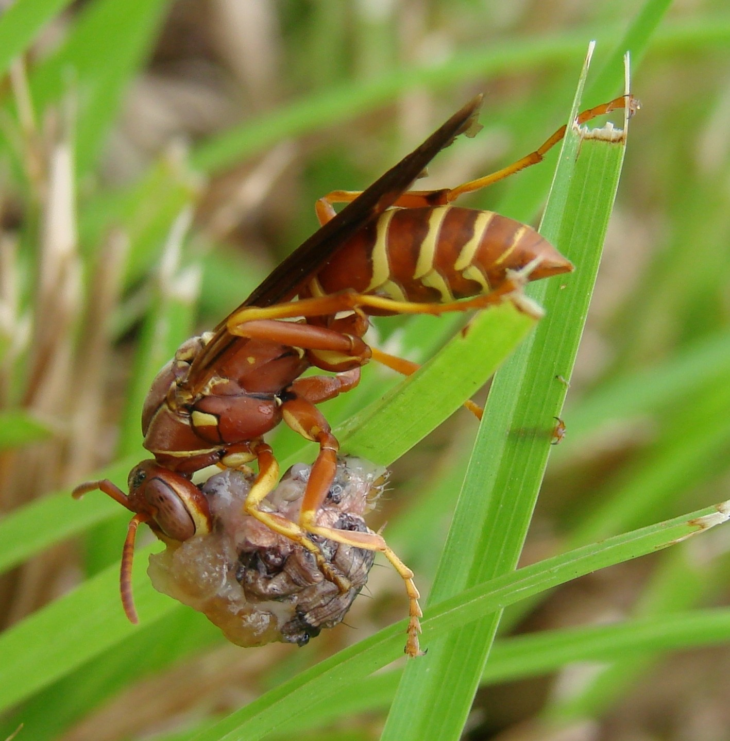
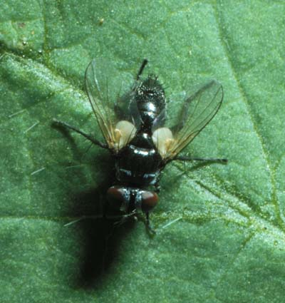
Identification is a key concept Bees, Flies and Wasps: Three groups that can be confused
Leaf-cutter bee
Tachinid fly
Paper wasp
Notes:
Bees flies and wasps can all be important pollinators and beneficial insects. Some members of all three groups can also be considered pests! The first step in sorting through this apparent dilemma is to be able to tell them apart. Bees have Longer, thinner antennae, eyes on the side of the head, Four wings, are often hairy (some bees) and carry loads of pollen. Flies have short, thick antennae, large eyes in the front of the head, two wings. They do have some hairs but aren’t “hairy” They have pollen stick to their body but don’t carry loads of it or have any specialized structures.
Bees often (but not always) fold their wings over their back at rest and do not hover in flight. Flies hold their wings out at a bit of an angle at rest and often do appear to hover in flight. Bees vs. Wasps
Bees:
Usually a broader body and a wider abdomen Face hairs are dull Body is Hairy (though not always) Carry pollen Usually their exoskeleton is one color (except sometimes stripes on the abdomen)
Wasps:Narrower bodies and sometimes a very pinched abdomen Face often have shiny or metallic hairs Very few hairs Don’t carry pollen loads though they can have pollen grains stuck to them
Have patterns or designs in their exoskeleton

Slide 3
Wasps vs Flies vs Bees
 | BEE | FLY | WASP
shape | Compact | Compact | elongate
hairy | Usually | Sometimes | rarely
antenna | Long | Short | long
wings | 2 pair | 1 pair | 2 pair
waist | Robust | None | narrow
eyes | Side | Large | side
hover | Rarely | Often | no
Pollen collecting structures | Most females | No | no
Notes:
Remember our chart with general characteristics that help separate the flies and wasps from bees and from each other. Please review those characters.

Slide 4
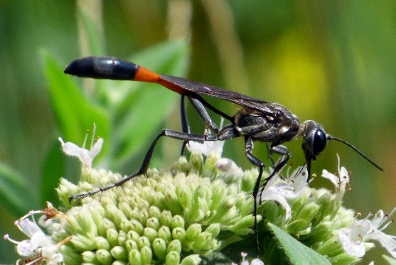
Wasps: Order Hymenoptera
Examples:
Paper wasp
Thread-waisted wasp
Tiphiid and Scoliid wasps
Potter wasps
Parasitic wasps, example Larra bicolor
Notes:
Lets take a look at some examples of common wasps known to visit flowers. They include paper wasps, thread-waisted wasps, tiphiid and scoliid wasps and many parasitic wasps. Our example will be Larra Bicolor a parasitoid of mole crickets.

Slide 5
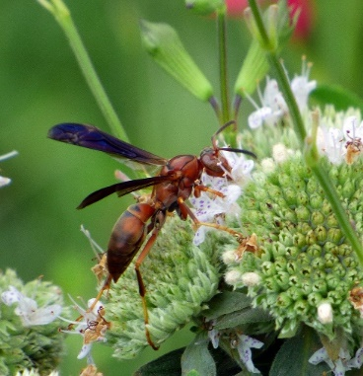
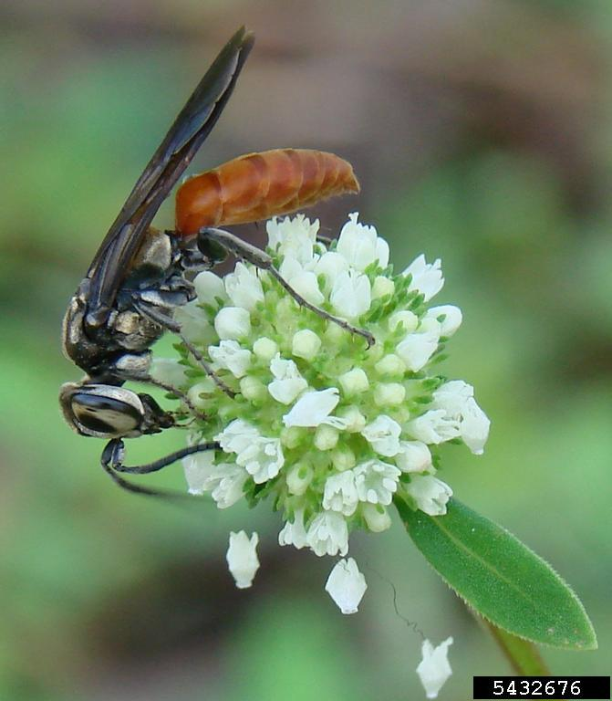
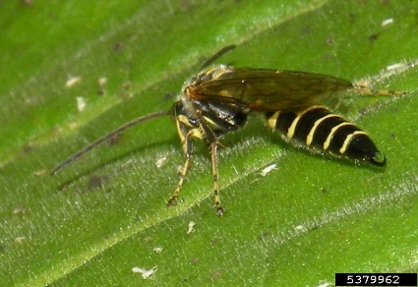
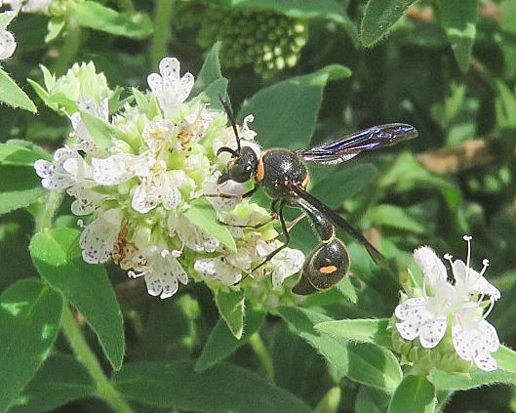
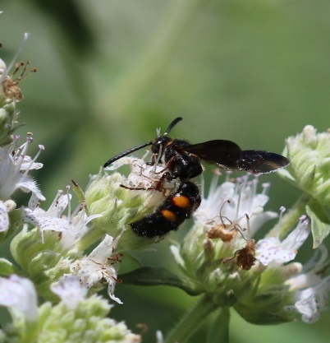
Wasps
Notes:
This graphic illustrates those examples. Clockwise from the top(and center) are paper wasps, a thread-waisted wasp, tiphiid, scoliid, potter wasp and two parasitic wasps. The two parasitoids represent the great diversity in size and and life history among parasitoids. Larra bicolor is an external parasitoid of mole cricket adults and large nymphs. Anagrus takeyanus, you may remember, is an internal parasitoid of lace bug eggs.

Slide 6
Long antennae 2 pr wings folded lengthwise at rest predators especially of caterpillars Family: Vespidae Genus: Polistes
Paper Wasp
Cheri Abraham photographer
New colonies establish in the spring
Polistes spp
Notes:
Paper wasps in the genus Polistes and the family Vespidae can be voracious predators of insects especially caterpillars. They are also sometimes called umbrella wasps because of the shape of their paper nests. They have long antennae, 2 pair of wings, eyes on the sides of their head, a narrow constriction between thorax and abdomen, few hairs and no pollen bearing structures. New colonies are established in the spring.

Slide 7
Long antennae 2 pr wings folded lengthwise at rest predators especially of caterpillars Family: Vespidae Genus: Eumenes
Potter Wasp
Jon Yuschock, Bugwood.org
David Cappaert, Bugwood.org
Notes:
Potter wasps also belong to the family Vespidae although some sources pull them out as a separate family. These beneficial insects capture caterpillars or other insects and use them to provision their brood cells, the clay based little compartment where the larval wasp will develop. Females do not defend their nests and are rarely aggressive.

Slide 8
Long antennae 2 pr wings folded lengthwise at rest predators especially of caterpillars Family: Sphecidae Genus: Ammophila
Thread-waisted Wasp
Dave Cappert, bugwood, photographer
Wasp carrying caterpillar to nest and nectaring on mountain mint
Notes:
Thread-waisted wasps and mud daubers in the family Sphecidae can be fascinating predators of insects and spiders. Depending on the species, these specialized predators paralyze their prey and carry them back to their nests to feed their young. They have long antennae, 2 pair of wings, eyes on the sides of their head, a narrow constriction between thorax and abdomen, few hairs and no pollen bearing structures.

Slide 9
Long antennae 2 pr wings folded lengthwise at rest predators especially of caterpillars Families: Tiphiidae and Scoliidae Genera: Tiphia and Scolia
Tiphiid and scoliid wasps Wasp
Scolia
Parasites of Japanese beetle and other scarab larvae
Tiphia vernalis
Mike Reding and Betsy Anderson
Notes:
Some Tiphiid and scoliid wasps in the familes Tiphiidae and Scoliidae are parasitoids of Japanese beetle and other scarab beetle larvae. Some like Tiphia vernalis were introduced to help control Japanese beetles. They are frequent flower visitors . They have long antennae, 2 pair of wings, eyes on the sides of their head, a narrow constriction between thorax and abdomen, few hairs and no pollen bearing structures.

Slide 10
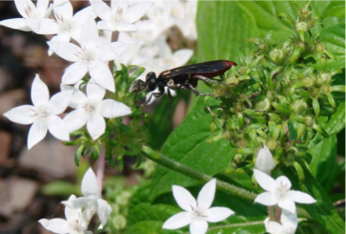
Long antennae 2 pr wings folded lengthwise at rest predators especially of caterpillars Family: Crabronidae Genus: Larra
Larra bicolorWasp
Cheri Abraham photographer
white pentas
Parasites of mole crickets
false buttonweed
Notes:
These introduced wasps feed on nectar as adults, with the shrubby false buttonweed (Spermacoce verticillata) thought to be preferred. Females hunt mole crickets, stinging them on the underside to paralyze them for several minutes. A single egg is deposited between the first and second pairs of legs. Research by Cheri Abraham and David Held determined that white pentas were suitable as floral resources and attractive and easier to use to help support activity by Larra bicolor

Slide 11
Flies: Order Diptera
Examples:
Flower, hover or syrphid flies
Tachinid flies
Long-legged flies
Robber flies
Bee flies
Notes:
Flies in the order Diptera that you may encounter at flowers include syrphid flies (also called hover or flower flies), tachinid parasitoids, long-legged flies robber flies and bee flies.

Slide 12
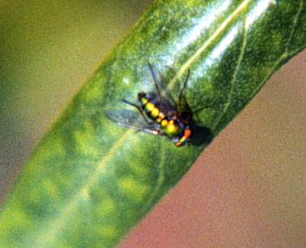
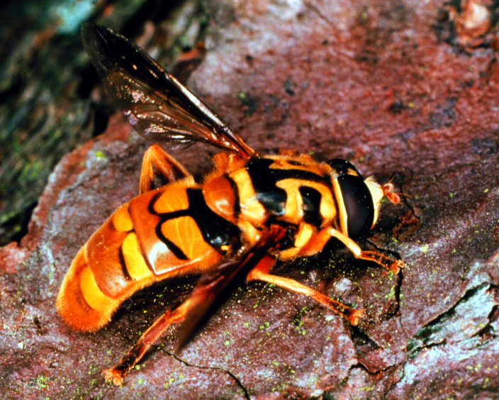
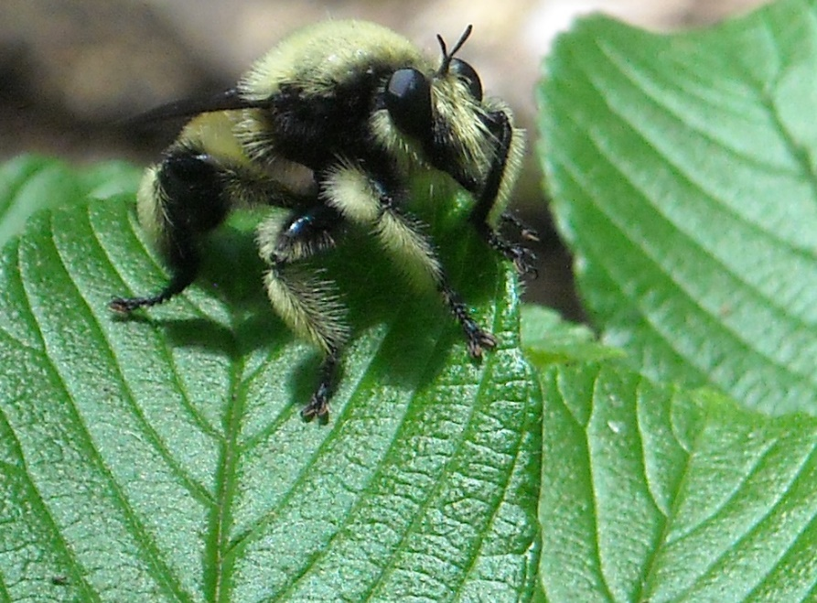
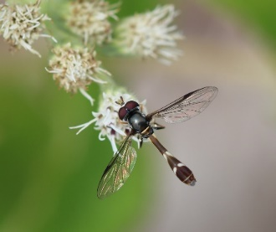
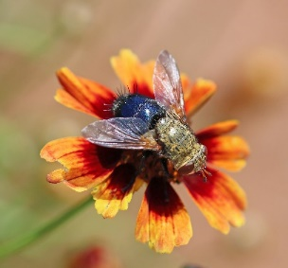
Flies
Notes:
Flies can be green metallic like some bees but will have 2 wings not 4, different antennae and will hold their wings differently. Many flies mimic bees but can be distinguished by the 2 wings, antennae lack of pollen carrying structures ( although they do transfer pollen grains adhering to their bodies) and how they hover in flight.

Slide 13
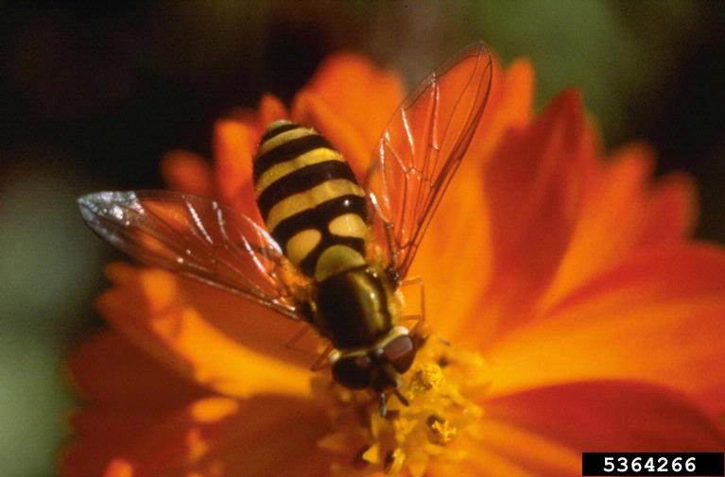
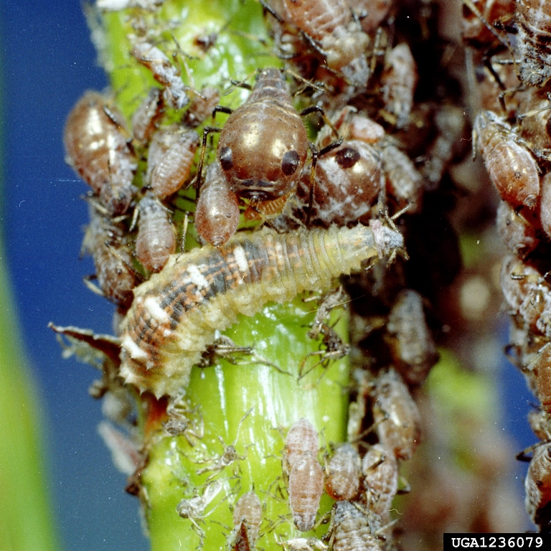
Short antennae 1 pr wings predators as larvae especially of aphids Family: Syrphidae
Syrphid, flower, hover fly
Whitney Cranshaw, Bugwood.org
Clemson University - USDA Cooperative Extension Slide Series, Bugwood.org
Notes:
Syrphid flies often mimic bees and have a hovering flight pattern. Their larvae are voracious predators of aphids.

Slide 14
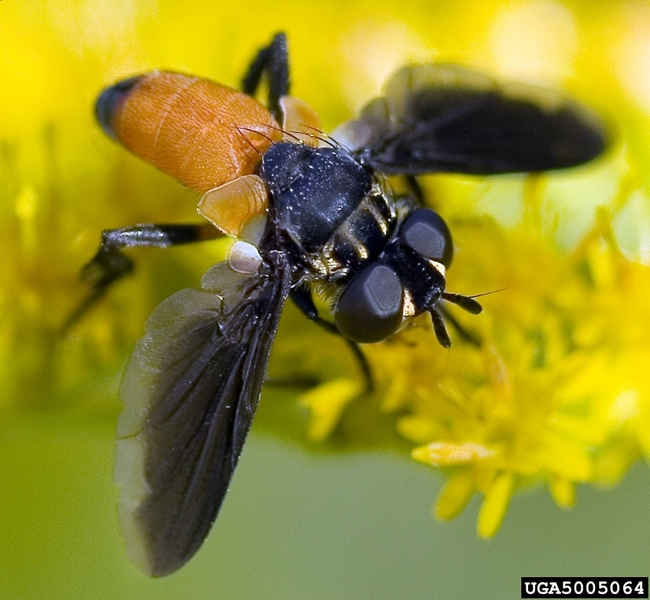
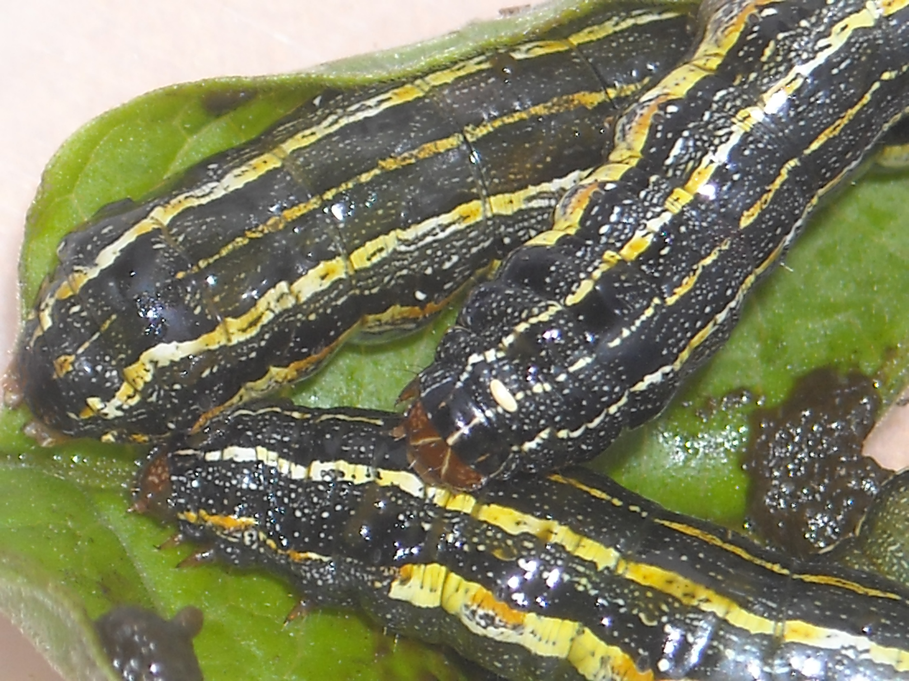
Short antennae 1 pr wings parasitoids on many insect taxa Family: Tachinidae
Tachinid fly
Tachinid fly parasitoid egg
feather-legged flies (Trichopoda sp.)
David Cappaert, Bugwood.org
Notes:
Tachinid flies vary in appearance depending upon species. Often they resemble house flies, but some are brightly colored orange and black. You may see insects with eggs deposited on the body often on the back behind the head. This is evidence of parasitism often by tachinid flies.

Slide 15
hort antennae 1 pr wings Family: Dolichopodidae
Long-legged fly
Notes:
Long-legged flies in the family Dolichopodidae include small metallic green, blue copper or bronze flies. Although poorly known, these flies are predators.

Slide 16
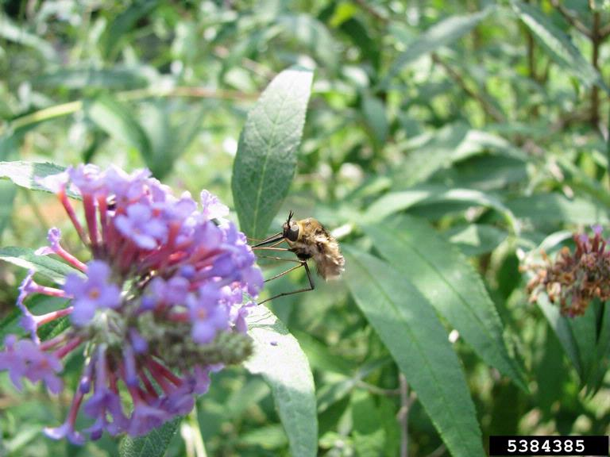
Short antennae 1 pr wings Family: Bombyliidae
Bee fly
Joe Berry, Bugwood.org
Notes:
Bee flies are often covered in long hairs and have a hovering flight pattern and can superficially resemble bees. Many are parasitoids of wasps, bees, beetles and flies or can be hyperparasitoids (parasites of other parasites!).

Slide 17
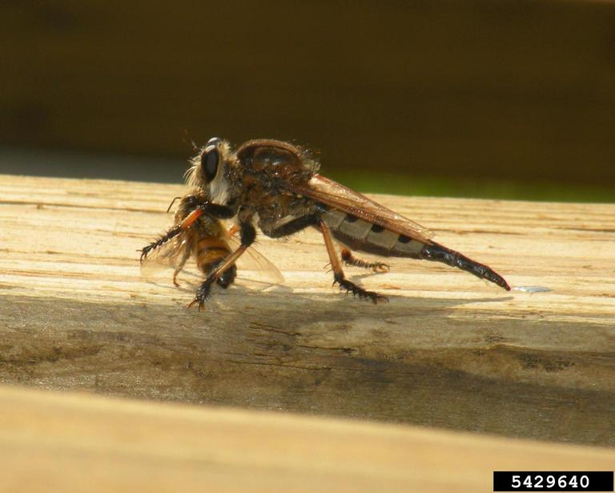
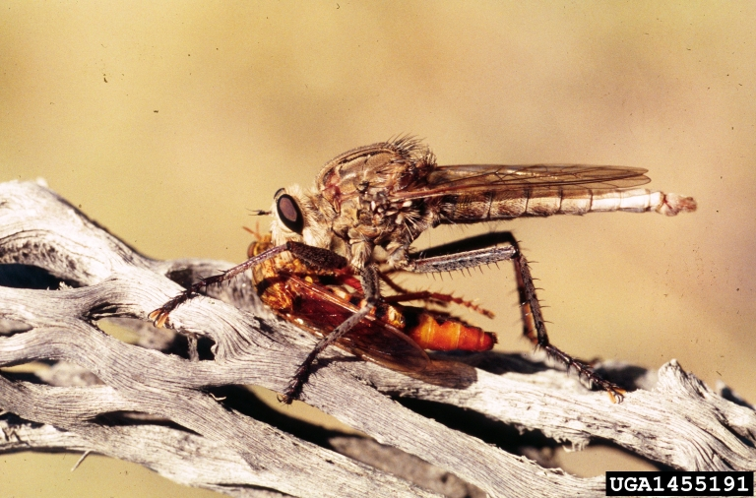
Short antennae 1 pr wings predators Family: Asillidae
Robber fly
Whitney Cranshaw, Bugwood.org
Jessica Louque, Smithers Viscient, Bugwood.org
Notes:
Robber flies vary tremendously in shape and size. Some closely mimic bees. They are predators capturing other insects in flight- often bees. They all have a “heart-shaped” head and a “bearded” face.

Slide 18
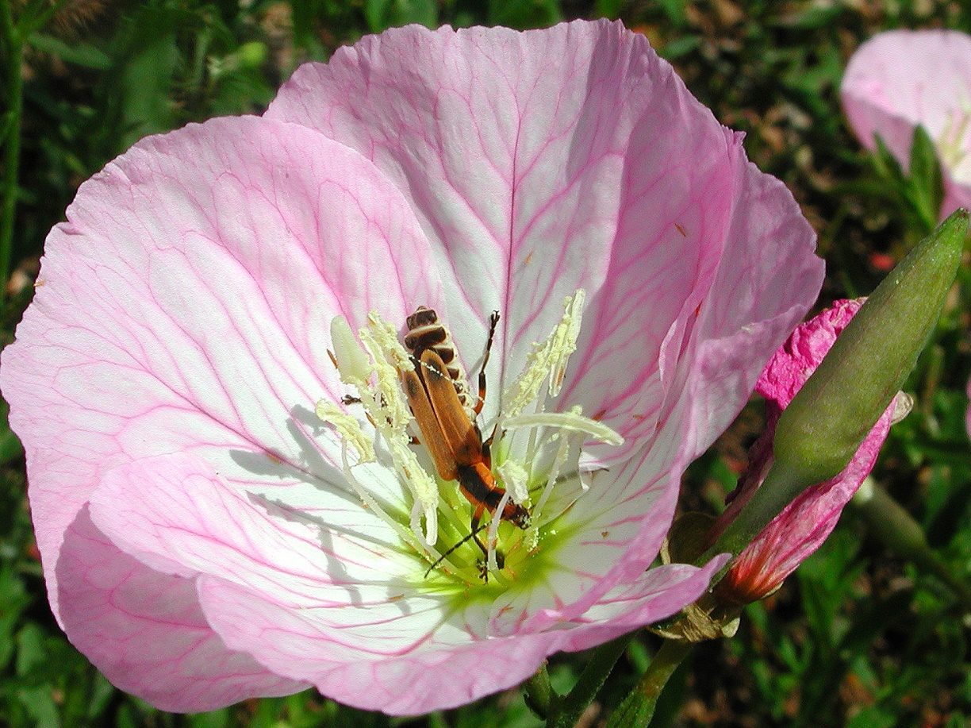
Beetles: Order Coleoptera
Examples:
Soldier
Wedge-shaped
Longhorn
Tumbling flower beetles
Notes:
Examples of beetles in the Order Coleoptera that you might frequently see include soldier beetles, wedge shaped beetles longhorn beetles and tumbling flower beetles.

Slide 19
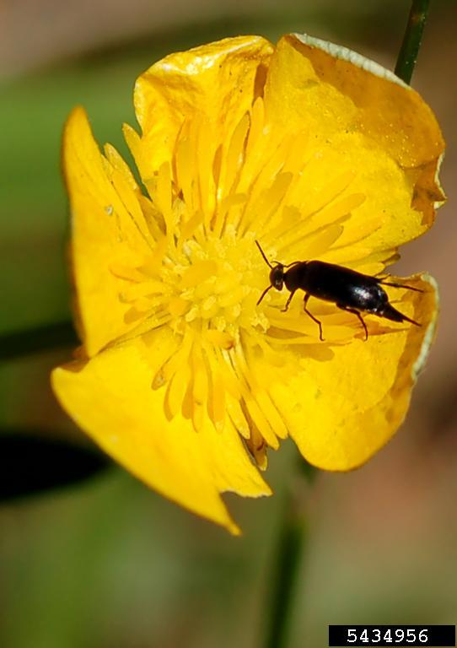
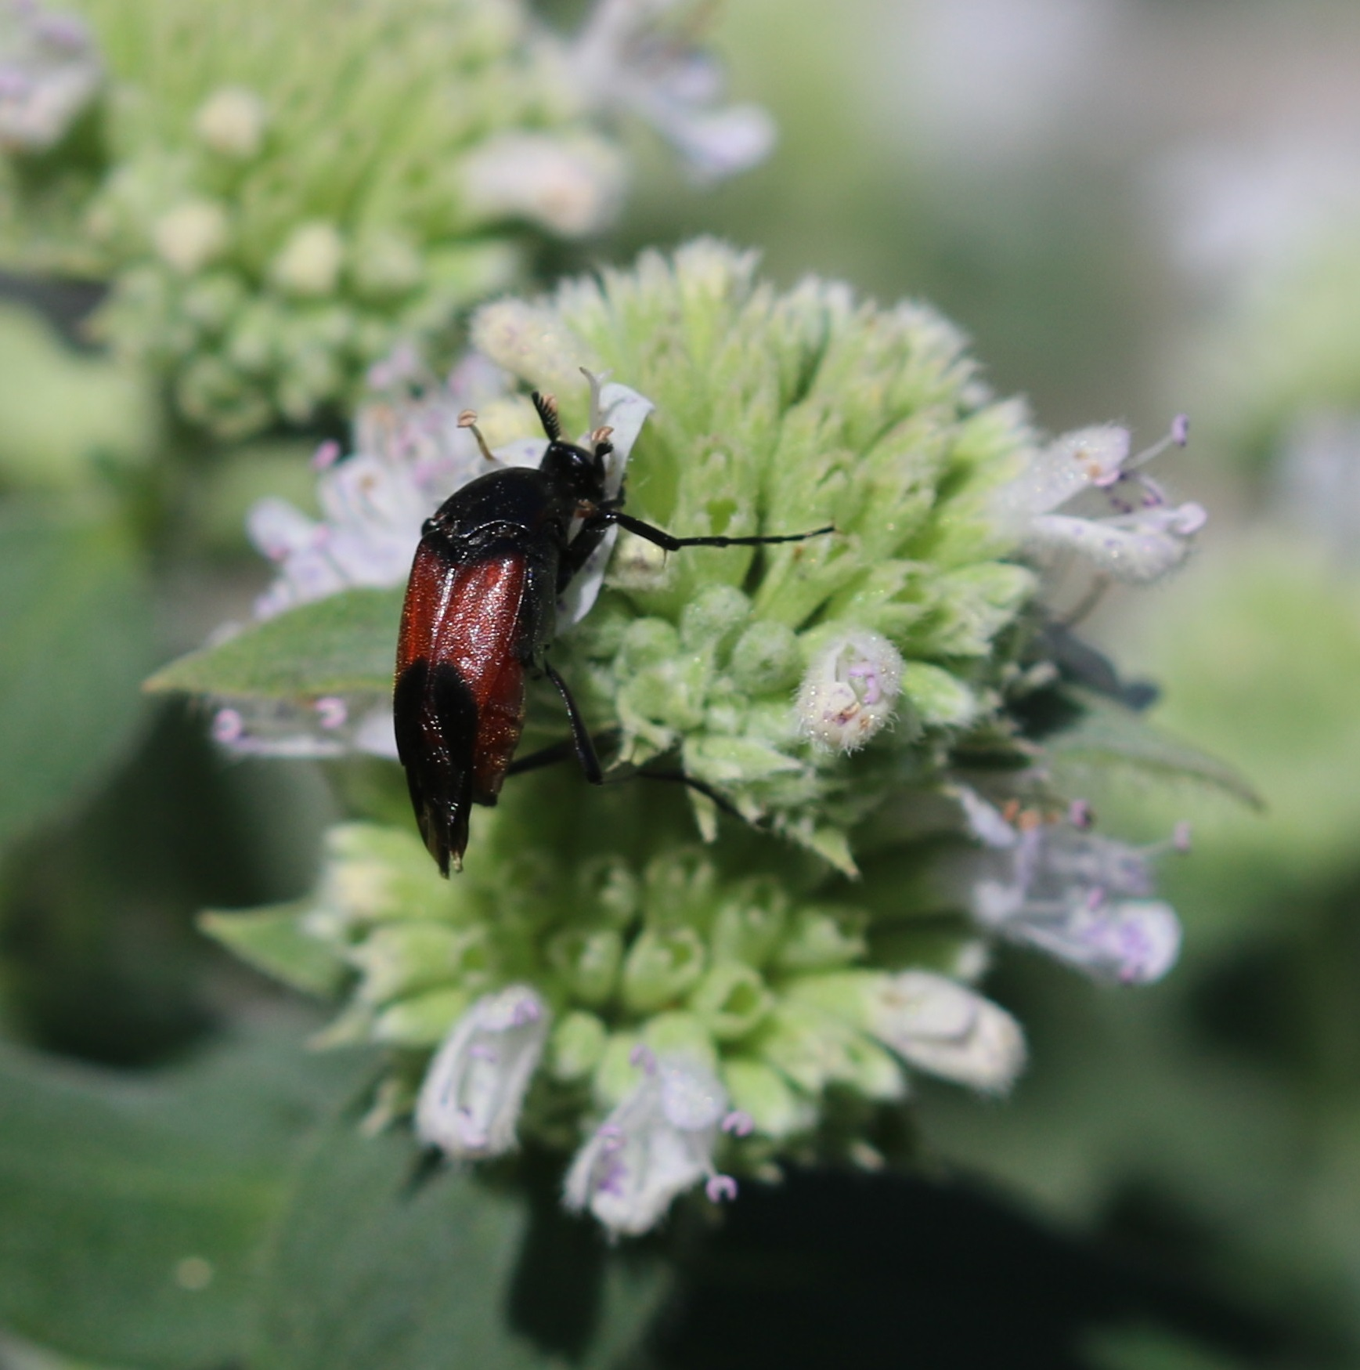
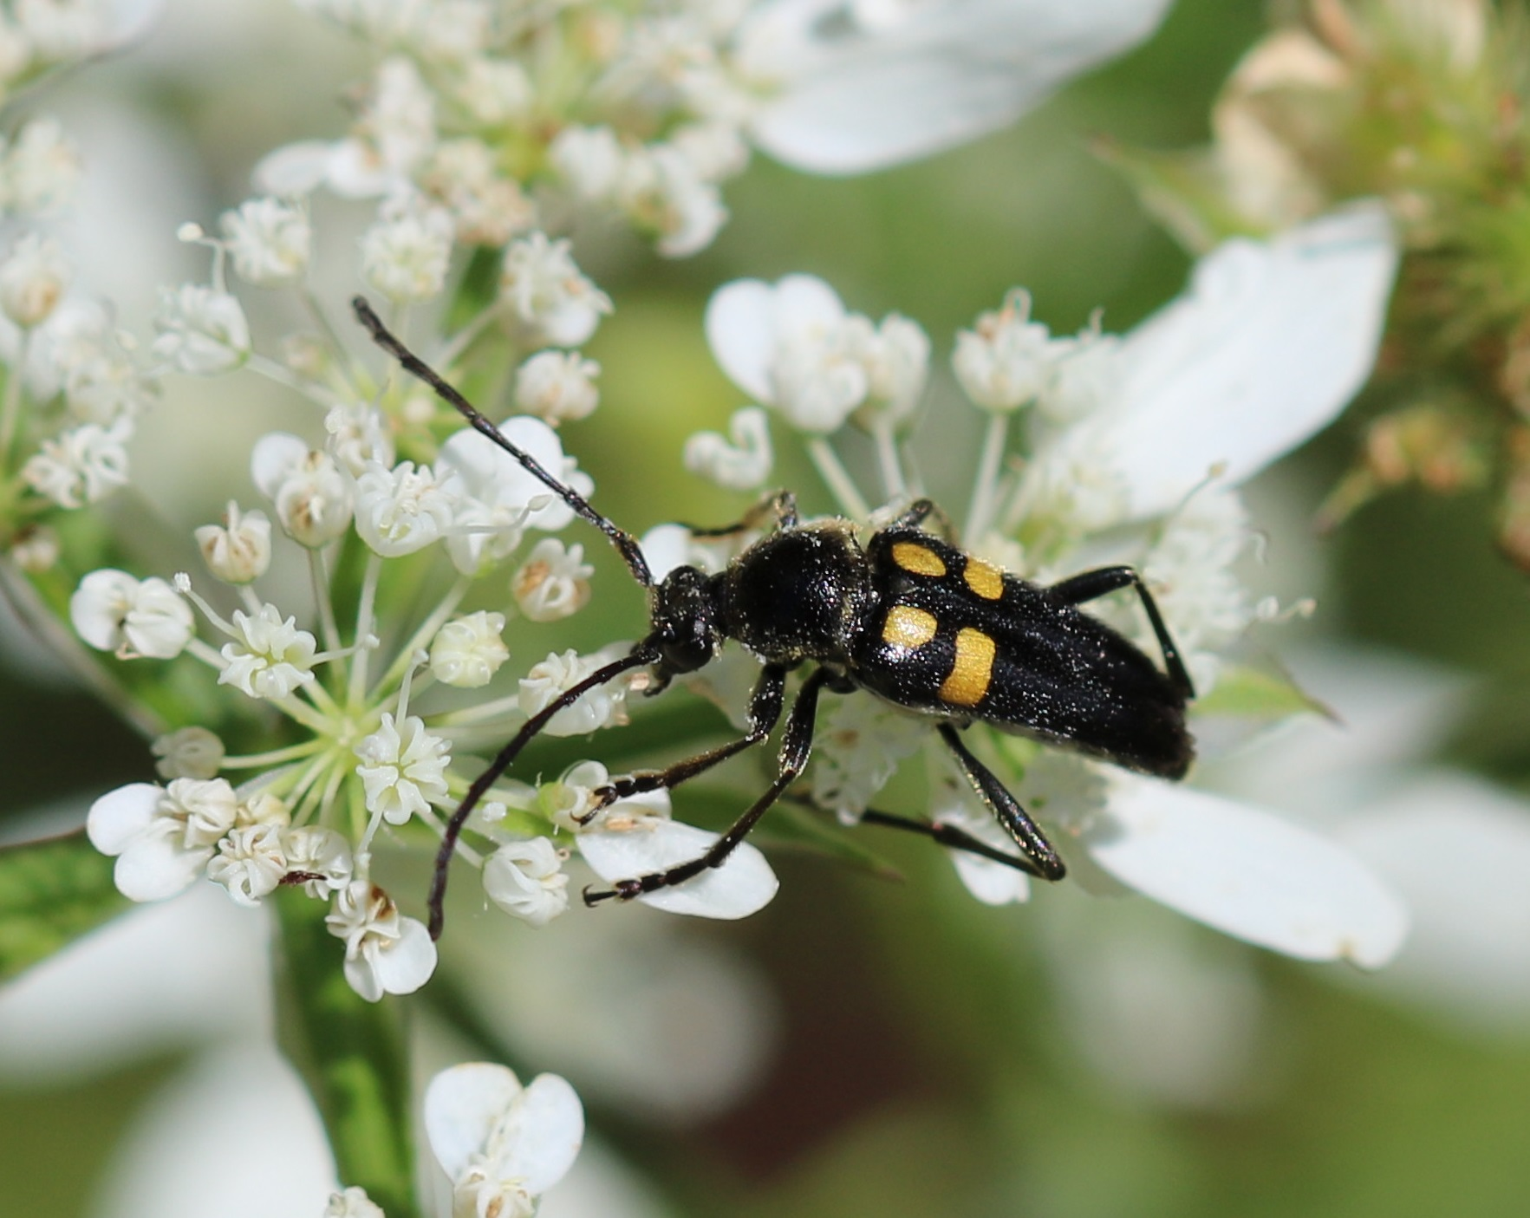
Beetles
Notes:
Beetles vary in size, shape, color pattern and antennal structure. All have hardened front wings termed elytra.

Slide 20
Family: Cantharidae
Soldier beetle
Notes:
Soldier beetles in the family Cantharidae are frequent visitors to flowers. Cantharids are predators.

Slide 21
Family: Cerambycidae
Longhorned beetle
Notes:
Long horned beetles in the family Cerambycidae derive their name from their very long antennae. These beetles are borers. In fact the common name for their larvae is round-headed borers. While some can achieve pest status, many are responsible for “shaping” forest resources, pruning the canopy and recycling dead wood into soil.

Slide 22
Family: Ripiphoridae
Wedge-shaped beetle
Notes:
Wedge-shaped beetles are common floral visitors. They are parasitoids of bees and wasps. Females may deposit eggs in flowers. Larvae that hatch climb aboard visiting bees and hitchhike back to the nest where they parasitize larval bees. Some resemble our next example…

Slide 23
Family: Mordellidae
Tumbling flower beetle
Notes:
The tumbling flower beetle in the family Mordellidae. These are very active little beetles commonly seen on flowers, especially composits. Some feed on fungi, decaying wood or plant stems.

Slide 24
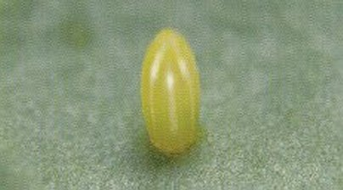
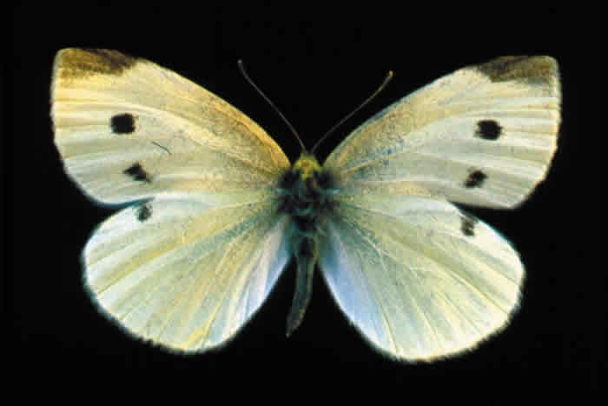
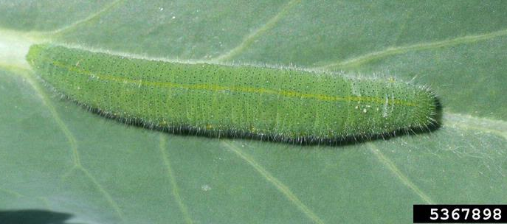
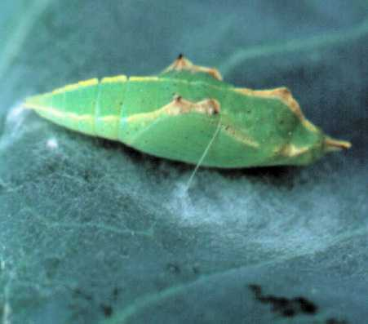
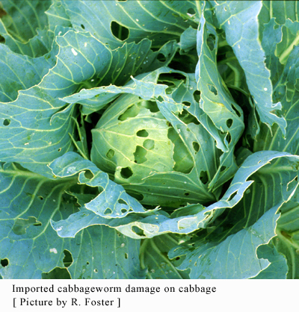
Imported Cabbageworm
Egg
Adult
Larva
Pupa
Russ Ottens
Notes:
Imported cabbageworm can cause considerable damage to crops and gardens but has an attractive adult stage that you may observe frequently

Slide 25
Notes:
These butterflies can be pollinators on flowers as adults but we also recognize their pest status as larvae!

Slide 26
Butterflies and Moths: Order Lepidoptera
Butterflies
Nymphalidae
Papilionidae
Hesperiidae
Lycaenidae
Pieridae
Moths
Sphingidae
Saturniidae
Notes:
In this lecture, we will start with Butterflies and moths in just a few families. There are over 725 species of butterflies in North America. In Georgia over 160 different butterflies have been recorded. We can, alas, only highlight a few of the many species that you might see. Nymphalidae are the brush-footed butterflies. Papilionidae are the swallowtail butterflies. Hesperiidae are commonly called skippers. Blues and hairstreaks are in the family Lycaenidae. Pieridae contains the sulphurs. Sphinx moths including clearwinged sphinx moths are in the family Sphingidae. Some of our largest and most spectacular moths are in the family Saturniidae.

Slide 27
Lepidoptera- Nymphalidae
Largest and most diverse
The first pair of legs is significantly reduced in all members and modified into small brush-like structures
Brush-footed butterflies
Notes:
Largest and most diverse of the butterfly families
first pair of legs is significantly reduced in all members and modified into small brush-like structures giving the family its name and the appearance of having only 4 legs

Slide 28
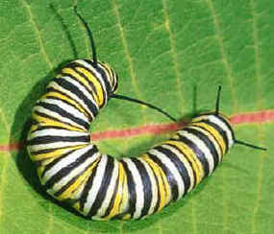
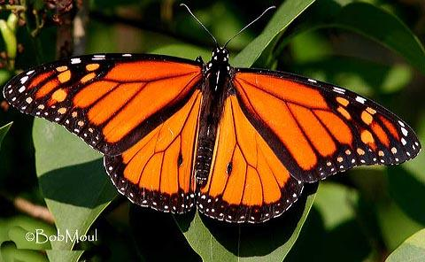
Monarch
Range:
Widespread
United States
Host Plant(s)
Milkweeds
Attractors
milkweeds
Buddleja
Phlox, Tithonia
Joe Pye Weed
Brood Period:
April + July
Comments:
Significant
Migration
Danaus plexippus
Notes:
Monarchs are the most well-known butterfly in GA in addition to its wonderful migratory pattern it is unique in that it feeds on only one plant species, the milkweed (A. tuberosa). Loss of habitat and climate change have created great concern for the survival of the species.

Slide 29
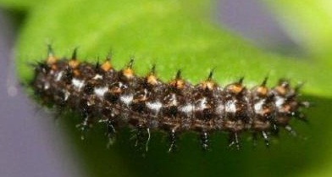
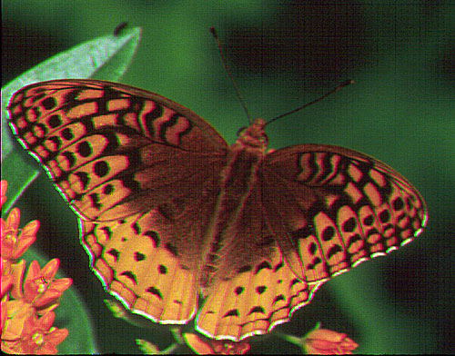
Great Spangled Fritillary
Range:
Widespread
Host Plant(s)
Violets
Attractors
Phlox, Buddleja
Lantana, Pentas
Echinacea
Brood Period:
June/July
Comments:
Fast flier,
Females live much
longer than males
Speyeria cybele
Notes:
The Great Spangled Fritillary has a wide range of environments in the US. It feeds on common violets, including the weeds! Because of this it is found all over the US.

Slide 30
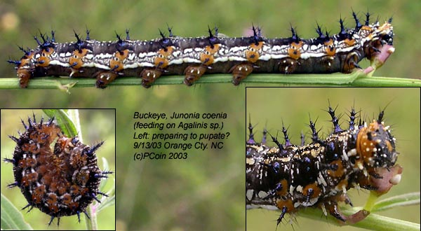
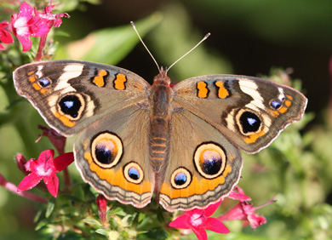
Ohio Buckeye
Range:
Widespread
Host Plant(s)
Plantain
Vervains
Attractors
Verbena, Buddleja
Echinacea, Echinops
Pentas, Tithonia
Brood Period:
April + July
Comments:
Eyespots may
serve as a defense
http://biology.duke.edu/
Junonia coenia
Notes:
The Ohio Buckeye has an unusual adaptation of having bright eye spots on the wings which it flashes to birds or other predators if they get too close. This makes the bird think that a larger animal is nearby.

Slide 31
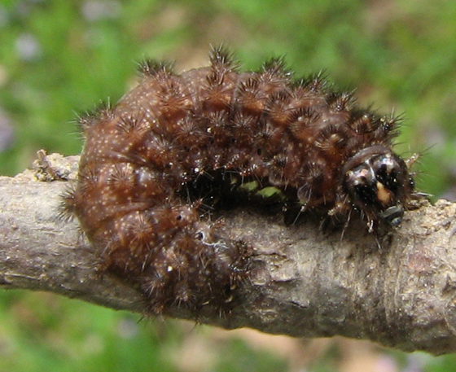
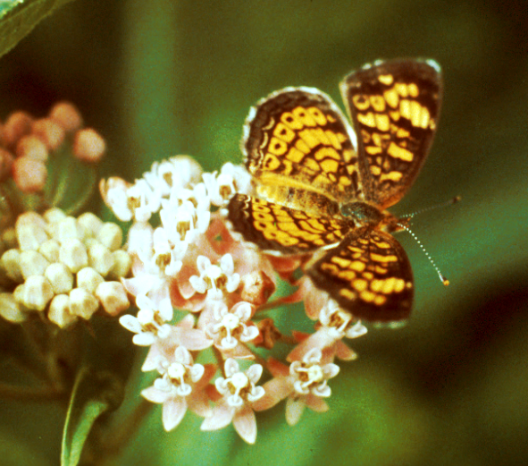
Pearl Crescent
Range:
Widespread
Host Plant(s)
Asters
Attractors
Helenium
Rudbeckia
Asclepias
Verbena
Tithonia
Brood Period:
April + September
Comments:
Males are
aggressive
bugguide.net
Phyciodes tharos
Notes:
The Pearl Crescent is a very common one that is often found on yarrow and helenium in GA.

Slide 32
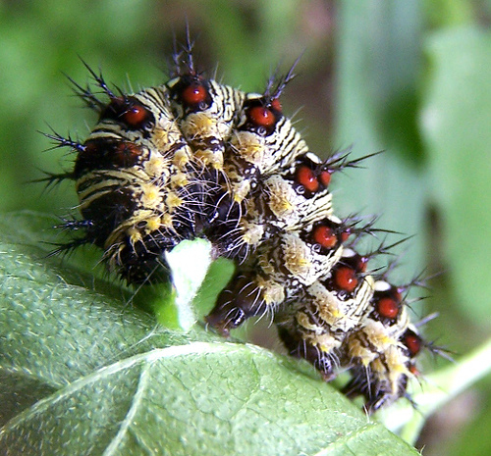
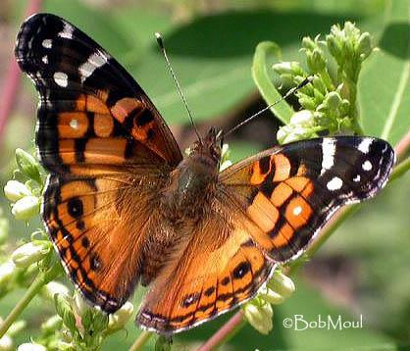
American Painted Lady
Range:
Widespread
Host Plant(s)
Composites
Attractors
Echinacea
Tithonia
Scabiosa
Verbena
Brood Period:
June –
September
Comments:
Overwinters
http://bugguide.net
Vanessa virginiensis
Notes:
The American Painted Lady is one of the most common species found in gardens. It has a wide variety of host plants. Common to abundant in open and disturbed sites and gardens. Multiple generations are produced.

Slide 33
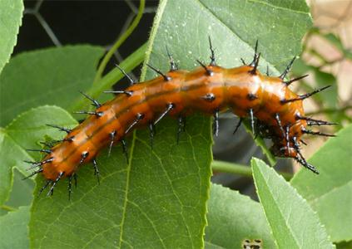
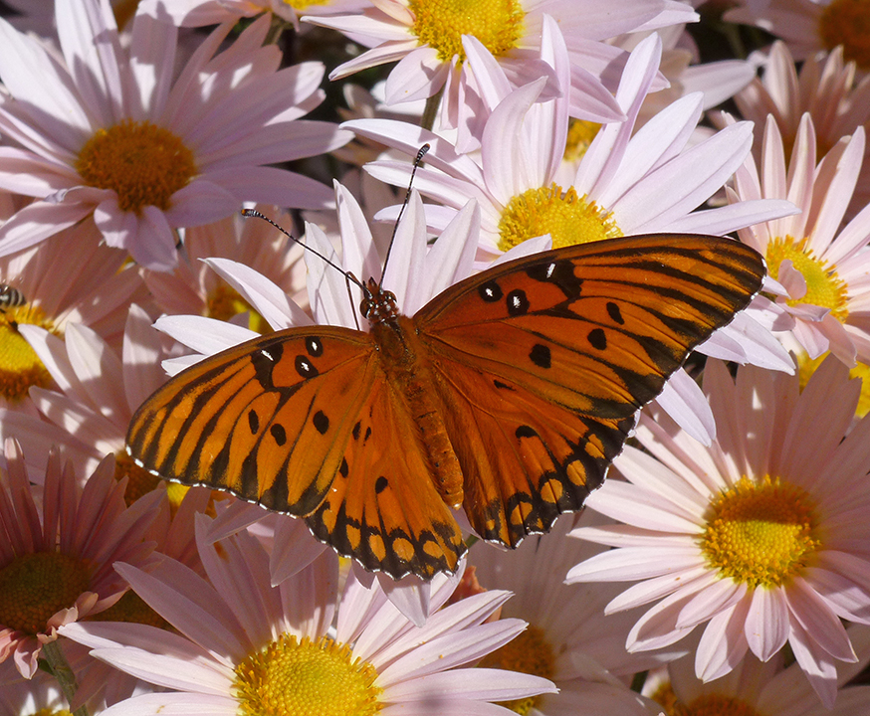
Gulf Fritillary
Range:
Widespread
Host Plant(s)
Passiflora
Attractors
Passiflora, Buddleja
Phlox, Tithonia
Echinacea
Brood Period:
April + July
Comments:
One-way
migration
Agraulis vanillae
Notes:
The Gulf Fritillary is a common southeastern butterfly that feeds on our native maypop (Passiflora). Its caterpillar is bright orange with black branched spines’.

Slide 34
Lepidoptera- Papilionidae
Easily recognized by their large size and long hindwing tails
Swift and powerful flight
Males often puddle on damp ground
Generally found along woodland edges and adjacent open areas
Swallowtails butterflies
Notes:
The swallowtails, Papilionidae are easily recognized by their large size and long hindwing tails
Swift and powerful flight
Males often puddle on damp ground
Generally found along woodland edges and adjacent open areas

Slide 35
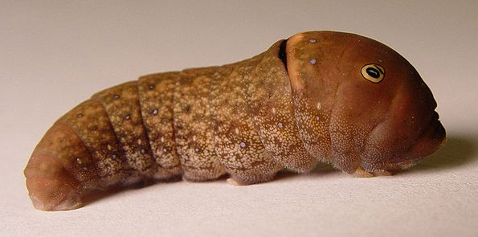
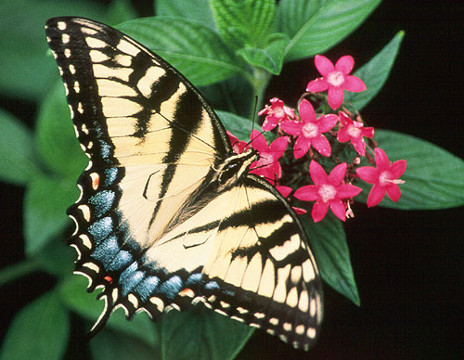
Eastern Tiger Swallowtail
Range:
US, Canada, Alaska
Larval Host Plant(s)
Tulip Poplar
Willow, Ash
Cherry
Attractors
Tithonia, Lantana
Phlox, Joe Pye Weed
Brood Period:
April & July
Comments:
Fast Flier, Some
females are
have dark wings
Papilio glaucus
Notes:
The Tiger swallowtails are the most visible and one of the most popular butterflies to have visit your garden. They have a slow, graceful flight pattern and will spend hours in the garden sipping nectar.

Slide 36
Order Lepidoptera: Butterflies
Swallowtail butterflies family Papilionidae
Swallowtail butterfliesPhotograph by Ronald F. Billings.
Karan Rawlins photographer
Eastern Tiger Swallowtail.
Notes:
The Eastern Tiger Swallowtail butterfly is the state butterfly of Alabama, Delaware, Georgia, and South Carolina. This species is commonly seen from spring to fall and produces two broods in the north, and three life cycles in the southeastern states.

Slide 37
Order Lepidoptera: Butterflies
Swallowtail butterflies family Papilionidae
Swallowtail butterfliy Photograph by Jim Occi.
Ansel Oommen, Bugwood.
Notes:
Young caterpillars are brown and white and resemble bird droppings. Great camouflage from hungry birds. Larger caterpillars have false “eyes” that may make the caterpillar appear “snakelike” as a defense against predators. The actual head of the caterpillar is small and inconspicuous.

Slide 38
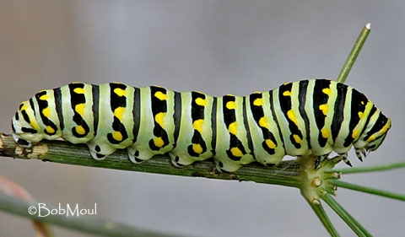
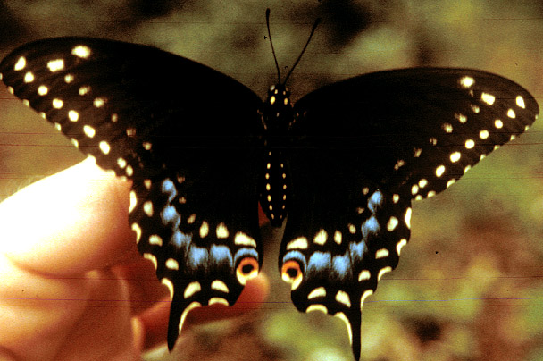
Black Swallowtail
Range:
Eastern North America (NA)
Host Plant(s)
Queen Anne’s Lace
Rue, Fennel, Dill
Attractors
Phlox, Thrift
Verbena, Tithonia
Buddleja
Brood Period:
April + July
Comments:
This is the common
Parsley/Dill Worm!
Papilio polyxenes
Notes:
The Black Swallowtail is one of the most common of the swallowtails in GA . The caterpillar is the common fennel or parsley worm that is the bane of gardener’s existence. One larva can devour a whole plant in a day!

Slide 39
Order Lepidoptera: Butterflies
Swallowtail butterflies family Papilionidae
Photograph by Ansel Oommen.
Sturgis McKeever photographer
Black Swallowtail.

Slide 40
Black Swallowtail
Black Swallowtail larval osmeterium
Larval host plants
Carrots
Parsley
Dill
Fennel
Bronze fennel
Queen Anne’s lace
Whitney Cranshaw photographer
Notes:
When disturbed caterpillars can extrude an orange osmeterium, a forked gland with a noxious scent that they wipe on startled would-be predators. Larval host plants are wild and cultivated members of the carrot family can include carrots, parsley, dill fennel, bronze fennel and queen Anne’s lace

Slide 41
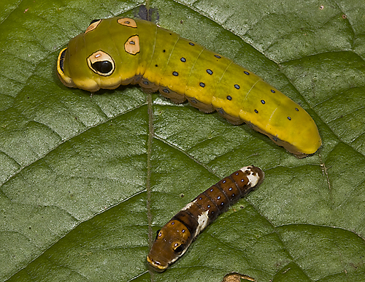
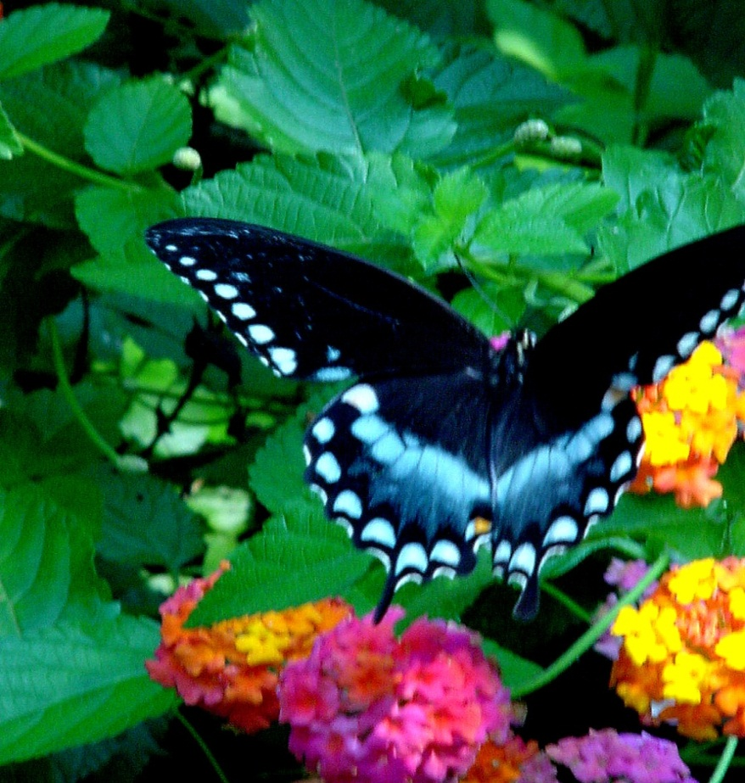
Spicebush Swallowtail
Range:
Eastern NA
Host Plant(s)
Spicebush, Sassafras
Perseas
Attractors
Lantana
Buddleja
Phlox
Joe Pye Weed
Brood Period:
April + July
Comments:
Nervous Flier
www.marietta.edu/~biol/biomes/
Papilio troilus
Notes:
The Spicebush Swallowtail is a shy and fast-moving butterfly in the garden. It never rests. While feeding, it constantly beats its wings showing off its iridescent blue markings. These markings are a sign to birds that the butterfly is poisonous or tastes bad. Actually, its caterpillars feed on spicebush which is not poisonous but the butterfly closely mimics the Pipevine Swallowtail which is poisonous.

Slide 42
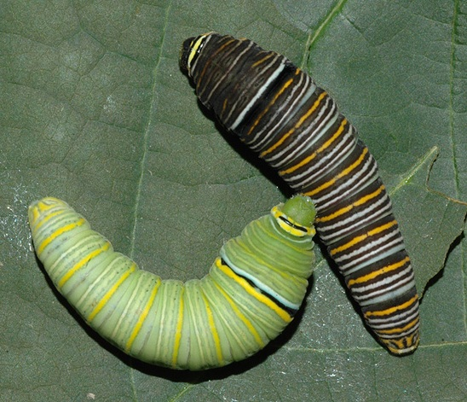
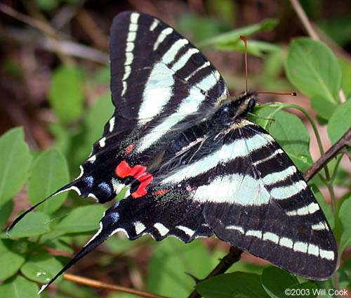
Zebra Swallowtail
Range:
Eastern NA
Host Plant(s)
Pawpaw and
other Asimina
Attractors
Blueberry
Buddleja, Phlox
Brood Period:
March, July
September
Comments:
Very nervous flier
Flies low to the ground
Eurytides marcellus
Notes:
The Zebra Swallowtail is the most nervous and the most difficult of the swallowtails in the garden to see. They are fast, erratic flier, and the stripes allow them to blend in the branches and shadows of any garden with ease. They commonly fly near the ground or at waist height avoiding most human observation.

Slide 43
Lepidoptera- Pieridae
Small to medium sized; typically white or yellow
Many have dark markings, most are sexually dimorphic and seasonally variable
Quick, erratic flight
Open disturbed sites where weedy larval host plants can be found
Sulphurs and Whites
Notes:
Small to medium sized; typically white or yellow
Many have dark markings, most are sexually dimorphic and seasonally variable
Quick, erratic flight
Open disturbed sites where weedy larval host plants can be found

Slide 44
Common Sulfur
Range:
Eastern NA
Host Plant(s)
Clovers
Alfalfa
Attractors
Echinacea
Thrift
Buddleja
Phlox
Brood Period:
April + July
Comments:
Very Common
Colias philodice
Notes:
The Common Sulfur is a not a native species. It produces several generations in the Southeast. It is the most easily recognized butterfly in the GA garden because of its bright yellow color.

Slide 45
Cloudless Giant Sulfur
Range:
Southern US
Host Plant(s)
Clover
Cassia
Attractors
Salvias, Phlox
Buddleja
Tithonia
Echinacea
Brood Period:
April + July
Comments:
migrates
Zerene cesonia
Notes:
The Cloudless Giant Sulfur is a late season butterfly that emigrates from FL for the same reasons as the other species. They will be persistent in the garden until November. As fall approaches the species undergo a massive southward migration into the Florida peninsula.

Slide 46
Lepidoptera- Lycaenidae
Diverse family includes coppers, blues, hairstreaks, metalmarks
Adults are small and often brightly colored but can be overlooked
Contains Georgia's smallest butterfly, the Pygmy -Blue
Gossamer wings
Notes:
Diverse family includes coppers, blues, hairstreaks, metalmarks
Adults are small and often brightly colored but can be overlooked
Contains Georgia's smallest butterfly, the Pygmy -Blue

Slide 47
Eastern Tailed Blue
Range:
Eastern NA
Host Plant(s)
Clovers, Beans, Peas
Attractors
Clover, Alfalfa
Asters, Eupatorium
Brood Periods:
March , May
July, September
Comments:
Caterpillars over-winter
in pea pods
Everes comyntas
Notes:
The Eastern Tailed Blue is one of the first spring butterflies. It is seen in February and March in most parts of GA. Flies low to the ground and can be seen feeding on moisture and salts in the garden soil. The butterflies form clusters of several butterflies that fly around as a group. Caterpillars over-winter in pea pods.

Slide 48
Grey Hairstreak
Range:
Widespread
Host Plant(s)
Corn, Oak
Cotton, Mint
Strawberry
Attractors
Erigeron, Eupatorium
Echinacea
Asclepias, Tithonia
Brood Period:
April, June,
September
Comments:
Fast Flier
Strymon melinus
Notes:
The Gray Hairstreak is another mid- to late-summer butterfly that frequents ageratum and aster. It is the size of a dime with bright, gray wings and also tends to fly in clusters of 3-4.

Slide 49
Lepidoptera- Hesperiidae
Small to medium sized butterflies with stout bodies and compact wings
Generally brown, orange or white
Antennae have a very distinct hook at the tip
Quick and erratic in flight
Skippers
Notes:
Small to medium sized butterflies with stout bodies and compact wings
Generally brown, orange or white
Antennae have a very distinct hook at the tip
Quick and erratic in flight

Slide 50
Checkered Skipper
Range:
Eastern NA
Host Plant(s)
Mallows
Hibiscus
Hollyhock
Attractors
Blueberry
Buddleja
Phlox
Brood Period:
April, July
September
Comments:
Males are territorial
bugguide.net
Pyrgus communis
Notes:
The Checkered Skipper is a mid to late-summer garden visitor that prefers our native ageratum or asters. You can often see the male fighting off other males for territorial control of the flowers, much like male hummers around feeders.

Slide 51
Silver Spotted Skipper
Insects.tamu.edu
Range:
Widespread
Host Plant(s)
Wisteria, Locust
Beans
Attractors
Tithonia, Buddleja
Verbena, Pentas
Helianthus
Brood Period:
April + July
Comments:
Showy Flier
Epargyreus clarus
Notes:
The Silver Spotted Skipper is a common visitor to the mid-summer to late summer garden. They are fast fliers, and once they find a food source they do not stray far from it.

Slide 52
Branded Skipper
Range:
Widespread
Host Plant(s)
Grasses
Attractors
Tithonia
Buddleja
Helianthus
Asters
Brood Period:
April + July
Comments:
Fast Flier
Hesperia comma
Notes:
The Branded Skipper and its 21 cousins that populate GA gardens are the jet airplanes of the butterfly world. They frequently are seen in the garden seemingly having dog-fights in large groups. Actually this is a mating ritual.

Slide 53
The Difference Between
Butterflies and Moths
Butterflies
Moths
Have Knobby Antennae
Fly During Daylight
Rest w/ wings closed
Have threadlike or Feathery Antennae (no knob)
Fly at Dusk and Night
Rest with wings flat across their back
Notes:
Have you ever wondered how to tell the difference between a butterfly and a moth? Butterflies have knobby antennae, fly during daylight, make chrysalises, and rest w/ wings closed. Moths, on the other hand, have Feathery antennae, fly at dusk and night, make cocoons / pupae, and rest with wings open and also with them flat across their backs.

Slide 54
Antennae
Moths antennae are specialized sensors that pick up scent of the opposite sex. Male Moths have very feathery antennae to sense
females that are very far away.
Butterfly antennae are knobby and do not express differences between the sexes.
Male
Female
Notes:
Moths antennae are specialized sensors that pick up scent of the opposite sex. Male Moths have very feathery antennae to sense females that are very far away. Butterfly antennae are knobby and do not express differences between the sexes.

Slide 55
Moths
Butterfly gardens are active at night as well.
There are many night-feeding insects that can be observed.
However, not all moths are
found at night. Your state has
many species of day-flying
moths. These moths feed on
the very same plants as
butterflies.
Notes:
Butterfly gardens are active at night as well. There are many night-feeding insects that can be observed. However, not all moths are found at night. Your state has many species of day-flying moths. These moths feed on the very same plants as butterflies.

Slide 56
Ctenucha Moth
Host: Grasses, irises and sedges
Mohammed El Damir
Notes:
The Viginia ctenucha is active by day but also comes to lights at night. It feeds on grasses, irises and sedges.

Slide 57
Luna Moth
Range:
Widespread
Host Plant(s)
Sweetgum
Hickory
Persimmon
Attractors
None
Brood Period:
April + July
Comments:
Poor Flier
Adults do not
feed
Actias luna
Notes:
The Luna Moth is the most widely recognized of the large silk moths in GA. Frequently seen on windows on warm evenings in spring and fall.

Slide 58
Polyphemus Moth
Range:
Eastern NA
Host Plant(s)
Oaks
Birch
Sycamore
Beech
Attractors
None
Brood Period:
April + July
Comments:
Adults do not
feed
Telea polyphemus
Notes:
The Polyphemus Moth is another nighttime visitor to bright windows whose wing beating makes a lot of noise. The insect has large eye spots that mimic a large creature hence the name ‘poly’—or many eye.

Slide 59
Cecropia Moth
Range:
Eastern NA
Host Plant(s)
Willow
Maple
Attractors
None
Brood Period:
April + July
Comments:
Poor Flier
Adults do not
feed
Samia cecropia
Notes:
The Cecropia Moth was once a common large silk moth in GA but because of changing weather patterns and destruction of native habitats (piedmont forest) this moth is now rare in GA. Once it hatches from a big cocoon it does not feed—it does not have mouth parts. For two weeks it just focuses on reproduction.

Slide 60
Hummingbird Clearwing Moth
Range:
Eastern NA
Host Plant(s)
Spicebush
Attractors
Blueberry
Buddleja
Phlox
Brood Period:
April + July
Comments:
Fast Flier
Haemorrhagia thysbe
Notes:
The Hummingbird Clearwing Moth is a commonly misidentified moth as it mimics the bumblebee. It has a flight pattern similar to hummingbirds, hence its name. It feeds on the nectar of deep-throated flowers, just like hummingbirds do.

Slide 61
White lined Sphinx Moth
Range:
Eastern NA
Host Plant(s)
evening primrose
Attractors
Salvias
Buddleja
Phlox
Brood Period:
April + July
Comments:
Fast Flier
Hyles lineata
Notes:
The Sphinx Moth is a beautiful night flying moth that mimics a hummingbird. What most gardeners do not know is that this is the adult of the tomato horn worm.

