Slide 1
Farming with Pollinators
Irenee Payne, Pollinator Coordinator GACD

Slide 2
In this activity, students will form groups. Each group will be assigned a farm that produces one type of crop. Students will create a “Pollinator Management Plan” to improve pollinator space on their farm.

Slide 3
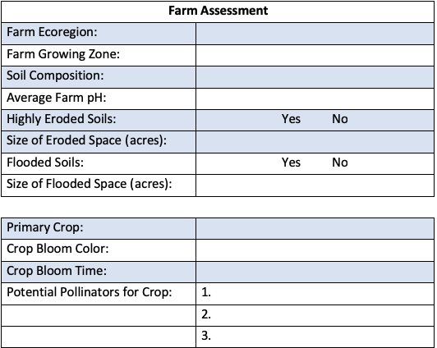
1
2
3
4
3
3
3
3
5
5
5
6
Notes:
This is the Pollinator Management Plan that every student will fill out. This portion assess what they currently have on their farm. They will use the various maps provided, their crop description sheet, and the Pollinator Syndromes sheet to fill in these spaces.

Slide 4
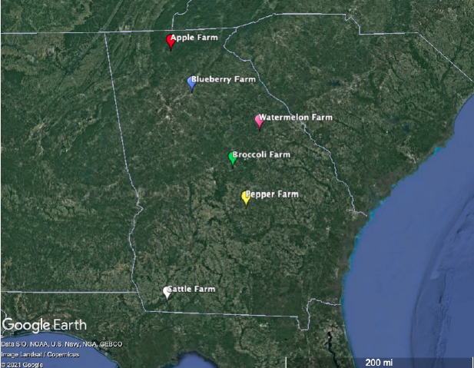
1
2
Notes:
Farm Locations Map

Slide 5
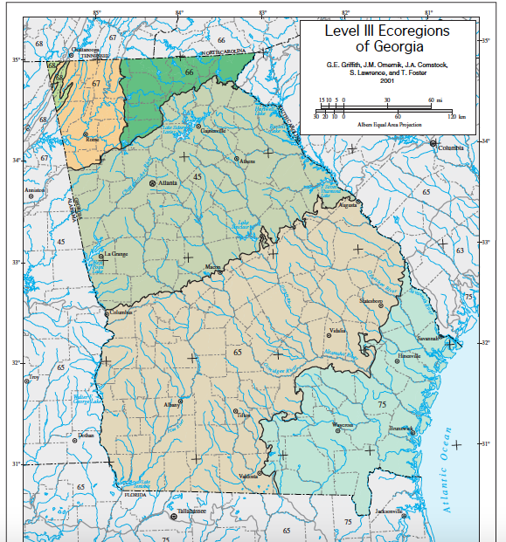
1
Notes:
Ecoregions of Georgia Map

Slide 6
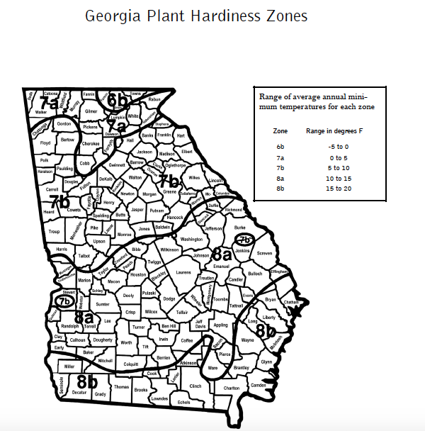
2
Notes:
Growing Zone/Hardiness Zone Map

Slide 7
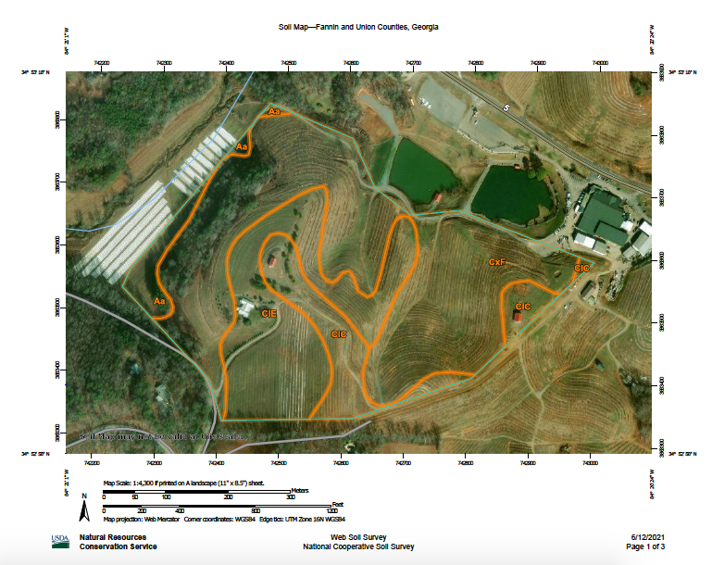
3
Notes:
Soil Map
This is a map created from NRCS’ Websoil Survey website. This website is accessible to the public, and any location can be entered into the “Area of Interest” search function on the website. All farms chosen for this activity are real farms in Georgia that were found using GA Farm Bureau’s Georgia Grown public-accessible farms list. However, if you are comfortable with the Websoil Survey, you can enter in your own farm or school to learn more about the soils in your area! The orange lines indicate boundaries for different soil types. They are NOT topographic lines. The faint green line shows the farm boundary.
If you want more information regarding NRCS’ Websoil Survey, there are informational YouTube videos: https://www.youtube.com/watch?v=ifAmQybESUM
And the link to the Websoil Survey page can be found here: https://websoilsurvey.nrcs.usda.gov/app/WebSoilSurvey.aspx

Slide 8
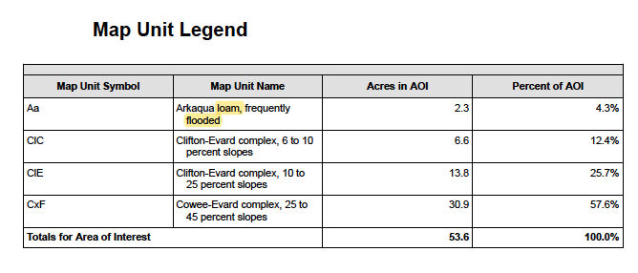
3
The “Map Unit Legend” provides the information you need to assess your farm’s soils! Students are looking to assess if soils are loamy, sandy, clay, or any combination of the three. They are also looking for the words “flooded” and ”eroded.” If your farm doesn’t have flooded or eroded soils, that’s great! Leave the information blank.
Notes:
Soil Map
Students can explore the soil names, like “Clifton-Evard,” but for the purpose of this activity, students are only expected to look for the words “loam,” ”sand,” ”clay,” “flooded,” and “eroded.” They can disregard the names unless you decide to explore soil types further with your students.

Slide 9
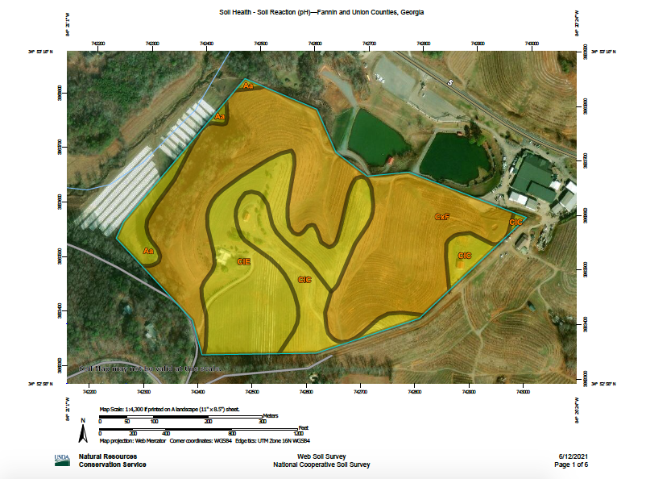
4
Notes:
Soil pH Map

Slide 10
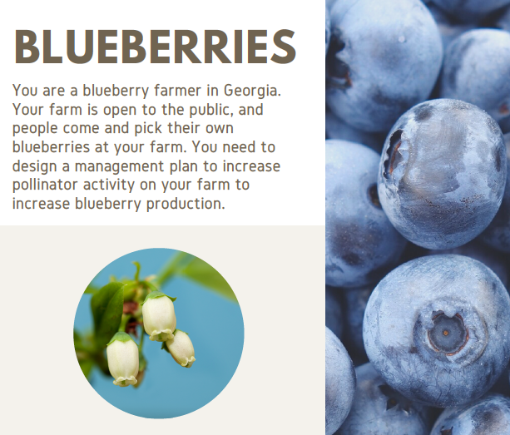
5
Notes:
Soil pH Map

Slide 11
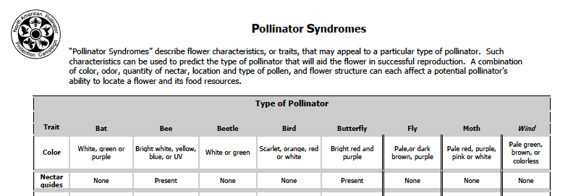
6
Notes:
Pollinator Syndromes Chart for identifying the pollinators that could be attracted to the bloom on the crop that students currently have on their farm, and this can be used to list pollinators that could be attracted to the new plants that students select as part of their Pollinator Management Plan.

Slide 12
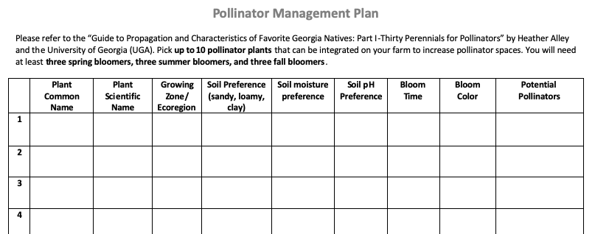
The provided guide will not list all of this information for every plant. Students are expected to fill out what is provided by the guide for the plant they select. If the information is not in the guide, you can have students look up the information from other sources or leave some information blank.
Notes:
This is the Pollinator Management Plan that every student will fill out. This portion is where students use the “Guide to Propagation and Characteristics of Favorite Georgia Natives: Part I—Thirty Perennials for Pollinators” by Heather Alley with UGA to brainstorm plants they could add to their farm to increase pollinator space. They need up to 10 plants, and the plants need to occur at different bloom times. Additionally, the plants need to match the growing conditions (climate and soil) on the students’ assigned farm.

Slide 13
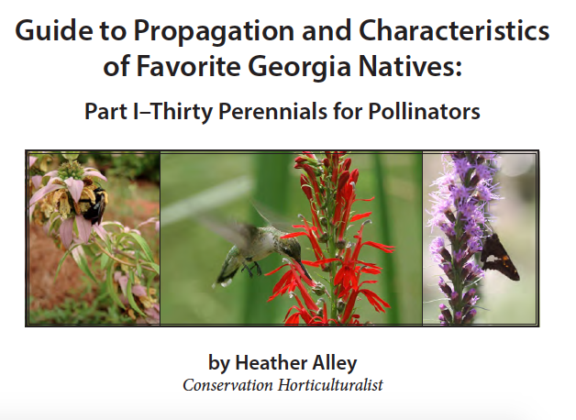
Notes:
Guide to Propagation and Characteristics of Favorite Georgia Natives: Part I—Thirty Perennials for Pollinators by Heather Alley with UGA will be used to select plants to add to students’ farms to increase biodiversity and pollinator habitat.

Slide 14
So remember...
We need our pollinators! And we need them on our farms!
Many crops rely on cross-pollination for reproduction, so they rely on pollinators!
Pollinators need habitat for all life cycles and they need variety
Always be aware of:
Pesticide use
Overwintering sites
Habitat requirements

