Slide 1
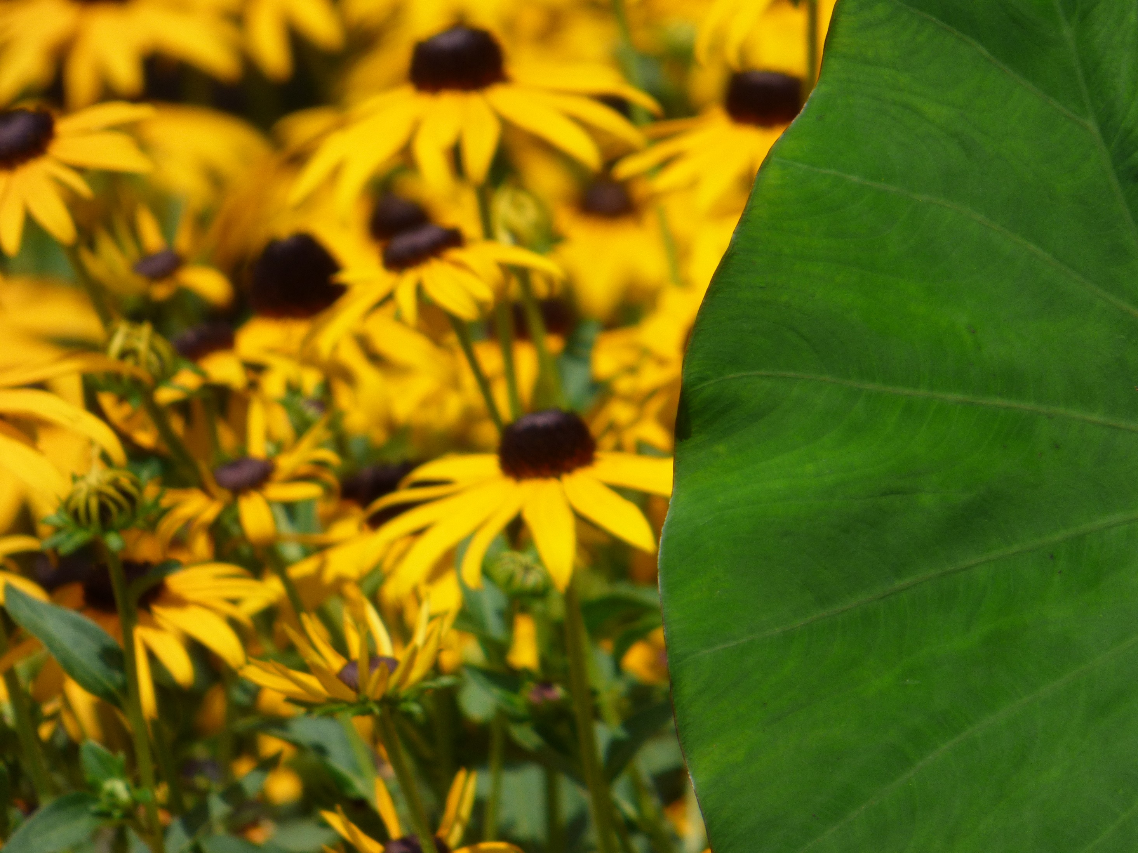
Landscaping with Native Wildflowers in Georgia
Notes:
This presentation is a brief overview of selection and culture of native perennial wildflowers.

Slide 2
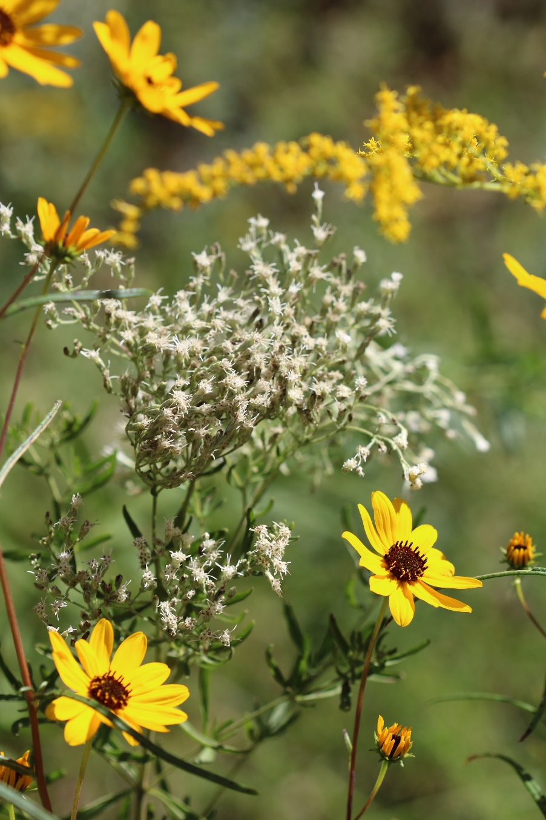
What are Native Plants?
Many definitions:
grow naturally in a particular region without direct or indirect human intervention;
present in a particular area prior to European settlement;
inhabited a particular region for thousands of years.
Federal government's "official" definition:
Plants that are "naturally occurring, either presently or historically, in any ecosystem of the United States."
Notes:
There are many definitions for native plants. Several references say native plants are those that grow naturally in a particular region without direct or indirect human intervention. Other references place a historical timeline on native plants, saying they are plants that were present in a particular area prior to European settlement of that area. Others say they are plants that have inhabited a particular region for thousands of years. Even the federal government published an “official” definition in the Federal Register, defining native plants as those that are “naturally occurring, either presently or historically, in any ecosystem of the United States.”

Slide 3
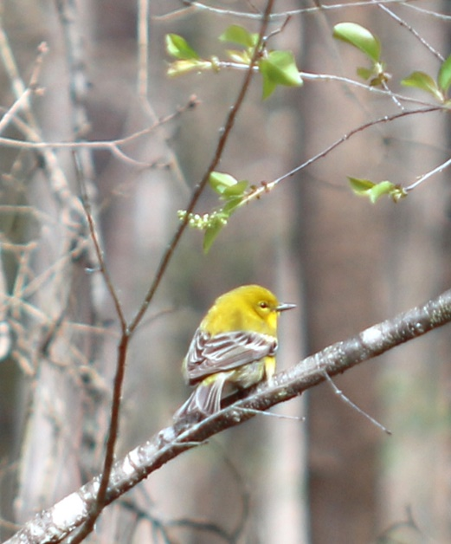
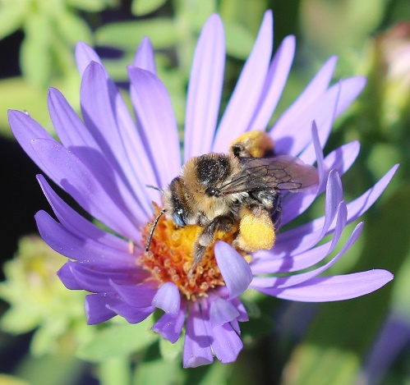
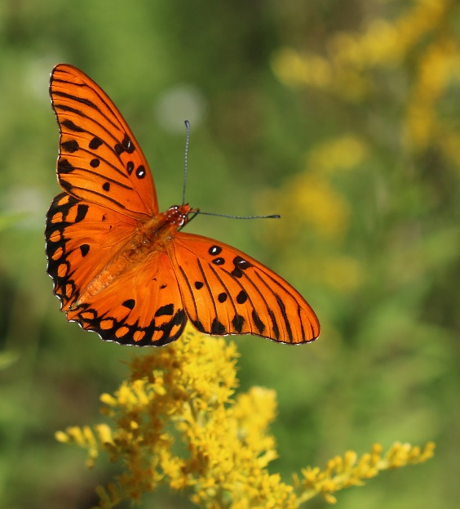
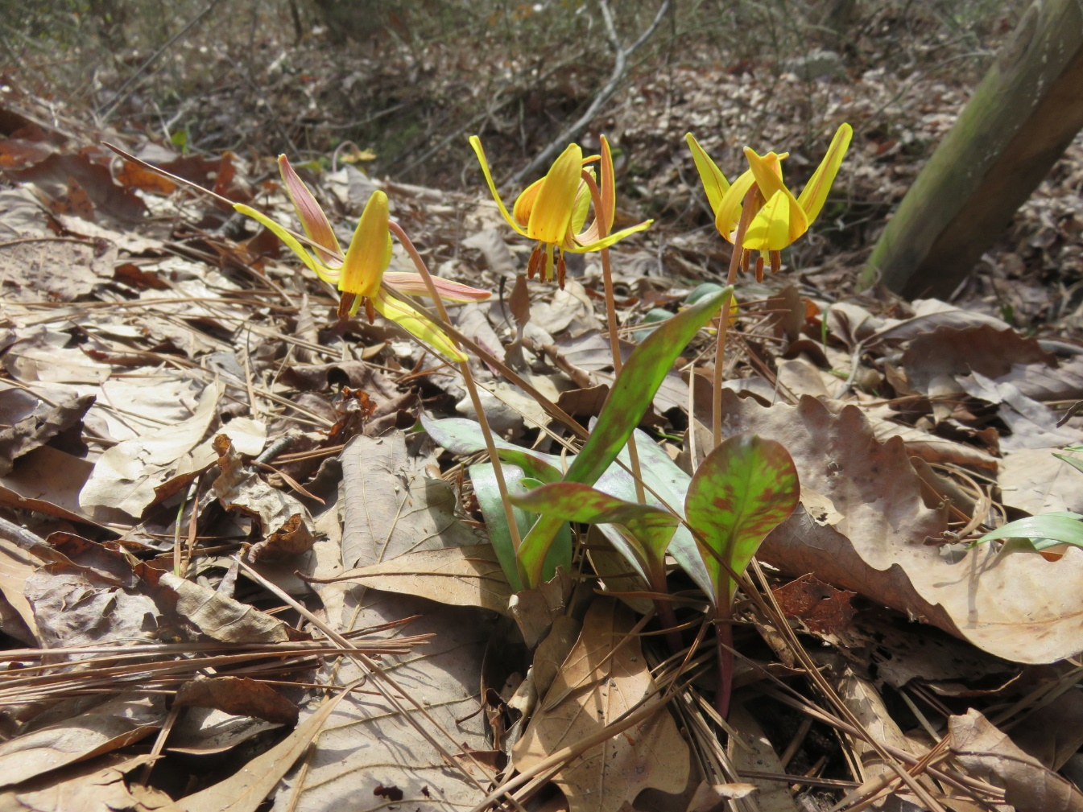
Why Native Plants?
A low maintenance & self-sufficient "green space."
Provide wildlife habitats.
Ecological preservation
Habitat protection & preservation are obligations of all Georgia citizens.
Dimpled Trout Lily
Erytronium umbilicatum
Notes:
A native plant community, left undisturbed and incorporated into a landscape, is low-maintenance and self-sufficient.
Native plants provide “watchable” wildlife habitats. Native butterflies, insects, birds, mammals, reptiles and other animals evolve with the native flora and are sustained by it year round, providing diverse food, shelter and support for native food webs.
Ecological preservation is another reason for using native plants. With the increasing destruction of natural environments for urban and agricultural use, many plant species and the animals they support have declined dramatically in numbers and in range. In fact, some native plants, having a limited growing range and very specific growing requirements, may decline or die when subtle alterations are made in their native habitat. Habitat protection and preservation are obligations of all Georgia citizens.

Slide 4
Plant Ecology of Georgia
Complex & wide-ranging:
Basic groupings: wet, moist, dry, upland or bottomland.
More than 100 distinct environments of plant communities in state.
Plants grow where they do because they have finely adjusted to local environment.
In nature, macroclimate of an area (winter & summer temperature extremes, precipitation & humidity) dictates geographic distribution of a native plant.
Notes:
The ecological diversity in Georgia is complex and wide-ranging, from high mountain ridges of north Georgia to flatwoods and swamps of south Georgia. Among the geographic regions of the state, numerous ecosystems or environments exist where unique plants and animals have adapted. In some cases, plant species have adapted to very specific and restricted environmental conditions. Others occur over much wider and more general environments.
Georgia environments can be divided into a number of basic groupings: wet, moist, dry, upland or bottomland. There are more than 100 distinct environments or plant communities in the state. Depending upon past adaptive changes in each of these environments, some plants will be dominant while others will be rare or unable to survive. Plants grow where they do because they have finely adjusted to the local environment. For example, some plants require a bare, mineral soil for seed germination. A thick layer of pine straw or leaf litter on the surface of the soil will prevent this type of species from getting started. Some bottomland species of trees grow well on upland sites once they have germinated. Their seeds, however, require wet soils in which to germinate. Other plants are tightly constrained by the environment to small ecological niches or “homes.” Although many of these plants will not grow and reproduce in cultivated landscapes like they do in their native habitat, they can adapt and become fine specimens.

Slide 5
Eight major habitats in GA, listed from north to south:
North
1. Cove hardwoods (rich, moist, protected pockets)
2. Mixed pine/hardwoods (“climax”) upland forest along valley slopes & bluffs
3. Forest gaps (breaks in the main forest canopy where light reaches the soil surface)
4. Rock outcrops (rocky ridge tops & bluffs)
5. Meadows (herbaceous pastures or prairies)
6. Pine woods (well-drained sands on the Coastal Plain)
7. Bottomland forests (streams, low slopes, flood plain & river areas with cypress & hardwoods)
South
8. Swamps
Notes:
Below are the eight major habitats in Georgia, listed from north to south:
North
1. Cove hardwoods (rich, moist, protected pockets)
2. Mixed pine/hardwoods (“climax”) upland forest along valley slopes and bluffs
3. Forest gaps (breaks in the main forest canopy where light reaches the soil surface)
4. Rock outcrops (rocky ridge tops and bluffs)
5. Meadows (herbaceous pastures or prairies)
6. Pine woods (well-drained sands on the Coastal Plain)
7. Bottomland forests (streams, low slopes, flood plain and river areas with cypress and hardwoods)
South
8. Swamps
One or more of these eight habitats are home to wildflowers we will talk about.

Slide 6
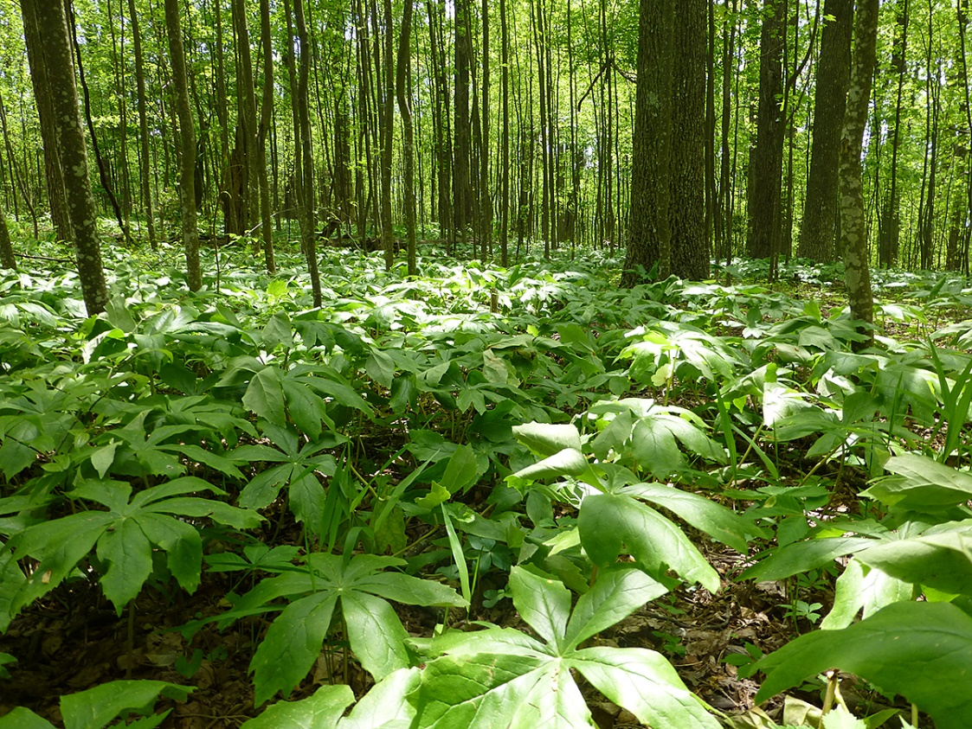
Right Plant in the Right Place!
For best results simulate the native environment as close as possible:
Light
Soil (pH, organic matter, drainage)
Moisture
Mayapple
Podophyllum peltatum
Notes:
By understanding a plant’s native habitat and simulating it in the landscape, you are more likely to have success growing the plant. Always remember – “Right plant in the right place”. Factors such as light, soil pH, organic matter content, drainage, and moisture are all important considerations when deciding which plants match which conditions at you particular site. For example, Mayapple’s natural habitat is hardwood forests, bottomlands and moist meadows. It prefers filtered shade and moist soils high in organic matter. If you are to grow Mayapple successfully, you should plant it in a spot where all conditions are met.

Slide 7
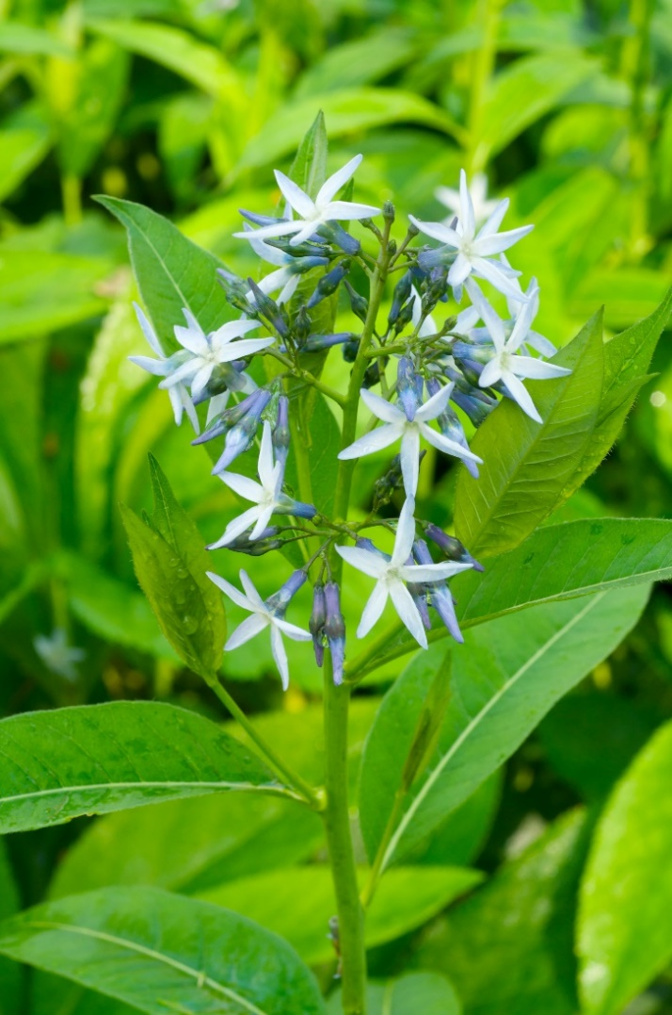
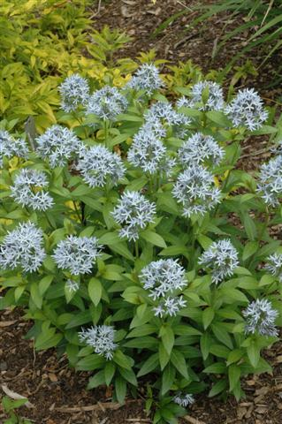
‘Nature-made’ (Wild-Type) vs. Cultivated variety
Eastern Blue Star,
Amsonia tabernaemontana
Amsonia tabernaemontana ‘Blue Ice’
Notes:
Before we start our foray into wildflowers, let’s address a couple of questions often asked. The first is: “What is the difference between wild species and a cultivar?” The simplest answer is, wild species have been growing for thousands of years without any intervention, while cultivated varieties have been selected, bred, and named by humans. Let’s use an example of Eastern blue star, Amsonia tabernaemontana. Photo on the left is of the wild species, which you may find while strolling in the woods. Notice the single flower spike. The photo on the right is of cultivated variety ‘Blue Ice’. Notice that it has multiple flower stalks and it is shorter. The aim of people who breed ornamental plants is to improve on nature, to offer a ‘better’ plant. Not only do scientists seek enhanced ornamental features such as larger blooms, more intense color, and better habit, but also improved disease and insect resistance, as well as general tolerance of stress. Such improved cultivated varieties are not only more likely to entice you to purchase them but also to be satisfied with the performance in your garden.

Slide 8
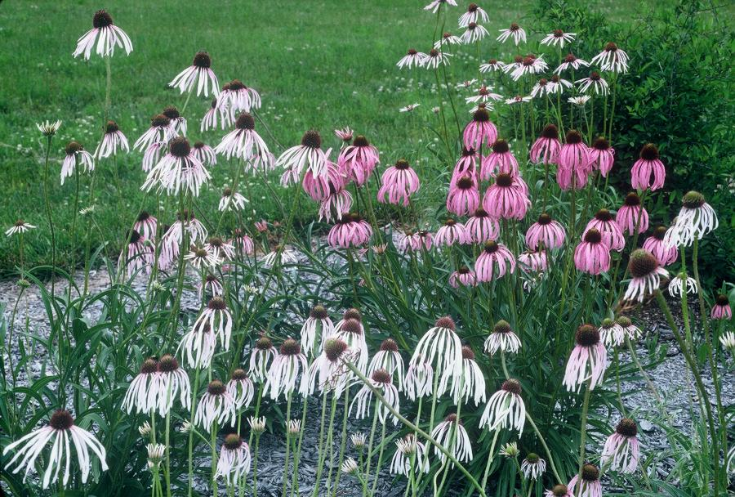
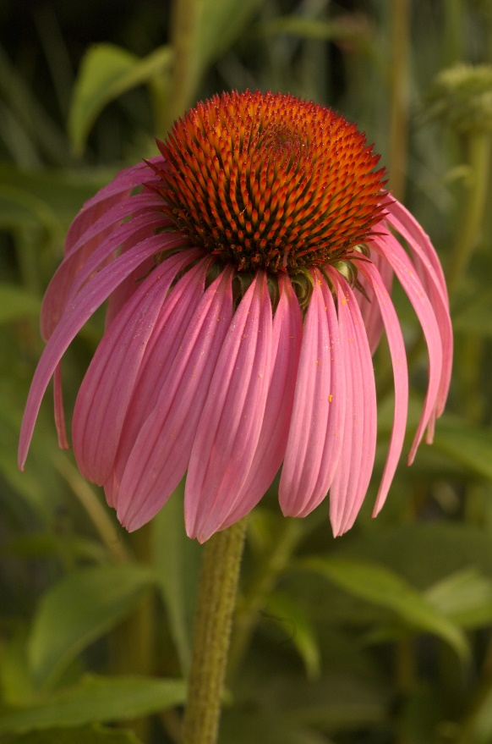
Coneflower
Echinacea pallida, E. simulata
Purple coneflower
E. purpurea
Notes:
Another example of how far the breeding efforts have come is a perennial favorite of humans and butterflies – the coneflower. Echinacea simulata is a coarse, hairy, Missouri native perennial found primarily on dolomite glades and slopes in the eastern Ozarks. It is basically identical to the more wide-spread Echinacea pallida, except for the pollen color on the anthers: E. simulata is yellow, while E. pallida is white. Purple coneflower Echinacea purpurea, is native to Georgia. The large, daisy-like flowers with drooping, pale pinkish-purple petals and spiny, knob-like centers have been a staple in the perennial garden. The coneflowers are sun-loving, drought-tolerant plants which unfortunately for us in Georgia, are prone to powdery mildew disease.

Slide 9
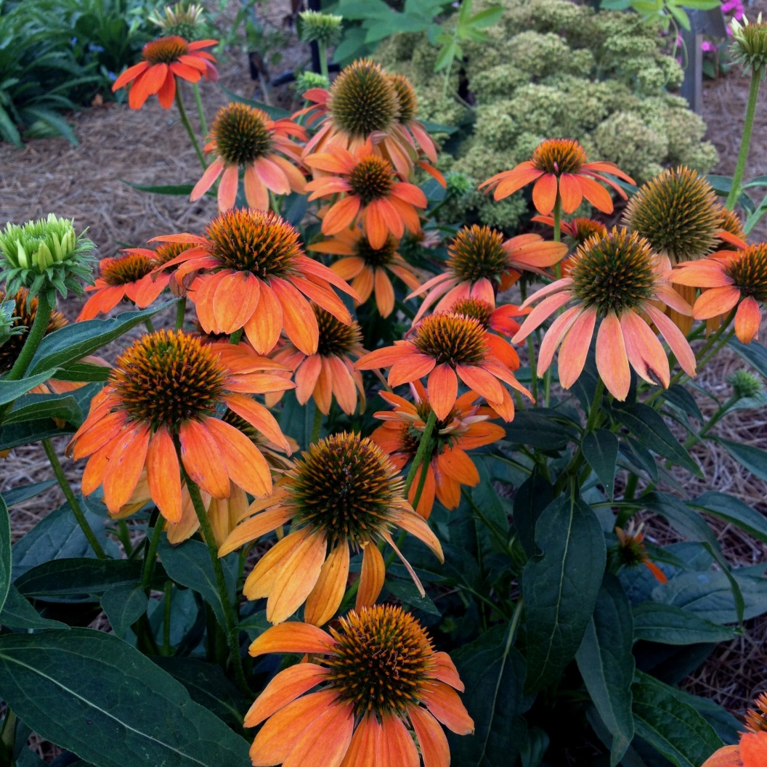
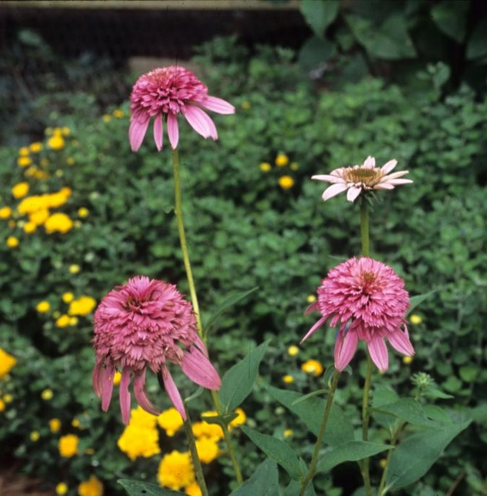
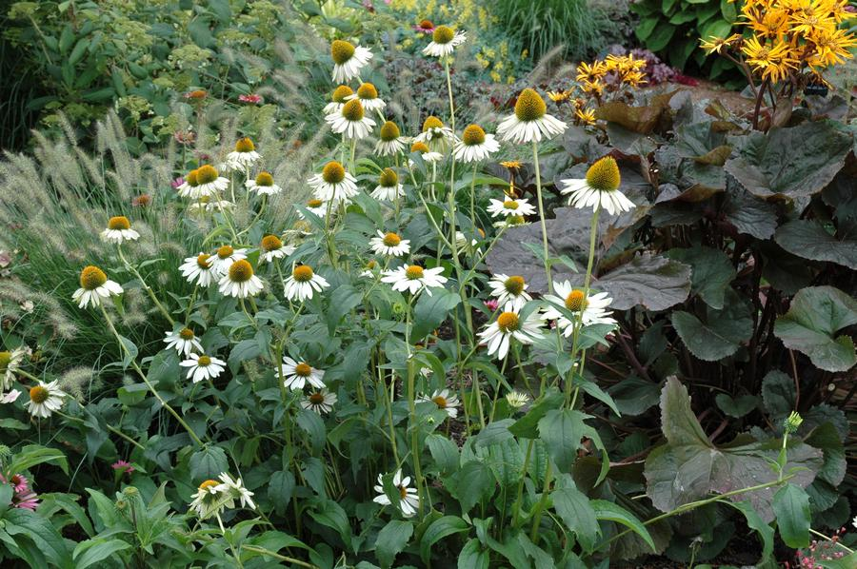
‘Sombrero Orange’
‘Razzmatazz’
The University of Georgia Trial Garden, Athens
http://ugatrial.hort.uga.edu/
‘Fragrant Angel’
Notes:
So scientists have taken these wild species and bred and selected new plants. These cultivars may be hybrids of two species, or they may be selections of one species. Notice the different shape, size, and color of blooms, as well as the more appealing names; such as Echinacea ‘Fragrant Angel’, while ‘Sombrero Orange’ boasts large fiery blooms. ‘Razzmatazz’ is rather unique with the shorter petals, definitely a ‘wow factor’. Many, but not all, cultivated varieties do well in Georgia; while the aesthetic features may be enhanced, they may still be susceptible to powdery mildew. It is therefore important to trial such plants under local conditions to determine if they exhibit superior performance. The University of Georgia Trial Garden in Athens performs such a function. Its website lists annual trial results and ranks each plant’s performance. ‘Sombrero Orange’, for example, received high marks, and so did ‘Fragrant Angel’.

Slide 10
Ecological Value of Cultivars vs. Wild-Type Native Plants
UGA study¹: Coreopsis grandiflora, Monarda fistulosa, Oenothera fruticosa, and Schizachyrium scoparium were compared to Coreopsis ‘Tequila Sunrise’, Monarda ‘Claire Grace’, Oenothera ‘Cold Crick’, and Schizachyrium ‘Prairie Blues’.
Insect community (plant feeding hemipterans) associated with cultivars was distinct from that associated with wild-type plants for each plant species.
Total insect abundance and insect biomass differed between cultivars and wild-propagated plants, but the direction of the difference changed over time and was not consistent among plant species.
Species richness did not differ between cultivars and wild-type plants.
These findings suggest that abundance and diversity of hemipteran insects does not depend on the source of the plant material per se, but rather on the particular characteristics of cultivars that distinguish them from the wild type.
¹Environmental Entomology, 47(4), 2018, 890–901 doi: 10.1093/ee/nvy057
Notes:
A question is often raised of the ecological value of native plant cultivars versus wild-type native plants. Because of concerns over recent declines in overall biodiversity in suburban areas, we want to grow more native plants. Native plants are important for supporting native herbivorous insects, but it is unknown whether the native plants that are commercially available, typically cultivated varieties (cultivars) of a single genotype, are equally effective as food sources as the local, wild-type plants. University of Georgia scientists compared the insect communities feeding on cultivars and wild-propagated plants for four species of native perennials commonly used as ornamentals. Of 65 hemipteran species collected, 35 exhibited a preference for some plant species over others, indicating a high degree of host-plant specialization. Moreover, the insect community associated with cultivars was distinct from the insect community associated with wild-type plants for each plant species, with three to four insect species accounting for most of the observed difference. Total insect abundance and insect biomass differed between cultivars and wild-propagated plants, but the direction of the difference changed over time and was not consistent among plant species. Species richness did not differ between cultivars and wild-type plants. These findings suggest that abundance and diversity of hemipteran insects does not depend on the source of the plant material per se, but rather on the particular characteristics of cultivars that distinguish them from the wild type.

Slide 11
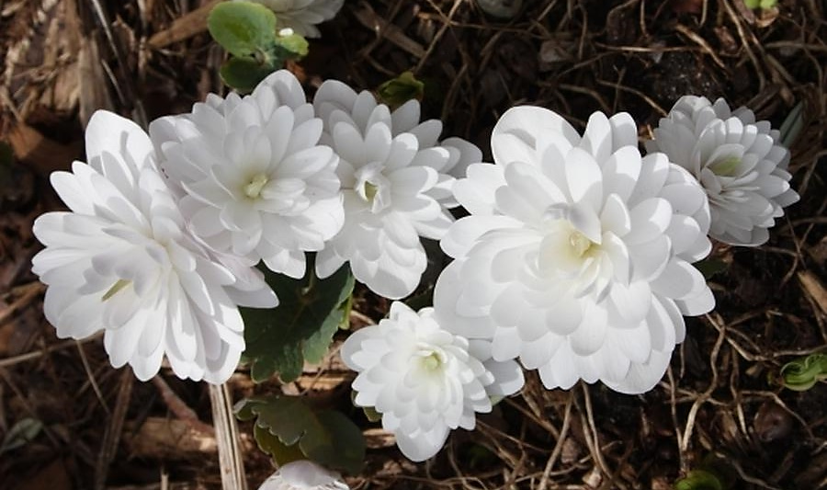
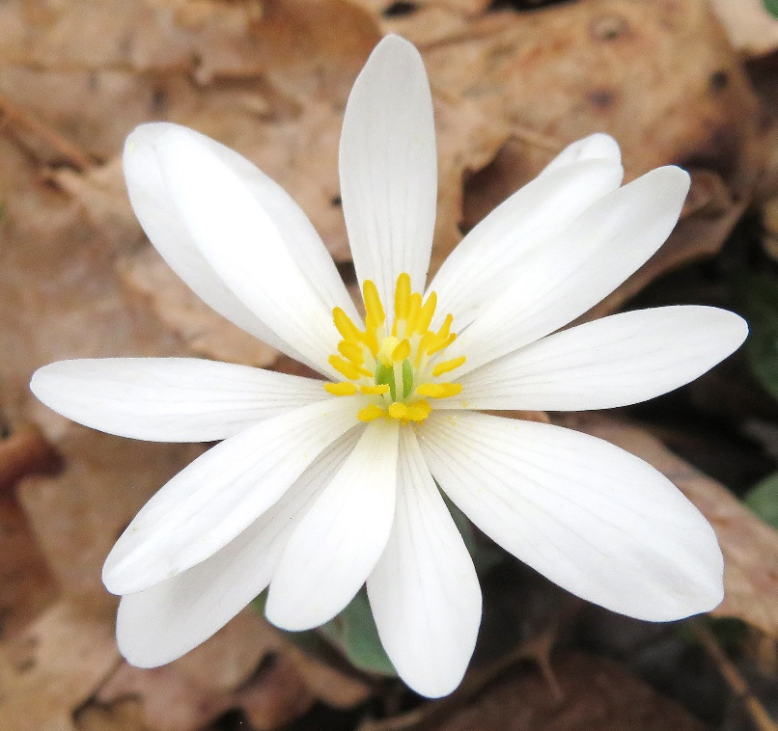
Depends on the Features Changed, Extent of Change, etc.
Other research:
Cultivars with altered flower morphology were visited by fewer pollinators or fewer species of pollinators than the wild-type plants. In some cases, the change in morphology reduced nectar secretion.
Sterile cultivars have fewer seed-feeding insects.
Selections with strong foliar colors, esp. purple, have fewer leaf-feeding insects.
Bloodroot, Sanguinaria canadensis
Sanguinaria canadensis ‘Mulitplex’
JLBG @ Juniper Level Botanic Gdn, NC
Notes:
Other researchers observed that cultivars with altered flower morphology were visited by fewer pollinators or fewer species of pollinators than the wild-type plants. A typical example is selection with multiple petals, such as the one shown here. Bloodroot, Sanguinaria canadensis is a woodland perennial; the wild species has fertile flowers with 8 -10 white petals and yellow stamens. A genetic mutation that caused all of the stamens to become petals resulted in a modified flower morphology. These doubled flowers resemble miniature, doubled peonies and are favored among gardeners who know them as Sanguinaria canadensis ‘Multiplex.’ The flowers are sterile and not only lack nectar but also restrict pollinator access to nectaries inside the bloom. Such change in morphology often results in reduced nectar secretion. For the cases in which nectar secretion was unaffected, it is speculated that reduced accessibility caused the observed reduction in pollinator visits. In either case, fewer insects were supported by cultivars because the insect’s food source was unavailable. Similarly, fewer seed-feeding insects were found on sterile cultivars because their food resource was absent.

Slide 12
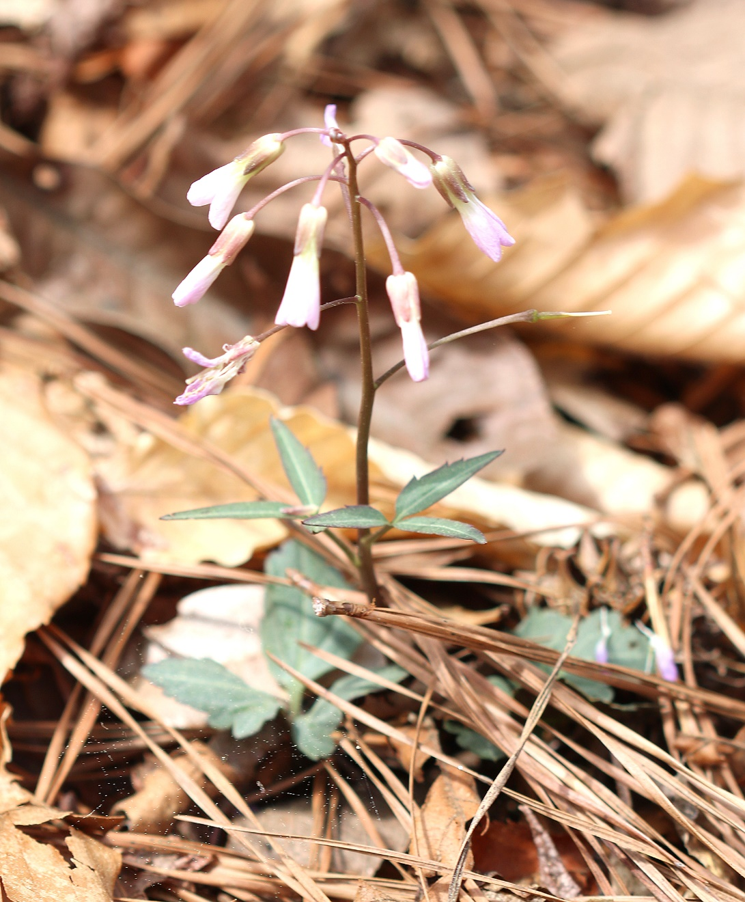
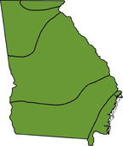
Native Perennials
Notes:
The following is a list of native perennials which are suitable for growing all across Georgia and are easy to grow.

Slide 13
Wideleaf Blue Star, Eastern Blue Star
Characteristics: Compact, clump-forming plant with narrow, lustrous green leaves that radiate around stem.
Leaves turn yellow-gold in fall.
From spring to early summer, blue, star-shaped flowers, ½ in across are borne in loose clusters at stem tips.
Culture:
Well-drained soil & full sun to partial shade
Cut back plants after flowering to encourage compact growth.
Deer do not like the milky sap.
Size: 2 to 3 feet tall & 2 to 3 feet wide
Habitat: Rich hardwood forests, floodplains & stream banks.
Amsonia tabernaemontana
Notes:
Wideleaf Blue Star, also Eastern Blue Star, is a compact clump-forming plant with narrow, lustrous green leaves that radiate around the stem. Leaf shape is variable, ranging from ovate to lanceolate. Leaves turn yellow-gold in fall. From spring to early summer, blue, star-shaped flowers, ½ inch across, are borne in loose clusters at stem tips. The petals have fine hairs along their margins. This is a low-maintenance perennial for perennial borders or containers. Wideleaf Blue Star is easy to grow in well-drained soil and full sun to partial shade. It may grow leggy in shaded areas. It is drought tolerant once established. Cut back plants after flowering to encourage compact growth. Deer do not like the milky sap.
Size: 2 to 3 feet tall and 2 to 3 feet wide
Habitat: Rich hardwood forests, floodplains and stream banks

Slide 14
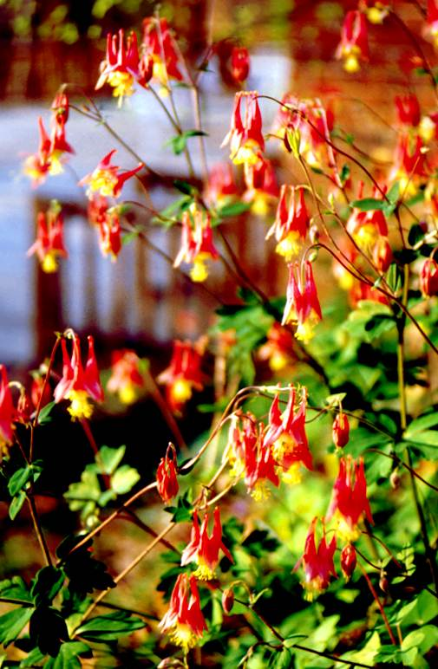
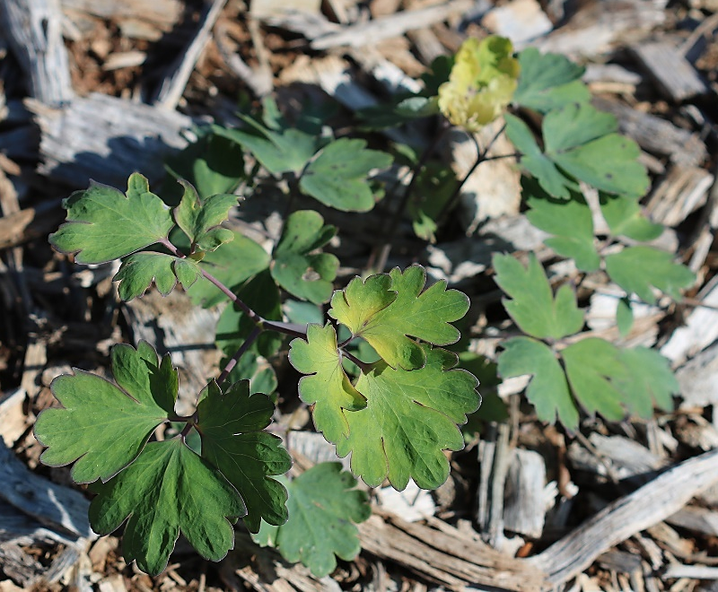
Eastern Columbine
Characteristics: Erect, branching plant.
Leaves have 3 round lobes.
Delicate red & yellow bell-like nodding flowers with spurred petals are produced on branch terminals in early spring & remain for about 6 weeks.
Culture:.
full sun to partial shade
slightly alkaline well-drained soils
Prune after flowering to discourage re-seeding & reduce leaf miner problems.
Size: 2 to 3 feet tall & 1 to 1 ½ feet wide.
Habitat: Calcareous or mafic woods & nutrient-rich rocky slopes.
Aquilegia canadensis
Notes:
Eastern Columbine is an erect, branching plant. Leaves have three round lobes. Delicate red and yellow bell-like nodding flowers with spurred petals are produced on branch terminals in early spring and remain for about six weeks. Use Eastern Columbine in wildflower meadows, butterfly and hummingbird gardens or in woodlands having filtered shade. This plant is easy-to-grow in full sun to partial shade. It prefers slightly alkaline soils that are well drained. The plant tends to re-seed readily and establish expanding colonies. Pruning after flowering will discourage re-seeding and will help avoid leaf miner problems.
Size: 2 to 3 feet tall and 1 to 1½ feet wide
Habitat: Calcareous or mafic woods and nutrient-rich rocky slopes

Slide 15
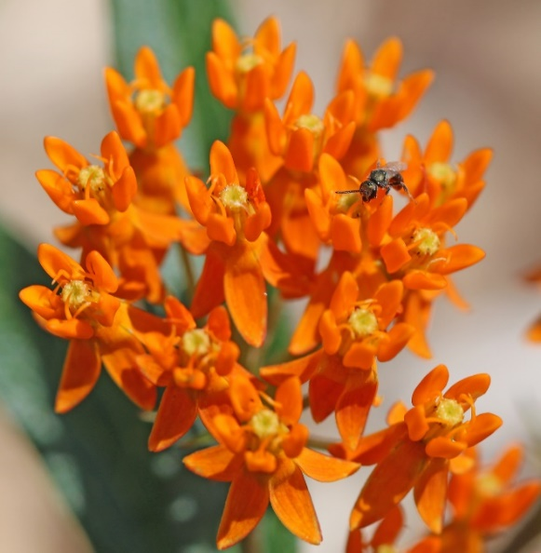
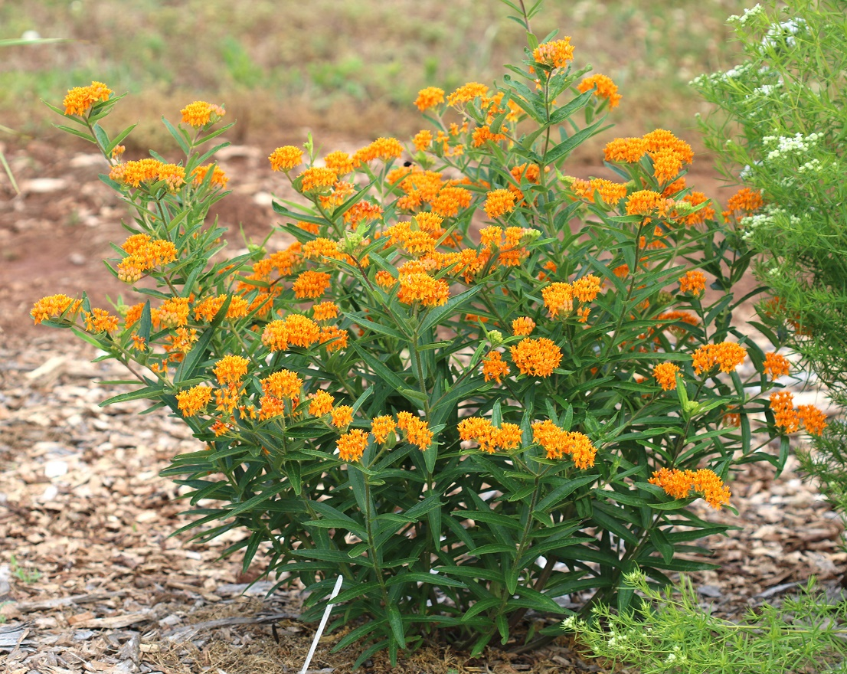
Butterfly Weed, Butterfly Milkweed
Characteristics: Bushy plant w/ several flowering branches emerging from a single crown.
Leaves alternate, lance-shaped, 1 ½ to 2 ¼ in long, w/ pointed ends & smooth margins.
Stems are hairy & sap is clear.
In late spring through summer, many small, bright orange flowers borne in clusters, 2 to 5 in across, on stem terminals.
Seeds are borne in spindle-shaped pods that are 3 to 6 in long.
Culture:
full sun & well-drained soil
remove aphid infestations w/ water stream
Size: 1 to 2 feet high & 1 to 2 feet wide
Habitat: Dry open woods, fields & roadsides.
Asclepias tuberosa
Notes:
Butterfly Weed is a bushy plant having several flowering branches emerging from a single crown. Leaves are alternate, lance-shaped, 1½ to 2¼ inches long, with pointed ends and smooth margins. Stems are hairy and the sap is clear. In late spring through summer, many small, bright orange flowers are borne in clusters, 2 to 5 inches across, on stem terminals. Seeds are borne in spindle-shaped pods that are 3 to 6 inches long. The pods split in late winter and the silky-haired seeds float to new locations. This plant is an excellent addition to butterfly gardens, native plant gardens, rock gardens and wildflower meadows. Butterfly Weed is easy to grow. It prefers full sun and well-drained soil. Once established, it is drought tolerant. It is difficult to transplant established plants from the wild, so it is best to plant container-grown plants. Milkweeds tend to get infested with aphid; remove them regularly with strong stream of water.
Size: 1 to 2 feet high and 1 to 2 feet wide
Habitat: Dry open woods, fields and roadsides

Slide 16
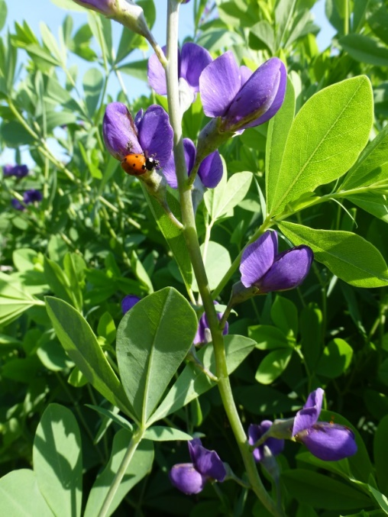
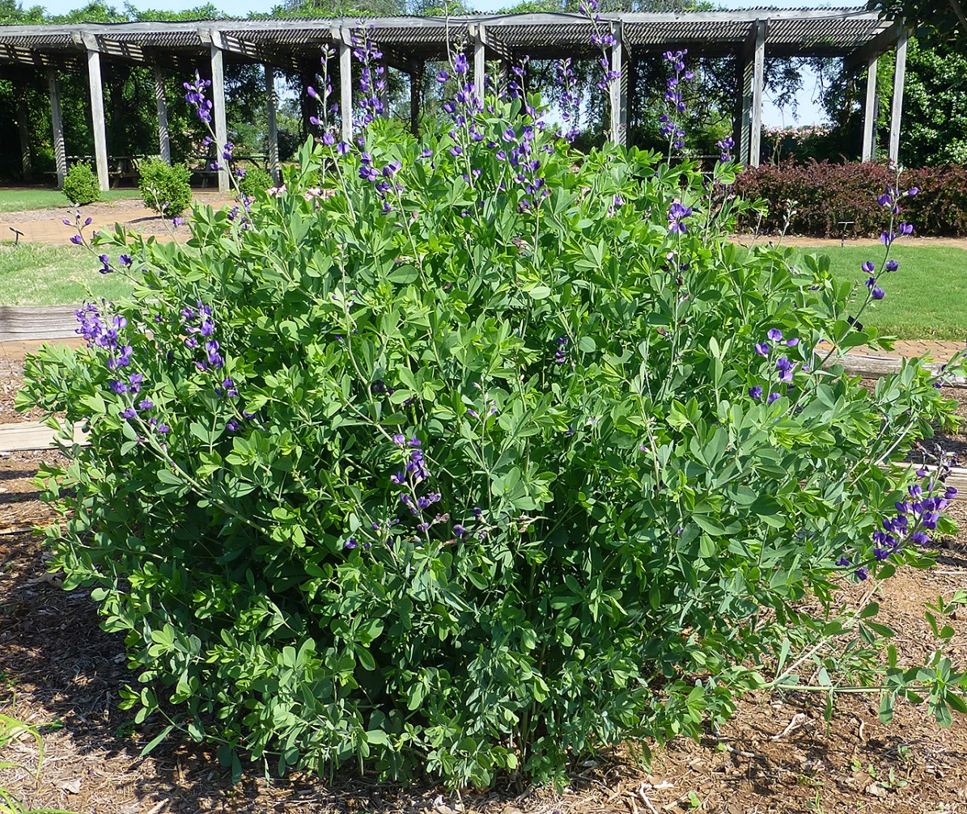
Blue Wild Indigo
Characteristics: Bushy, upright plant with clover-like leaves having 3 bluish-green leaflets up to 2 in long.
Purple, pea-like blooms appear in spring in dense terminal racemes, 4 to 16 in long, above foliage.
Culture:
full sun to partial shade & slightly moist to dry soil
Cutting plants back after flowering promotes more compact growth & prevents self-seeding.
Size: 3 to 4 feet tall & 3 to 4 feet wide.
Habitat: Riverbanks, gravel bars & open meadows.
Baptisia australis
Notes:
Blue Wild Indigo is a bushy, upright plant with clover-like leaves having three bluish-green leaflets up to 2 inches long. Purple pea-like blooms appear in spring in dense terminal racemes, 4 to 16 inches long, above the foliage. Charcoal black seed pods, up to 2½ inches long, rattle when dry. Use Blue Wild Indigo in wildflower meadows, butterfly gardens and perennial borders. Blue Wild Indigo is easy to grow. It prefers full sun to partial shade and slightly moist to dry soil. Once established, it is drought tolerant and low maintenance. Cutting plants back after flowering promotes more compact growth and prevents self-seeding; however, it also prevents the formation of seed pods, which are an attractive feature of the plants.
Size: 3 to 4 feet tall and 3 to 4 feet wide
Habitat: Riverbanks, gravel bars and open meadows

Slide 17
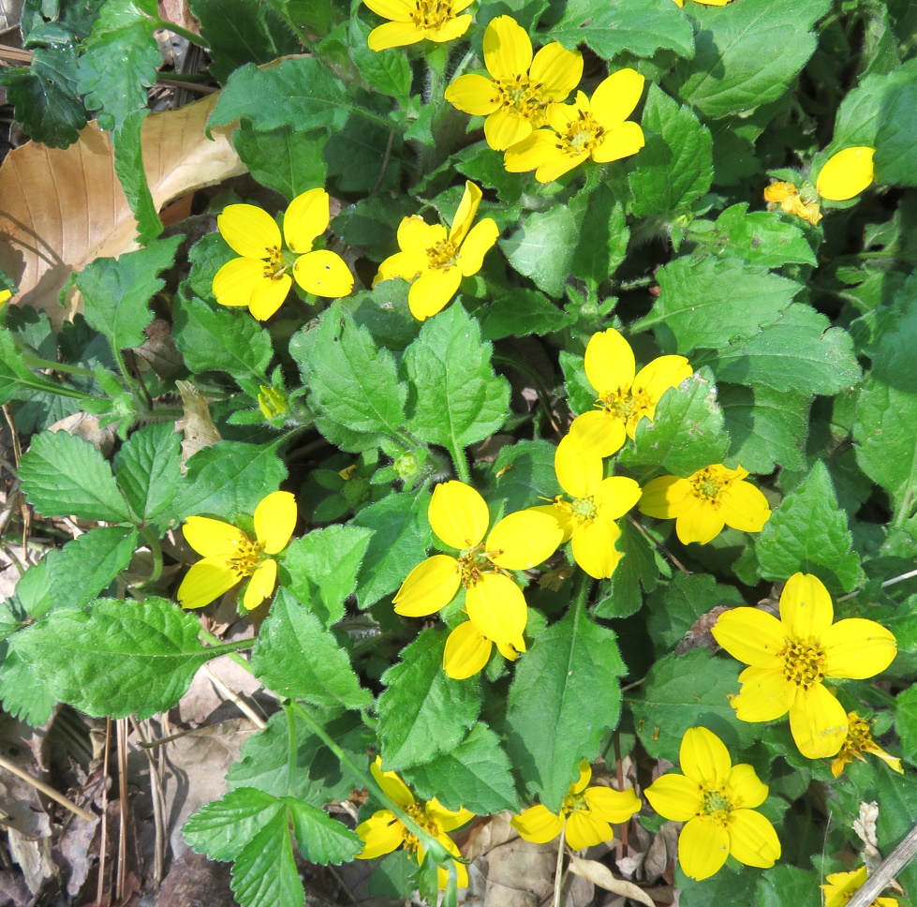
Green-and-gold
Characteristics: Low-growing, semi-evergreen, groundcover.
Leaves oval, toothed, hairy & up to 3 in long.
In May, bright yellow star-shaped flowers, 1 ½ in across, arise from upper leaf axils.
Each flower head has 5 yellow, rounded, notched, ray petals surrounding a central disk of tiny yellow flowers.
Profuse spring bloom followed by sparse flowering through October.
Culture:
Prefers sun to partial shade & moist, well-drained soil high in organic matter.
Size: 6 to 9 in tall & 15 to 18 in wide
Habitat: Moist woodlands.
Chrysogonum virginianum
Notes:
Green-and-Gold is a low-growing, semievergreen, herbaceous perennial groundcover. Leaves are oval, toothed, hairy and up to 3 inches long. They hug the ground. In May, bright yellow star-shaped flowers, approximately 1½ inch across, arise from the upper leaf axils. Each flower head has five yellow, rounded, notched ray petals surrounding a central disk of tiny yellow flowers. A profuse spring bloom is followed by sparse flowering through October. The plant spreads by stolons (above-ground stems that creep along the ground).
Landscape Uses: Use this plant as a groundcover in moist woodland gardens or naturalized areas. Green-and-Gold prefers sun to partial shade and moist, well-drained soil high in organic matter.
Size: 6 to 9 inches tall and 15 to 18 inches wide
Habitat: Moist woodlands

Slide 18
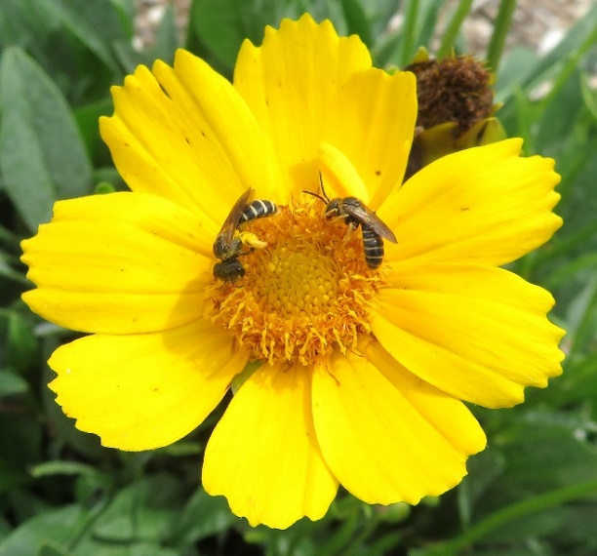
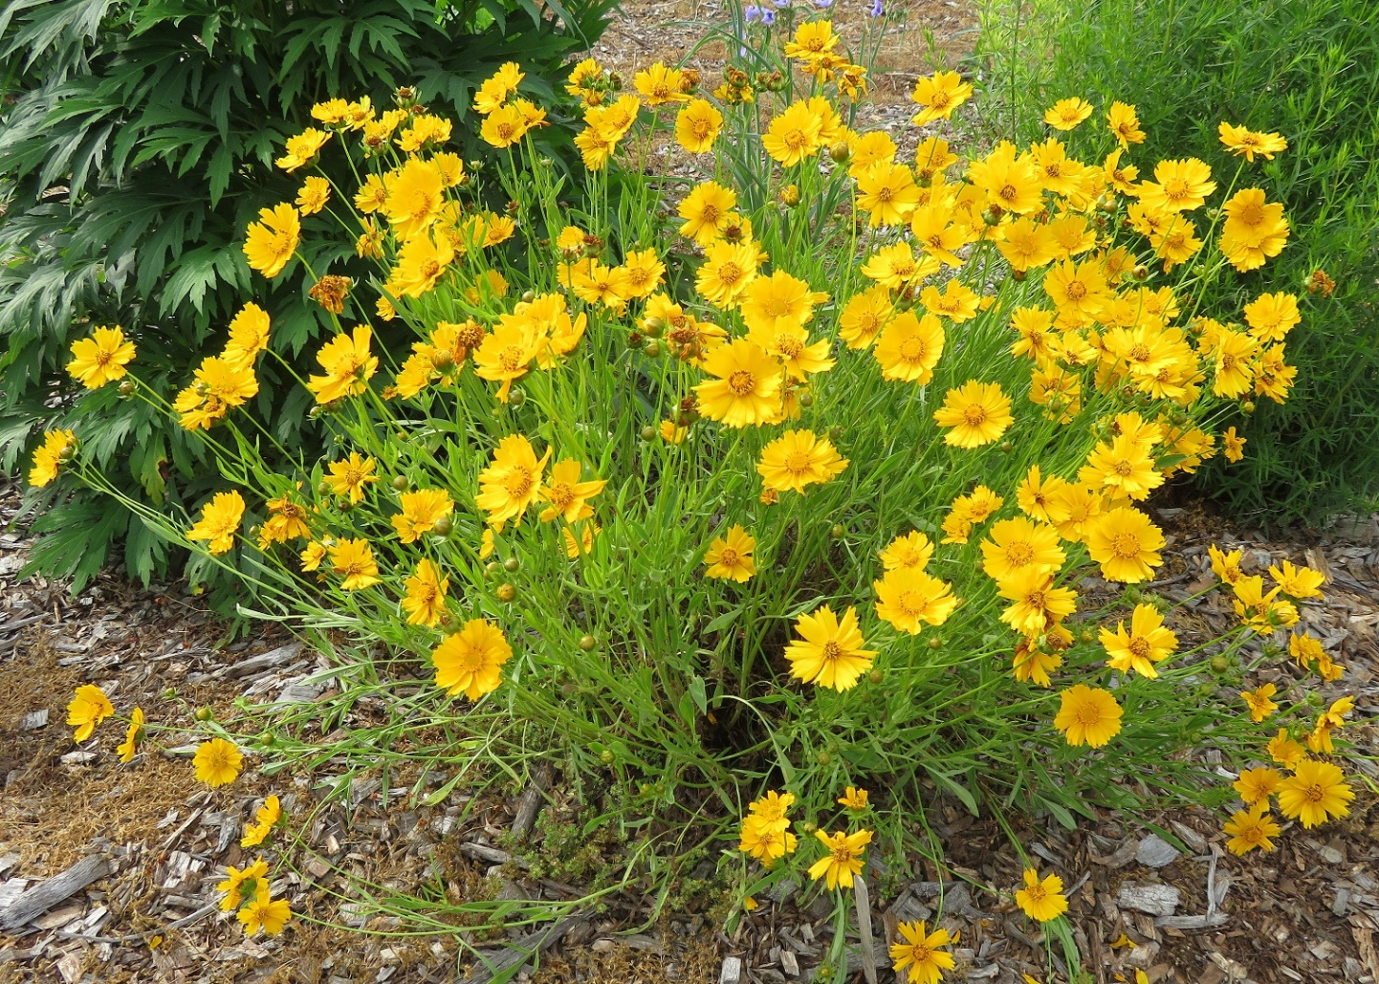
Large-flowered Coreopsis
Characteristics: Dark green lance-shaped leaflets, up to 4 in long & 1 in wide, are borne on wiry stems.
From mid-June to October, daisy-like yellow flower heads, 2 to 3 in across, are borne on long terminal stalks.
Ray flowers w/ notched tips surround a central disk of tiny golden flowers.
Coreopsis grandiflora
Culture:
Tolerates intense heat & dry sites.
Prefers full sun to partial shade & well-drained soil.
Cut back when frost damages its foliage.
Size: 6 to 12 in tall & 6 to 12 in wide.
Habitat: Dry sandy soil, open rocky upland forests, granite flatrocks.
Coreopsis grandiflora
Notes:
Large-flowered Coreopsis has dark green lance-shaped leaflets, up to 4 inches long and 1 inch wide, are borne on wiry stems. From mid-June to October, daisy-like yellow flower heads, 2 to 3 inches across, are borne on long terminal stalks. Ray flowers with notched tips surround a central disk of tiny golden yellow flowers. This is a tough garden plant. It tolerates intense heat and dry sites and is a good plant for naturalizing along roadsides and in meadows. Large-flowered Coreopsis prefers full sun to partial shade and well-drained soil. Cut the plant back when frost damages its foliage.
Size: 6 to 12 inches tall and 6 to 12 inches wide
Habitat: Dry sandy soil, open rocky upland forests, granite flatrocks and roadsides

Slide 19
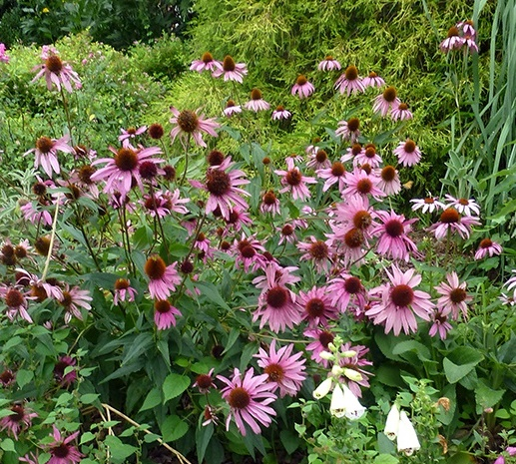
Purple Coneflower
Characteristics: Leaves are dark green, lance-shaped, alternate, hairy & coarsely toothed along their margins.
Echinacea purpurea
From late spring to early summer, flower heads, 2 to 3 in across, borne on stalks rising 2 to 4 feet.
Ray flowers, pink, disk flowers dark purple
Culture:
Easy to grow almost anywhere, except in wetlands.
Prefers full sun to light shade.
Powdery mildew may be a problem in moist, shady sites
Divide clumps every 3 to 4 years.
Size: 2 to 4 feet tall & spreading.
Habitat: Dry to slightly moist areas in full sun or light shade.
Notes:
Purple Coneflower has dark green leaves, lance-shaped, alternate, hairy and coarsely toothed along their margins. From late spring to early summer, flower heads, 2 to 3 inches across, are borne on stalks rising 2 to 4 feet. The ray flowers are pink and the disk flowers are dark. Use Purple Coneflower in perennial beds, meadows or at woodland edges. It is a very adaptable plant. This is an easy plant to grow almost anywhere, except in wetlands. It prefers full sun to light shade. Powdery mildew may be a problem when it is grown in moist, shady sites. Dividing clumps every three to four years will invigorate the plant.
Size: 2 to 4 feet tall and spreading
Habitat: Dry to slightly moist areas in full sun or light shade

Slide 20
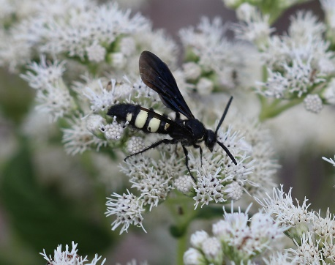
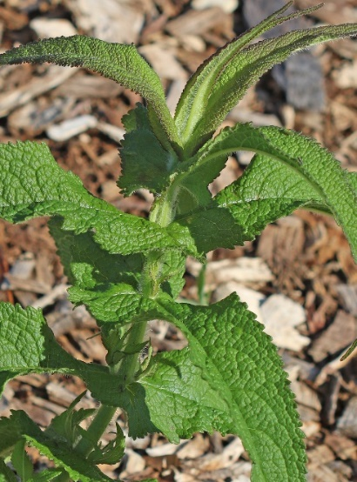
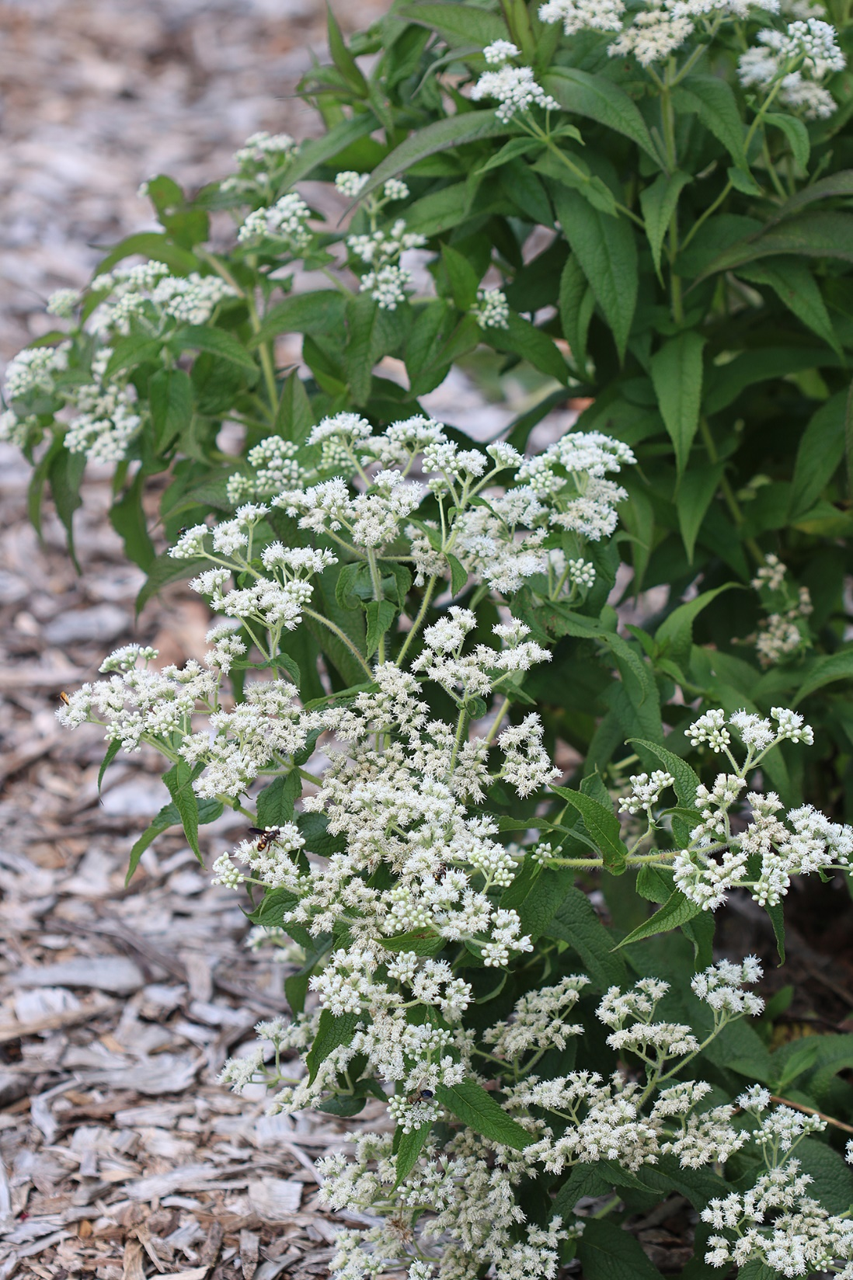
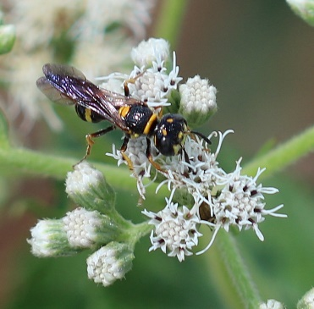
American Boneset
Characteristics: Pairs of opposite, lance-shaped, wrinkled, light green leaves are joined directly to stem (sessile).
Leaves look as though stem has pierced through them; stems are hairy.
Flat-topped clusters of small white flower heads appear above foliage from August to September.
Culture:
Grows best in moist soil & sunny to partially shaded areas.
Does well in both clay & sandy soils.
Pinch back shoots periodically to encourage branching & a stockier plant.
Size: 3 to 5 feet tall.
Habitat: Marshes, swamps, open moist meadows & ditches.
Eupatorium perfoliatum
Notes:
American Boneset bears pairs of opposite, lance-shaped, wrinkled, light green leaves are joined directly to the stem (sessile). They look as though the stem has pierced through them. Stems are hairy. Flat-topped clusters of small white flower heads appear above the foliage from August to September. This plant attracts butterflies and a large variety of other insects. Since it gets tall, use it as a background plant in a perennial border. American Boneset grows best in moist soil and sunny to partially shaded areas. It does well in both clay and sandy soils. Pinch back the shoots periodically to encourage branching and a stockier plant. It has strong stems that don’t need staking.
Size: 3 to 5 feet tall
Habitat: Marshes, swamps, open moist meadows and ditches

Slide 21
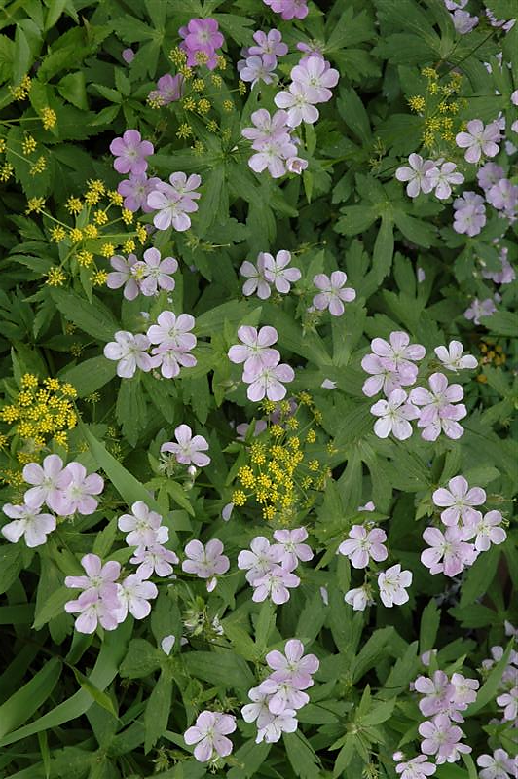
Wild Geranium, Cranesbill Geranium
Characteristics: Mottled, medium green leaves, up to 6 in across, have finger-like lobes with toothed margins.
Flowers emerge in spring on long stalks rising above leaves.
Flowers are pink to lilac, 1 ¼ in across & saucer-shaped, with 5 upward-curving petals.
Culture:
Easy to grow in average, well-drained soil & full sun to partial shade.
Moisture is essential, especially in early spring.
Deadhead for repeat bloom.
Size: 12 to 24 in tall & 18 in wide.
Habitat: Rich, moist hardwood forests & shaded roadsides.
Geranium maculatum
Notes:
Wild Geranium, also known as Cranesbill Geranium has mottled, medium green leaves, up to 6 inches across, and finger-like lobes with toothed margins. Flowers emerge in spring on long stalks rising above the leaves. Flowers are pink to lilac, 1¼ inches across and saucer-shaped, with five upward-curving petals. In the fall, the leaves turn shades of red and persist throughout the winter. Seeds are borne in beaked capsules (hence the name Cranesbill). Wild Geranium is a beautiful addition to a woodland garden or perennial border. Wild Geranium is easy to grow in average, well-drained soil and full sun to partial shade. Moisture is essential, especially in early spring. Deadheading will encourage repeat bloom.
Size: 12 to 24 inches tall and 18 inches wide
Habitat: Rich, moist hardwood forests and shaded roadsides

Slide 22
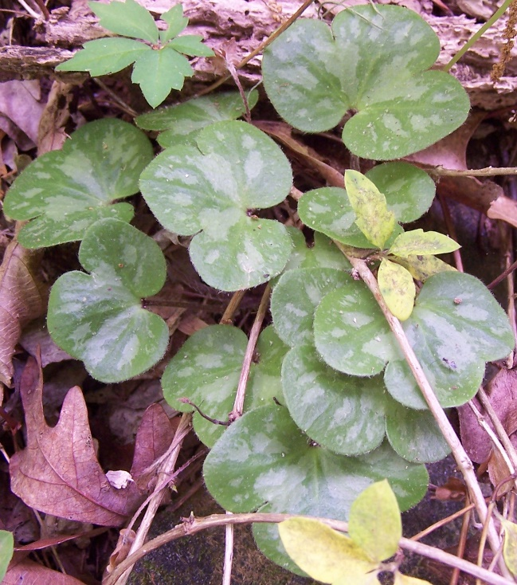
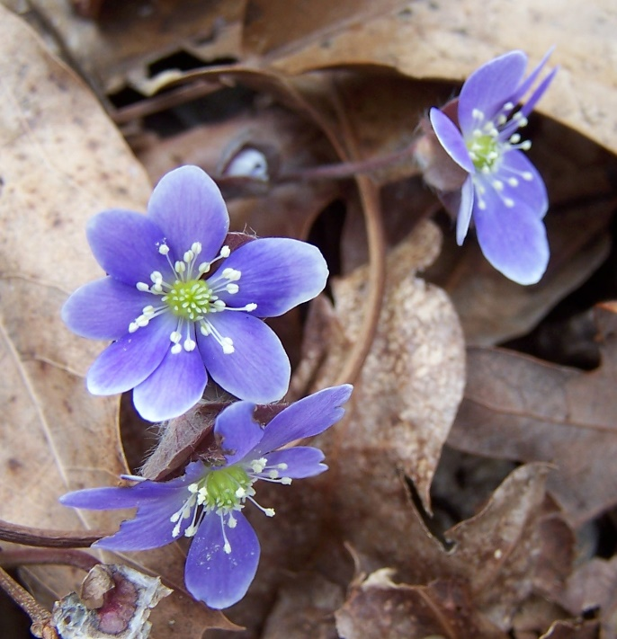
Hepatica, Liverleaf Hepatica
Characteristics: Leaves are basal & heart-shaped with 3 lobes.
Some may have speckled leaves, while others have leaves that are maroon on their undersides.
In March or April numerous hairy flower stalks, 4 to 6 in long, rise above foliage, each bearing a single saucer-shaped bloom composed of 5 to 7 petal-like sepals.
Flower color ranges from blue to lavender, shades of pink or white.
Culture: Plant in small drifts in shaded, moist woodlands, stream banks or shaded rock gardens.
Prefers moist, organic soils & partial shade.
Size: 4 to 6 in tall & wide.
Habitat: Nutrient-rich hardwood forests.
Hepatica americana
Notes:
Hepatica, or Liverleaf Hepatica, bears basal and heart-shaped leaves with three lobes. Some plants may have speckled leaves, while others have leaves that are maroon on their undersides. In March or April numerous hairy flower stalks, 4 to 6 inches long, rise above the foliage, each bearing a single saucer-shaped bloom composed of five to seven petal-like sepals. Occasionally double flower forms are found having up to 20 sepals. Flower color ranges from blue to lavender, shades of pink or white. A mature clump can produce 20 to 30 flowering stalks. When the sepals fall, new leaves emerge. The leaves are bright shiny green as they unfurl, turn dark green as they mature, then become dark brown in the fall. Seeds bear nutrient-rich appendages that attract ants. The ants carry the seeds back to their nests where they germinate and establish new colonies. Plant Hepatica in small drifts in shaded, moist woodlands, stream banks or shaded rock gardens. Hepatica prefers moist, organic soils and partial shade.
Size: 4 to 6 inches tall and wide Habitat: Nutrient-rich hardwood forests

Slide 23
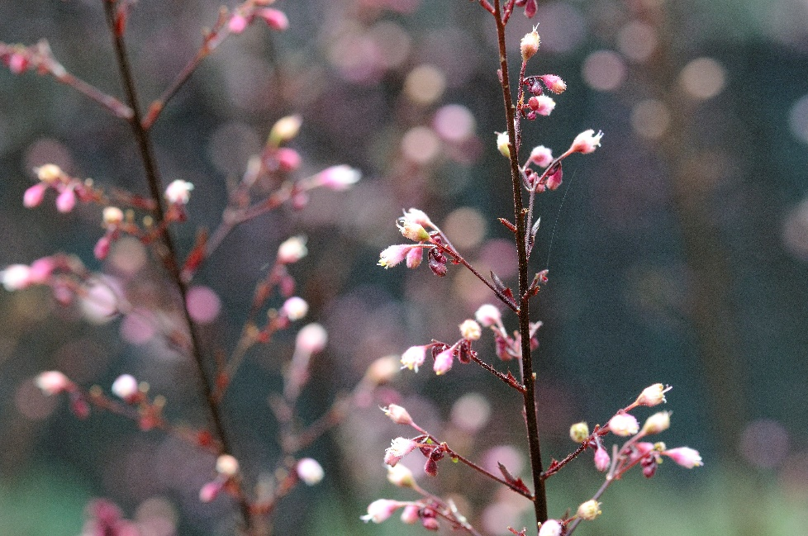
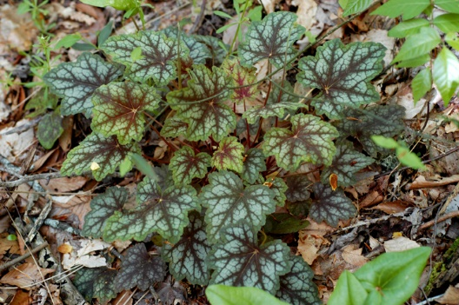
Coral Bells, Alumroot
Characteristics: Basal rosette of evergreen heart-shaped leaves.
Each leaf is 3 to 5 in wide & has 5 to 7 lobes.
New leaves emerge purplish-brown, then turn green.
Leaf venation is silver or rose-purple.
A flowering stem emerges in early spring & rises 18 to 24 in above plant.
Heuchera americana
Culture: Use in shaded areas of perennial borders, rock gardens or woodlands.
Plant in well-drained soil high in organic matter.
Prefers shade or partial shade (morning sun).
Deadhead to encourage repeat blooms.
Size: 1 to 2 ½ feet tall & 1 to 1 ½ feet wide.
Habitat: Drainage slopes of rich woods, dry woods & rocky areas.
Notes:
Coral Bells, or Alumroot bears a basal rosette of evergreen heart-shaped leaves. Each leaf is 3 to 5 inches wide and has five to seven lobes. New leaves emerge purplish-brown, then they turn green. Leaf venation is silver or rose-purple. A flowering stem emerges in early spring and rises 18 to 24 inches above the plant. It bears panicles of small, inconspicuous, bell-shaped flowers that range in color from pale yellow to purple. The orange-tipped stamens are the most noticeable part of the flower. Use Coral Bells in shaded areas of perennial borders, rock gardens or woodlands. Since its leaves are evergreen, it looks good year-round. Plant Coral Bells in well-drained soil that is high in organic matter. It prefers shade or partial shade (morning sun). Deadheading encourages repeat blooms.
Size: 1 to 2½ feet tall and 1 to 1½ feet wide
Habitat: Drainage slopes of rich woods, dry woods and rocky areas

Slide 24
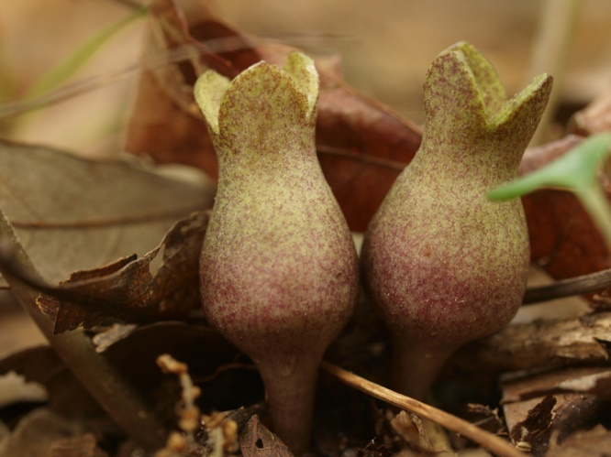
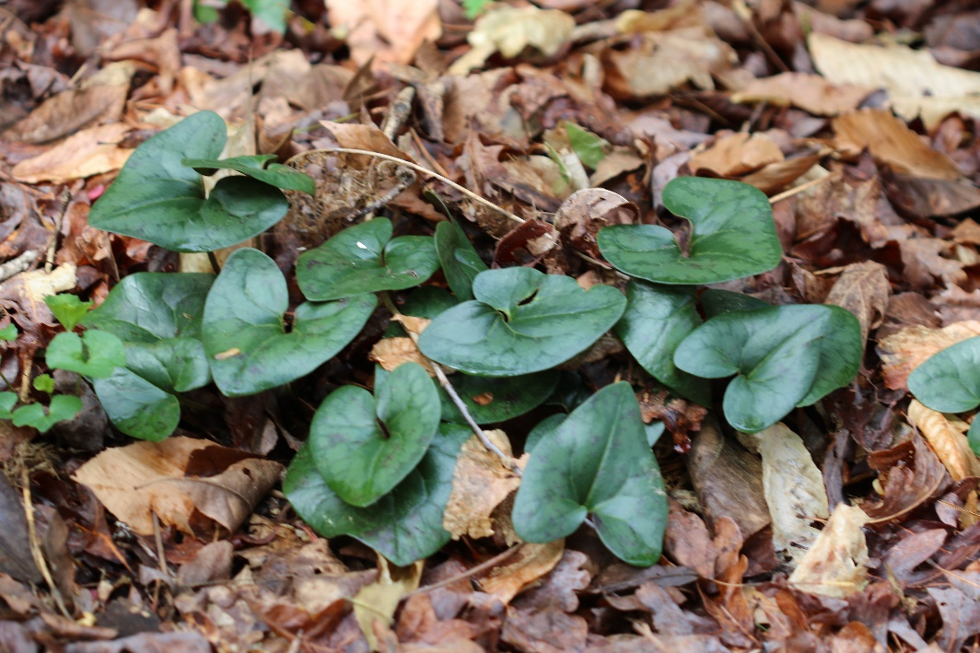
Little Brown Jug, Evergreen Wild Ginger
Characteristics: Shiny, thick, heart-shaped evergreen leaves, 3 to 6 in long, are borne at ground level.
Leaves are dark green with pale green splotches in spring & summer, then they turn bronze in winter.
Reddish-brown flowers appear in April & May at ground level; no petals & are actually composed of thick, fleshy, fused sepals shaped like little brown jugs.
Hexastylis arifolia
Culture: Use in shaded woodland gardens.
In a natural setting, only 2 or 3 leaves may be seen, but under cultivation, it forms large clumps of basal foliage.
Shade-tolerant, but prefers partial shade.
Will adapt to both moist & dry soils.
Size: 3 to 6 in tall.
Habitat: Mixed deciduous or pine forests.
Notes:
Little Brown Jug, also Evergreen Wild Ginger has shiny, thick, heart-shaped evergreen leaves, 3 to 6 inches long, are borne at ground level. They are dark green with pale green splotches in spring and summer, turning bronze in winter. Reddish-brown flowers appear in April and May at ground level. They are inconspicuous and often hidden in the leaf litter. They have no petals and are actually composed of thick, fleshy, fused sepals shaped like little brown jugs. Rhizomes spread slowly. Use Little Brown Jug in shaded woodland gardens. Since the leaves are evergreen, the plant looks nice year-round. In a natural setting, only 2 or 3 leaves may be seen, but under cultivation, the plant forms large clumps of basal foliage. It is shade-tolerant but prefers partial shade. It will adapt to both moist and dry soils. Slugs like to eat this plant.
Size: 3 to 6 inches tall
Habitat: Mixed deciduous or pine forests

Slide 25
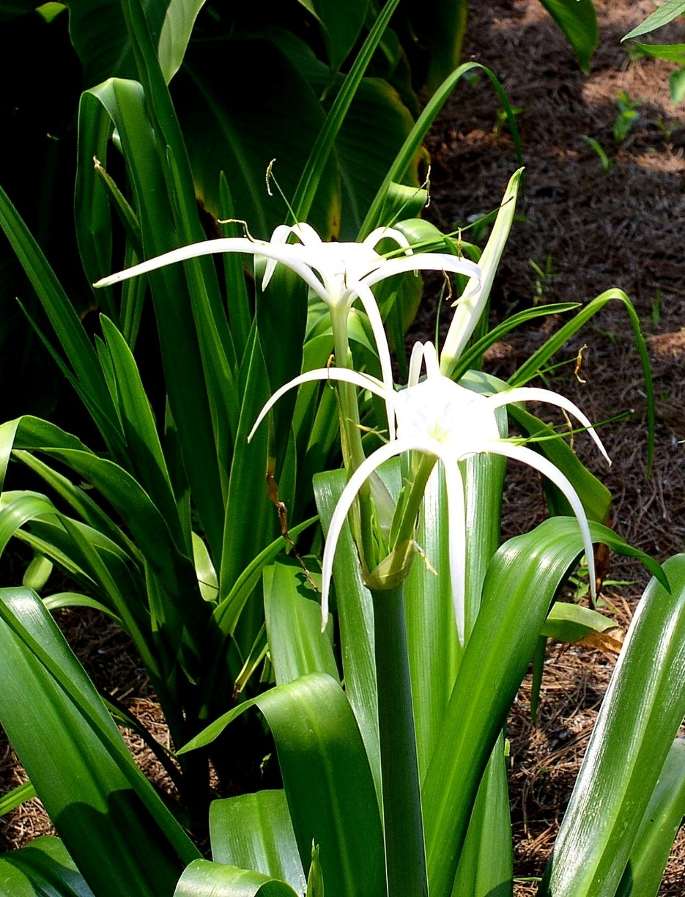
Spider Lily, Carolina Spiderlily
Characteristics: A basal clump of strap-shaped leaves, up to 17 in long, rises from a bulb.
In summer, a flowering stalk, up to 22 in tall, emerges from center of foliage & bears 3 to 6 white fragrant blossoms.
Each flower is up to 7 in across & has 6 segments & a center tubular cup.
Culture: Use in perennial borders, open woodland gardens & along streams & ponds.
Best grown in moist to wet soils in full sun or partial shade.
Allow foliage to remain after flowering to feed bulb & developing bulblets.
Size: 1 ½ to 2 ½ feet tall & 1 to 1 ½ feet wide.
Habitat: Swamps, moist fields, bottomlands & rich, moist forests.
Hymenocallis occidentalis
Notes:
Spider Lily, also Carolina Spiderlily, bears a basal clump of strap-shaped leaves, up to 17 inches long, rising from a bulb. In summer, a flowering stalk, up to 22 inches tall, emerges from the center of the foliage and bears three to six white fragrant blossoms. Each flower is up to 7 inches across and has six segments and a center tubular cup. Flowers are followed by oval seed capsules.
Landscape Uses: Use Spider Lily in perennial borders, open woodland gardens and along streams and ponds. Spider Lily is best grown in moist to wet soils in full sun or partial shade. Allow the foliage to remain after flowering to feed the bulb and developing bulblets.
Size: 1½ to 2½ feet tall and 1 to 1½ feet wide.
Habitat: Swamps, moist fields, bottomlands and rich, moist forests

Slide 26
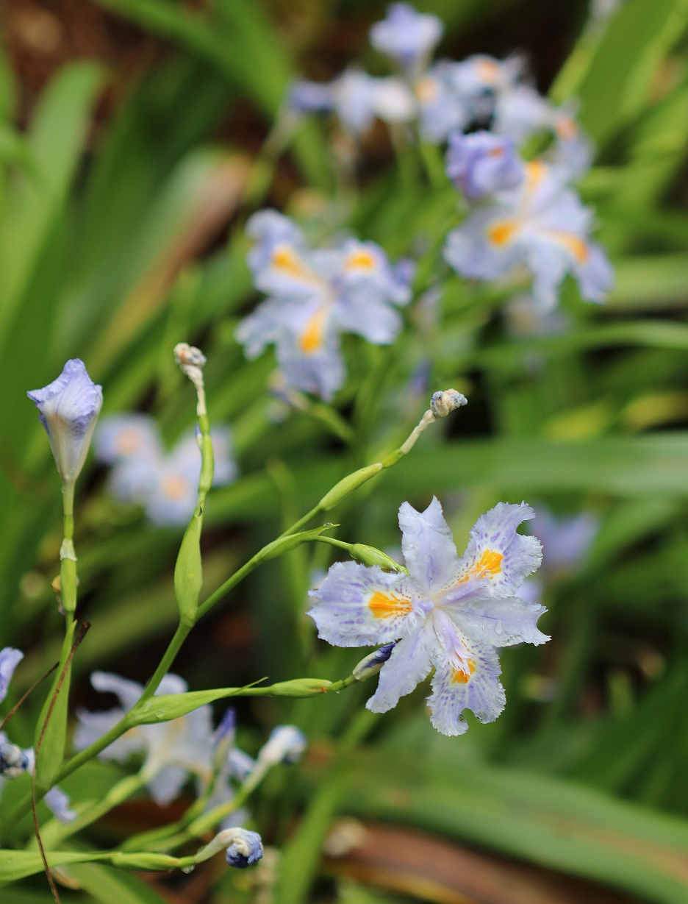
Dwarf Crested Iris
Characteristics: Low-growing, spreading plant with narrow, sword-shaped, medium-green leaves up to 6 in long & 2 in wide.
Leaves arise from branching rhizome that spreads to form colonies.
In spring, pale blue flowers w/ gold crests on short stalks.
Sepals are distinctly marked with a central band of white, yellow or purple.
Culture:
Under favorable growing conditions, plant spreads & becomes a ground cover.
Plant in sun to partial shade & moist enriched with organic matter.
Size: 6 to 12 in high & spreading.
Habitat: Moist, fertile wooded slopes & flood plains.
Iris cristata
Notes:
Dwarf Crested Iris is a low-growing, spreading plant with narrow, sword-shaped, medium-green leaves up to 6 inches long and 2 inches wide. Leaves arise from a branching rhizome that spreads to form colonies. In spring, pale blue flowers with gold crests appear on short stalks. Sepals are distinctly marked with a central band of white, yellow or purple. Seeds are produced in capsules. Plant Dwarf Crested Iris along the edges of moist shaded woodland where its diminutive size can be readily seen. Under favorable growing conditions, the plant spreads and becomes a ground cover. Plant Dwarf Crested Iris in sun to partial shade and moist soil enriched with organic matter. Divide plants when they become crowded.
Size: 6 to 12 inches high and spreading
Habitat: Moist, fertile wooded slopes and flood plains

Slide 27
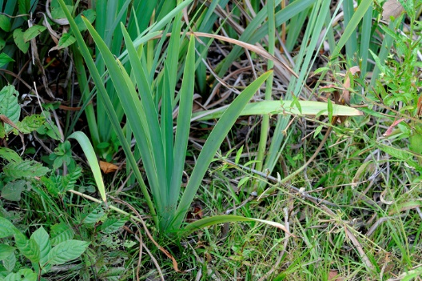
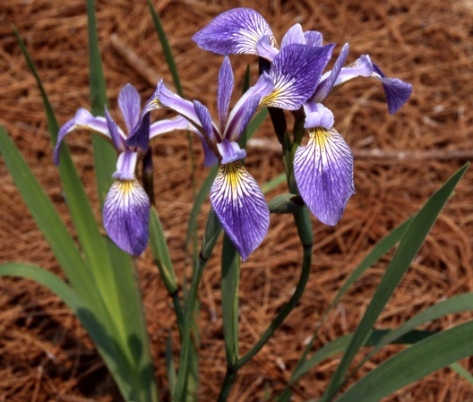
Virginia Iris, Southern Blueflag
Characteristics: Narrow sword-like leaves, 1 to 2 feet tall & 2 to 3 in wide, grow from rhizomes.
New leaves have a burgundy tinge at their bases that persists until early summer.
Flowers are borne on stalks that rise 1 to 3 feet from base of plant in spring; each stalk bears 1 to 3 flowers.
Falls are violet-blue & crests are yellow or white.
Culture: Use along edges of streams or ponds, in drainage ditches or in water gardens.
Also does well in low-lying areas that are subject to flooding.
Wetland species that likes consistent moisture.
Adapts to sun or partial shade. Spreads slowly & is not aggressive.
Size: 2 to 3 feet high.
Habitat: Marshes, wet ditches & swamps in open areas.
Iris virginica
Notes:
Virginia Iris, Southern Blueflag bears narrow sword-like leaves, 1 to 2 feet tall and 2 to 3 inches wide, which grow from rhizomes. New leaves have a burgundy tinge at their bases that persists until early summer. Flowers are borne on stalks that rise 1 to 3 feet from the base of the plant in spring. Each stalk bears one to three flowers. Falls are violet-blue and crests are yellow or white. The rhizome spreads to form colonies. Seeds are borne in capsules. Use Virginia Iris along the edges of streams or ponds, in drainage ditches or in water gardens. It also does well in low-lying areas that are subject to flooding. Virginia Iris is a wetland species that likes consistent moisture. It adapts to sun or partial shade. It spreads slowly and is not aggressive.
Size: 2 to 3 feet high
Hardiness Zones: All of Georgia

Slide 28
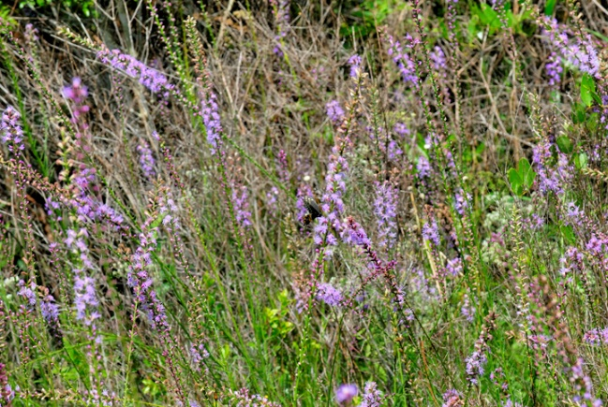
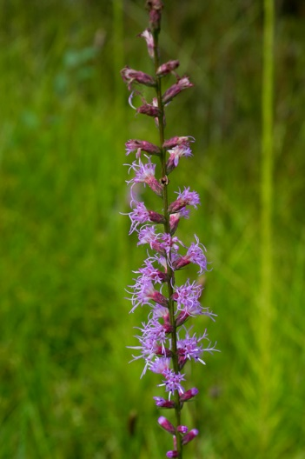
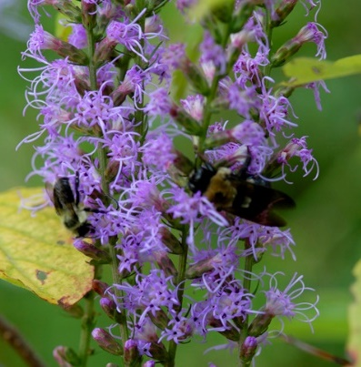
Dense Blazing Star, Marsh Blazing Star
Liatris spicata
Characteristics: Basal leaves are narrow, grass-like & up to 8 in long.
Stem leaves are shorter than basal leaves & gradually decrease in size as they ascend stem.
Flower spikes, 6 to 12 in long, appear in June.
They consist of numerous round, deep purple flower heads about ¾ in across.
Each flower head is comprised of 4 to 10 narrow tubular flowers with long, prominent branching styles.
Culture:
sun or partial shade & moist to wet soil
Too much fertilizer can result in floppy stalks.
Size: 2 to 5 feet tall, clump-forming.
Habitat: Wet meadows, mountain outcrops & marsh margins.
Notes:
Dense Blazing Star, Marsh Blazing Star, bears basal, grass-like leaves up to 8 inches long. Stem leaves are shorter than basal leaves and gradually decrease in size as they ascend the stem. Flower spikes, 6 to 12 inches long, appear in June on the tips of stems. They consist of numerous round, deep purple flower heads about ¾ inch across. Each flower head is comprised of four to 10 narrow tubular flowers with long, prominent branching styles. Use Dense Blazing Star in native plant gardens, perennial borders or cottage gardens. Dense Blazing Star is easy to grow in sun or partial shade and moist to wet soil. It needs more moisture than other Liatris. Too much fertilizer can result in floppy stalks. It tolerates heat and humidity well.
Size: 2 to 5 feet tall, clump-forming
Habitat: Wet meadows, mountain outcrops and marsh margins

Slide 29
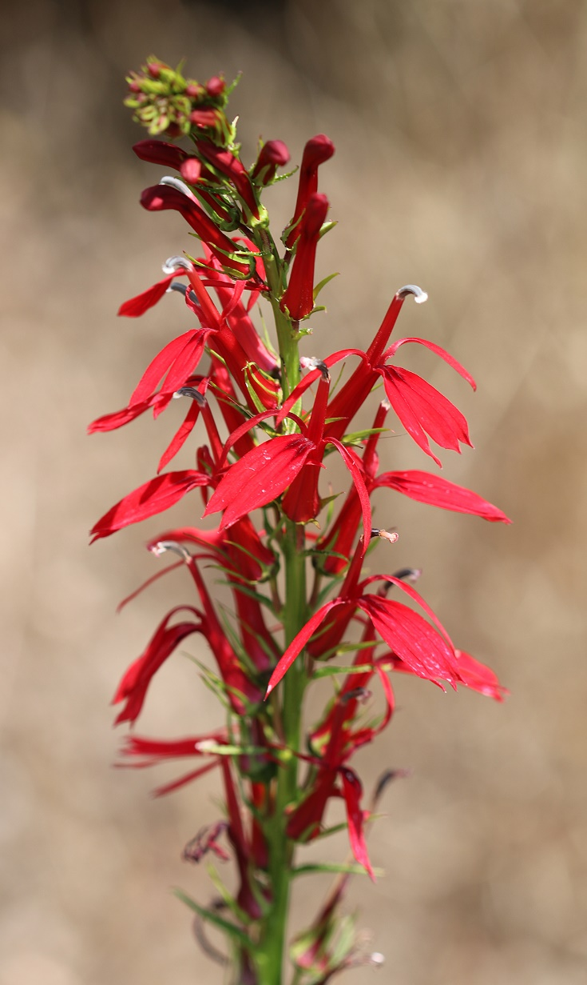
Cardinal Flower
Characteristics: Leaves are alternate & lance-shaped with toothed margins, 6 in long & 2 in wide.
Deep red flowers, about 1 in long, & are borne in racemes at top of stems in late summer.
Flowers are tubular & have two flaring lips.
Stamens are united to form an erect tube that is topped with a small tuft of white hairs.
Flowering begins in August & lasts about 3 weeks.
Culture:
Prefers morning sun & afternoon shade & moist, humus-enriched soils.
Does not like wet sites.
Size: 2 to 4 feet tall & 12 in wide.
Habitat: Moist areas, stream banks, ditches & lakeshores.
Lobelia cardinalis
Notes:
Cardinal Flower has alternate, lance-shaped leaves with toothed margins. They are 6 inches long and 2 inches wide. Lower leaves have short petioles while upper leaves lack petioles. Deep red flowers, about 1 inch long, and are borne in racemes at the top of the stems in late summer. Flowers are tubular and have two flaring lips. The stamens are united to form an erect tube that is topped with a small tuft of white hairs. Flowering begins in August and lasts about three weeks. Flowers are followed by capsules containing brown seeds.
This is a great plant for perennial borders as well as hummingbird and butterfly gardens. Cardinal Flower prefers morning sun and afternoon shade and moist, humus-enriched soils. It does not like wet sites.
Size: 2 to 4 feet tall and 12 inches wide
Habitat: Moist areas, stream banks, ditches and lakeshores

Slide 30
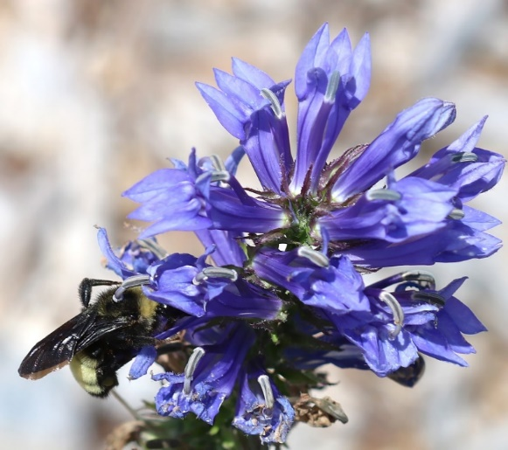
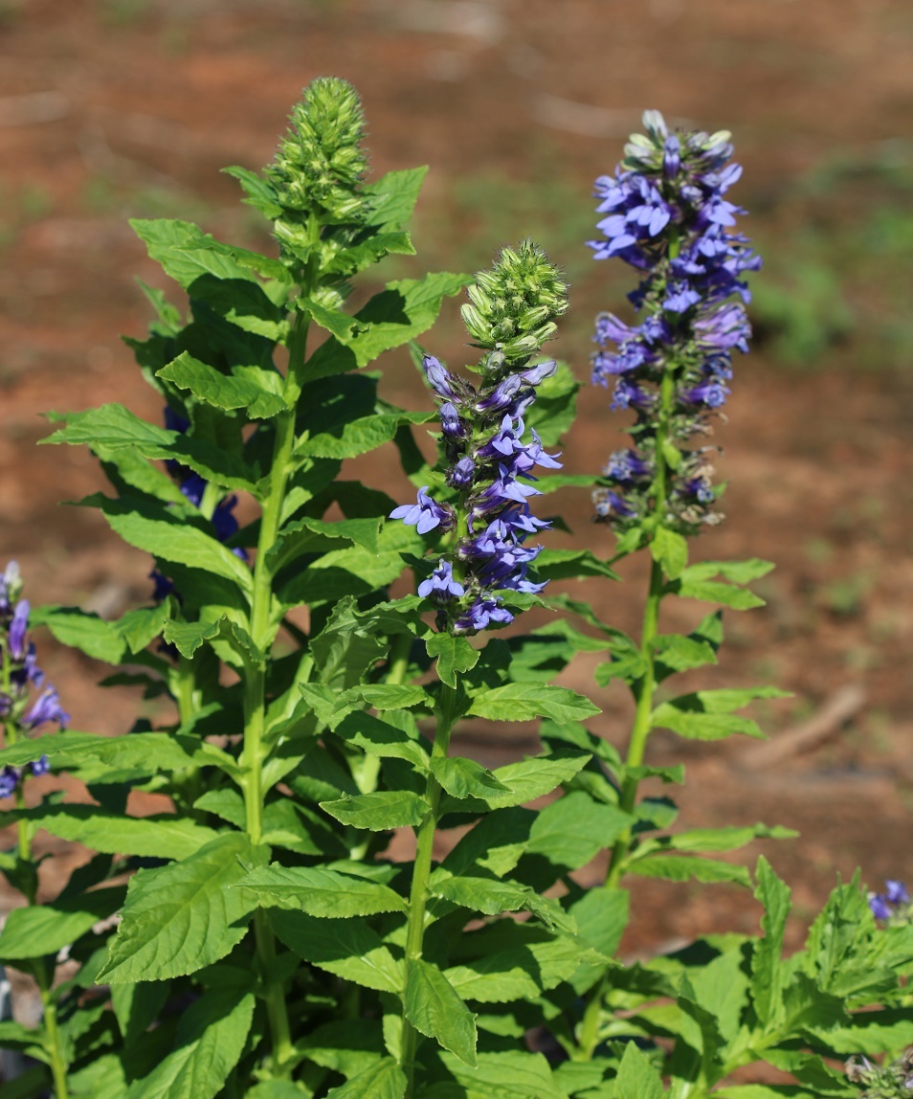
Great Blue Lobelia
Characteristics: Leaves are alternate, lance-shaped & 3 to 5 in long w/ toothed margins & square stems.
Flowers are blue, about 1 in in length, two-lipped & tubular borne in terminal racemes in August & September.
Leafy bracts are interspersed among flowers.
Culture:
Easy to grow in moist, acidic, humus-enriched soils on sites having morning sun & afternoon shade.
Needs uniform moisture for best performance.
Size: Up to 3 feet tall & 1 foot wide.
Habitat: Swamps, stream banks, roadside ditches & other wet areas.
Lobelia siphilitica
Notes:
Great Blue Lobelia bears alternate, lance-shaped leaves, 3 to 5 inches long with toothed margins. Stems are square. Flowers are blue, about 1 inch in length, two-lipped and tubular. They are borne in terminal racemes in August and September. Leafy bracts are interspersed among the flowers. Fruits are spherical capsules containing yellowish-brown seeds. Use Great Blue Lobelia in bog gardens, wet areas or hummingbird and butterfly gardens. Great Blue Lobelia is easy to grow in moist, acidic, humus-enriched soils on sites having morning sun and afternoon shade. Plants need uniform moisture for best performance.
Size: Up to 3 feet tall and 1 foot wide
Habitat: Swamps, stream banks, roadside ditches and other wet areas

Slide 31
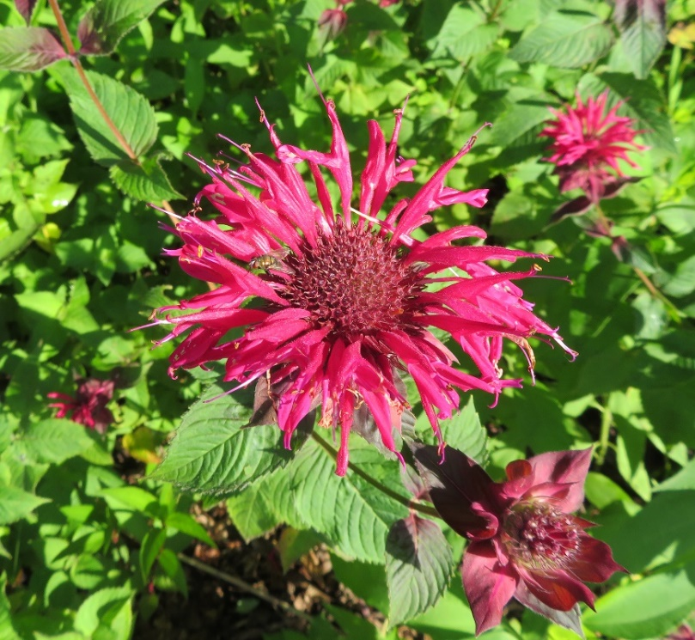
Beebalm
Characteristics: Leaves are opposite, lance-shaped, toothed & 3 to 6 in long w/ square stems.
Flower head consists of a cluster of two-lipped tubular flowers.
Flower color ranges from maroon to pale pink, violet-blue or flaming scarlet.
Flowering occurs in late summer & lasts 1 to 2 months.
Culture:
morning sun, afternoon shade & moist, fertile soil
Easy plant to grow, but can look rough in summer due to powdery mildew.
Size: 3 to 5 feet high & 1 foot wide.
Habitat: Moist mountain woods & bottomlands, stream banks & seeps
Monarda didyma
Notes:
Beebalm, also Oswego tea has opposite, lance-shaped, and toothed leaves, 3 to 6 inches long. Stems are square. The flower head consists of a cluster of two-lipped tubular flowers. Flower color ranges from maroon to pale pink, violet-blue or flaming scarlet. Two stamens and the style protrude from each flower. Flowering occurs in late summer and lasts one to two months. Fruit are small brown oval nutlets. Spreading rhizomes help the plant colonize an area. Use Beebalm in perennial borders, wildflower gardens, herb gardens, butterfly and hummingbird gardens or woodland gardens. Beebalm prefers morning sun, afternoon shade and moist, fertile soil. It is an easy plant to grow, but it can look rough in summer due to its susceptibility to powdery mildew, a disease that turns the foliage white, then brown. Provide good air circulation between plants to discourage powdery mildew problems.
Size: 3 to 5 feet high and 1 foot wide
Habitat: Moist mountain woods and bottomlands, stream banks and seeps

Slide 32
Appalachian Bergamot
Monarda fistulosa
Characteristics: Leaves are opposite, oblong, toothed along their margins & 2 to 4 in long w/ square stems.
In summer, clusters of lavender two-lipped tubular flowers are borne in dense heads, 1 to 2 in across, on the tips of stems.
Each flower head is subtended by a whorl of pale-pink leafy bracts.
Culture:
Prefers moist, well-drained soil & full sun to partial shade.
Good air circulation between plants to discourage powdery mildew.
Size: 2 to 4 feet tall, 1 foot wide & spreading.
Habitat: Dry clearings, roadsides & woodland edges
Notes:
Appalachian Bergamot bears opposite, oblong leaves, toothed along their margins, and 2 to 4 inches long. Stems are square. In summer, clusters of lavender two-lipped tubular flowers are borne in dense heads, 1 to 2 inches across, on the tips of stems. Each flower head is subtended by a whorl of pale-pink leafy bracts. Fruit are small shiny brown nutlets. Use Appalachian Bergamot in moist woodland gardens, meadows, herb gardens or butterfly and hummingbird gardens. This plant prefers moist, well-drained soil and full sun to partial shade. Good air circulation between plants will discourage powdery mildew disease. The plant tends to self-seed, so dead-heading (removing spent blossoms) will discourage re-seeding. Thin plants every two to three years or whenever they become crowded.
Size: 2 to 4 feet tall, 1 foot wide and spreading
Habitat: Dry clearings, roadsides and woodland edges

Slide 33
Spotted Horse-mint
Monarda punctata
Characteristics: Square stems w/ opposite lance-shaped leaves, 1 to 3 in long & have toothed margins.
From July to Sept, yellow two-lipped flowers with purple spots are borne in dense terminal spikes.
Culture:
Prefers full sun to partial shade & moist, well-drained soils.
Will adapt to dry sites & poor soils.
deadheading after flowering will prevent it from spreading.
Provide good air circulation between plants to minimize powdery mildew disease.
Size: 1 to 3 feet tall, 1 foot wide & spreading.
Habitat: Dry sandy soils, flood plains, sand hills, rocky woodlands & maritime forests
Notes:
Spotted Horse-mint has square stems with opposite lance-shaped leaves. They are 1 to 3 inches long and have toothed margins. From July to September, yellow two-lipped flowers with purple spots are borne in dense terminal spikes. Each flower is subtended by greenish-purple bracts. Fruits are small black nutlets. Use Spotted Horse-mint in wildflower meadows, rock gardens, herb gardens or hummingbird gardens. Spotted Horse-mint prefers full sun to partial shade and moist, well-drained soils. It will adapt to dry sites and poor soils. It tends to self-seed, so deadheading after flowering will prevent it from spreading. Provide good air circulation between plants to minimize powdery mildew disease.
Size: 1 to 3 feet tall, 1 foot wide and spreading
Habitat: Dry sandy soils, flood plains, sand hills, rocky woodlands and maritime forests

Slide 34
Smooth Beardtongue
Characteristics: semi-evergreen, erect, clump-forming.
Basal leaves are oval w/ long petioles, while stem leaves are lance-shaped & sessile.
Stem leaves are arranged in pairs on the stem; variable - 3 to 6 inches long and ½ to 2 inches wide.
White, two-lipped, tubular flowers, 1 inch long, in clusters at the tops of stems from May to July.
Culture:
full sun to partial shade & moist, well-drained soils.
provide good air circulation between plants to minimize powdery mildew disease.
Size: Up to 3 feet tall, 1 foot wide & spreading.
Habitat: moist open woods & disturbed areas
Penstemon digitalis
Notes:
Smooth Beardtongue is a semi-evergreen, erect, clump-forming plant. Basal leaves are oval in shape with long petioles, while stem leaves are lance-shaped and sessile (attached directly to the stem). Stem leaves are arranged in pairs on the stem. Leaf size is variable, ranging from 3 to 6 inches long and ½ to 2 inches wide. White, two-lipped, tubular flowers, about 1 inch long, appear in clusters at the tops of stems from May to July. Flowers have red streaks near their bases. Seeds are borne in capsules. Each capsule is about ½ inch in length.
Smooth Beardtongue prefers full sun and moist, well-drained soil. It is easy to grow and low-maintenance when provided the right growing conditions. Remove the old flowers to maintain a neat appearance.
Size: Up to 3 feet tall and 1 foot wide
Habitat: Moist open woods, meadows and disturbed areas

Slide 35
Garden Phlox, Summer Phlox
Characteristics: Stems smooth w/ red streaks.
Leaves are opposite, short-stalked, lance-shaped to oval & 4 to 6 in long, hairy underneath & minutely toothed along their margins.
Flowers are bright pink to lavender, 1 in across, tubular, w/ 5 lobes, borne in clusters at top of stems from July to Sept.
Culture:
Requires moist loamy soil & sun to partial shade (at least 6 hrs of sunlight/ day).
Provide good air circulation.
Size: Up to 4 feet tall & 1 foot wide.
Habitat: Stream banks, rich forests, woodlands & woodland borders
Phlox paniculata
P. ‘Cosmopolitan’
Notes:
Garden Phlox, Summer Phlox has smooth stems with streaks of red. Leaves are opposite, short-stalked, lance-shaped to oval and 4 to 6 inches long. They are hairy underneath and minutely toothed along their margins. Flowers are bright pink to lavender, 1 inch across, tubular, with five lobes. They are borne in clusters at the top of stems from July to September. Seeds form in capsules that are ¼ inch long. Garden Phlox is a favorite plant for perennial borders, cottage gardens, woodlands and hummingbird or butterfly gardens. It also looks nice along pond edges. Garden Phlox requires moist loamy soil and sun to partial shade (at least six hours of sunlight per day). Provide good air circulation between plants and avoid overhead irrigation to prevent powdery mildew disease. Deadhead to maintain compact growth and to minimize re-seeding.
Size: Up to 4 feet tall and 1 foot wide
Habitat: Stream banks, rich forests, woodlands and woodland borders

Slide 36
Creeping Phlox
Phlox stolonifera
Characteristics: A mat-forming, creeping plant with semi-evergreen foliage.
Leaves are oblong to oval, up to 3 in long.
From July to Sept, clusters of fragrant lavender flowers, ¾ in long, are borne on tops of flowering stalks.
Each flower consists of a short tube & five rounded, spreading lobes.
Culture: groundcover in moist woodlands.
Prefers partial shade & moist, well-drained soil.
Size: ½ to 1 foot tall & spreading.
Habitat: Rich hardwood forests, wooded areas & stream banks
Notes:
Creeping Phlox is a mat-forming, creeping plant with semi-evergreen foliage. Leaves are oblong to oval, up to 3 inches long. From July to September, clusters of fragrant lavender flowers, ¾ inch long, are borne on the tops of flowering stalks. Each flower consists of a short tube and five rounded, spreading lobes. The plant spreads by stolons that creep along the ground. Use Creeping Phlox as a groundcover in moist woodlands. Creeping Phlox prefers partial shade and moist, well-drained soil.
Size: ½ to 1 foot tall and spreading
Habitat: Rich hardwood forests, wooded areas and stream banks, especially on nutrient-rich substrates

Slide 37
Moss Phlox, Moss Pink
Characteristics: A spreading, mat-forming groundcover.
Leaves are opposite or in whorled bundles, ½ in long, awl-shaped & pointed.
In late March or early April, a profusion of fragrant, tubular flowers, ¾ in across, rise above foliage.
Flowers are violet purple, pink or occasionally white. Each flower consists of a short tube & 5 flat, petal-like lobes with distinct notches on ends.
Culture: rock gardens, dry beds or banks.
Adapts to hot, dry locations.
Prefers morning sun & afternoon shade.
Good drainage is essential.
Size: 6 to 10 in tall & spreading.
Habitat: Dry, rocky slopes, primarily in the mountains
Phlox subulata
Notes:
Moss Phlox, also Moss Pink, is a spreading, mat-forming groundcover. Leaves are opposite or in whorled bundles. They are ½ inch long, awl-shaped and pointed. In late March or early April, a profusion of fragrant, tubular flowers, ¾ inch across, rise above the foliage. Flowers are violet purple, pink or occasionally white. Each flower consists of a short tube and five flat, petal-like lobes with distinct notches on their ends. Seeds are borne in capsules. Each capsule is about ¼ inch long. This is a great plant for rock gardens, dry beds or banks. Moss Phlox adapts to hot, dry locations. It prefers morning sun and afternoon shade. Good drainage is essential. Cut back plants to half their size after flowering to promote dense growth. Spider mites can be a problem in hot, dry weather.
Size: 6 to 10 inches tall and spreading
Habitat: Dry, rocky slopes and clearings, primarily in the mountains

Slide 38
Solomon’s-seal, Smooth Solomon’s Seal
Characteristics: Leaf stalks are zigzag & arching.
Leaves are alternate, oval in shape, up to 4 in long with parallel veins.
In spring, small tubular greenish-white flowers are bone in pairs at leaf axils on upper portion of stalks.
Flowers hang down & are somewhat hidden by foliage.
Flowers are followed by dark blue to black berries, approximately ½ in across.
Culture: understory plant in shaded, moist woodlands or in wildlife gardens.
Requires shade & consistent moisture.
Size: 1 to 3 feet tall & 1 to 1 ½ feet wide.
Habitat: Rich, moist hardwood forests, thickets & calcareous hammocks
Polygonatim biflorum
Notes:
Solomon’s-seal, also Smooth Solomon’s Seal has arching, zigzag leaf stalks. Leaves are alternate, oval in shape, up to 4 inches long with parallel veins. In spring, small tubular greenish-white flowers are borne in pairs at the leaf axils on the upper portion of the stalks. Flowers hang down and are somewhat hidden by the foliage. Flowers are followed by dark blue to black berries, approximately ½ inch across. Rhizomes spread slowly and will colonize an area when growing conditions are favorable. Use Solomon’s-seal as an understory plant in shaded, moist woodlands or in wildlife gardens. Solomon’s Seal requires shade and consistent moisture. When given these conditions, the plant will thrive.
Size: 1 to 3 feet tall and 1 to 1½ feet wide
Habitat: Rich, moist hardwood forests, thickets and calcareous hammocks
Native To: Montana, New Mexico, east to New England, south to Florida

Slide 39
Black-eyed Susan
Characteristics: Leaves are alternate, oval to lance-shaped, 2 to 7 in long with bristle-like hairs on both surfaces that give them a sandpaper-like texture.
From summer to early fall, daisy-like flower heads, 2 to 3 in wide, are borne near tips of stems. Flower heads consist of showy golden yellow ray flowers surrounding a raised central disk of dark brown flowers.
Culture:
Prefers full sun & moderate moisture.
May get leaf-spot disease in hot, humid weather.
Deadhead
Size: 1 to 3 feet tall with a spread of 1 to 2 feet.
Habitat: Open fields, prairies, plains, savannahs, roadsides and woodland edges
Rudbeckia hirta
Notes:
Black-eyed Susan has alternate, oval to lance-shaped leaves, 2 to 7 inches long with bristle-like hairs on both surfaces that give them a sandpaper-like texture. Lower leaves are larger than upper leaves. Stems are hairy. From summer to early fall, daisy-like flower heads, 2 to 3 inches wide, are borne near the tips of stems. Flower heads consist of showy golden yellow ray flowers surrounding a raised central disk of dark brown flowers. Fruit are small dry four-angled seed-like achenes. Black-eyed Susan is a good plant for naturalized areas, wildflower meadows, cottage gardens, perennial borders or wildlife habitats. Black-eyed Susan prefers full sun and moderate moisture. It may get leaf-spot disease in hot, humid weather so be prepared to spray with a fungicide, if necessary. The plant is drought-tolerant once established. Deadheading is necessary in high visibility areas to maintain a good appearance and to prevent self-seeding, if that is a concern. Cut plants back in early winter if they look unsightly.
Size: 1 to 3 feet tall with a spread of 1 to 2 feet
Habitat: Open fields, prairies, plains, savannahs, roadsides and woodland edges

Slide 40
Wrinkle-leaf Goldenrod, Rough-stemmed Goldenrod
Solidago rugosa ‘Fireworks’
Characteristics: Tall, rough, hairy stems arch outward from base.
Basal leaves are broad, raggedly toothed, rough textured & have winged petioles.
Upper leaves are lance-shaped, toothed & less hairy; Leaves have a wrinkled appearance.
In late summer, small light yellow flower heads are borne on upper portion of stems.
Culture:
Prefers full sun & moist, well-drained soils.
Remove spent flower clusters to encourage repeat bloom.
Size: 2 to 6 feet tall (extremely variable).
Habitat: Low woods, meadows, old once-cultivated fields, pine barrens & bogs
Notes:
Wrinkle-leaf Goldenrod, Rough-stemmed Goldenrod has tall, rough, hairy stems which arch outward from the base. Basal leaves are broad, raggedly toothed, rough textured and have winged petioles. Upper leaves are lance-shaped, toothed and less hairy. Leaves have a wrinkled appearance. In late summer, small light yellow flower heads are borne on the upper portion of the stems. The plant spreads by rhizomes. Use Wrinkled-leaf Goldenrod in perennial borders, meadows, wildlife gardens and flood plains where moisture is available. Wrinkled-leaf Goldenrod prefers full sun and moist, well-drained soils. Remove spent flower clusters to encourage repeat bloom. This is one of the easiest species of goldenrod to cultivate. There is a cultivar called ‘Fireworks’ that is shorter and more compact than this species.
Size: 2 to 6 feet tall (extremely variable)
Habitat: Low woods, meadows, old once-cultivated fields, pine barrens and bogs

Slide 41
New England Aster
Characteristics: Stout, erect stems bear rough, hairy, sessile, lance-shaped leaves up to 5 in long & ¾ in across.
The stems branch near their top & produce terminal clusters of daisy-like flowers, 1½ in wide, from late summer to early fall.
Color of the ray flowers is variable, ranging from pink to purple, lavender or white. Disk flowers are yellow.
Symphyotrichum novae-angliae
Culture:
Prefers moist, well-drained soil & full sun to partial shade.
Prune lightly before July to encourage more compact growth.
Size: 6 to 8 feet tall & 2 to 3 feet wide.
Habitat: Moist, open woodlands, meadows, mesic prairies, disturbed sites & stream banks
Notes:
New England Aster has stout, erect stems which bear rough, hairy, sessile, lance-shaped leaves up to 5 inches long and ¾ inch across. The stems branch near their top and produce terminal clusters of daisy-like flowers, 1½ inches wide, from late summer to early fall. Color of the ray flowers is variable, ranging from pink to purple, lavender or white. Disk flowers are yellow. Self-seeding occurs readily in the fall if plants are left unpruned. Use New England Aster in perennial borders, cottage gardens or butterfly gardens. New England Aster prefers moist, well-drained soil and full sun to partial shade. Provide good air circulation among plants to prevent powdery mildew disease. Pruning plants lightly before July will encourage more compact growth. Otherwise, staking may be required to prevent plants from flopping over. Cut plants back to ground level after flowering if self-seeding is not desired.
Size: 6 to 8 feet tall and 2 to 3 feet wide
Habitat: Moist, open woodlands, meadows, mesic prairies, disturbed sites and stream banks

Slide 42
Spotted Wakerobin, Spotted Trillium
Characteristics: 3 horizontal sessile leaves are attached directly to top of stems 6 to 12 in tall.
Leaves are heart-shaped, 3 to 6 in long & 2 to 3 in wide & mottled.
From February to early April a solitary erect flower is borne at top of stem above leaves.
The flower has 3 strap-like, upright red-maroon petals that are 1 to 2 in long, subtended by 3 horizontal maroon sepals.
Culture:
Prefers moist soil high in organic matter & partial shade.
Size: 6 to 12 in tall & 12 in wide.
Habitat: Moist, shaded calcareous forests & bottomlands high in organic matter
Trillium maculatum
Notes:
Spotted Wakerobin, Spotted Trillium has three horizontal sessile leaves that are attached directly to the top of stems that are 6 to 12 inches tall. Leaves are heart-shaped, 3 to 6 inches long and 2 to 3 inches wide and mottled. From February to early April a solitary erect flower is borne at the top of the stem above the leaves. The flower has three strap-like, upright red-maroon petals that are 1 to 2 inches long. They are subtended by three horizontal maroon sepals. The flower lacks the brown overtones that the flowers of several other species have. Seeds are borne in a single fleshy capsule that follows the flower. Use this plant in shaded moist woodlands or on shaded stream banks. Spotted Wakerobin prefers moist soil high in organic matter and partial shade.
Size: 6 to 12 inches tall and 12 inches wide
Habitat: Moist, shaded calcareous forests and bottomlands high in organic matter

Slide 43
Native Grasses
Notes:
Few plants on Earth are more versatile or have a greater impact on the environment than grasses. They are major contributors to the production of biomass in the world. They tame the erosive splash of raindrops, stabilize soil and assist the infiltration of water into the ground and aquifers. They interact ecologically with a diverse number of flora and fauna, both above and below ground, including insects, fungi, birds and mammals. Many insects, for example, rely on native grasses as a substrate on which they lay their eggs or as a larval food source in order to complete their life cycles. These same insects, in turn, are eaten by birds and mammals higher up the food chain. We include several grasses which are easy to grow in Georgia.

Slide 44
Bushy Bluestem
Andropogon glomeratus
Characteristics: A narrow bunch grass with flattened blue-green linear leaf blades up to 10 in long & ¼ to ½ in wide.
In late summer, dense, silvery pink to white panicles are borne on terminals of culms.
After first frost, foliage & panicles turn bronze & panicles become fluffy.
Culture: moist, low-lying areas.
Prefers full sun & moist to wet soils.
Provides good erosion control on slopes.
Cut clumps back to the ground in late winter to make way for new spring growth.
Size: 3 to 4 feet tall & 2 to 3 feet wide.
Habitat: Peripheries of swamps, marshes, low pastures & moist areas.
Jeff McMillian, hosted by the USDA-NRCS PLANTS Database
Ted Bodner, hosted by the USDA-NRCS PLANTS Database / James H. Miller and Karl V. Miller. 2005. Forest plants of the southeast and their wildlife uses. University of Georgia Press., Athens.
Notes:
Bushy Bluestem is a narrow bunch grass with flattened blue-green linear leaf blades up to 10 inches long and ¼ to ½ inch wide. In late summer, dense, silvery pink to white panicles are borne on the terminals of culms. After the first frost, the foliage and panicles turn bronze and the panicles become fluffy. Bushy Bluestem is a handsome grass for moist, low-lying areas. It provides good erosion control on slopes. Foliage is a larval food source for butterflies, and birds and other wildlife relish the seeds in winter. The plant can spread aggressively under ideal cultural conditions. Bushy Bluestem prefers full sun and moist to wet soils. It is not tolerant of dry sites. Cut clumps back to the ground in late winter to make way for new spring growth.
Size: 3 to 4 feet tall and 2 to 3 feet wide
Habitat: Peripheries of swamps, marshes, low pastures and moist areas.

Slide 45
Purple Lovegrass
Eragrostis spectabilis
Characteristics: A fine-textured bunch grass w/ stiffly erect growth habit.
Leaf blades up to 12 inches long and ⅛ to ⅜ inches wide, tapering to a fine point.
In August, reddish-purple panicles, up to 15 inches long and 20 inches across, rise above the foliage.
Culture: moist, low-lying areas.
Prefers full/partial sun & well-drained soil.
Tolerates poor, infertile soil.
Provides good erosion control on slopes.
Size: 2 feet tall & 1 foot wide.
Habitat: Disturbed sandy areas, upland prairies and savannas, limestone glades and along railroads.
James H. Miller, hosted by the USDA-NRCS PLANTS Database / James H. Miller and Karl V. Miller. 2005. Forest plants of the southeast and their wildlife uses. University of Georgia Press., Athens.
Notes:
Purple Lovegrass is a fine-textured bunch-forming grass with a stiffly erect growth habit. The leaf sheaths are longer than the internodes and usually hairy at their tops. Leaf blades are up to 12 inches long and ⅛ to ⅜ inches wide, tapering to a fine point. In August, reddish-purple panicles, up to 15 inches long and 20 inches across, rise above the foliage. The panicles are open and airy and have a cloud-like appearance. The panicles have a purple glow when dew drop-lets on the spikelets reflect the morning sun. Plants spread by seeds and short rhizomes. Purple Lovegrass prefers full sun to partial shade and well-drained soil. It tolerates poor, infertile soil and has good drought tolerance. It is intolerant of heavy, wet soils. The plant makes an attractive showing when planted in groups in perennial borders, meadows or open woodlands. It is often used for erosion control on banks.
Size: 2 feet tall and 1 foot wide
Habitat: Peripheries of swamps, marshes, low pastures and moist areas.

Slide 46
Pink Muhly Grass, Hair-awn Muhly Grass
Characteristics: Medium-green, erect leaves 2 feet long grow from a basal clump.
The leaves are about 1/16 in wide & either flat or rolled inward.
In fall, masses of airy, pinkish flowers are formed in loosely branched inflorescences, up to 12 in long.
Culture: best when planted in groups of 3 or more.
Prefers full sun to partial shade & moist to dry, well-drained soil.
Cut plant back in late winter to make way for new spring growth.
Size: 3 feet tall & 3 feet wide.
Habitat: Dry, exposed sites, such as rocky clay soils or open woodlands & savannas, in the Piedmont & Coastal Plain.
Muhlenbergia capillaris
Notes:
Pink Muhly Grass, or Hair-awn Muhly Grass has medium-green, erect leaves 2 feet long that grow from a basal clump. The leaves are about 1 / 16 inch wide and either flat or rolled inward. In the fall, masses of airy, pinkish flowers are formed in loosely branched inflorescences, up to 12 inches long. The flowers seem to float like pink clouds above the foliage and make a dramatic statement. The seed plumes are tan and persist throughout the winter. Pink Muhly Grass makes a spectacular showing when planted in groups of three or more plants in perennial borders, wildflower gardens, roadsides, parks or golf courses. Pink Muhly Grass prefers full sun to partial shade and moist to dry, well-drained soil. Cut the plant back in late winter to make way for new spring growth.
Size: 3 feet tall and 3 feet wide
Habitat: Dry, exposed sites, such as rocky clay soils or open woodlands and savannas, in the Piedmont and Coastal Plain. It is restricted to calcareous outcrops in the mountains.

Slide 47
Switchgrass
Panicum virgatum ‘Heavy Metal’
Characteristics: A clump-forming grass with a stiff vertical form.
Leaf blades are flat, ⅓ in wide, 2 to 3 feet long & glabrous, green in summer & pale yellow in fall.
In late summer, pink-tinged, branched flower panicles appear above foliage like airy clouds.
Culture:
Prefers full sun to partial shade & moist, well-drained soil.
Will adapt to dry soils & both clay or sandy soils.
Can be aggressive under ideal growing conditions.
Size: 3 to 6 feet tall & 2 to 3 feet wide.
Habitat: Dry or moist prairies, bluffs, stream banks, pine savannas & open woodlands.
Notes:
Switchgrass is a clump-forming grass with a stiff vertical form. Leaf blades are flat, ⅓ inch wide, 2 to 3 feet long and glabrous. They are green in summer and turn pale yellow in the fall. In late summer, pink-tinged, branched flower panicles appear above the foliage like airy clouds. The panicles turn beige as the seeds mature in the fall, and the seed plumes persist well into winter. The plant spreads by seed and rhizomes. Use Switchgrass in meadows, open woodlands, wildlife habitats, erosion-prone sites or right-of-ways. Switchgrass prefers full sun to partial shade and moist, well-drained soil. It will adapt to dry soils and both clay or sandy soils. It can be invasive under ideal growing conditions. If seed dispersal and spread are a concern in cultivated landscapes, it can be cut back before the seeds are mature or confined to a specific area where its spread can be managed.
Size: 3 to 6 feet tall and 2 to 3 feet wide
Habitat: Dry or moist prairies, bluffs, stream banks, pine savannas and open woodlands.

Slide 48
Little Bluestem, Bunchgrass
Characteristics: A dense mounding plant with fine-textured foliage & a distinctive blue-green color.
Leaves are 6 to 10 in long and ⅛ to ¼ in wide.
In August, purplish-bronze flowers appear on 3-inch-long racemes, borne singly or in pairs along a zigzag rachis.
The foliage turns reddish-brown in fall.
Schizachyrium scoparium
Culture:
Prefers full sun to partial shade & moderately moist to dry well-drained infertile soil.
Will not tolerate wet sites, but it will thrive on poor soils.
Size: 18 to 24 in tall & 12 in wide.
Habitat: Woodland edges & open woodlands, slopes, prairies, meadows, pastures, rock outcrops, roadsides & savannas.
Notes:
Little Bluestem is a dense mounding plant with fine-textured foliage and a distinctive blue-green color. Leaves are 6 to 10 inches long and ⅛ to ¼ inch wide. In August, purplish-bronze flowers appear on 3-inch-long racemes. They are borne singly or in pairs along a zigzag rachis. The flowering stems have alternating nodes colored wine red and green for a barber pole effect. The foliage turns reddish-brown in fall. Use Little Bluestem in meadows, wildlife gardens and on erosion-prone sites, such as rights-of-ways and roadsides. Its small stature and bunching growth habit make it a perfect grass for combining with other forbs. Little Bluestem prefers full sun to partial shade and moderately moist to dry well-drained infertile soil. It will not tolerate wet sites, but it will thrive on poor soils. Mow or cut the plant to the ground in late winter to make way for new spring growth. It re-grows well after prescribed burns.
Size: 18 to 24 inches tall and 12 inches wide
Habitat: Woodland edges and open woodlands, slopes, prairies, meadows, pastures, rock outcrops, roadsides and savannas.

Slide 49
Further Resources:
http://extension.uga.edu/publications/detail.cfm?number=B987-3 Native Plants for Georgia Part III: Wildflowers
Georgia Native Plant Society
www.gnps.org
Bodie Pennisi
Department of Horticulture
The University of Georgia
AR10 (Agent Resource publication)
Copyright® 2019
Notes:
For more species and additional information on native wildflowers, please refer to the following resources…

